Slide 1


R.M.K. COLLEGE OF ENGINEERING AND TECHNOLOGY
(An Autonomous Institution)
DEPARTMENT OF COMPUTER SCIENCE AND ENGINEERING
REVIEW OF INTERNSHIP - DATE : __ / 10 / 2026
Name of the Student | Tamil Mani B
Register Number | 111624102217
Year / Semester | 3/5
Academic Year | 2026-2027
Period of Internship | 08/06/2026 to 22/06/2026
Name of the Company | Trios Technologies Private Limited
Address of the company | Rani Arcade, #24/5, 1st Avenue, Ashok Nagar, Chennai - 83. (Near Ashok Pillar)
[Paste your photo here]

Slide 2
R.M.K. COLLEGE OF ENGINEERING AND TECHNOLOGY
(An Autonomous Institution)
DEPARTMENT OF COMPUTER SCIENCE AND ENGINEERING
TABLE OF CONTENTS
• Abstract
• About the Company – Trios Technologies Private Limited
• Plan of Internship
• Training Task and Outcomes
• Project Architecture
• Project Results
• Conclusion
• Internship Photographs and Certificate

Slide 3
R.M.K. COLLEGE OF ENGINEERING AND TECHNOLOGY
(An Autonomous Institution)
DEPARTMENT OF COMPUTER SCIENCE AND ENGINEERING
Abstract
• Completed a 15-day Cloud Computing internship at Trios Technologies Private Limited, Chennai, from 08 June to 22 June 2026.
• Learned cloud service models, virtualisation, storage, networking, identity and access management, monitoring and cloud pricing.
• Started the mini project CloudPulse: a cloud cost monitoring and optimisation platform for Microsoft Azure.
• CloudPulse finds wasted cloud spend, assigns each problem to its creator and proves every saving on the next bill.
• Built with Python, FastAPI, SQLAlchemy, JavaScript, Azure CLI, Docker and Git; validated by 27 automated tests.
• Improved cloud knowledge, secure design, testing and documentation skills.

Slide 4
R.M.K. COLLEGE OF ENGINEERING AND TECHNOLOGY
(An Autonomous Institution)
DEPARTMENT OF COMPUTER SCIENCE AND ENGINEERING
About the Company – Trios Technologies Private Limited
• Trios Technologies Private Limited (Trios Technologies Pvt. Ltd.) is located at Rani Arcade, Ashok Nagar, Chennai - 83.
• Tagline: “We There Wherever The Technology Is”.
• Website: www.triostechnology.com | E-mail: support@triostechnology.com | Phone: 044 4854 0077.
• Internship domain: Cloud Computing.
• Industry mentor: Ms. Kalaiyarasi S.
• [Add 1-2 lines on the company's business and services from its website]

Slide 5
R.M.K. COLLEGE OF ENGINEERING AND TECHNOLOGY
(An Autonomous Institution)
DEPARTMENT OF COMPUTER SCIENCE AND ENGINEERING
Plan of Internship
• 08 Jun – 14 Jun: Orientation; cloud service and deployment models, virtualisation and compute, storage, networking, identity and access management; defining the problem of wasted cloud spend.
• 15 Jun – 22 Jun: Governance, monitoring, cloud pricing and FinOps; architecture planning and the first version of CloudPulse with read-only Azure access and waste detection.
• Final review: Reviewed the work, organised notes and project files, and received the internship completion letter.

Slide 6
R.M.K. COLLEGE OF ENGINEERING AND TECHNOLOGY
(An Autonomous Institution)
DEPARTMENT OF COMPUTER SCIENCE AND ENGINEERING
Training Task and Outcomes
• Project: CloudPulse – Cloud Cost Monitoring and Optimisation Platform for Microsoft Azure.
• Features: idle disk, IP, snapshot and VM detection; spend anomalies; budget forecast; owner from Activity Log; P1–P4 priority; savings verified on the bill.
• Cloud concepts applied: VMs and power states, storage, networking, IAM and RBAC, monitoring, pricing and FinOps, security, automation.
• Outcome: working application with 27 automated tests; demo reported $262.94/month open waste and $33.44/month verified savings.
• Skills: Python, FastAPI, Azure CLI, REST APIs, Docker, Git, testing.

Slide 7
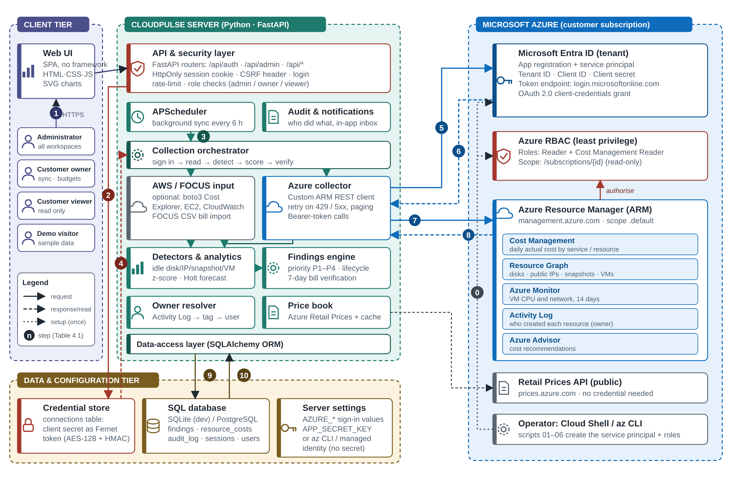
R.M.K. COLLEGE OF ENGINEERING AND TECHNOLOGY
(An Autonomous Institution)
DEPARTMENT OF COMPUTER SCIENCE AND ENGINEERING
Project Architecture – CloudPulse
Read-only Azure access: service principal (Reader + Cost Management Reader) → Entra ID token → Azure Resource Manager

Slide 8
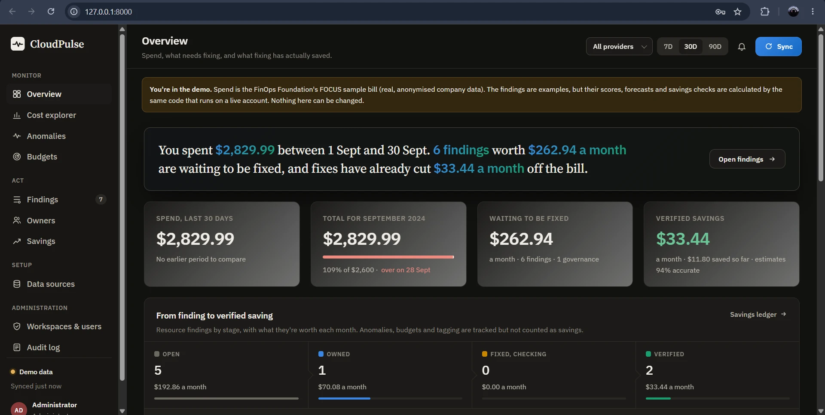
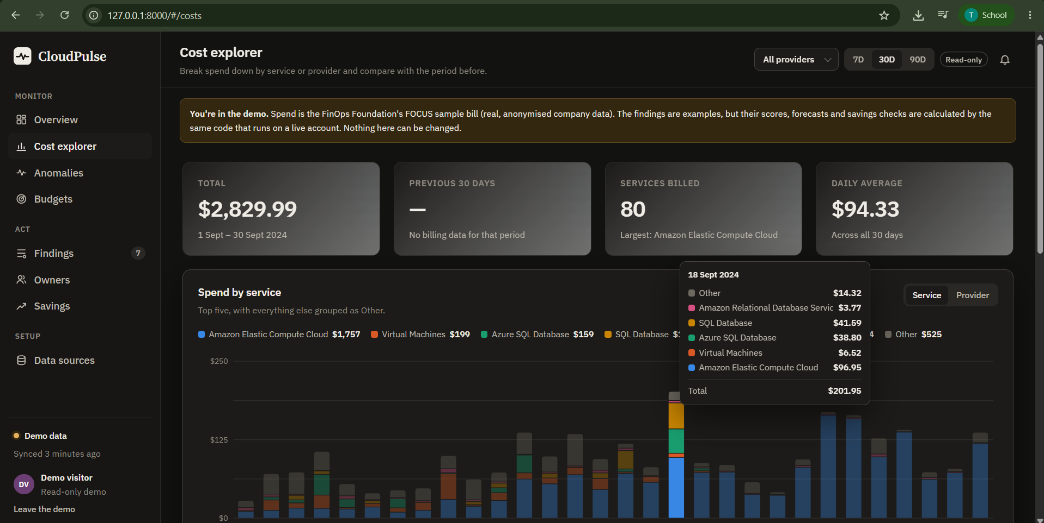
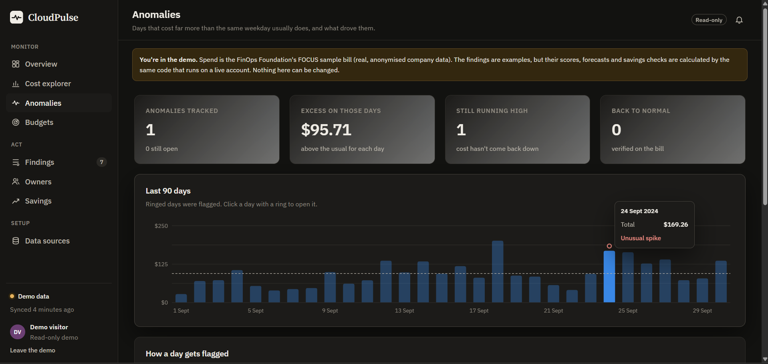
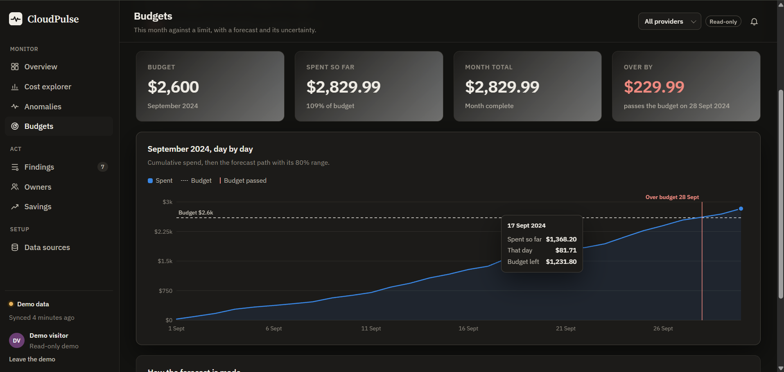
R.M.K. COLLEGE OF ENGINEERING AND TECHNOLOGY
(An Autonomous Institution)
DEPARTMENT OF COMPUTER SCIENCE AND ENGINEERING
Project Results
Overview: $2,829.99 spend; $262.94/month to fix; $33.44/month verified
Cost explorer: 80 services; daily average $94.33
Anomalies: 24 Sep flagged ($169.26 vs usual $73.55)
Budgets: $2,600 budget passed on 28 Sep

Slide 9
R.M.K. COLLEGE OF ENGINEERING AND TECHNOLOGY
(An Autonomous Institution)
DEPARTMENT OF COMPUTER SCIENCE AND ENGINEERING
Conclusion
• Gained practical exposure to cloud computing concepts during the internship.
• Started and developed CloudPulse, a read-only Azure cost monitoring and optimisation platform.
• Learned how cloud resources are billed, secured and monitored, and how to prove a saving on the bill.
• Improved Python, REST API, testing, documentation and problem-solving skills.
• Next: Entra ID sign-in, e-mail and Teams alerts, Google Cloud support and approval-gated remediation.
• Thank you to Ms. Kalaiyarasi S, my faculty guides Ms. Gokila E and Dr. Uma Mageshwari G, and Trios Technologies Private Limited for their guidance and support.

Slide 10
R.M.K. COLLEGE OF ENGINEERING AND TECHNOLOGY
(An Autonomous Institution)
DEPARTMENT OF COMPUTER SCIENCE AND ENGINEERING
Internship Photographs
[Paste your workspace / internship photograph here]
My workspace
CloudPulse – Overview page

Slide 11
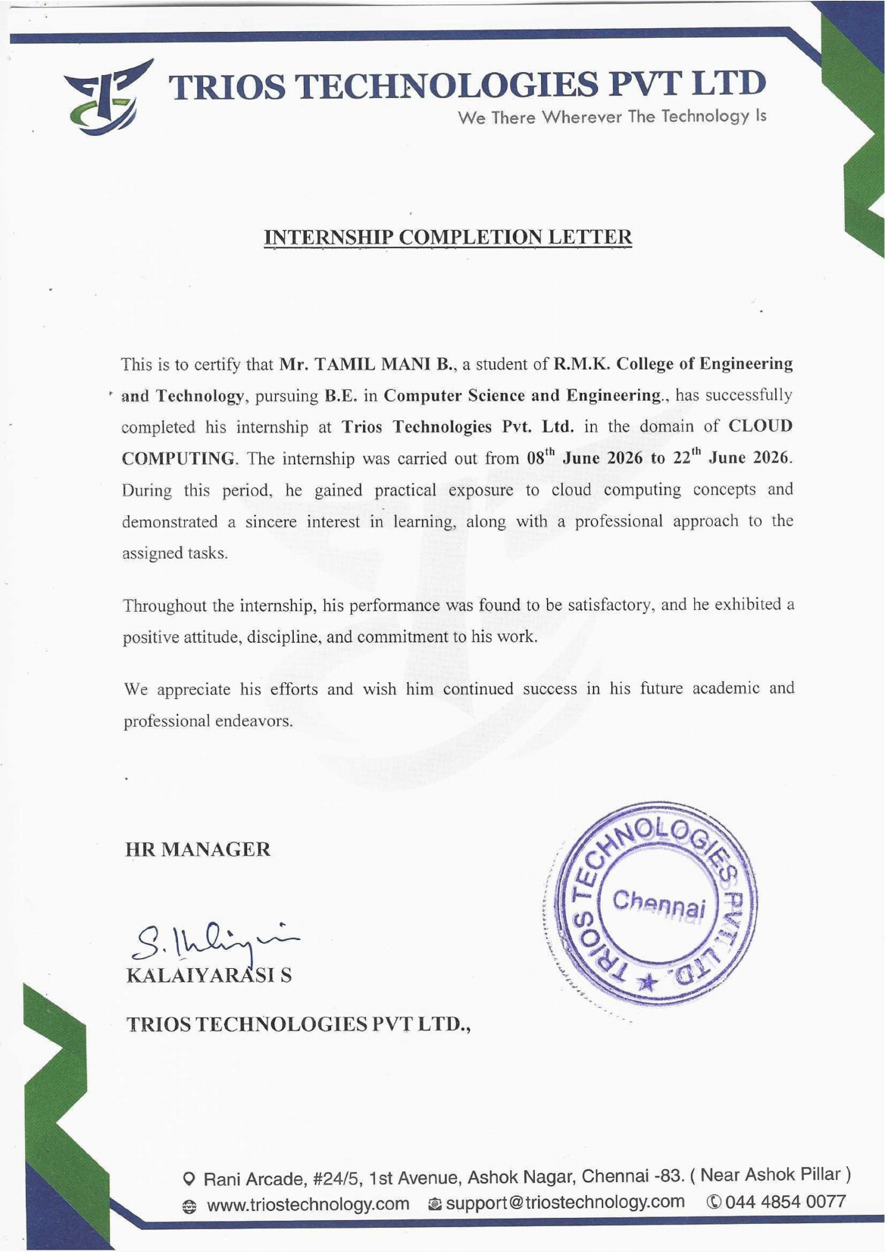
R.M.K. COLLEGE OF ENGINEERING AND TECHNOLOGY
(An Autonomous Institution)
DEPARTMENT OF COMPUTER SCIENCE AND ENGINEERING
Internship Certificate

Slide 12
R.M.K. COLLEGE OF ENGINEERING AND TECHNOLOGY
(An Autonomous Institution)
DEPARTMENT OF COMPUTER SCIENCE AND ENGINEERING
Thank you!

