Slide 1

SMART INDIA HACKATHON 2026
TITLE PAGE
Solution – PashuRaksha
Problem Statement ID – SIH26128
Problem Statement Title – Efficient systems for early detection, prevention, and management of livestock diseases and animal health issues
Theme – MedTech / BioTech / HealthTech
PS Category – Software
Team ID – 178601
Team Name (Registered on portal) – TechDevs_6
From the first sick animal to a coordinated response, measured in hours.

Slide 2
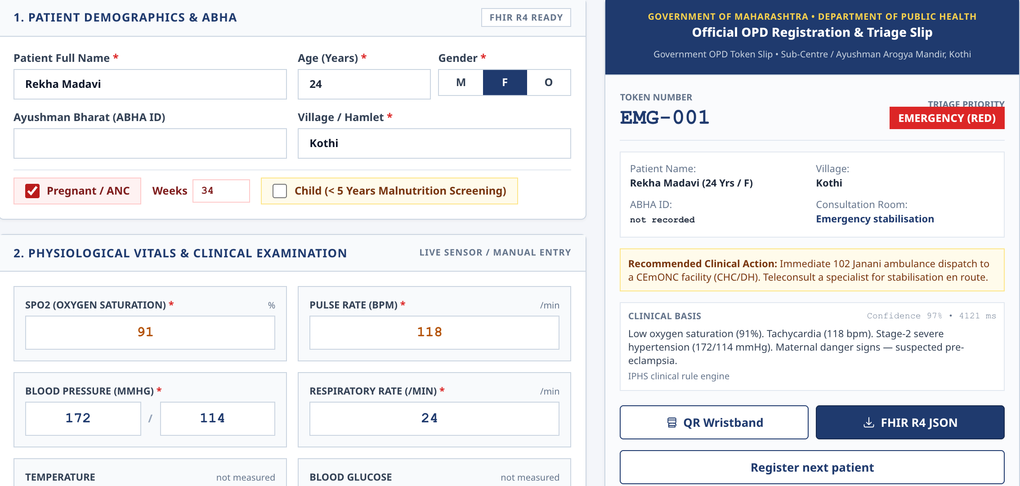
Why Livestock Disease Is Found Late and Handled Slowly
TechDevs_6
1
Late reporting
2
Distant diagnosis
3
Incomplete histories
4
Fragmented data
5
No signal, late zoonotic alert
Farmers try home remedies first or hide cases for fear of movement restrictions. Nobody tells them what happens next.
Samples are not taken, spoil on the way, or the result never returns to the person who sent it.
Ear-tag, vaccination and treatment records sit in paper registers, so nobody can say who is overdue.
Dispensary, lab, drives and surveillance keep separate records; the block officer sees totals, not village patterns.
Online-only tools fail where outbreaks start. Human health hears of anthrax or rabies exposure late.
TODAY
Sick animal
Home remedy first
Late report
Manual relay,
no feedback
Slow response
PASHU
RAKSHA
Sick animal
4-tap or missed-call
report
Triage + cluster
check
Escalation timer,
reporter feedback
Sample, lab,
response
The outbreak clock: hours from first report to action, recorded for every case and shown for every block.
The three jobs in the problem statement: Detect (notice the pattern early), Prevent (vaccinate and advise), Manage (sample, refer, contain, close). Most reporting apps stop at the first.

Slide 3
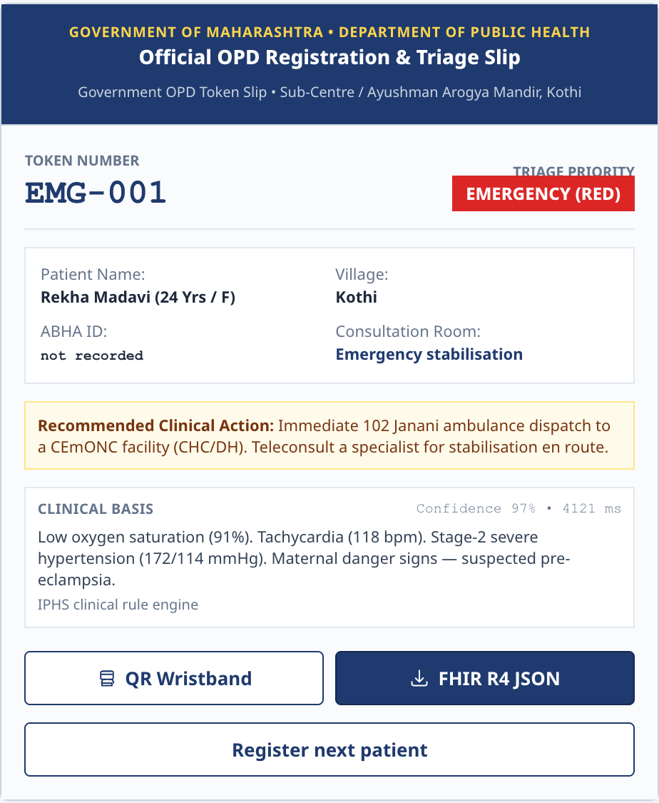
PashuRaksha: Detect, Prevent, Manage in One Workflow
TechDevs_6
DETECT
PREVENT
MANAGE
Late reporting
Incomplete histories
Distant diagnosis
Para-vet app: 4 taps, offline. Farmer: missed call, IVR in Marathi / Hindi. Assisted or anonymous reports.
Herd record first, animal level where an ear tag exists.
Sample checklist, nearest lab suggested, status tracked, result returned to the reporter.
Unclear severity
Missed vaccinations
Delayed escalation
Syndrome rules per species give: routine advice, vet visit, or suspected notifiable disease.
Due-lists: who in this village is overdue, with reminders.
Unanswered suspect cases move up to the next officer on a timer.
Invisible patterns
Unseen risk
Zoonotic blind spot
Cluster thresholds across villages and weeks; baseline learned as data grows.
Weather and past-outbreak layer gives block-level risk guidance. Multilingual advisories.
Zoonotic flag alerts human health. Officer dashboard shows open cases and lab turnaround.
One case, timestamped end to end (the outbreak clock)
First symptom
Reported
Triaged
Sample sent
Lab result
Officer response
Contained
Closed
Rules decide
ML assists
Veterinarian decides
Safety-critical steps: syndromes, thresholds, escalation, missing data
Anomaly and risk ranking where history exists; labelled as assistive
Diagnosis, treatment and containment. The system never prescribes

Slide 4
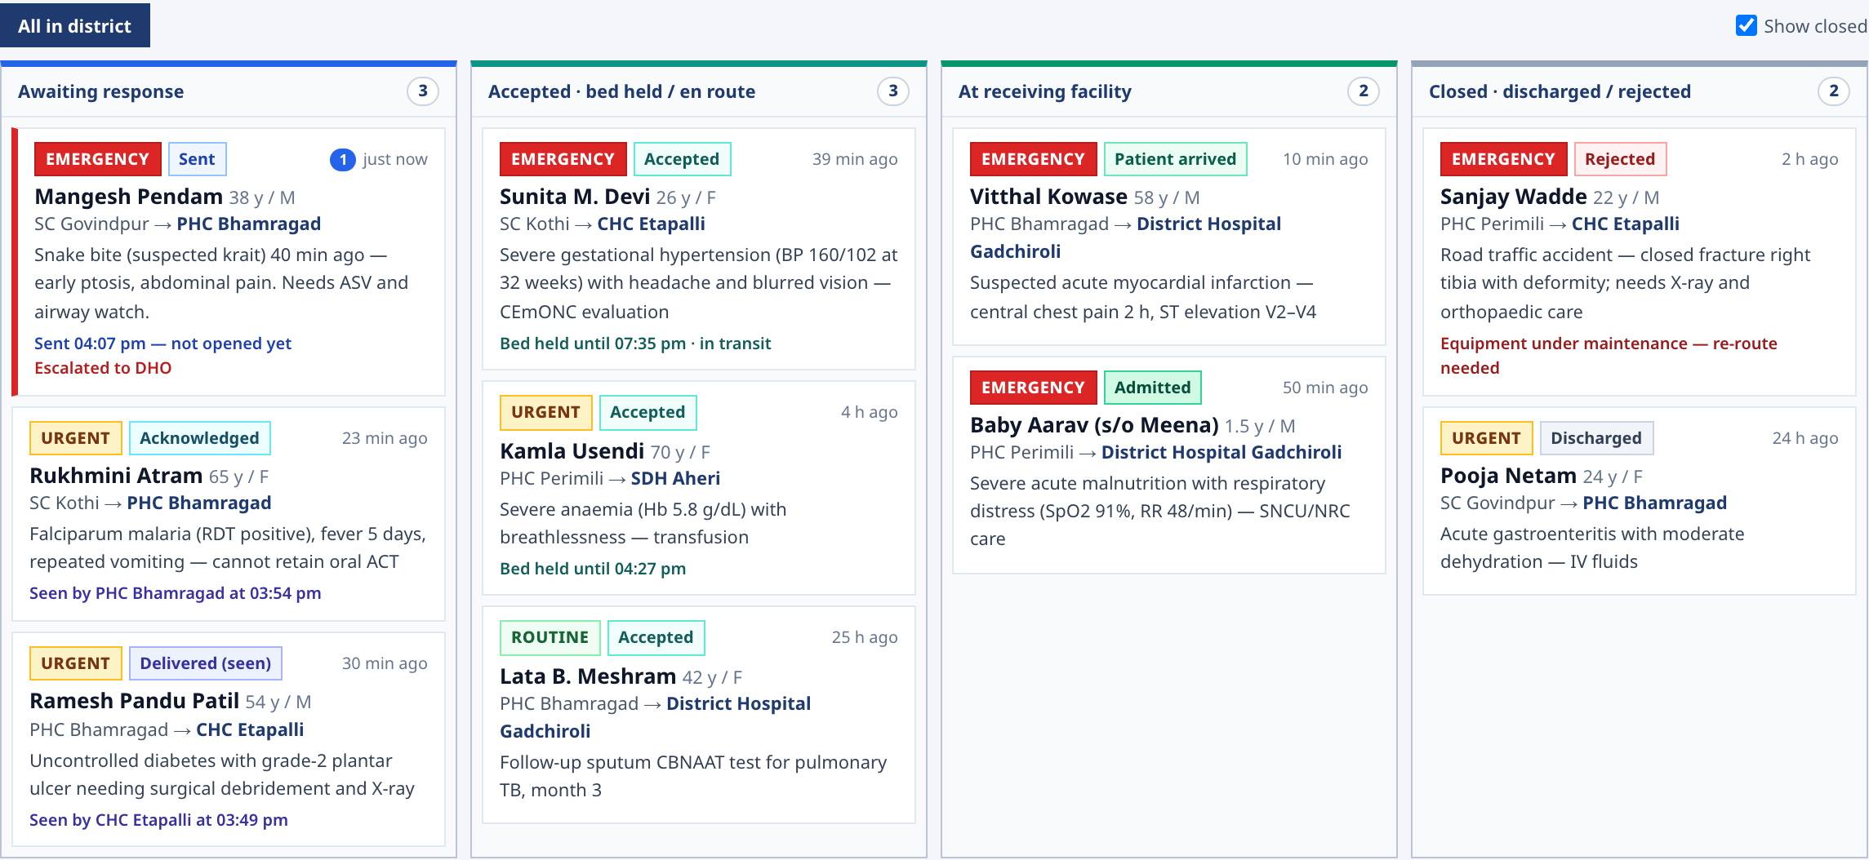
Architecture and How We Will Prove It Works
TechDevs_6
Architecture
How We Will Validate
Para-vet / vet app
(offline)
Farmer IVR / SMS
Lab and
vaccination-drive data
Historical replay
1
Run past outbreak reports through the rules and see whether, and when, an alert would have fired.
Case intake · sync outbox · identity: village code, herd / ear tag
Expert review
2
Veterinarians check that syndrome rules and thresholds match field practice.
Syndrome rules
(per species)
Cluster rules
+ learned baseline
Risk layer
(weather, history)
Pilot in one block
3
Measure the outbreak clock and the other process measures with real users.
Escalation
timer
Lab referral
tracker
Vaccination
due-lists
One Health
alert
Holdout checks
Multilingual alerts
SMS / IVR / app
Officer dashboard: outbreak clock,
village map, coverage
4
Test on unseen blocks and periods once enough data exists.
Proposed stack: Next.js PWA + Capacitor Android (offline, IndexedDB), FastAPI / Node relay, PostgreSQL + PostGIS, an IVR provider, Bhashini for language, MapLibre for the map. Nothing here has been built or benchmarked yet.
Proposed measures
Report-to-response time
Suspects with sample sent
Due-list coverage
False-alarm rate

Slide 5
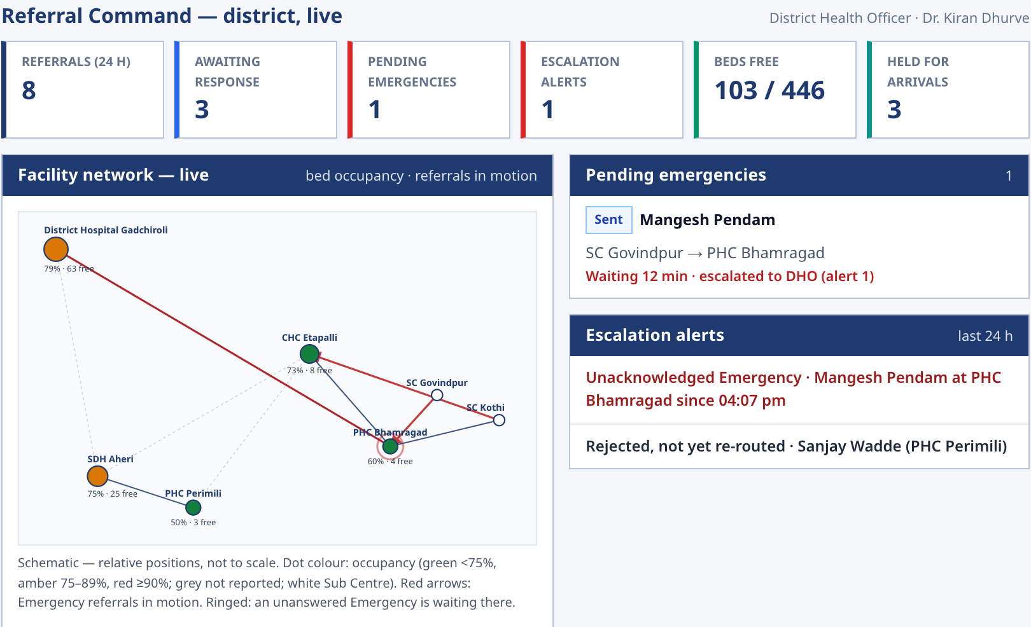
From One-Block Pilot to State-Level Surveillance
TechDevs_6
PILOT
1 block, a few villages, local dispensary and lab
DISTRICT
Multiple blocks, district officer view
STATE
Shared rules, local thresholds
Field loop (conceptual workflow)
Report offline
Triage + cluster check
Sync, alert, escalate
Response and sample
Feedback to reporter
FARMER
PARA-VET
VETERINARY OFFICER
DISTRICT / STATE
HUMAN HEALTH
gets advice and a next step after reporting
one entry point, works without signal
sees suspect clusters and overdue vaccinations
evidence for planning and response
early notice of zoonotic risk
What we will measure in the pilot (proposed)
Report-to-response time
Suspects with sample sent
Escalation acknowledgement time
Due-list coverage
False-alarm rate
Main risks and how they are handled
Under-reporting
False alarms
Thin baseline data
Low digital literacy
Data privacy
assisted and anonymous reports; feedback to reporter
alert levels, thresholds, officer review
rules first; baseline learned; confidence stated
pictures, voice, IVR; para-vet enters data
role-based access; aggregated for planning

Slide 6
RESEARCH AND REFERENCES
TechDevs_6
S. No | Reference | Published by | Used for
1 | National Animal Disease Control Programme (NADCP) | Dept. of Animal Husbandry and Dairying, GoI | Vaccination-programme context
2 | Livestock Census | Dept. of Animal Husbandry and Dairying, GoI | Livestock populations by area
3 | Veterinary epidemiology and disease informatics | ICAR-NIVEDI | Surveillance practice, disease information
4 | Bharat Pashudhan / National Digital Livestock Mission | Dept. of Animal Husbandry and Dairying, GoI | Animal ID and records integration path
5 | Terrestrial Animal Health Code; notifiable diseases | WOAH | Case definitions, reporting criteria
6 | One Health Joint Plan of Action | FAO, UNEP, WHO, WOAH | Zoonotic alert pathway
7 | A spatial scan statistic (Kulldorff) | Communications in Statistics | Space-time cluster detection
8 | Early Aberration Reporting System (Hutwagner et al.) | Journal of Urban Health | Counts-based aberration detection
9 | Bhashini | MeitY | Multilingual speech and text

