Slide 1

SMART INDIA HACKATHON 2026
TITLE PAGE
Problem Statement ID – 26240
Problem Statement Title – AI-Based Spring Revival and Recharge Planning for Tribal Areas
Theme – Agriculture, Food and Rural Technology
PS Category – Software
Team ID – 178601
Team Name (Registered on portal) – TechDevs_6

Slide 2
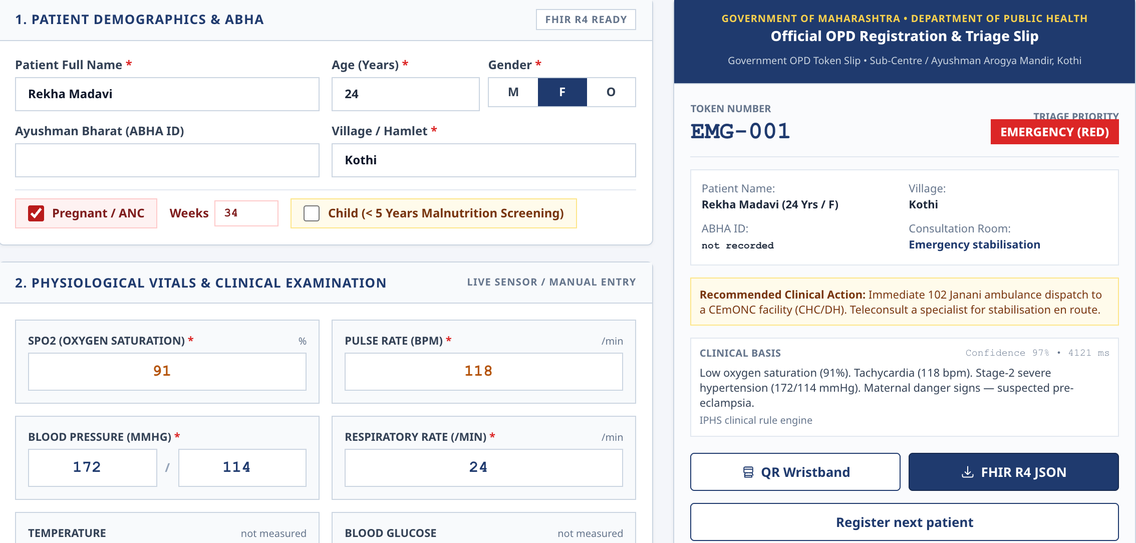
JalSrot (Spring Revival Planning)
TechDevs_6
Problem:
System Flow:
• Where a spring's water comes from cannot be read off the surface; terrain alone misleads
• Finding recharge sites needs a hydrogeologist on foot, so remote tribal hamlets wait years
Inputs
DEM · geology & structure · rainfall · land use · spring records · field notes
Our Solution:
Springshed zone
with probability
Recharge suitability
+ confidence
Risk and no-go
flags
Ranked sites +
structure type
• A web GIS tool that combines terrain, geology, rainfall, land use and spring records
• It marks the probable springshed and ranks sites for recharge work
How it solves the problem:
• Experts verify a short ranked list, not every hillside
• Each map shows how sure we are, so thin data is never hidden
• Field readings go back into the model
Loop closes:
new readings improve the next map
Model recalibrated
with field data
Discharge and
observations logged
Field team verifies
in the app
Innovation & Uniqueness:
Output sharpens with the data the department has:
• Springshed follows rock dip and fractures, not just the watershed line
• Starts from DEM + rainfall alone and sharpens as data arrives
• Offline phone app records strike, dip and discharge in the village
DEM + rainfall only
Low confidence
+ geology, land use, spring list
Medium
+ dip/strike and discharge
High

Slide 3
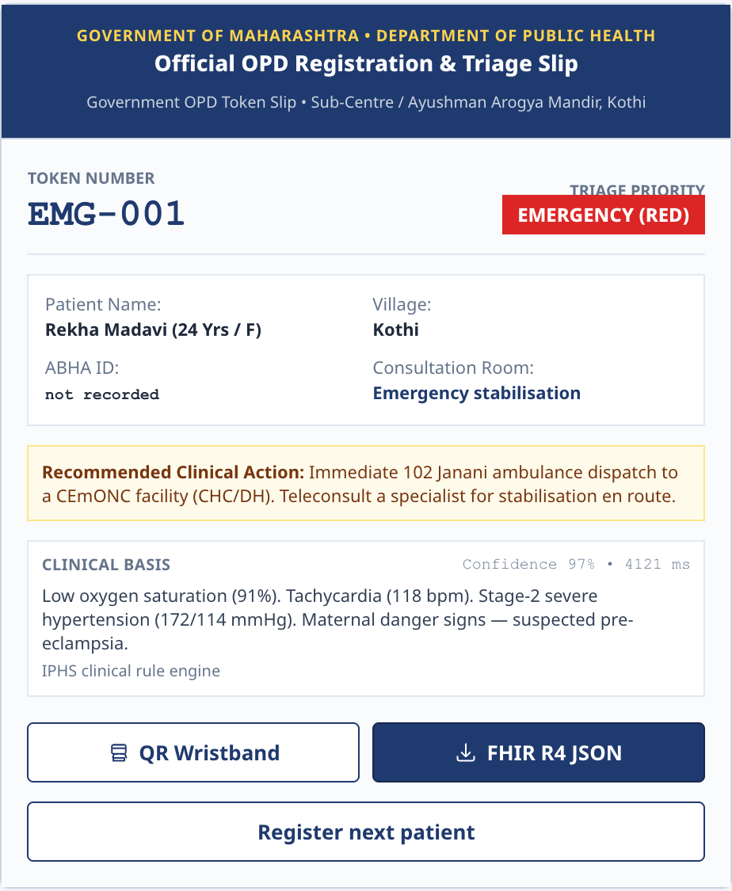
TECHNICAL APPROACH
TechDevs_6
Technology Used:
Architecture:
Geo processing: Python, GDAL, rasterio, WhiteboxTools
ML: scikit-learn, XGBoost, SHAP
Backend: FastAPI, Celery + Redis
Database: PostgreSQL + PostGIS
Map serving: TiTiler (COG tiles), MinIO
Web GIS: Next.js, MapLibre GL
Field app: Capacitor Android / PWA, IndexedDB sync
Open data: SRTM / Cartosat DEM, GSI Bhukosh, IMD, Bhuvan land use
MLOps: MLflow, GitHub Actions
Language: Hindi and regional, via Bhashini
Data sources
DEM
Geology &
structure
Rainfall
Land use
Spring
records
Field &
community
Prepare
GDAL / rasterio: align projections, fill gaps, score data quality per layer
Analysis
Terrain and lineament
features
Springshed engine
(dip-aware, Monte Carlo)
ML suitability
(RF + XGBoost, SHAP)
Decision
Intervention rules
(structure by site type)
Risk and landslide
flags
Priority ranking +
confidence
Serve
PostGIS · COG tiles · FastAPI
Web GIS
MapLibre
Field app
(offline)
Field observations and discharge readings feed back into the model

Slide 4
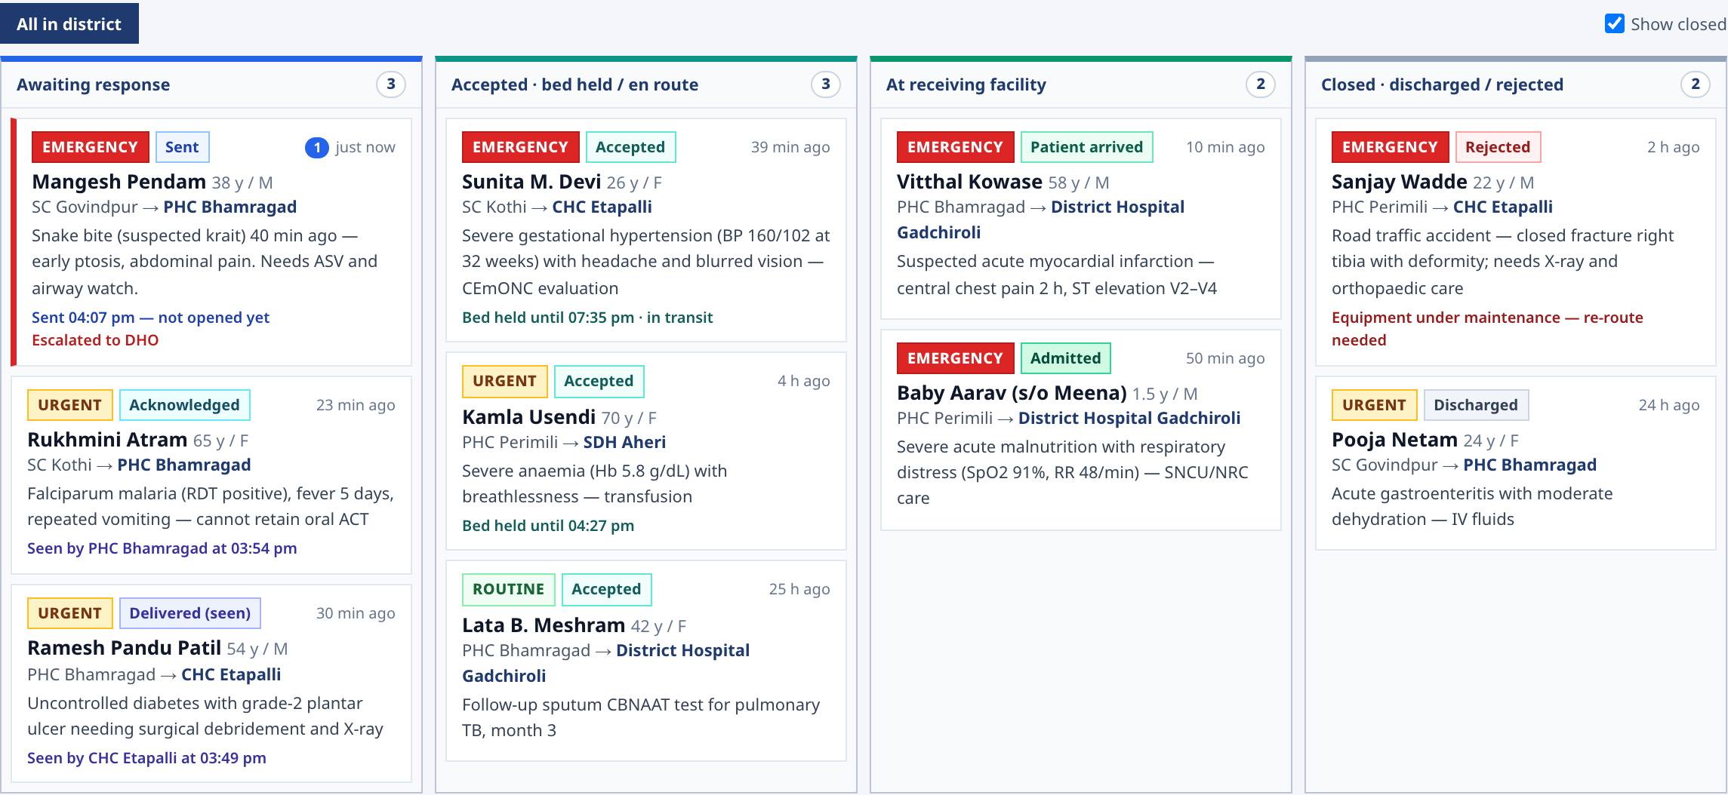
FEASIBILITY AND VIABILITY
TechDevs_6
Feasibility:
Challenges & Risks: | Strategies to Overcome:
Few labelled springs | Expert-weighted fallback; map marked low confidence
Coarse DEM in some areas | Resolution stated on the map; confidence drops
No structural measurements | Lineaments inferred from the DEM; field team adds readings
Map trusted too much | Every output says "indicative, verify on site"
Landslide-prone slopes | Separate risk layer; no-go flag on the site
Low field adoption | Four-step app, voice notes, local language
Technical: all inputs are open data and the stack is open source; one pilot springshed runs on a single server
Operational: field team needs only an Android phone; works offline in the village
Economic: no licence cost; the phone compass replaces survey equipment for strike and dip
Data: Bhuvan, GSI, IMD and India-WRIS; outputs as GeoTIFF / GeoJSON and OGC map services
Rollout: one block (20-30 springs) → district → state
Pilot plan: verify top-ranked sites in the monsoon, log discharge through the next dry season, compare against the model

Slide 5
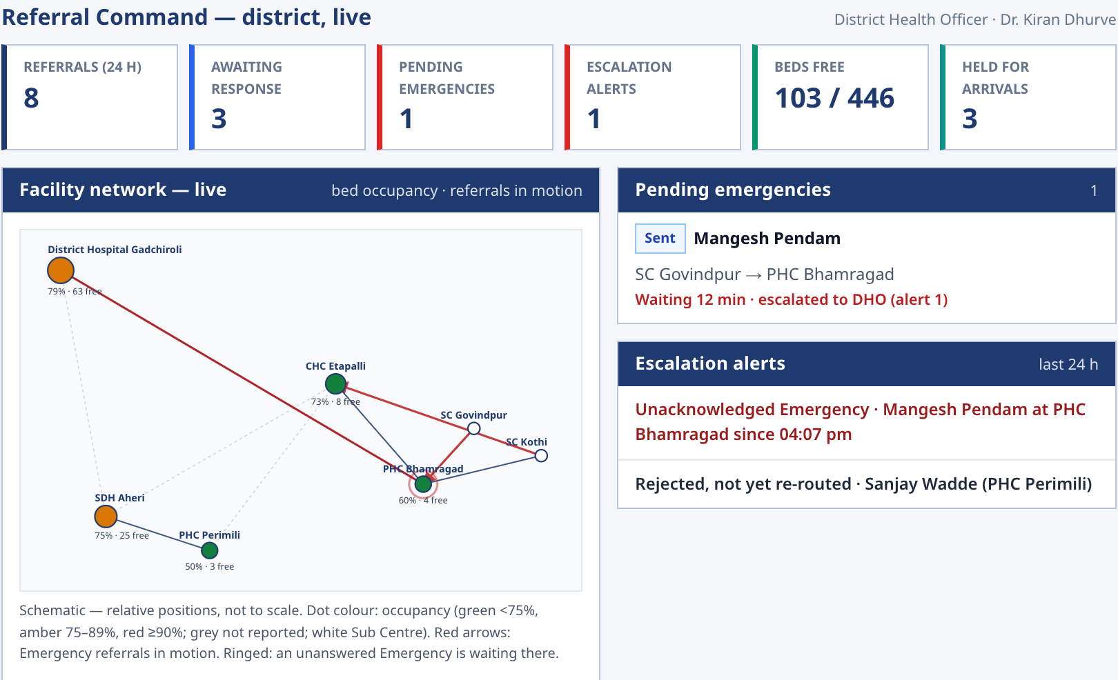
IMPACT AND BENEFITS
TechDevs_6
Today vs with JalSrot:
Benefits:
 | Today | With JalSrot
Find recharge area | Field survey, spring by spring | Probable zone from data, then verified
Choose sites | Expert judgement, case by case | Ranked list with reasons
Know the risk | Found after the structure is built | Flagged before work starts
Learn from results | Discharge rarely recorded | Logged and fed back to the model
Reach remote areas | Waits for an expert visit | Pre-screened; team visits the best sites first
Field officer: knows which sites to visit first
Hydrogeologist: time goes into verifying, not scanning
District / department: a ranked list with reasons to support funding
Tribal community: more dependable water in the dry months
Impacts:
Social: less time spent fetching water, mostly by women and children
Economic: fewer structures built where they do not work
Environmental: right aquifers recharged; no works on unstable slopes
System: a growing spring-discharge record for the department

Slide 6
RESEARCH AND REFERENCES
TechDevs_6
S. No | Title | Published by | Year | Used for
1 | SRTM Digital Elevation Model | NASA / USGS | 2000 | Slope, aspect, drainage, flow paths
2 | Bhuvan land use / land cover and Cartosat DEM | ISRO – NRSC | 2022 | Land cover and finer terrain
3 | Bhukosh geological maps | Geological Survey of India | 2021 | Rock types, contacts, faults
4 | CHIRPS rainfall dataset (Funk et al.) | UC Santa Barbara CHG | 2015 | Rainfall trends
5 | India-WRIS | Ministry of Jal Shakti | 2010 | Drainage, groundwater context
6 | Inventory and Revival of Springs in the Himalayas | NITI Aayog | 2018 | Springshed approach, revival practice
7 | Random Forests (Breiman) | Machine Learning journal | 2001 | Recharge suitability model
8 | SHAP – A Unified Approach to Interpreting Model Predictions | Lundberg & Lee, NeurIPS | 2017 | Explaining each site score
9 | WhiteboxTools (Lindsay) | University of Guelph | 2016 | Terrain and hydrological analysis

