Slide 1
Arc Fault Analysis Using Statistical Parameters
Guide: N. Ratnakar Sir
Team Members: K. Tharun Kumar
B. Raju Ch. Naga Jaya Lakshmi G. Meghana

Slide 2
Overview of Arc Faults
Definition: An electrical discharge or breakdown of the current flow through an unintended path, often caused by damaged or deteriorating insulation, loose connections or faulty equipment.

Slide 3
It can generate intense heat and produce sparks, potentially leading to electrical fires, equipment damage and personal injury.

Slide 4
Real time situation of an Arc Fault occurrence

Slide 5
Importance of Arc Fault Analysis
Arc fault analysis helps identify and locate potential arc fault occurrences, enabling timely preventive measures to mitigate hazards.

Slide 6
By conducting arc fault analysis, compliance with electrical safety standards and regulations can be ensured, reducing liability and promoting a safe working environment.

Slide 7
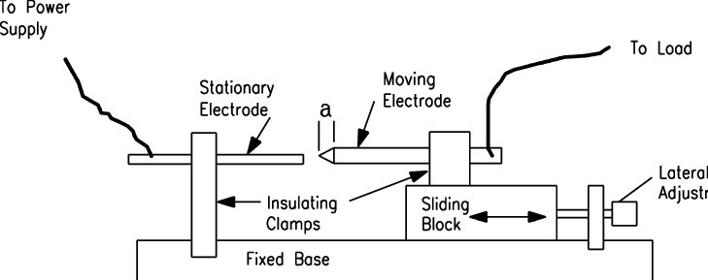
Experimental Setup

Slide 8
Statistical Parameters for Arc Fault Analysis
1. Standard deviation
It measures the dispersion of data points around the mean, allowing identification of abnormal fluctuations in current and voltage waveforms.
High standard deviation values indicate irregularities.

Slide 9
2. Skewness
Skewness measures the degree and direction of asymmetry in the data distribution.
A significant positive or negative skewness indicates non-symmetrical waveforms.

Slide 10
3. Kurtosis:
Kurtosis measures the peakedness or flatness of a distribution, indicating whether the waveform has sharp spikes or is more spread out.
Abnormal kurtosis values can indicate distorted or non-standard waveform shapes.

Slide 11
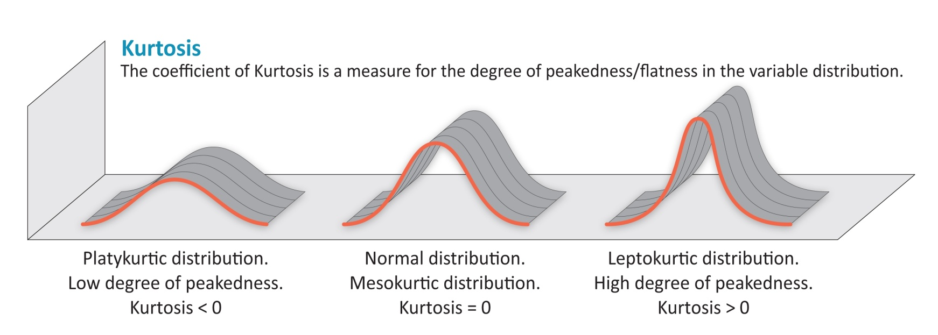
Example:

Slide 12
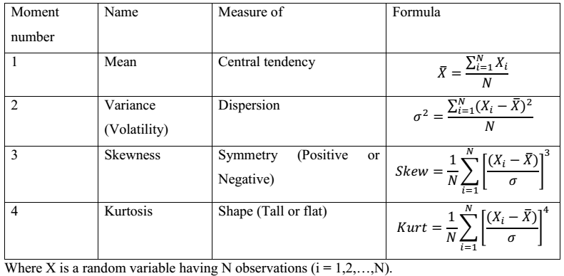

Slide 13
Arc Fault Analysis Process
Integration of statistical parameters into the arc fault analysis process
Collection and processing of current and voltage waveform data
Calculation of standard deviation, skewness and kurtosis
Comparative analysis with threshold values for fault detection

Slide 14
Different loads used to collect data:
Drill Machine
Inductive load(Fan)
Inverter with desktop system
Kettle
Laptop
Resistive load(Rheostat)
Switching load(LED)
Combination of loads in parallel

Slide 15
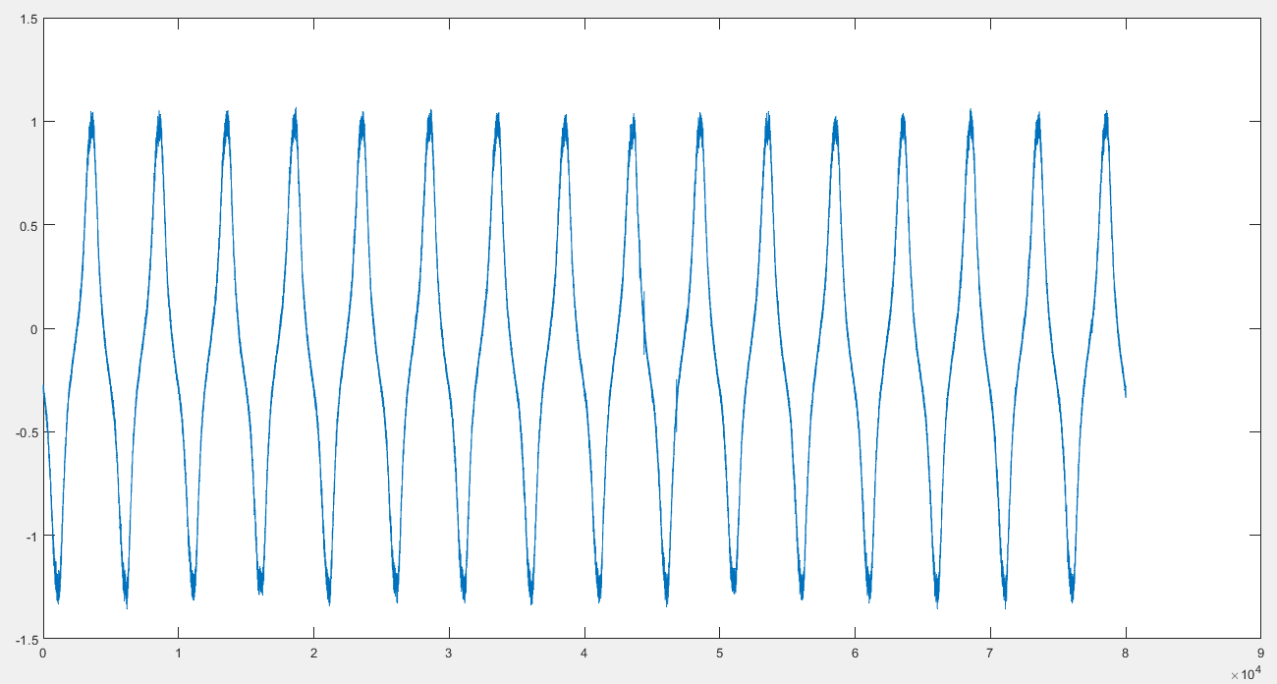
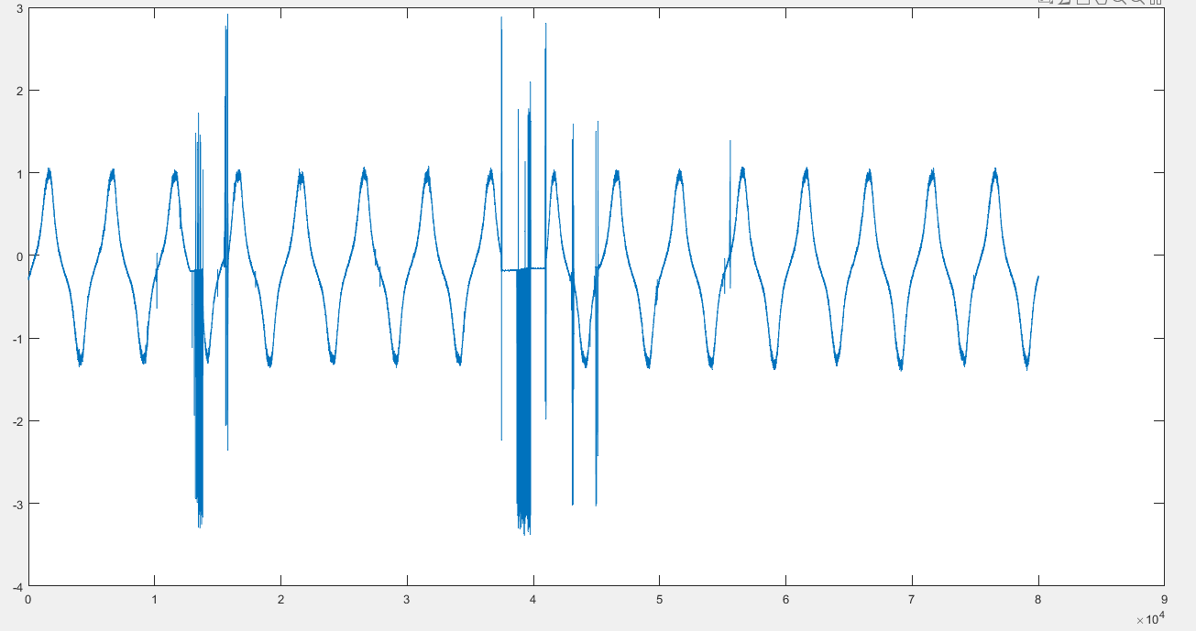
Drill Machine

Slide 16
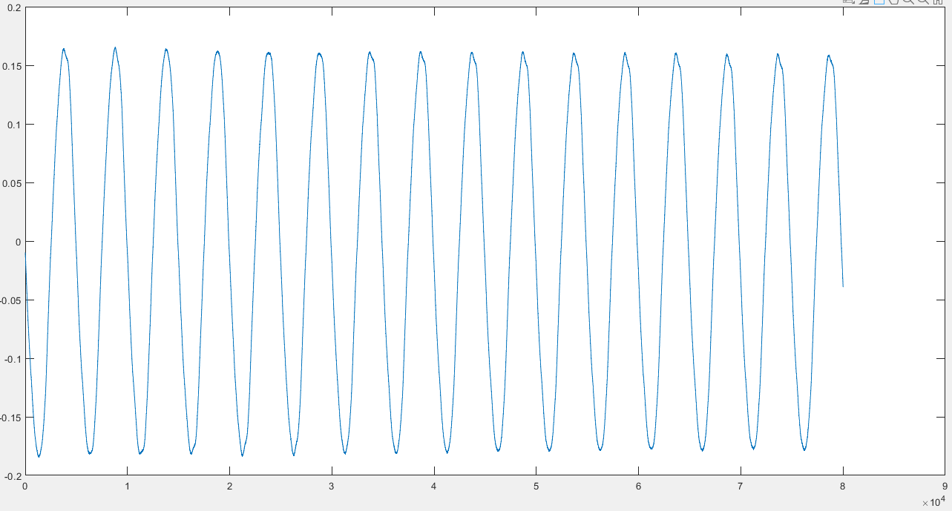
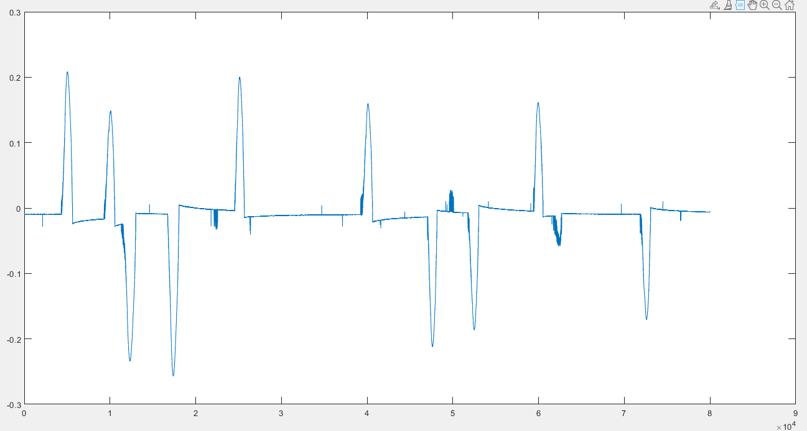
Inductive Load

Slide 17
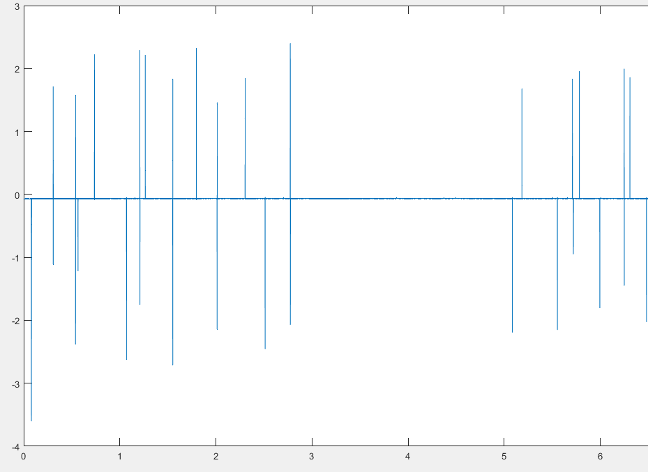
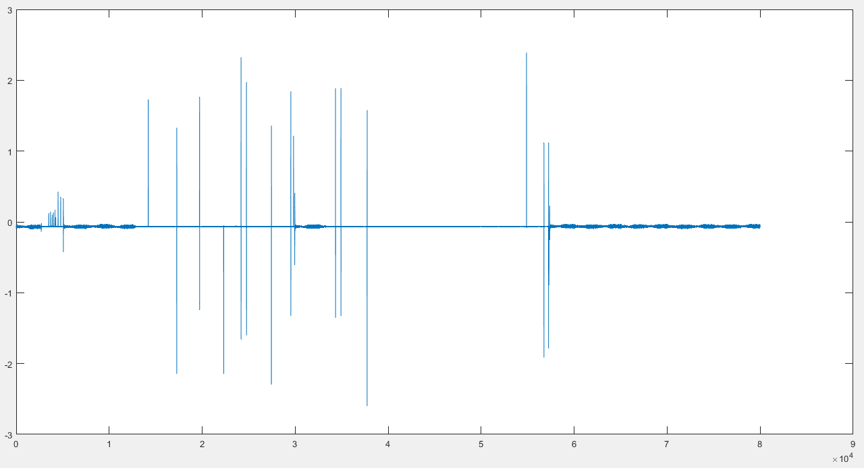
Inverter with Desktop System

Slide 18
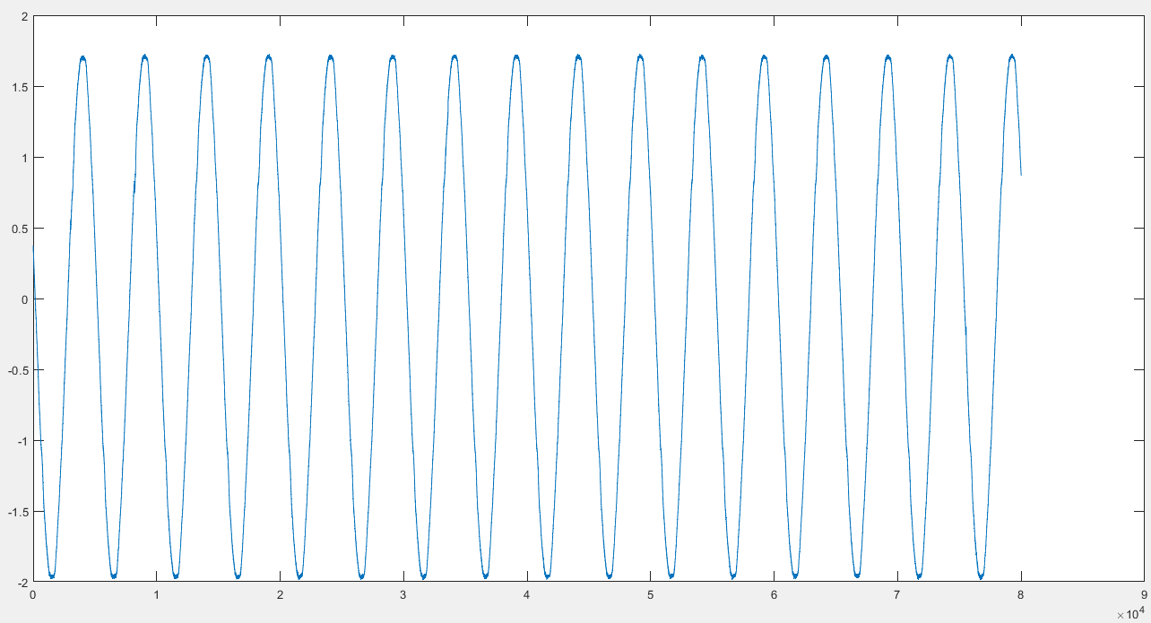
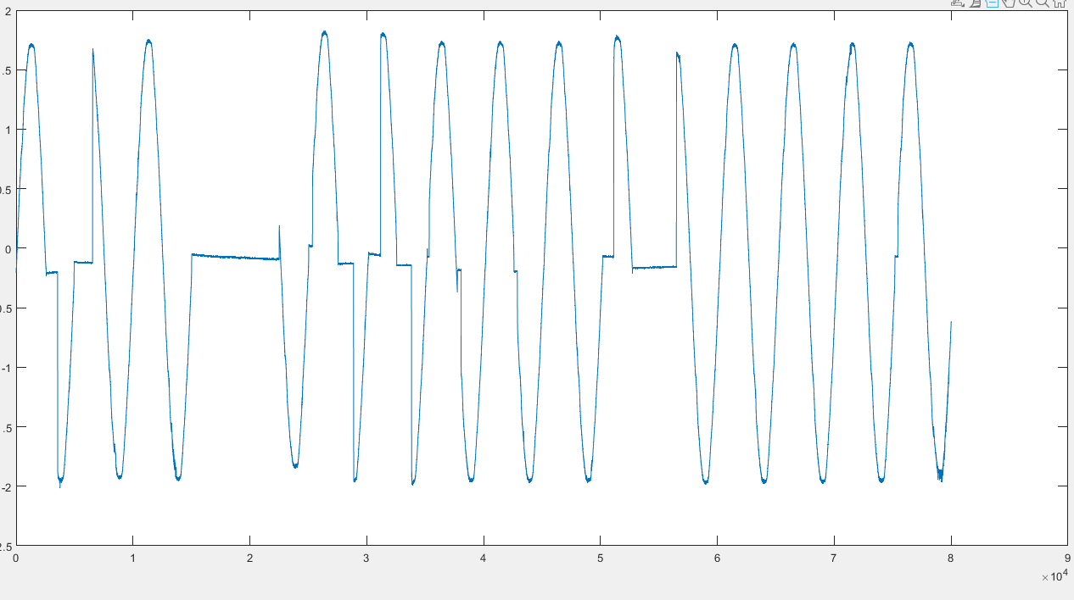
Kettle

Slide 19
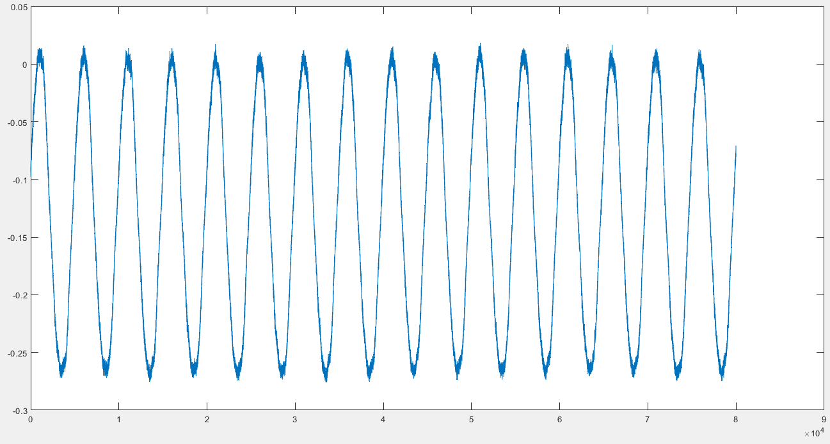
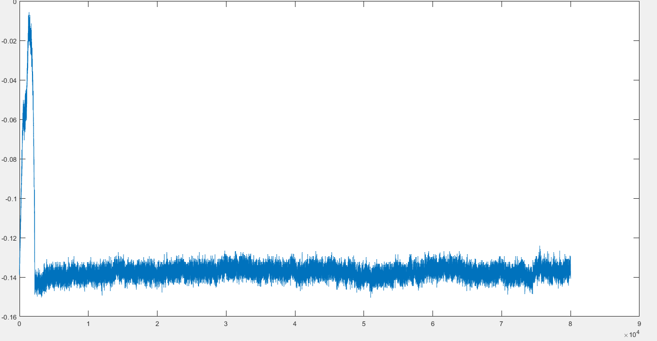
Parallel Load

Slide 20
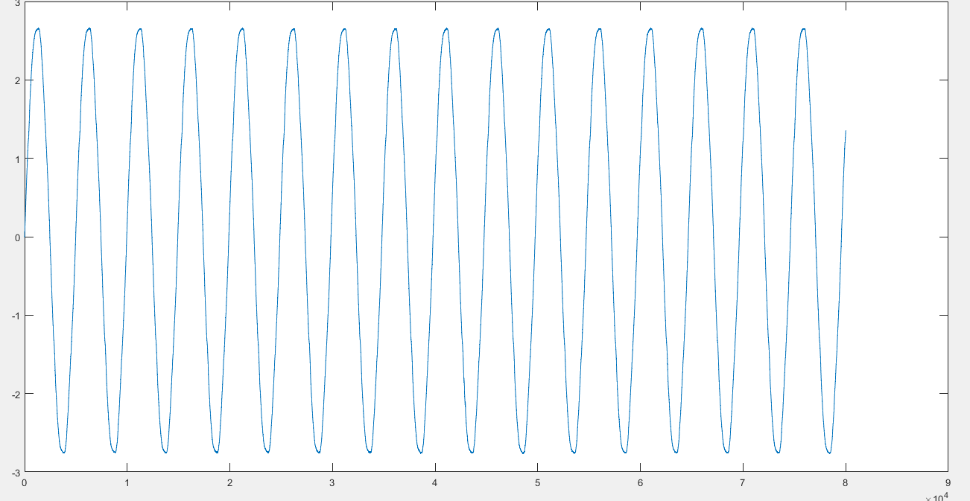
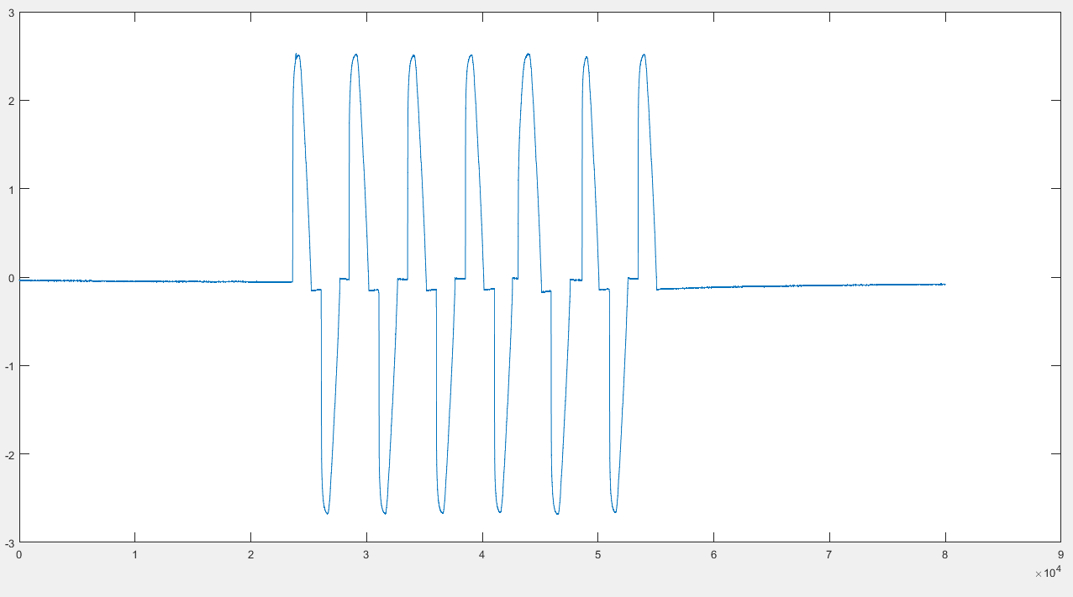
Resistive Load

Slide 21
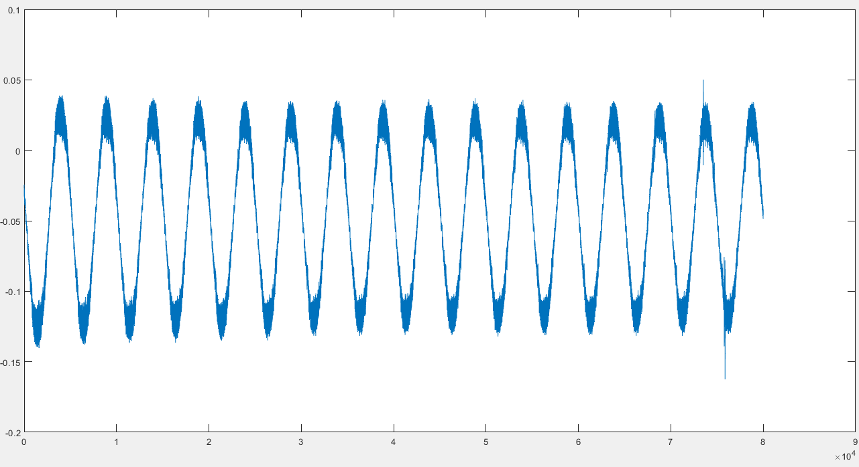
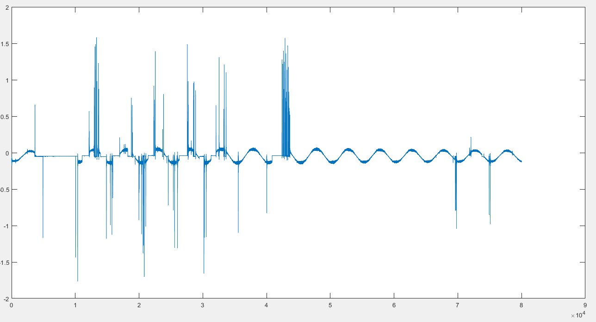
Switching Load(LED)

Slide 22
Conclusion
Arc fault analysis using statistical parameters enables early detection and mitigation of electrical faults, reducing the risk of fires, equipment damage and personal injury.

Slide 23
By comparing calculated values(Standard deviation, Skewness, Kurtosis) with predefined thresholds, potential arc faults can be identified, allowing for timely preventive measures and improved electrical safety.

Slide 24
Thank You

