Slide 1


SVASTHA
SVASTHA
WISHING PEOPLES HEALTH

Slide 2

PROBLEM STATEMENT
How might we help a Covid patient to track his health status and be connected to a Remote Doctor ?

Slide 3

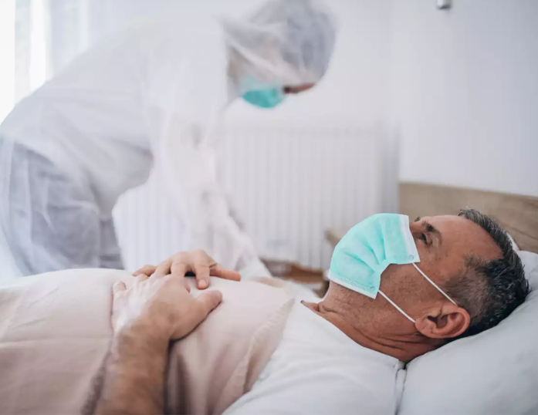

Solution & Target Audience
SOLUTION : SVASTHA A WEARABLE BASED APPLICATION
TARGET AUDIENCE : PATIENTS AND DOCTORS
Globally Covid 173,768,149 cases
Globally Active Covid 13,383,362 cases
Only in our country
There are 28,809,339 cases
Active 1,477,799 cases
Globally 9.2 million doctors
Only in our country : 12,55,786
It is estimated that around 10.05 lakh doctors may be actually available for active service
As per the Indian Medical Council

Slide 4
OUR SOLUTION

Slide 5

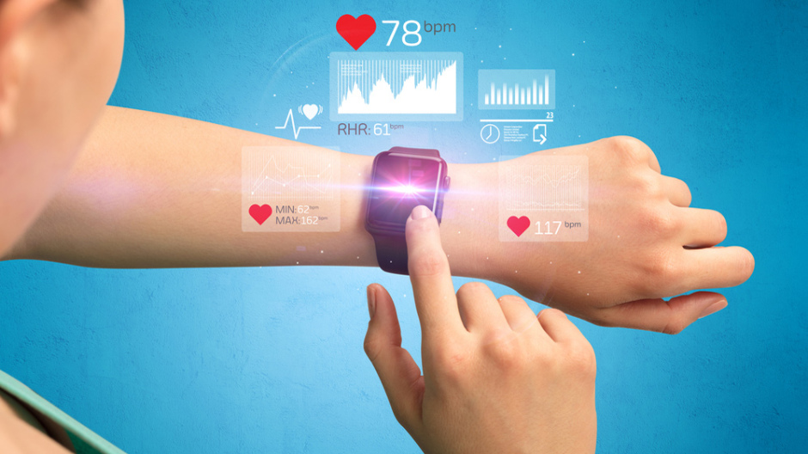

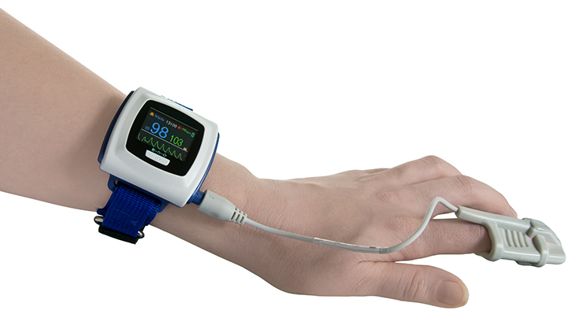
PRODUCT
SVASTHA is a product based technology which will use a (wearable wrist band) that is capable of detecting human physiology status, such as heartbeat, blood pressure, body temperature, or other complex vital signs (e.g. electrocardiograms), functional moments and heart rate. The application is connected to a Remote Doctor

Slide 6

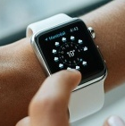
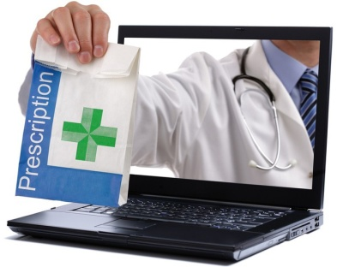

Features involved
Connected to a wearable which can track patient’s possible physical information
Exchanges the information in between the doctor and patient
Hence the entire algorithm is made for the patient recovery
Our app suggests proper diet with proper filtration according to the patients health condition
Our app suggests the best drug according to the economic status of the patient
Our app is also packed up with a one tap order place feature to order the medicine
Our app guides the patients with some physical activities and exercises at regular intervals
If the patients condition becomes serious our app automatically comes with a pop up notification to change the doctor to next higher grade doctor to take extra care and save live.

Slide 7


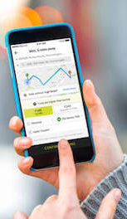
If the patient is in critical condition and needed to admit in a hospital Our app suggests and fills the digital admitting form in a best hospital surrounded patient with all the facilities that the patient needs to recover.
Our app tries to represent the medical data digitally in a statistical way which an be understood to patient and doctor easily
To know all these the patient needs a general lab check up So the particular lab or hospital is suggested by app itself and fill the application of consultation through the online portals connected to our app directly. Only the patient should go there and give his blood sample and get back to home
The app itself connected to local transportation vehicles as OLA and UBER so in case of emergency we can make a one tap call and book the vehicle

Slide 8

Any Queries

Slide 9
Thank you

