Slide 1


Introduction to Robotic Process Automation
Dream Girl’s Beauty Bot
220701303
Tharuna Sri.
Mrs. U.Farjana, M.Tech.,
Supervisor
Department of Computer Science and Engineering.

Slide 2
Abstract
The Dream Girls Beauty Bot is a cutting-edge AI-powered system designed to deliver personalized skincare and makeup recommendations. Using Generative AI and UiPath automation, it analyzes user inputs like skin type, melanin level, and age to provide tailored beauty solutions.
This project addresses challenges like input variability and the dynamic beauty product landscape, offering scientifically backed,
user-specific recommendations. The Dream Girls Beauty Bot
for
redefines beauty personalization, setting a foundation
advanced features like real-time analysis and dynamic updates, making it a game-changer in the beauty and wellness industry.
‹#›

Slide 3
Need for the Proposed System
Automates Personalized Beauty Solutions: Provides instant, tailored skincare and makeup recommendations.
Accurate and Inclusive: Adapts to diverse skin types, melanin levels, and age groups for precise results.
User-Friendly Design: Simplifies the process of discovering beauty routines and products.
Efficient Data Processing: Handles multiple user inputs and product databases seamlessly.
Enhances Accessibility: Makes personalized beauty care more accessible and inclusive for all users.
‹#›

Slide 4
Advantages of the Proposed System
Time-Saving: Automates personalized skincare and makeup recommendations instantly.
Accurate Results: Delivers precise beauty solutions tailored to individual skin types and preferences.
User-Friendly Interface: Simple and intuitive design for effortless navigation.
Efficient Data Handling: Processes diverse user inputs and product databases seamlessly.
‹#›

Slide 5
Literature Survey
Title: Generative AI for Personalized Skincare and Makeup Recommendations
Advantages:
Provides tailored beauty solutions based on individual skin type, age, and melanin content.
Utilizes advanced AI techniques for precise recommendations and user satisfaction.
Automates the process, saving time and effort while ensuring consistency.
Disadvantages:
Limited scope in accounting for rapidly changing product availability.
Challenges in ensuring dataset diversity to represent all skin tones and types.
‹#›

Slide 6
Main Objective
To develop an automated and efficient skincare and makeup recommendation system using UiPath’s Generative AI capabilities, enabling personalized beauty solutions based on user-specific inputs such as skin type, age, and melanin content. This system aims to streamline the recommendation process, ensure robust performance across diverse user profiles, and provide a user-friendly interface for real-world applications in the beauty and wellness industry.
‹#›

Slide 7
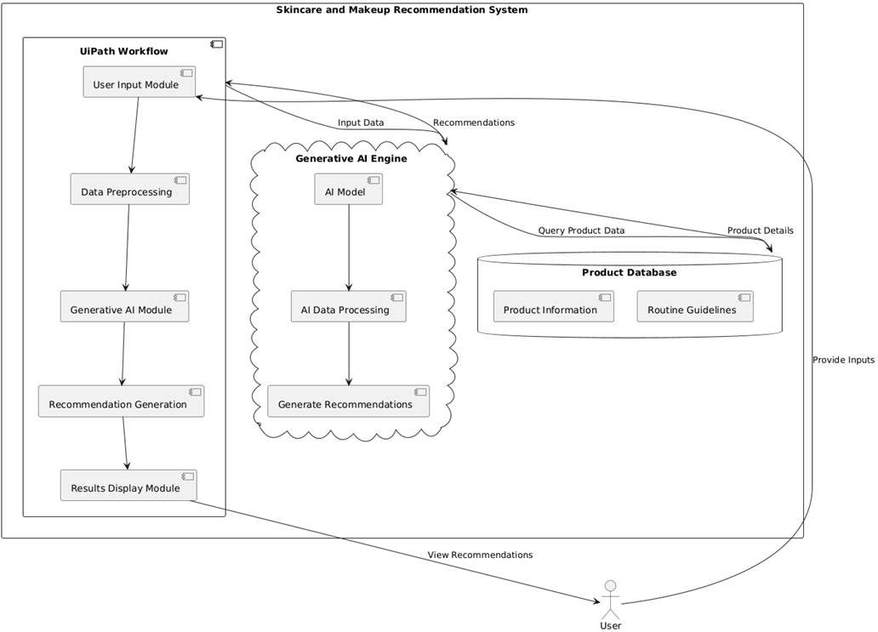
Architecture
‹#›

Slide 8
System Requirements
Hardware Requirements
Processor: Intel Core i5 or higher (or equivalent)
RAM: 8 GB or higher
Storage: 256 GB SSD or more
Software Requirements
Operating System: Windows 10 or later
UiPath Studio: Latest version with Generative AI and Computer Vision activities enabled
‹#›

Slide 9
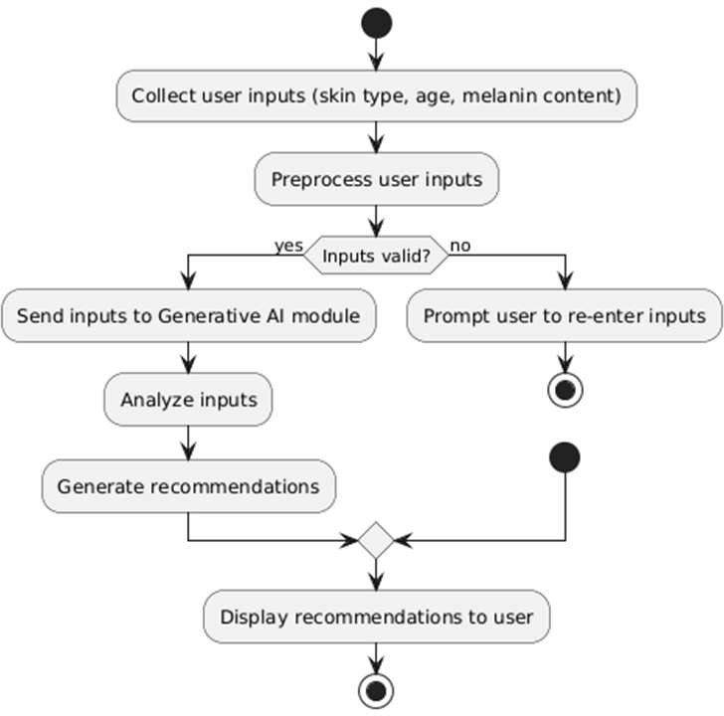
System Flow Diagram
‹#›

Slide 10
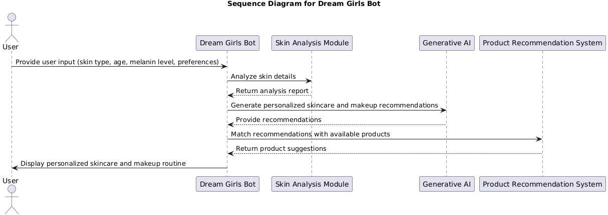
Sequence Diagram
‹#›

Slide 11
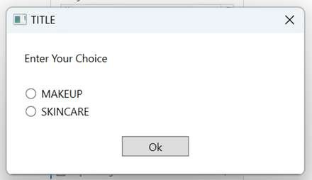
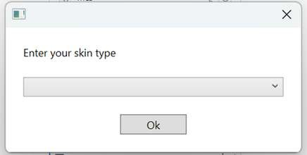
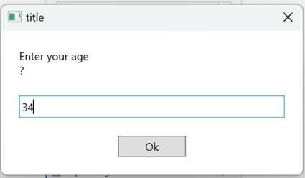
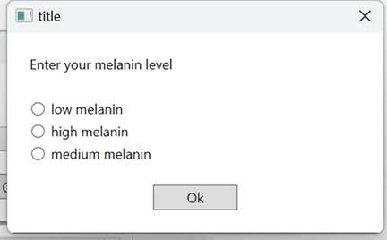
Testing
Testing ensures the Dream Girls Beauty Bot functions correctly by validating its features, accuracy, and performance. The testing process includes unit, integration, and user acceptance testing to guarantee reliable recommendations and a seamless user experience.
Sample Input
‹#›

Slide 12
Testing
Sample Output
‹#›

Slide 13
Conclusions
The Dream
personalized
Girls
skincare
Beauty
and
Bot
makeup recommendations. By
successfully
automates
leveraging UiPath’s automation capabilities and generative AI,
it efficiently handles diverse user inputs,
beauty
analyzes skin
solutions. The
characteristics, and provides tailored
system enhances user experience by reducing manual effort and ensuring accurate, data-driven recommendations. Future improvements can focus on integrating real-time skin analysis and expanding the product database for even more precise and comprehensive results.
‹#›

Slide 14
Future Enhancement
Real-Time Recommendation Processing: Implementing real-time analysis for personalized beauty recommendations, allowing users to receive instant skincare and makeup suggestions based on their inputs and current needs. This includes automatic updates for new product additions and seasonal trends.
Expanded Product Database Integration: Enhancing the bot by integrating data from a wider range of beauty brands and product lines, ensuring comprehensive and diverse beauty solutions while improving the accuracy and customization of recommendations.
‹#›

Slide 15
References
UiPath Documentation:
UiPath Gen AI Activities: https://docs.uipath.com/activities/other/latest/integration-
service/uipath-uipath-airdk-about
UiPath Studio (2024).
Generative AI Integration.
Retrieved from https://www.uipath.com.
Russell, S., & Norvig, P. (2021).
Artificial Intelligence: A Modern Approach (4th Edition). Pearson.
ISBN: 9780134610993.
‹#›

Slide 16
Queries

Slide 17
Demonstration

Slide 18
Thank You

