Slide 1
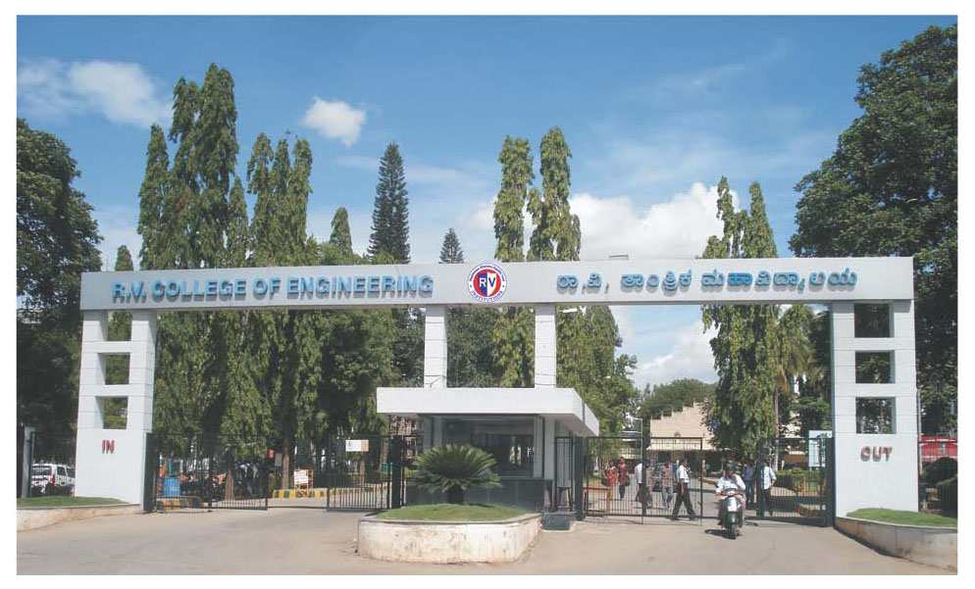
AaharAI — India-First Nutrition Intelligence Platform
An AI-Powered Personalised Nutrition Platform for Indian Users
Team Members: [Member 1] | [Member 2] | [Member 3] | [Member 4]
Guide: [Guide Name] | Interdisciplinary Phase 1 Presentation | March 2026

Slide 2
INTRODUCTION
What is AaharAI?
AaharAI is an AI-powered conversational nutrition platform designed exclusively for India. It generates personalised daily meal plans based on who the user is, where they live, what health condition they have, and which medicines they are taking — using verified Indian nutritional science (IFCT 2017 and ICMR-NIN 2024 guidelines).
Why is it needed?
India has 77 million diabetics, 200 million+ hypertensive patients, and 57% anaemia prevalence among women of reproductive age. Existing nutrition apps are built on Western databases and ignore India’s regional food diversity across 700+ districts, and drug-nutrient interactions from Indian pharmacopeia. No current platform unifies these into one personalised system.
Key Features
User profiling across 5 dimensions: age group, profession/activity, state and district, health condition, and current medications
District-level Indian food culture database (Zone → State → District) using IFCT 2017 food composition data
Drug-nutrient interaction catalog for 200+ common Indian medicines (Metformin, Thyronorm, Ferrous Sulphate, INH, etc.)
LangGraph stateful AI agent with session memory; per-meal nutrient calculation in Indian portion units (katori, chapati, glass)
Admin dashboard for food/medicine database management and population-level health trend monitoring
Technology Stack
Python (FastAPI) | LangGraph + LangChain | Claude API (claude-sonnet-4-6) | Next.js 15 | PostgreSQL via Supabase | IFCT 2017 | ICMR-NIN 2024

Slide 3
LITERATURE SURVEY (1 of 2)
# | Author(s) / Title | Journal/Source | Year | Key Contribution | Limitation
1 | Jayanthi et al. / Diet recommendation using ML for diabetic patients | J. Health Informatics | 2022 | ML model personalises diet for Type 2 diabetes using glycaemic index data | Uses generic Western food database; no Indian regional foods
2 | Ravindra et al. / Personalised nutrition using IoT and AI | IEEE IOTM | 2023 | IoT sensor + AI pipeline for real-time dietary monitoring | No medication-nutrition interaction; limited to urban users
3 | Deshpande & Kulkarni / IFCT-based mobile nutrition app | Indian J. Nutr. Dietetics | 2021 | First app using IFCT 2017 for Indian food nutrient lookup | No AI personalisation; only static food look-up
4 | Srivastava et al. / Drug-nutrient interactions in Indian patients | Indian J. Pharmacology | 2022 | Documents B12 depletion from Metformin in Indian diabetic cohort | Clinical study only; not integrated into a software system
5 | Goyal & Sharma / NLP chatbot for diet counselling in Hindi | ACL India Workshop | 2023 | Hindi-language chatbot for basic dietary Q&A using NLP | No stateful memory; no health-condition-aware meal planning
6 | Verma et al. / Region-wise dietary patterns across Indian states | Nutrition Journal | 2021 | Maps state-level food consumption using NSSO survey data | State-level only; no district granularity or AI integration
7 | Anand et al. / LLM-based meal plan generation | arXiv / NeurIPS | 2024 | GPT-4 generates USDA-aligned meal plans with nutrient constraints | USDA-centric; no Indian food data; no regional personalisation
8 | Kumar & Prasad / Anaemia-specific nutrition intervention app | JAMIA | 2022 | Mobile app for iron-deficiency anaemia with food pairing logic | Single condition; no multi-condition or medication context
9 | Pillai et al. / Pregnancy nutrition tracker for Indian women | BMC Pregnancy Childbirth | 2023 | Trimester-based micronutrient tracker using ICMR-NIN targets | Pregnancy-only; no life-stage switching or AI reasoning
10 | Bhatt & Iyer / Conversational AI for chronic disease diet management | Health Informatics J. | 2024 | LangChain agent for chronic disease dietary guidance | No Indian food database; no regional or medication integration

Slide 4
LITERATURE SURVEY — Research Gap
Identified Research Gaps from Literature Review
Gap 1: Absence of Indian Regional Food Databases
Reviewed studies (Verma et al., 2021; Deshpande & Kulkarni, 2021) operate at state level at best. No existing system maps food culture at the district level (700+ districts) with verified IFCT 2017 nutrient profiles, leaving the majority of Indian food diversity unrepresented in AI-driven nutrition tools.
Gap 2: No Integration of Drug-Nutrient Interactions in Nutrition Software
Srivastava et al. (2022) documented drug-nutrient depletion in Indian patients clinically, but no reviewed software system translates this pharmacological knowledge into real-time meal adjustments. Metformin-induced B12 depletion, Thyronorm-calcium interaction, and INH-induced B6 loss are all unaddressed by existing nutrition platforms.
Gap 3: Single-Condition Systems Cannot Handle Co-Morbidities
Kumar & Prasad (2022) and Pillai et al. (2023) address single conditions (anaemia, pregnancy) in isolation. India’s patient population frequently presents with overlapping conditions (e.g., diabetes + hypertension + anaemia). No reviewed system resolves multi-condition nutritional requirements into a single coherent meal plan.
Gap 4: LLM-Based Systems Use Western Data and Lack Statefulness
Anand et al. (2024) and Bhatt & Iyer (2024) demonstrate the feasibility of LLM-driven meal generation but use USDA databases and stateless architectures. Indian foods (ragi, bajra, dosa, poha, khichdi) are absent; no system maintains user health context across sessions. AaharAI addresses all four gaps simultaneously.

Slide 5
PROBLEM STATEMENT AND OBJECTIVES
Problem Statement
India’s 1.4 billion population presents one of the world’s most diverse and complex nutritional landscapes, yet no AI-powered nutrition platform currently addresses the combined requirements of Indian regional food culture (at district level), multi-condition health profiling, drug-nutrient interaction management, and ICMR-NIN-aligned dietary guidance within a single personalised system. Existing global platforms use Western food databases inapplicable to Indian diets, offer no medication-aware recommendations, and ignore the dietary diversity across India’s 700+ districts. This results in nutritionally inappropriate and clinically unsafe dietary guidance for the majority of Indian users managing chronic health conditions or undergoing medical treatment.
Objectives
Primary Objectives
Develop an AI-powered nutrition platform tailored for India using IFCT 2017 and ICMR-NIN 2024 dietary data
Implement 5-dimension user classification: age, profession, state/district, health condition, and medication
Build a LangGraph stateful AI agent with persistent session memory and multilingual support (Hindi/English)
Generate per-meal and day-total nutrient calculations against ICMR-NIN targets using IFCT 2017 data
Deploy an Admin Dashboard for food/medicine data management and population health trend monitoring
Secondary Objectives
Curate a district-level Indian food culture database (Zone → State → District) for 100+ high-population districts at MVP
Build a medicine-nutrition impact catalog for 200+ common Indian drugs with food-timing and depletion flags
Resolve multi-condition nutritional conflicts (e.g., diabetes + hypertension + pregnancy) into a single coherent daily plan
Validate system accuracy against NSSO dietary surveys and NFHS-5 health data for regional relevance
Evaluate user experience across diverse Indian demographic groups and refine the conversational agent accordingly

Slide 6
METHODOLOGY (1/4) — System Overview and User Classification
AaharAI processes every user request through a 5-stage pipeline. This slide details Stages 1 and 2: User Classification and Profile Resolution.
Stage 1 — User Classification (Onboarding)
Age Group
Teen · Adult
Senior · Elderly
Profession
Sedentary · Light
Moderate · Heavy
Athlete
Region
State (36)
District (700+)
Zone (6)
Health Cond.
Diabetes · BP
Anaemia · Thyroid
PCOS · Pregnancy
+ 6 more
Medication
Active medicines
Drug name + dose
Timing + phase
Stage 2 — Nutrition Inference Engine
ICMR-NIN RDA Calculator
Looks up life-stage
DRI targets from
ICMR-NIN 2024 table
(14 nutrients per
life stage + sex)
Condition Rule Engine
Adjusts targets for
active health condition
Diabetes: carbs 45%
Anaemia: iron x1.5
Pregnancy: folate 600mcg
Medicine Impact Modifier
Maps each medicine
to nutritional impact
Metformin -> B12+30%
Thyronorm -> Ca flag
INH -> B6+30%
Physio-State Boost Layer
Daily check-in scores
apply nutrient boosts
Low energy -> B12+iron
Poor sleep -> Mg+Zn
Low focus -> Omega-3
NutritionContext Object
nutrient_targets | condition_flags | medicine_flags | physio_boosts | priority_nutrients

Slide 7
METHODOLOGY (2/4) -- Nutrition Inference Engine
4-step pipeline from user profile to daily nutrient specification
Step 1 — ICMR-NIN RDA Calculator
Looks up Dietary Reference Intake table keyed by (life_stage, sex)
Returns base targets for 14 nutrients: calories, protein, calcium, iron, zinc, folate, B12, vitamin D, vitamin C, magnesium, potassium, fiber, omega-3, carbs
Source: ICMR-NIN 2024 Dietary Guidelines for Indians
Example: Pregnant female -> iron=27mg, folate=600mcg, protein=78g, calcium=1200mg
Step 2 — Health Condition Modifier
Applies condition-specific rules on top of base RDA
Diabetes: reduce carbs% to 45%, increase fiber to 35g, flag high-GI foods
Hypertension: sodium limit 1500mg/day, potassium priority, flag pickle/papad
Anaemia: iron x1.5, add vitamin C pairing rule, B12 daily source required
Hypothyroidism: add goitrogen-avoidance flag, selenium priority, iodised salt
Pregnancy: elevated iron, folate, DHA; nausea-safe food flags if first trimester
Step 3 — Medicine Impact Modifier
Loads user's active medicines from database
Matches each medicine name against medicine_impacts.json catalog
For each matched medicine: boosts depleted nutrients by 1.3x, adds food_avoid flags
Metformin -> boost B12 target by 30%, add ‘take with food' note
Thyronorm -> add empty-stomach flag, separate calcium by 2 hrs
Ferrous Sulphate -> pair with vitamin C source, avoid tea 1hr after dose
Step 4 — Physio-State Nutrient Boosts
Daily check-in scores (energy 1-5, sleep hours, focus 1-5) trigger nutrient boosts
Energy < 3 -> boost B12 by 30%, iron by 25%, magnesium by 20%, add iron-rich food flag
Sleep < 6hrs -> boost magnesium by 30%, add tryptophan-rich food flag
Focus < 3 -> boost omega-3 by 30%, add choline-rich food flag (eggs, chicken liver)
Output: NutritionContext object with final daily targets + all food flags
OUTPUT: NutritionContext -- Final nutrient targets + food flags -> passed to LangGraph meal_node

Slide 8
METHODOLOGY (3/4) -- LangGraph Agent & Meal Generation
5-node stateful AI agent with Claude API integration and IFCT nutrient calculation
Node: intake
Parse user message, update session state (energy/sleep/focus). Load user profile, medicines, and district from Supabase if not in session.
Claude API — Meal Generation Prompt Structure
System prompt contains: user profile context, daily nutrient targets from inference engine, regional food list from district database, medication flags and food-timing rules, language preference
User message: "Generate my meal plan for today"
Output format: structured JSON with breakfast, lunch, dinner, snack -- each with food items, Indian portions, and a nutrition rationale note
Guard rails: post-processing Python rule engine validates protein floor, checks against food flags, verifies minimum micronutrient coverage
Node: route
LLM call classifies intent into: meal_request | medicine_question | nutrient_query | food_log | general_chat. Routes to correct downstream node.
Node: meal
Runs inference engine (Step 2). Fetches district foods. Calls Claude API with nutrient-constrained prompt. Saves plan to meal_plans table.
IFCT 2017 Nutrient Calculation
After Claude returns the meal plan JSON, each food item is matched to IFCT 2017 database
Gram weights calculated using portion_conversions.json: 1 katori=150g, 1 chapati=35g, 1 glass=240ml
14 nutrients computed per food item at the stated gram weight
Meal-level totals and day-total computed and stored in meal_plans table
Node: info
Answers nutrition questions, medicine interaction queries, and RDA explanations using Claude API with user health context loaded in system prompt.
Persistent Memory (LangGraph PostgreSQL Checkpointer)
After every message, full AaharState is saved to PostgreSQL via LangGraph checkpointer
State includes: full conversation history, user profile, active medicines, today's nutrient targets, foods eaten so far today
Next session: agent restores state -- remembers past preferences, avoidances, and health context
Session identified by user_id -- different devices resume the same conversation thread
Node: format
Translates response to user language (Hindi/English/Hinglish). Converts gram weights to Indian portions (katori, chapati, glass). Adds medicine timing notes.

Slide 9
METHODOLOGY (4/4) -- End-to-End System Architecture
Complete data flow from user request to personalised meal plan output
LAYER 1: USER INPUT -- Web Browser (Next.js) -> FastAPI Backend (Python) -> Supabase Auth JWT Validation
LAYER 2: LANGGRAPH AGENT ENTRY -- intake_node loads user context -> route_node classifies intent (LLM call <500ms)
LAYER 3: INFERENCE ENGINE -- get_rda() -> apply_condition_rules() -> apply_medicine_impact() -> apply_physio_boosts()
LAYER 4: DATA LOOKUP -- district_foods DB (state/district match) + IFCT 2017 food nutrients + medicine_impacts.json
LAYER 5: CLAUDE API CALL -- Nutrient-constrained prompt -> JSON meal plan generated -> IFCT nutrient enrichment
LAYER 6: RESPONSE -- Meal plan + nutrient totals saved to Supabase -> format_node localises language + Indian portions
LAYER 7: FRONTEND DISPLAY -- Meal plan cards + Micronutrient gauge dashboard + Food log + Admin Dashboard
Data Sources & Validation
IFCT 2017 (NIN Hyderabad) -- 600 Indian foods with verified lab-tested nutrient profiles per 100g
ICMR-NIN 2024 Dietary Reference Values -- life-stage RDA for 14 nutrients; Indian population specific
Medicine-Nutrition Catalog -- 200+ common Indian brand/generic drugs curated by pharmacist; validated against clinical literature
District Foods DB -- NSSO consumption surveys + manual curation; 100 high-population districts at MVP; expanding to 770 districts

Slide 10


