Slide 1
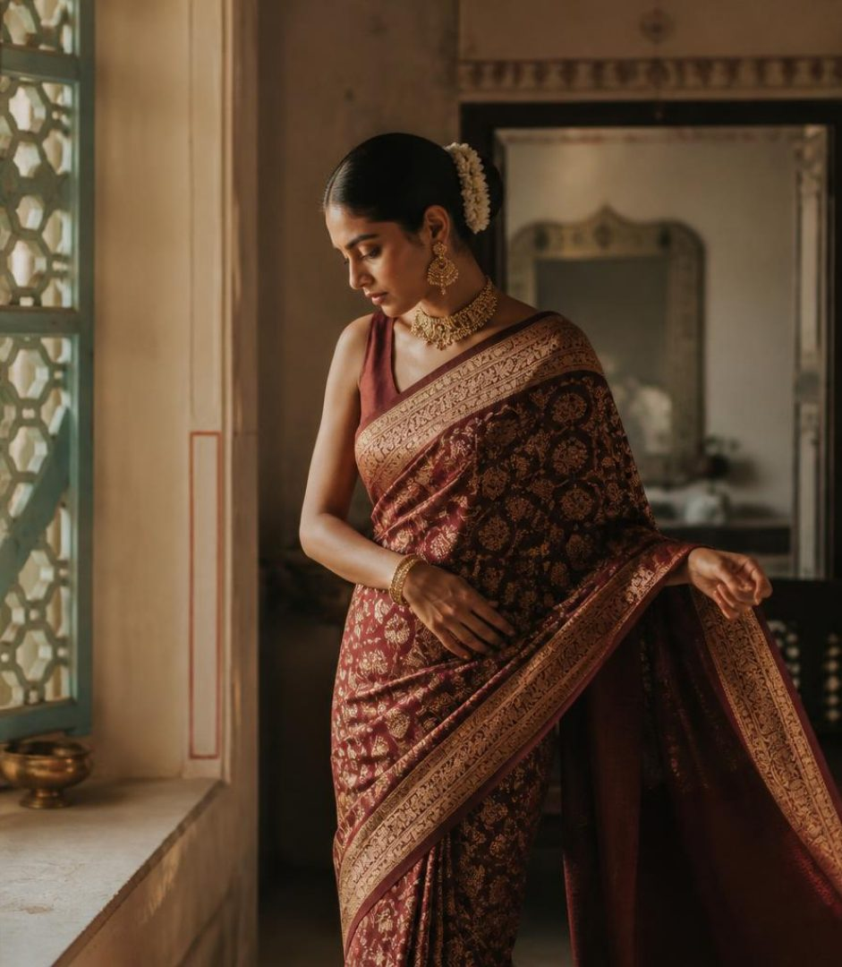

https://shree-boutique-website--tharunithammine.replit.app/
Shree
Boutique
A responsive portfolio demo for a
fictional Indian clothing boutique.
Maroon, cream, and teal—rooted in
tradition, made for today.

Slide 2
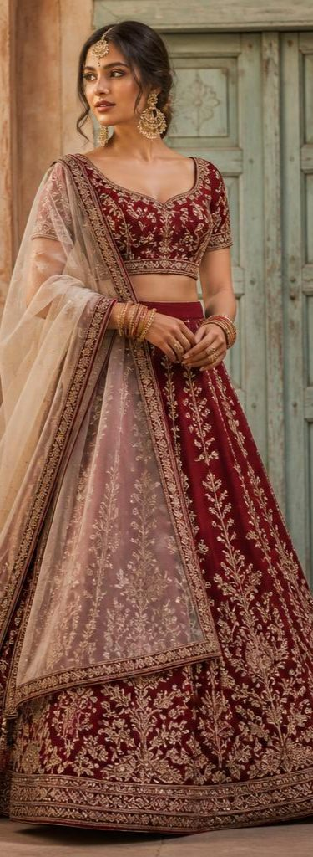
Project overview
A single-page showcase for an imagined Indian clothing boutique
Sarees, blouses, and traditional dresses appear as fictional sample
products
About, customization, and contact content complete the brand story
This is a portfolio demo—not a live shop

Slide 3
Key features
Responsive navigation and layouts for desktop and mobile
Filterable gallery with six fictional products and clearly labeled INR sample prices
About, customization concept, and contact sections
Accessible color contrast, keyboard focus, and reduced-motion support
WhatsApp link is a clearly labeled placeholder; no orders or payments are enabled

Slide 4
Tools and development
React + Vite + TypeScript
CSS with a maroon, cream, and teal visual system
Product data and editable page copy centralized in src/content.ts
Original generated fashion imagery stored with the website
Static frontend; no backend or payment processing

Slide 5
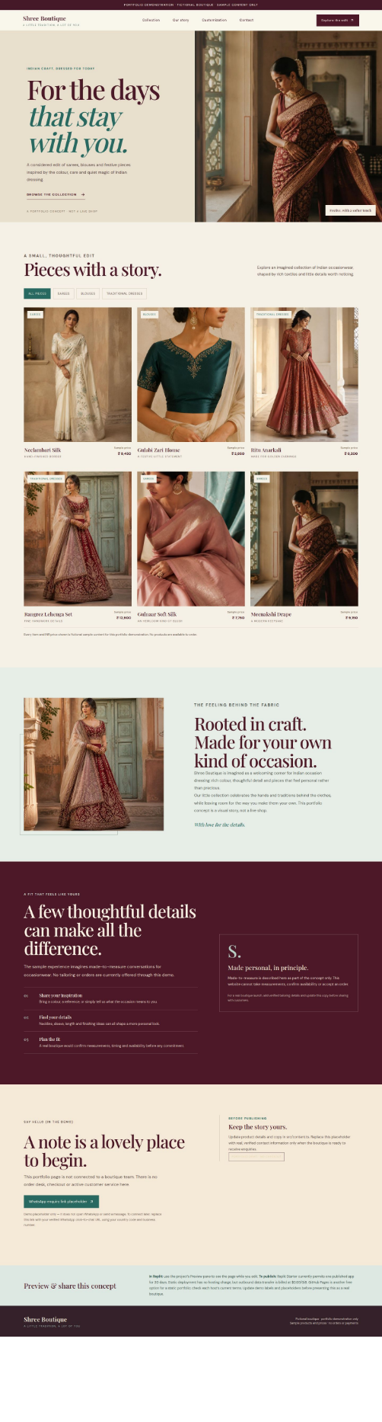
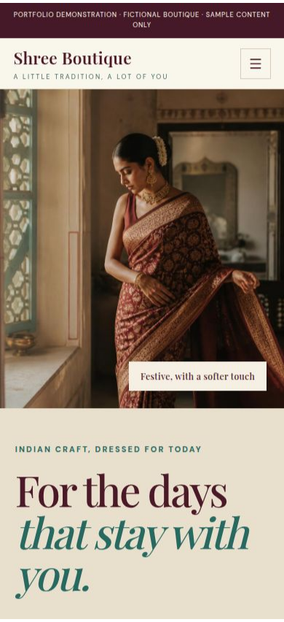
Website
screenshots
Desktop and mobile views of
the Shree Boutique portfolio
website.

Slide 6
Learning outcomes
This project demonstrates how to:
Carry one visual identity across desktop and mobile layouts
Keep product details and page copy easy to update
Use accessible contrast, clear focus states, and reduced-motion support
Label a portfolio concept clearly so it is not mistaken for a live store

