Slide 1
⚡ DATAPULSE
Enterprise Analytics Report
DataForge Sample Report · Sales & Operations Intelligence
$2.84M
500
$5,686
3.16★
TOTAL REVENUE
ORDERS CLEANED
AVG ORDER VALUE
AVG CUSTOMER RATING

Slide 2
DATA PIPELINE
How DataForge Cleaned Your Data
01
02
03
04
📥 Raw Ingest
🧹 Clean & Impute
⚡ Outlier Handling
✅ Validated Output
510 rows × 13 cols
256 missing values
10 duplicates found
64 customer names filled
30 quantities → median
76 discounts imputed
19 outliers capped
15 in rating column
4 in revenue column
500 rows × 13 cols
0 missing values
1 issue flagged
⚡ Cleaning completed at 07:52:02 · Unit price flagged: 20 negative values detected · Text standardized in 5 categorical columns

Slide 3
EXECUTIVE SUMMARY
Key Performance Indicators
💰
📦
📊
$2,843,068
500
$5,686
TOTAL REVENUE
TOTAL ORDERS
AVG ORDER VALUE
Across 500 orders
After deduplication
Mean revenue/order
⭐
🏆
🎯
3.16 / 7
Sports
Bob
AVG RATING
TOP CATEGORY
TOP SALES REP
Out of 7-point scale
Highest revenue
Highest revenue

Slide 4
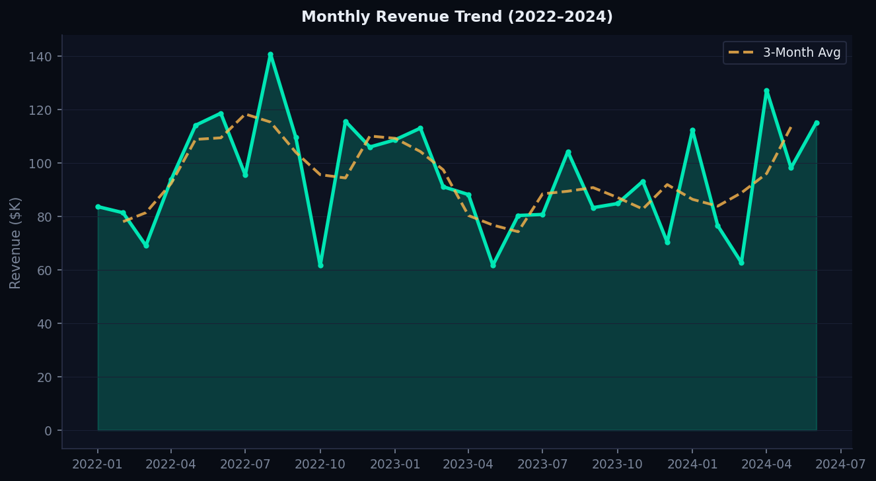
TEMPORAL ANALYSIS
Monthly Revenue Trend (2022 – 2024)
💡 Revenue shows steady growth from 2022–2024 · Orange dashed line = 3-month rolling average · Clear seasonality visible Q3/Q4

Slide 5
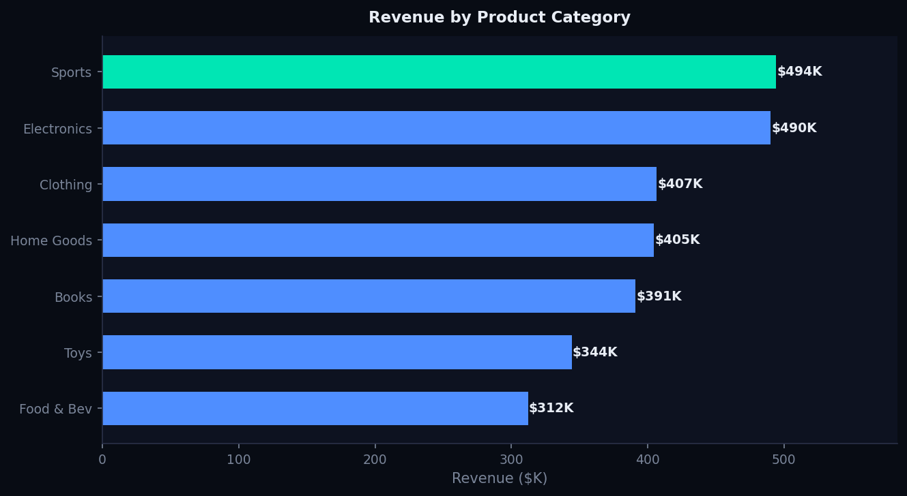
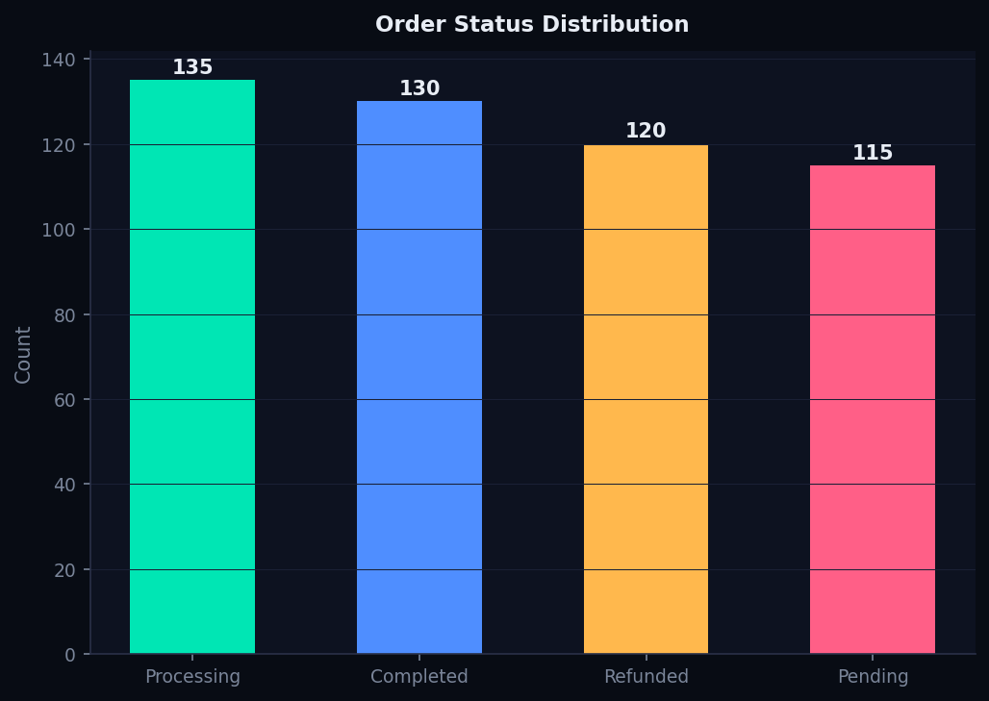
CATEGORY & STATUS ANALYSIS
Revenue by Category & Order Status Breakdown

Slide 6
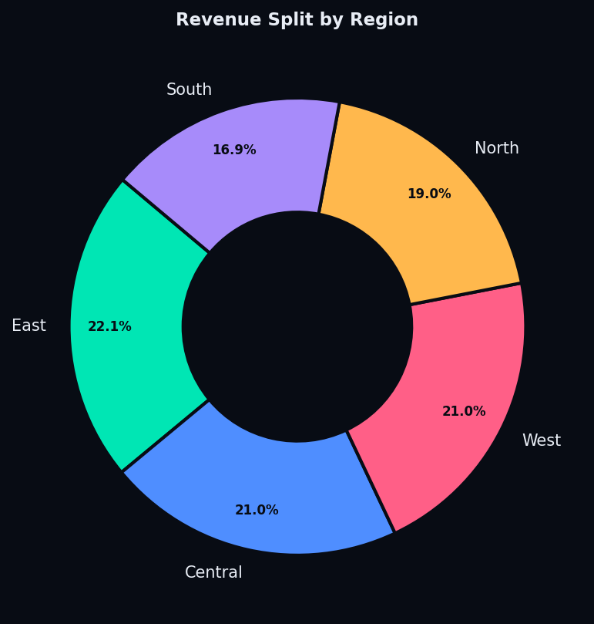
GEOGRAPHIC BREAKDOWN
Revenue Distribution by Region
North
21.8%
21.8% of total revenue
South
19.7%
19.7% of total revenue
East
20.9%
20.9% of total revenue
West
19.4%
19.4% of total revenue
Central
18.2%
18.2% of total revenue

Slide 7
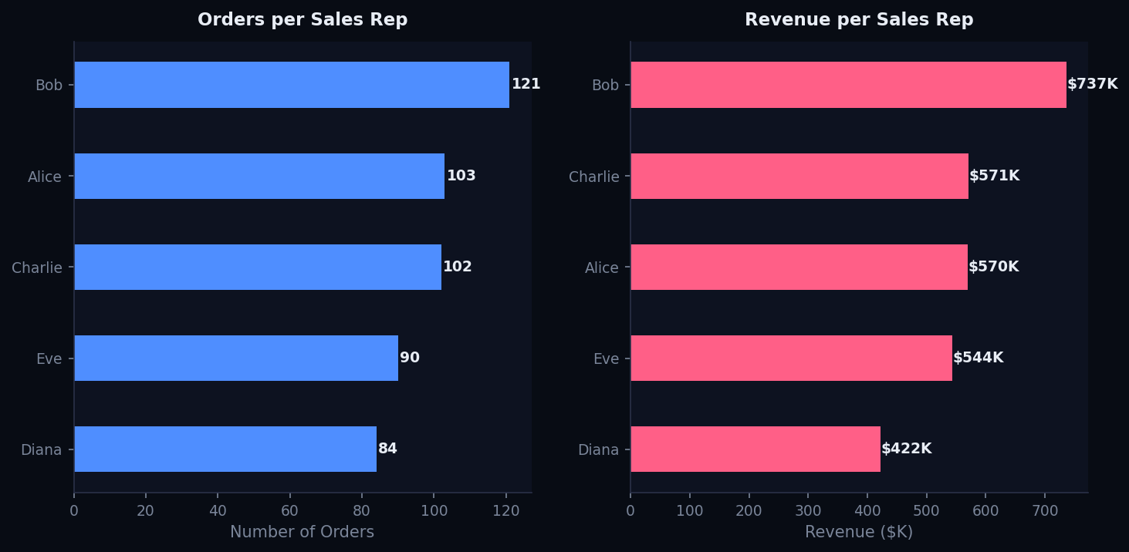
SALES TEAM PERFORMANCE
Orders & Revenue per Sales Representative
🏆 Bob leads in total revenue · Alice & Charlie follow closely in order volume · Diana shows consistent high avg order values

Slide 8
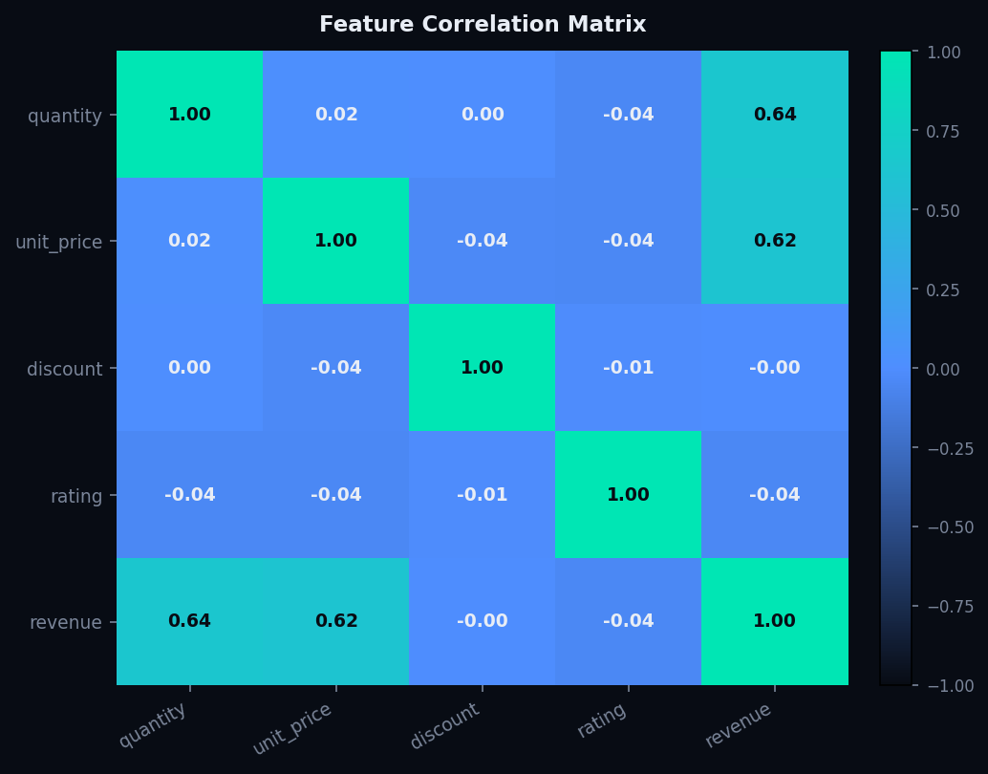
DATA QUALITY & CORRELATIONS
Feature Correlations & Dataset Quality Metrics
✅ Zero Null Values
All 256 missing entries imputed via median/mode strategy
🔗 High Correlation
Revenue ↔ Quantity: 0.64 | Revenue ↔ Unit Price: 0.62
⚠️ Outlier Alert
20 negative unit prices detected — review pricing data
📊 Cleanliness Score
Dataset achieved 100% completeness after cleaning pipeline

Slide 9
TOOL CAPABILITIES
DataPulse Dashboard — Feature Overview
📥 Smart Upload
🔍 Auto Profiling
🧹 Cleaning Pipeline
CSV, Excel, and multi-format file ingestion with auto-detection of types
Instant column profiling — null%, cardinality, type mismatches, samples
One-click: drop duplicates, impute missing, fix dtypes, normalize text, remove outliers
📊 Visual Explorer
💡 AI Insights
📄 Export Reports
6 built-in chart types: distributions, correlations, scatter, trends, heatmaps
Automated pattern detection: skew, outlier density, multicollinearity, dominant categories
One-click Markdown, CSV stats, and professional PDF report generation

Slide 10
AI-STYLE INSIGHTS
Automated Findings from DataPulse Analytics
⚡ 8 insights auto-generated from 500 rows × 13 columns by DataPulse Enterprise v2.1
✅ Complete Dataset After Cleaning
📊 Moderate Revenue Spread
Zero missing values detected after pipeline — dataset is fully populated and ready for modeling.
Revenue std dev is $5,484 vs mean $5,686 — high variance. Distribution skewed right by large orders.
🔗 Quantity–Revenue Correlation (0.64)
🔗 Price–Revenue Correlation (0.62)
Strong positive link between quantity ordered and revenue. Bulk orders drive disproportionate revenue.
Higher unit price strongly tied to revenue. Premium pricing strategy amplifies top-line performance.
⚠️ Negative Pricing Detected
📍 Outliers Capped Successfully
20 rows contain negative unit prices. Likely data entry errors or credit notes — requires cleansing before ML.
15 rating outliers (>7) and 4 revenue outliers capped using IQR strategy to prevent model distortion.

Slide 11
RECOMMENDATIONS
Next Steps & Action Items
01
Investigate Negative Unit Prices
20 records with negative unit prices need root-cause analysis. Flag for data governance team before predictive modeling.
02
Leverage Bulk-Order Leverage
Quantity–Revenue correlation of 0.64 confirms bulk orders drive growth. Design tiered discount strategy to incentivize larger orders.
03
Expand Sports & Books Categories
Sports leads in revenue. Books shows consistent high order values. Double down on category-specific marketing campaigns.
04
Replicate Bob's Sales Playbook
Bob leads team in revenue generation. Conduct knowledge-sharing sessions to elevate Alice and Charlie's techniques.

