Slide 1
AN AUTOMATED SMART BIOGAS PLANT (GOBARdhan) AND A NUTRIENT MEASUREMENT KIT (NURIX) WITH A NUTRIENT ENRICHMENT MODEL (BIOX)
THEME :FOOD WASTE MINIMIZATION AND CIRCULAR ECONOMY
TEAM : SOCIAL CHALLENGERS

Slide 2
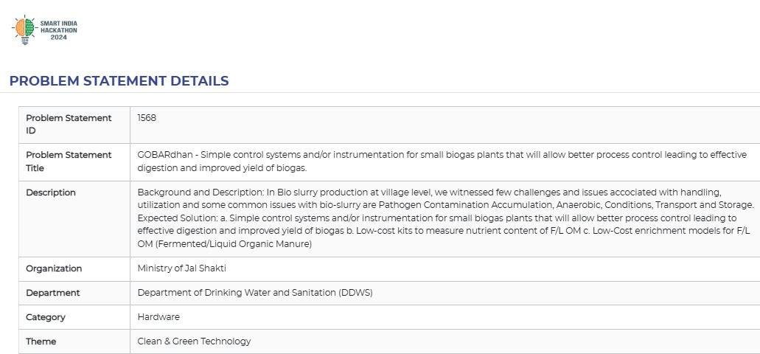
PROBLEM STATEMENT

Slide 3

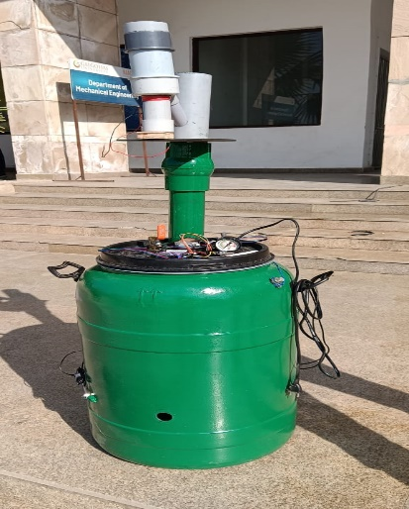
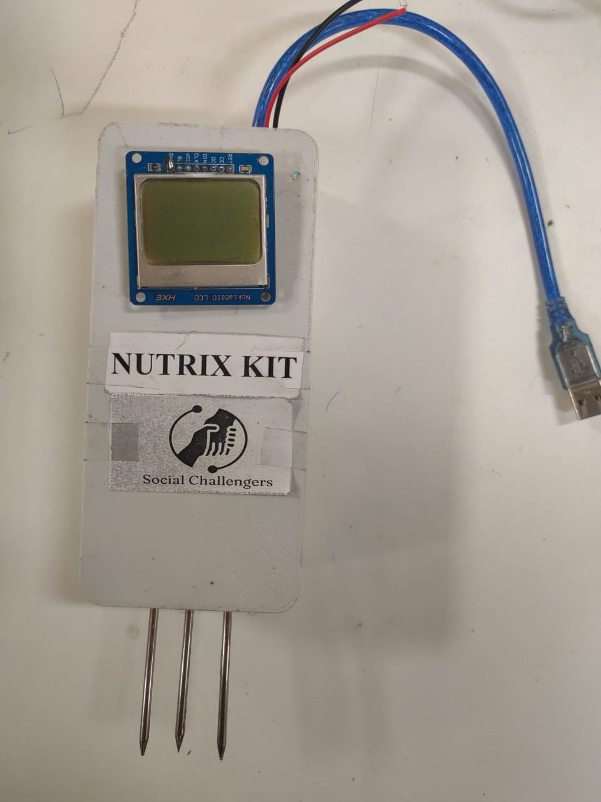
SOLUTION FOR THE STATEMENT
a. Simple Control System - GOBARdhan
Unique chamber design optimized for microbial digestion.
Advanced sensors for real-time monitoring and Safety check (pH, temperature, methane levels)
Automation via motors, heating coil
b. Nutrient Measurement Kit – NUTRIX
Measure the available nutrient content of the digested slurry
Achieve an average methane output efficiency of 80%.
c. Nutrient Enrichment Model – BIOX and User Manual
A low cost nutrient enrichment model for the fermented liquid or solid

Slide 4
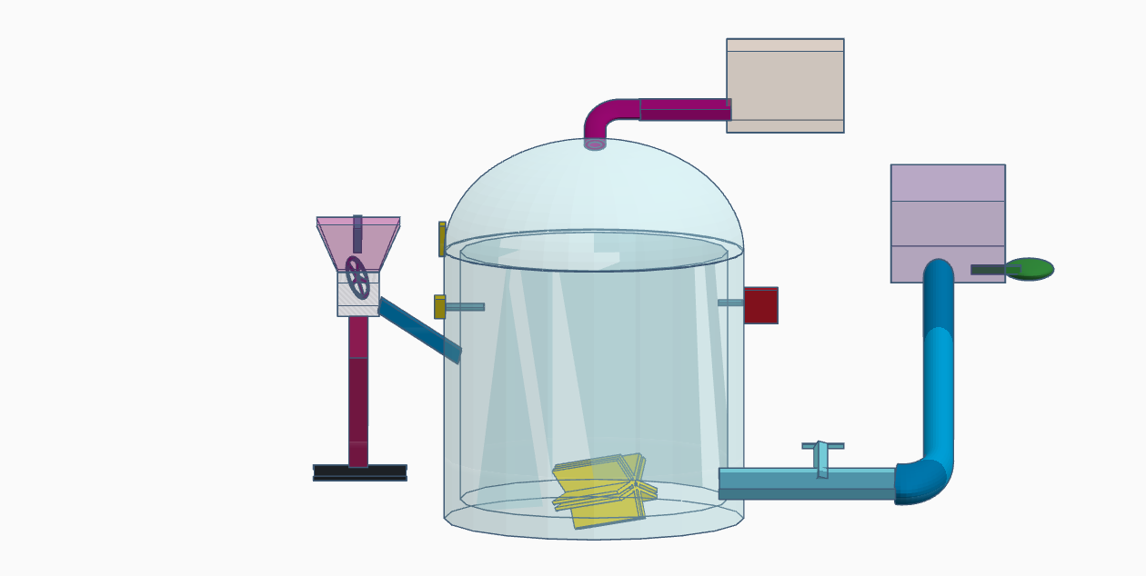
PROPOSED SYSTEM - BLOCK DIAGRAM
A) GOBARdhaan- An automated biogas plant for improved yield of biogas
5.Methane Storage and Supply
B) Enrichment unit for F/L OM – slurry gets aerated and addition of essential additives for higher nutrient availability
CH4
CH4
CH4
1.Organic manure + grinded wet vegetable wastes – Grinded to suitable proportion for higher availability towards microbial digestion
6.Slurry collection and Enrichment unit
CH4
CH4
CH4
C) Nutrient measurement kit - NPK
sensor circuit to measure and display the availability of Nitrogen, Phosphorous and Potassium
Methanogenesis
(6.8 – 7.5 ph)
Acetogenesis
(6.3 – 7 ph)
2.Ultrasonic sensor-Level of input slurry identified and controlled
Acidogenesis
(5-6.5 ph)
Hydrolysis
4.Methane sensor
3.Spinning Motor- Continual mixing of input slurry to avoid stagnant condition
pH sensor
Temperature sensor
Digestion chamber –Anaerobic condition is maintained suitable for microbial digestion
Pressure sensor

Slide 5
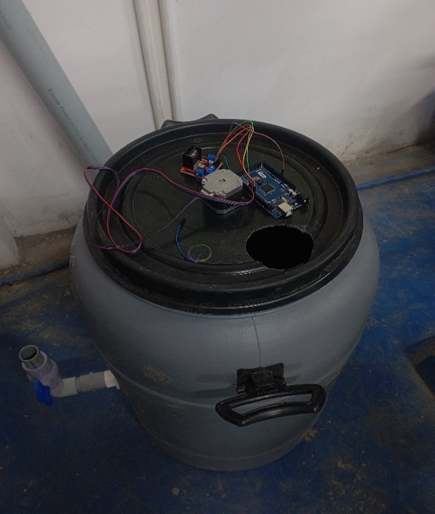

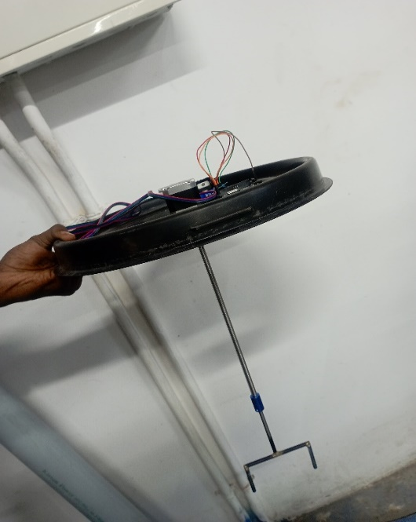
a. Simple Control System - GOBARdhan
Pre-mixer: organic waste and cow dung to a uniform slurry, ensures efficient digestion
Ultrasonic Level Sensor: Monitors slurry levels, triggers LED indicators on desired level
Methane Monitoring: Methane sensor detects gas leakage ensures safety
Automatic Agitation: Automatic motor agitation on low methane production to improve gas production
Temperature Regulation: Temperature sensor and heating coil integration
Safety Measure : Pressure increase triggers solenoid valves open ,directs gas to a storage container

Slide 6
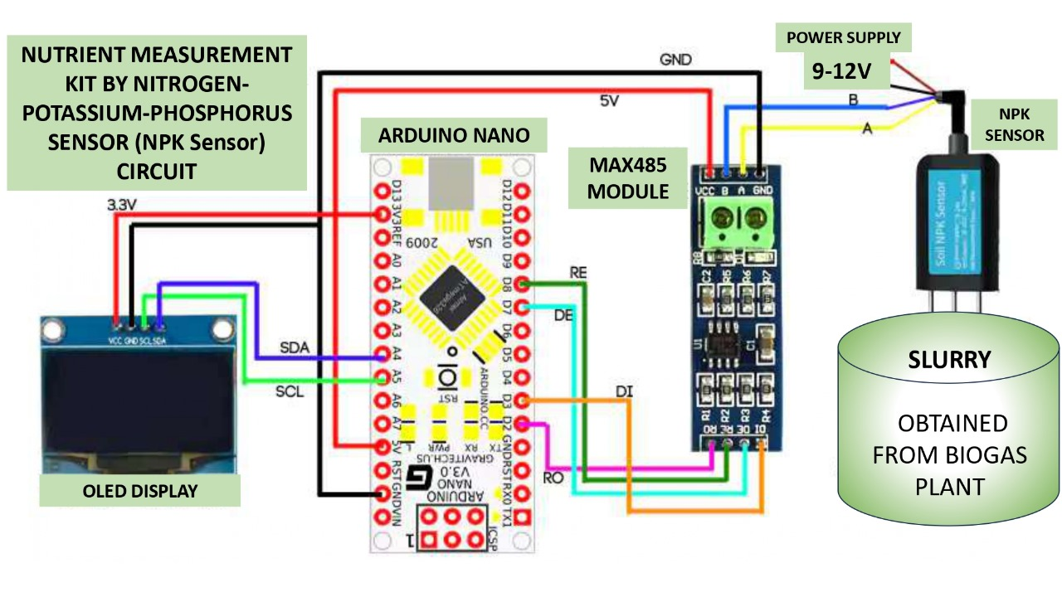
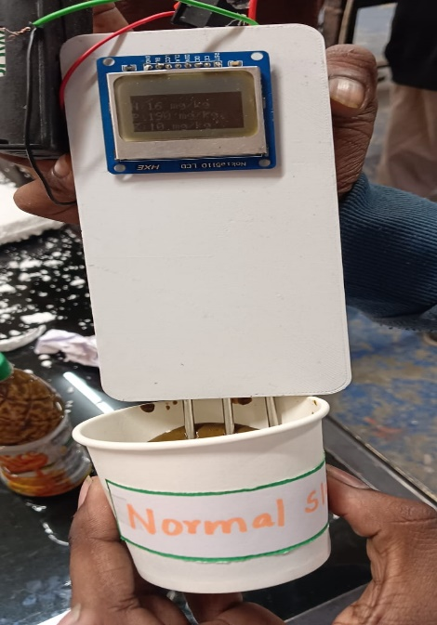
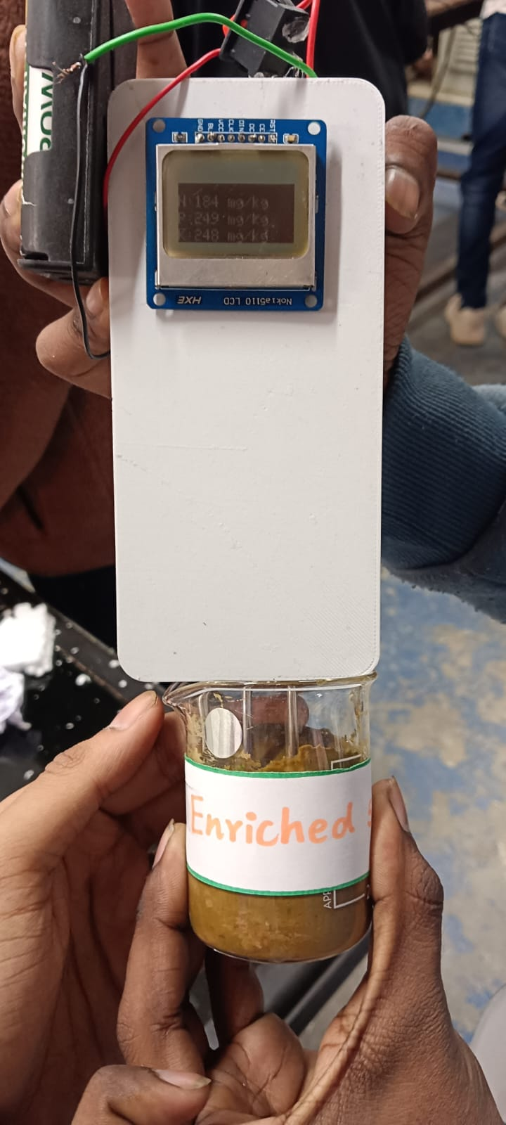
b. Nutrient Measurement Kit – NUTRIX
Nutrient Analysis: N, P, K values measured precisely in biogas slurry enriched with BIOX
User-Friendly and Cost-Effective: Compact, portable and alternative to lab testing, tailored for rural farmers
Real-Time Monitoring: Digital sensors for reliable readings
NUTRIX ensures precise measurement and enhancement of NPK values in biogas slurry
Helps optimizing fertilizer quality based on values obtained improve crop yield
Vs

Slide 7

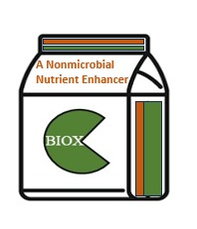
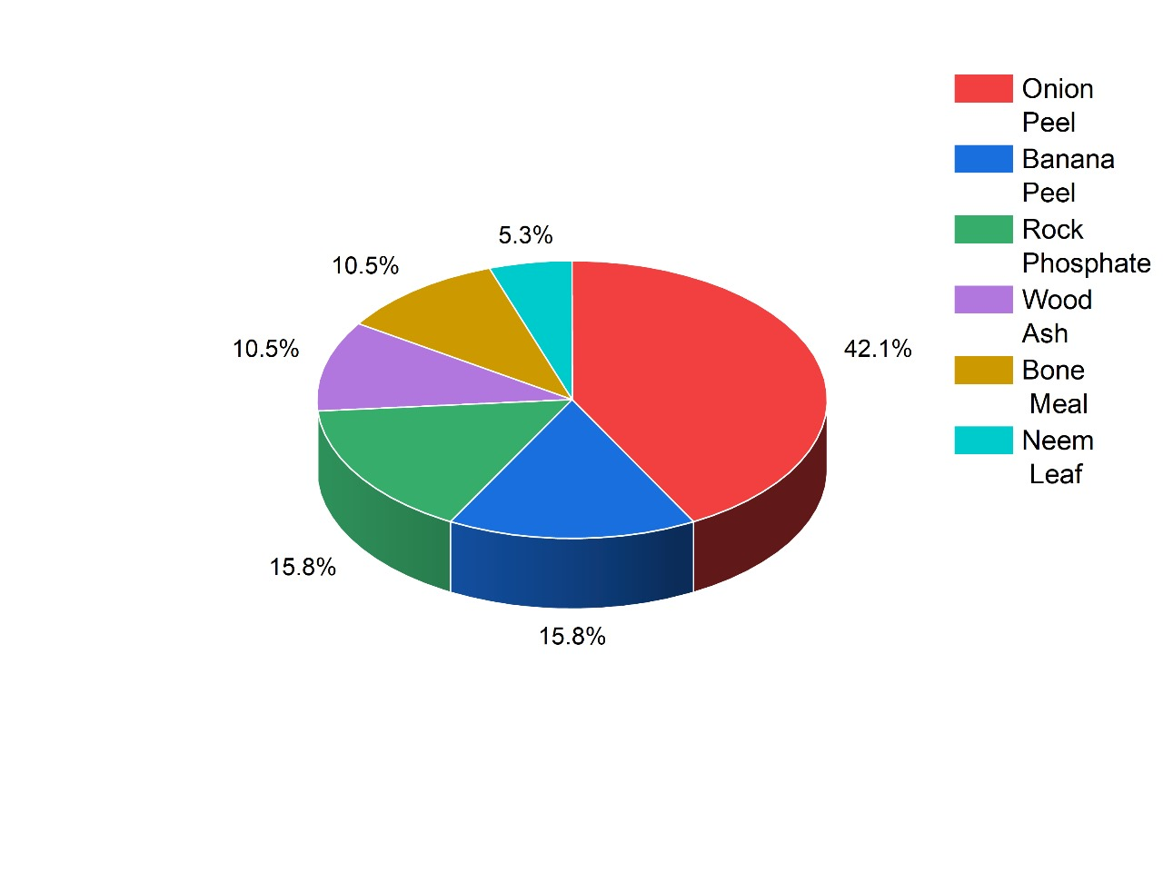
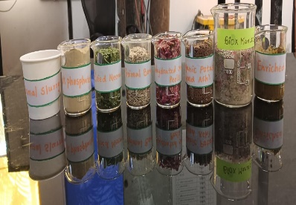
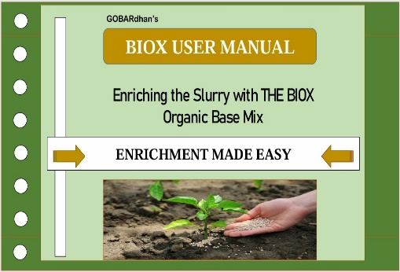
c. Nutrient Enrichment Model – BIOX and User Manual
A two-tiered enrichment approach for enhancing biogas slurry output into a high-value organic fertilizer
1
BIOX – Organic Base Fertilizer
Nutrient Composition
of BIOX
COMPOSITION OF BIOX
BIOX User Manual
2

Slide 8
Lean Canvas
Problem Simple control system: Enhances digestion and improves biogas yield. Low-cost nutrient analysis: Efficient measurement tools. Cost-effective enrichment models for F/L OM. | Solution Smart Control: Automates digestion and ensures safety. NUTRIX KIT: Low-cost nutrient analysis tool. BIOX Fertilizer: Converts slurry into nutrient-rich fertilizers |  | Unique Value Proposition An automated, smart biogas system enhanced with NUTRIX KIT and BIOX Fertilizer-Enrichment Model, transforming organic waste into energy and high-value bio-fertilizers | Unfair Advantage Proprietary algorithms Integrated Nutrient Analysis Kit – NUTRIX Advanced safety mechanisms Waste Valorisation Enrichment Model – BIOX | Customer Segments Domestic Households Farmers and Agricultural Units Local Municipal Corporations Non Governmental Organizations Environmental Organizations
Existing Alternatives Conventional biogas plants with manual monitoring and control Limited Waste Valorisation High Cost No Real time Monitoring Lack of Nutrient Analysis Lack of Enrichment Model Safety features are basic | Key Metrics Payback period : 1-2 years (GOBARdhan), 2-3 years (Market available) 5-year ROI : Rs.90,000 – Rs.1,80,000 (GOBARdhan) Annual savings: Rs.18,000 – Rs.36,000 for energy |  |  | Channels Inbound : Website, Social Media, Online Forums Outbound : Government bodies, NGO’s Partnerships : Agricultural Cooperatives, local Municipalities Expo’s ( REI Expo , World Biogas Expo)
Cost Structure Fixed Cost : 20,000 Variable Cost :4,000 Return on Investment : 1-2 Years |  | Revenue Structure Product Sale, Revenue from BIOX Fertilizer (Enrichment Model) Customization and Consulting Maintenance and Support Systems (Annual maintenance Contract)
Total Cost : 24000 / Unit
Agricultural Benefits
Biogas slurry can be used as organic fertilizer
Fertilizer savings: Rs.5,000 – Rs.10,000

Slide 9
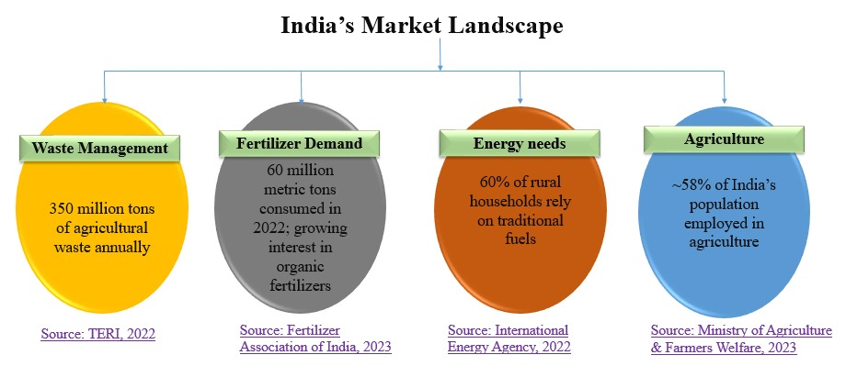
Return on Investment (ROI)
Factor | GOBARdhan (5-Year ROI) | Market Available Product (5-Year ROI)
Initial Investment | ₹20,000 - ₹24,000 | ₹26,000 - ₹62,000
Annual Energy Savings (LPG) | ₹18,000 - ₹36,000 | ₹18,000 - ₹30,000
Agricultural Savings (Fertilizer) | ₹5,000 - ₹10,000 per year | ₹2,000 - ₹4,000 per year
Maintenance Costs | ₹500 - ₹2,000 per year | ₹1,000 - ₹5,000 per year
Total 5-Year Savings | ₹90,000 - ₹1,80,000 | ₹70,000 - ₹1,50,000
Payback Period | 1-2 years | 2-3 years

Slide 10


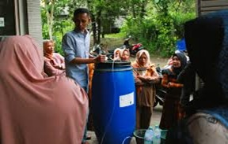
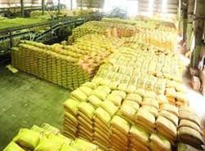
Target Audience for Biogas Plants in India
New National Biogas and Organic Manure Programme (NNBOMP) – Installation of biogas plants
Farmers using enriched slurry report a 30% reduction in dependency on chemical fertilizers
Field Trials Report, ICAR, 2022
Organic fertilizers like enriched slurry improve crop yields by 20-25% compared to untreated fields
Source: Indian Council of Agricultural Research, 2023
Collaborate with panchayats, farmer groups, and NGOss
(https://enam.gov.in/web/)
Biogas adoption reduces agricultural waste and creates additional income through slurry sales
Source: TERI, 2022
Fertilizer costs have risen sharply, with urea and DAP prices increasing by over 25% between 2021 and 2023
(Source: Fertilizer Association of India, 2023)

Slide 11
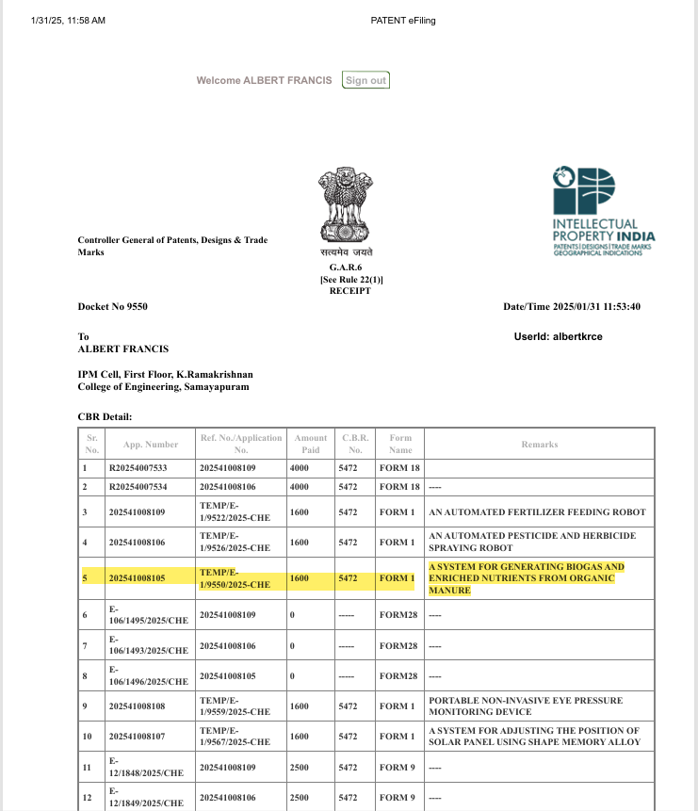
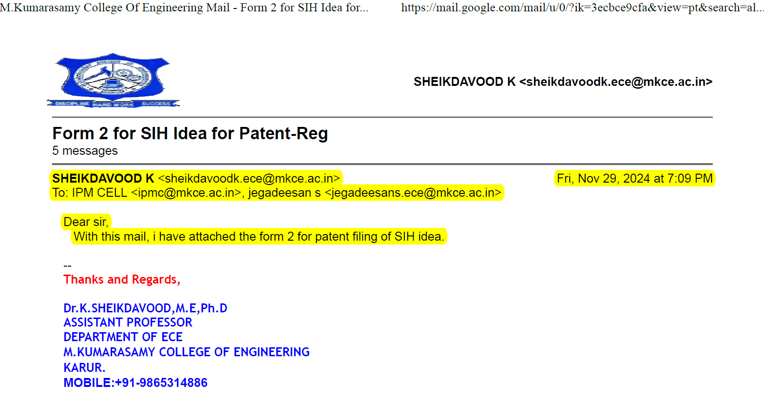
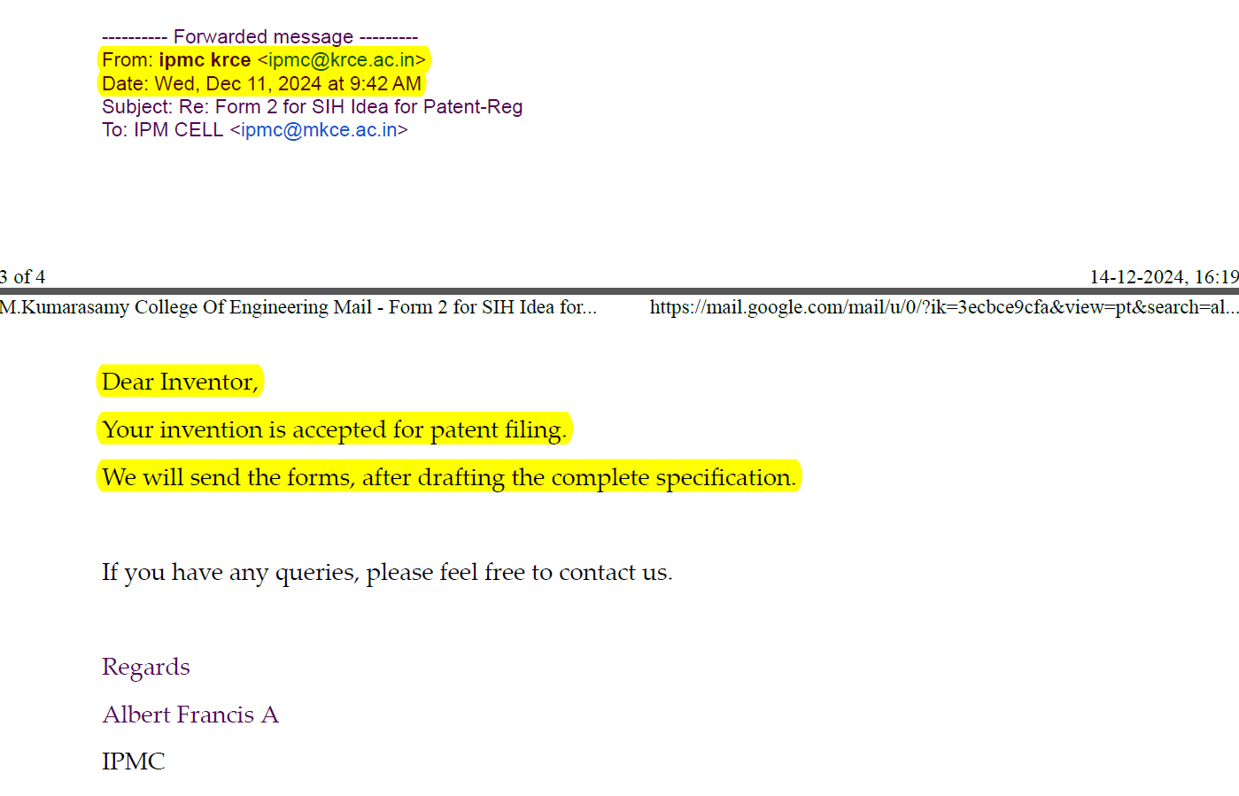
OUTCOME
Got Accepted for patent publication by IPM Cell, M.Kumarasamy College of Engineering, Karur, Tamilnadu.

Slide 12
THANK YOU

