Slide 1

GYM MANAGEMENT SYSTEM
DAMG 6210 Data Management and Database Design
Tharuni Sri Pulipati 002192407
Rehan Ahmed 002987431
Ujjwal Srivastava 001529293
Siddharth Kushal 002104288
Chengyan Mu 002198861
GROUP- 11

Slide 2
MISSION STATEMENT
A Gym Database Management System is the comprehensive database system, for a gym center that tracks, manages and stores data for existing members, all active memberships, and daily activities that are available to them.
A system like this can be used to efficiently generate reports and data on attendance, fee payment, as well as maintenance reports for equipment inventory.

Slide 3

2
1
HIGHLIGHTS AND PROCESS
3
4
To keep track of the members and their plans, and to communicate with them efficiently.
To store the data about the machinery being used, its maintenance and the data regarding staff.
To provide a variety of alternatives, in terms of equipment's, different fitness coaches based on availability and fee payment updates as well.
To create reports on various operations within the gym, including membership fee payment, which can be analyzed to get clear information about the members.

Slide 4
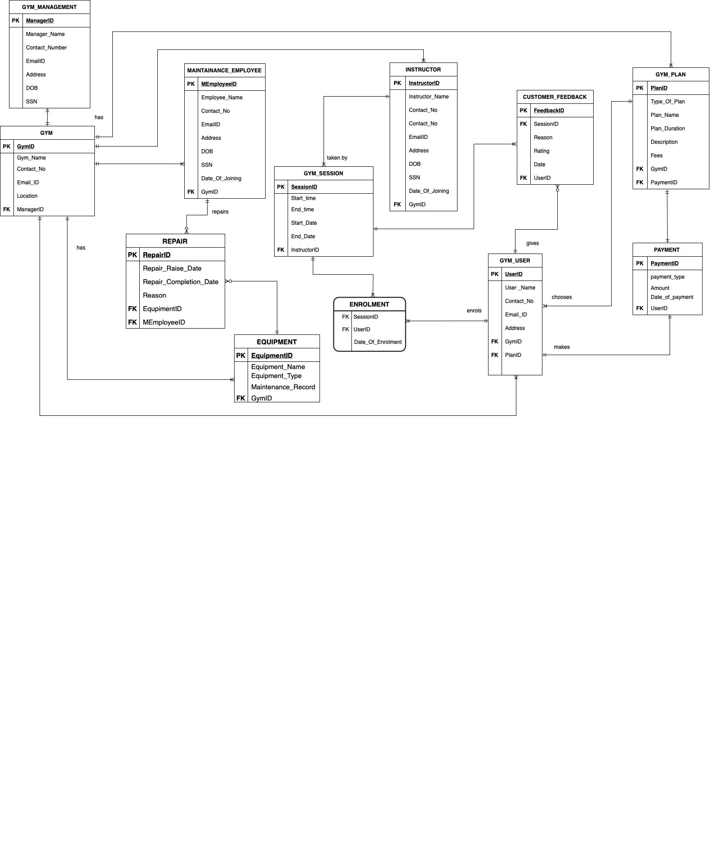
E-R DIAGRAM

Slide 5

VIEWS
STORED PROCEDURES
TRIGGERS
UDFs
DATABASE OBJECTS
To view number of users in a plan
To view Revenue according to the plan
To view number of equipment's acc. to equipment type
To view Instructor's Average Rating
To calculate session duration
To update broken equipment
To delete completed repairs from repair table
TO CALCULATE AGE OF USER FROM DATE OF BIRTH
TO CALCULATE NUMBER OF REPAIR DAYS
To store user plan history when the plan is updated
To generate payment billing automatically when user is added
To store repair history and change maintenance type in Equipment
DATA ENCRYPTION
OTHER
ENCRYPTING USER-ID IN CUSTOMER FEEDBACK
GYM, GYM_MANAGEMENT,
INSTRUCTOR,
MAINTAINANCE_EMPLOYEE & USER Tables
12 Table creations
Check Constraints
4 Indexes

Slide 6
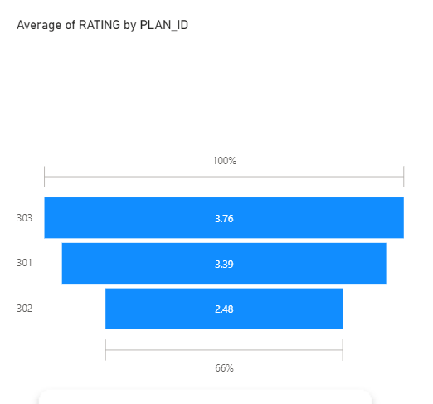
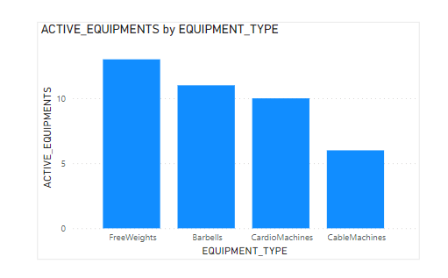
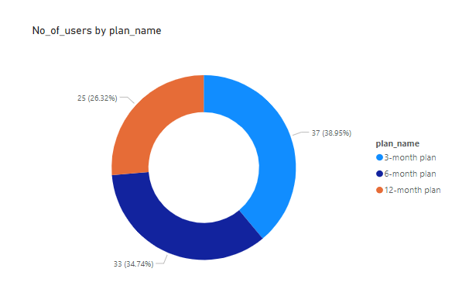
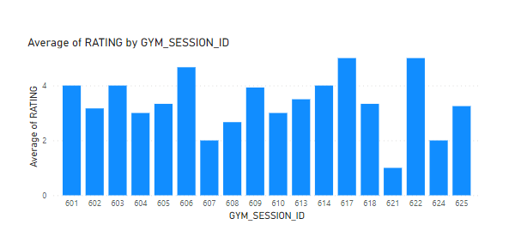
POWER BI DASHBOARD

Slide 7
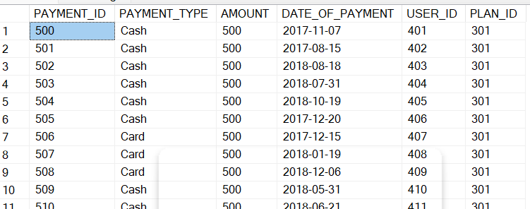
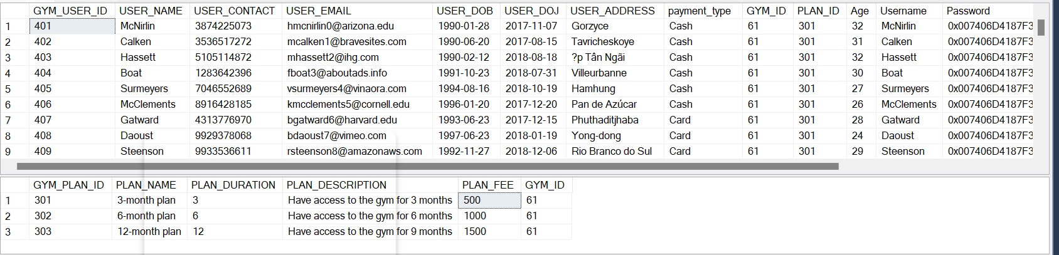
DATA POPULATION
INSERT INTO INSTRUCTOR VALUES (221,'Wernher',8574379576,'wernher05@gmail.com','Mockingbird','1989-02-06','8340258576','2015-01-05',63)
INSERT INTO INSTRUCTOR VALUES (222,'Torre',8574379577,'torre95@gmail.com','Delladonna','1989-02-07','8340258577','2015-01-06',63)
INSERT INTO INSTRUCTOR VALUES (223,'Park',8574379578,'parik950@gmail.com','Scoville','1984-12-03','8340258578','2015-01-07',63)
/*--------------Inserting gym-plan--------------------------*/
INSERT INTO GYM_PLAN VALUES (301,'3-month plan',3,'Have access to the gym for 3 months',500,61)
INSERT INTO GYM_PLAN VALUES (302,'6-month plan',6,'Have access to the gym for 6 months',1000,61)
INSERT INTO GYM_PLAN VALUES (303,'12-month plan',12,'Have access to the gym for 9 months',1500,61)
/*--------------Inserting user values--------------------------*/
INSERT INTO GYM_USER VALUES (401,'McNirlin',3874225073,'hmcnirlin0@arizona.edu','1990-01-28','2017-11-07','Gorzyce','Cash',61,301)
INSERT INTO GYM_USER VALUES (402,'Calken',3536517272,'mcalken1@bravesites.com','1990-06-20','2017-08-15','Tavricheskoye','Cash',61,301)
INSERT INTO GYM_USER VALUES (403,'Hassett',5105114872,'mhassett2@ihg.com','1990-02-12','2018-08-18','Ấp Tân Ngãi','Cash',61,301)
CREATE TRIGGER InsertPayment
ON GYM_USER
After INSERT, UPDATE
AS
BEGIN/*
DECLARE @USER_ID INT
DECLARE @DOP DATE
DECLARE @PLAN_ID INT
DECLARE @AMOUNT INT
DECLARE @PAYMENT_TYPE VARCHAR(40)
SELECT @USER_ID = GYM_USER_ID FROM inserted;
SELECT @DOP = [USER_DOJ] FROM inserted
SELECT @PLAN_ID = [PLAN_ID] FROM inserted
SELECT @PAYMENT_TYPE=PAYMENT_TYPE FROM INSERTED
SELECT @AMOUNT = (SELECT PLAN_FEE FROM [DBO].GYM_PLAN P WHEREP.GYM_PLAN_ID = @PLAN_ID)
INSERT INTO [dbo].PAYMENT VALUES (@PAMENT_TYPE,@AMOUNT,@DOP,@USER_ID,@PLAN_ID)
END
DEMO…

