Slide 1


K.RAMAKRISHNAN COLLEGE OF TECHNOLOGY
(AUTONOMOUS), TRICHY
Event Scheduling System
PRESENTED BY SUPERVISOR
THARUNIYA T Mr.MALARMANNAN M.E.,
2303811710422171 AP/CSE.

Slide 2
PRESENTATION OVERVIEW
Objective
Project Introduction
Problem Statement
Methodologies (Programming concepts relevant to problem statement)
Architecture of the proposed system
List of Modules
7. Merits
8. Results and Discussion
9. Queries

Slide 3
OBJECTIVE
The Event Scheduling System is a Java-based application designed to simplify event management. Users can register, log in, and schedule events while ensuring no time conflicts through real-time conflict detection. The system maintains event ownership, allowing users to manage their events efficiently. Built using Object-Oriented Programming principles, this project offers a structured and user-friendly solution for organizing events seamlessly.
2/7/20

Slide 4
PROJECT INTRODUCTION
The Event Scheduling System is a Java-based application designed to simplify the process of managing events. It allows users to register, log in, and create events with details like name, place, and time. The system detects scheduling conflicts and ensures efficient event management. The GUI, built using AWT, provides an intuitive interface for seamless user interaction.
2/7/20

Slide 5
PROBLEM STATEMENT
Need for automated event scheduling.
Difficulty in avoiding time conflicts.
Lack of secure user accounts.
Need for a user-friendly interface.
Challenges in managing multiple events.
2/7/20

Slide 6
METHODOLOGIES
Object-Oriented Programming (OOP): Encapsulation, Inheritance, and Classes (User, Event).
ArrayList: Dynamic data storage for users and events.
Control Structures: Loops (while), Conditionals (if, switch).
Input Handling: Scanner class for user inputs.
String Operations: equalsIgnoreCase() for comparisons.
Error Prevention: Conflict detection and duplicate checks.
Modularity: Methods for specific tasks (e.g., registration, login, event creation).
2/7/20

Slide 7
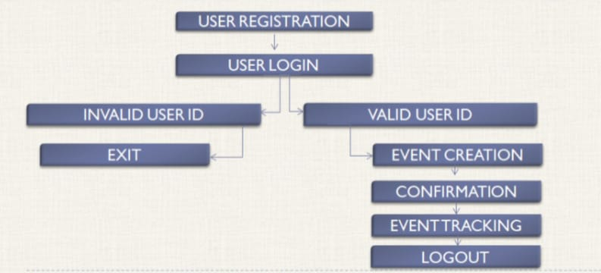
ARCHITECTURE
OF THE
PROPOSED SYSTEM
2/7/20

Slide 8
LIST OF MODULES
User Registration: Creates accounts with unique email validation.
User Login: Secure access for registered users.
Event Creation: Schedules events with conflict detection.
Conflict Check: Prevents overlapping event schedules.
Event Tracking: Displays all scheduled events with details.
Notifications: Alerts users about actions or errors.
Logout: Allows secure user logout.
2/7/20

Slide 9
MERITS
Simplifies event scheduling with automation.
Detects and prevents time conflicts effectively.
Ensures secure user account management.
Provides a user-friendly and intuitive GUI.
Supports multiple users and events efficiently.
2/7/20

Slide 10
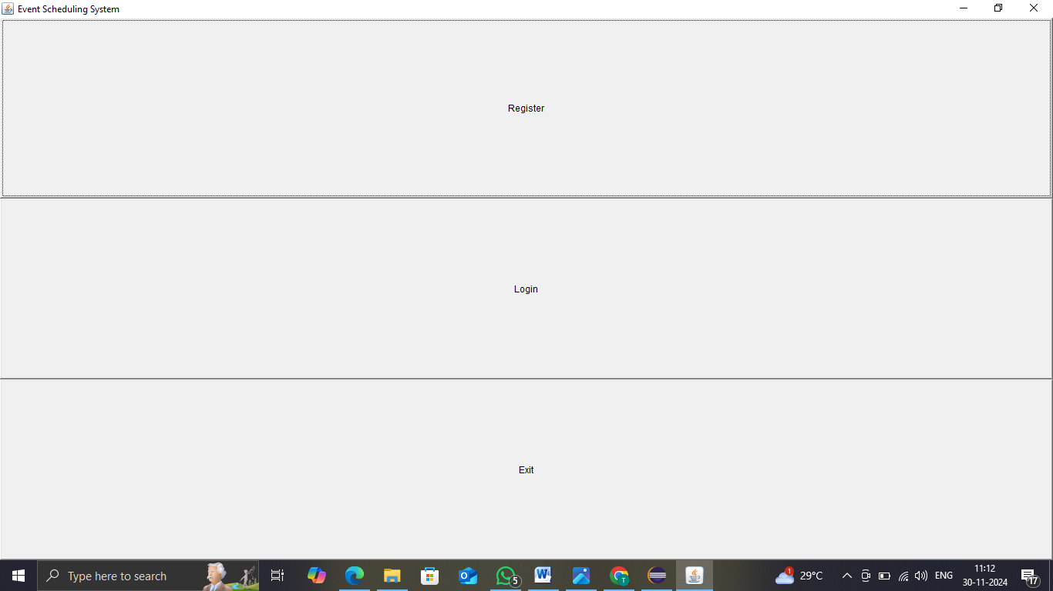
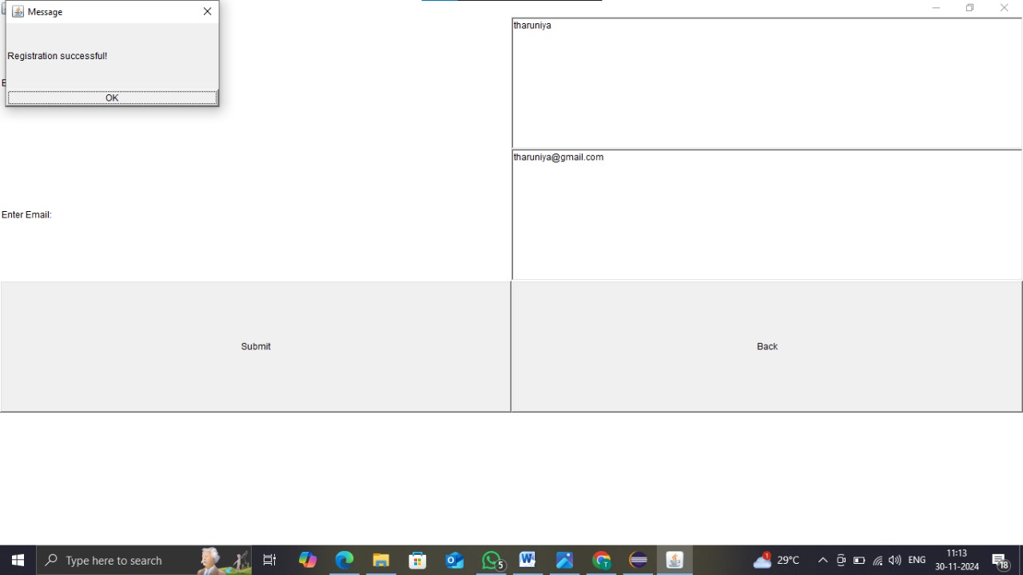
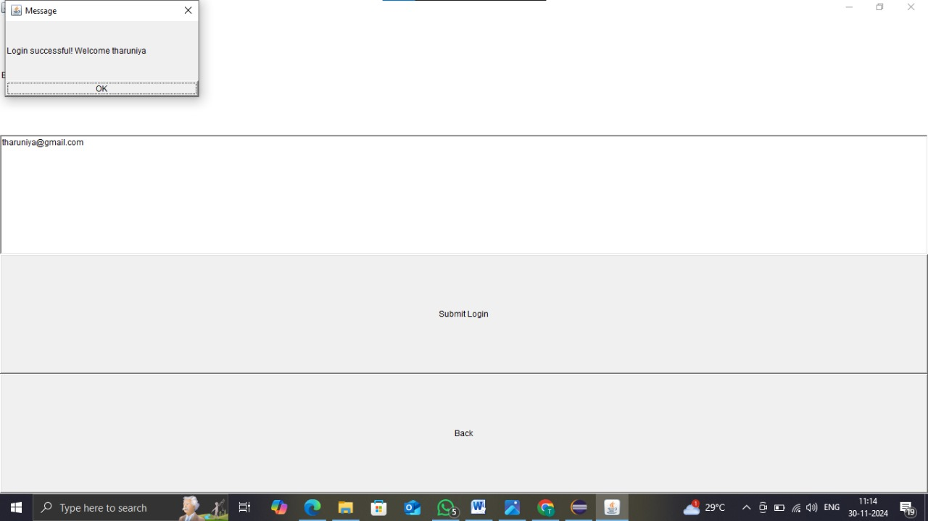
RESULTS AND DISCUSSION
2/7/20

Slide 11
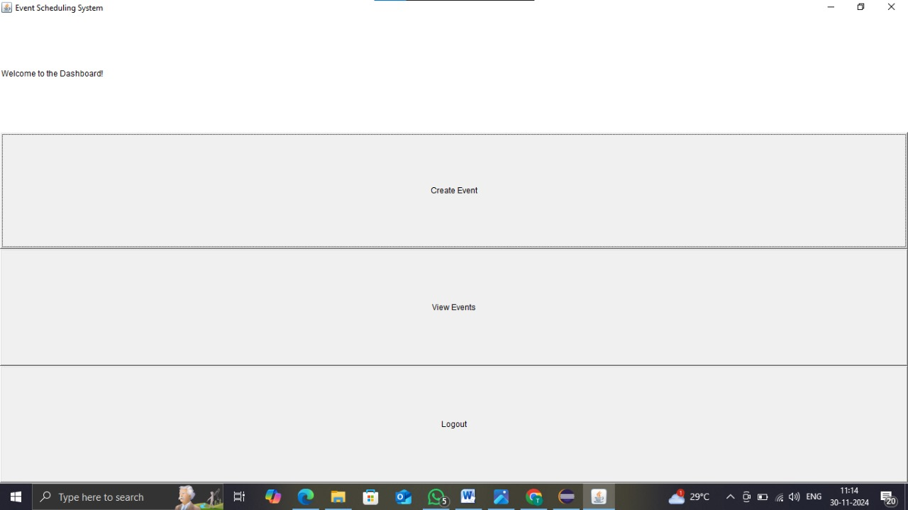
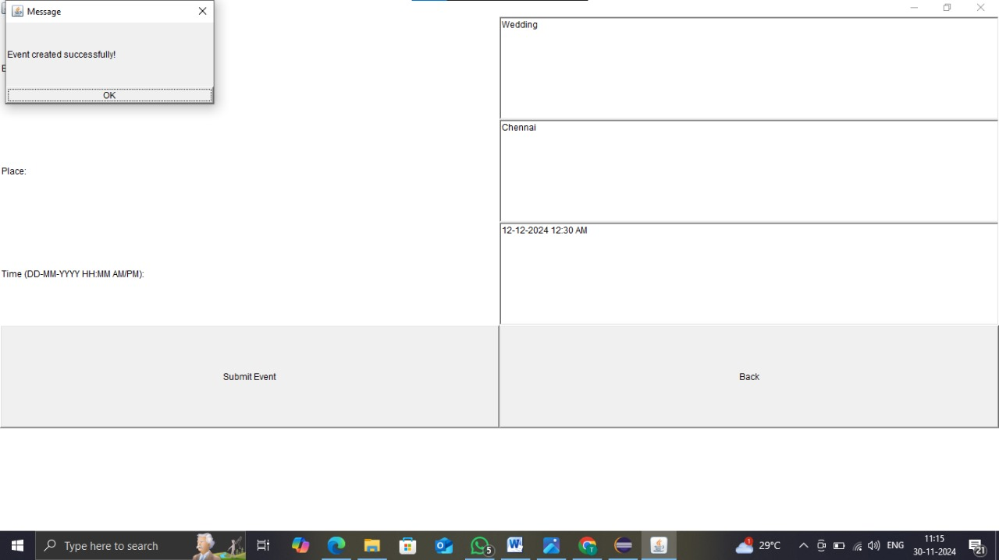
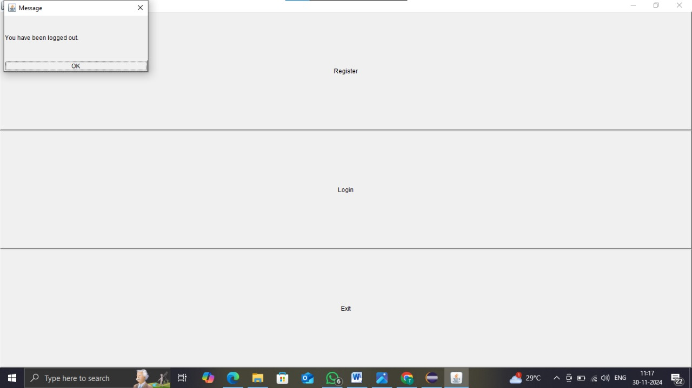
RESULTS AND DISCUSSION
2/7/20

Slide 12
QUERIES
How do I register?
Enter your name and email to create an account.
2. Can I view all my events?
Yes, you can view all scheduled events after logging in.
3. What happens if an event conflicts with another?
The system notifies you and prevents scheduling conflicts.
2/7/20

Slide 13
THANK YOU
2/7/20

