Slide 1
EGB1201 – JAVA PROGRAMMING
Department of Electronics and Communication Engineering
Academic Year: 2024 – 2025 (Odd Semester)
Register Number : 2303811710621114
Name : THARUN KUMAR M
Year : II
Semester : III
Section : B
Date : 07.12.24

Slide 2
Title of the Project
STOCK MANAGEMENT SYSTEM

Slide 3
Problem Identification
The inefficiency and inaccuracy of manual inventory management, which often leads to challenges like overstocking, understocking, and human errors in tracking products and orders.
These issues can result in financial losses, poor customer satisfaction, and operational delays.

Slide 4
Objective
To develop a user-friendly and efficient software solution for managing inventory, including adding products, updating stock levels, processing customer orders, and generating order summaries.
To minimize manual errors, enhance operational efficiency, and provide real-time updates using Java programming principles and a graphical user interface.

Slide 5
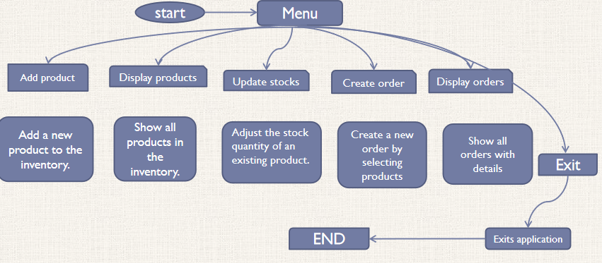
Proposed Architecture

Slide 6
Java Programming - Concepts Used
OOPS concepts:
Encapsulation: In the Product and Order classes, product details (ID, name, price) are encapsulated within the class, and public getter and setter methods are provided for controlled access.
Abstraction: Users interact with high-level methods like addProduct and createOrder, without needing to understand the internal workings of how products are added to the inventory or how orders are processed.
Graphical User Interface (Event driven programming):
The application uses Swing for building the graphical user interface (GUI), with event listeners attached to menu items (ActionListener). This allows for a responsive interface where actions (like clicking buttons or selecting menu items) trigger specific behaviors.

Slide 7
List of Modules
Product Management
Stock Update
Order creation
Reporting Module
Graphical user interface Module

Slide 8
Module Description
1. Product Management Module
Allows users to add new products to the inventory by providing details like product ID, name, quantity, and price.
Displays the list of all available products with their details.
2. Order Management Module
Enables users to create new orders by selecting products and specifying quantities.
Updates stock levels in real time after an order is processed.
Tracks order details like order ID, product list, and total price.
3. Stock Update Module
Facilitates stock adjustments for existing products.
Allows users to increase or decrease stock quantities based on business needs.

Slide 9
Module Description (Cont..)
4. Reporting Module
Generates and displays current stock levels for all products.
Provides a summary of all orders, including product details and total amounts.
5. GUI Module
Create a main application window with a menu-driven interface.
Provide dialog boxes(add,display, order, update) ,Offer a clear and visually appealing layout, including menus, buttons, and form fields for efficient interaction.

Slide 10
Source Code
import javax.swing.*;
import java.awt.*;
import java.awt.event.*;
import java.util.ArrayList;
import java.util.HashMap;
import java.util.List;
import java.util.Map;
class Product {
private String productId;
private String name;

Slide 11
Source Code
private Product findProductById(String productId) {
for (Product product : products) {
if (product.getProductId().equals(productId)) {
return product; } }
return null; }
public static void main(String[] args) {
SwingUtilities.invokeLater(() -> {
Main gui = new Main();
gui.setVisible(true); });
} }

Slide 12
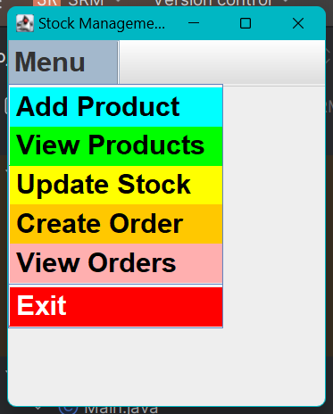
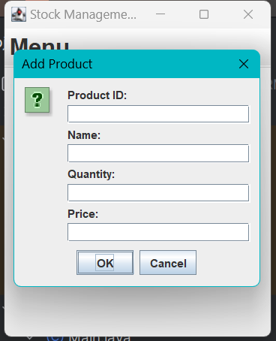
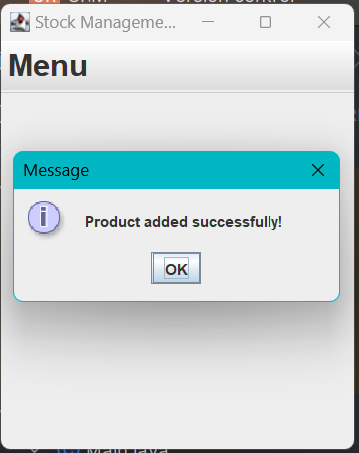
Results
Menu
Add products

Slide 13
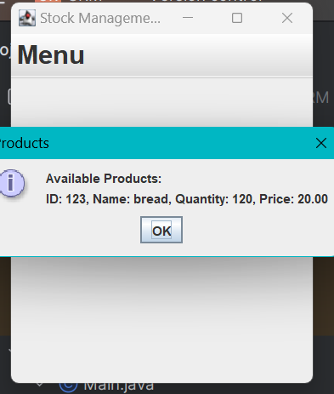
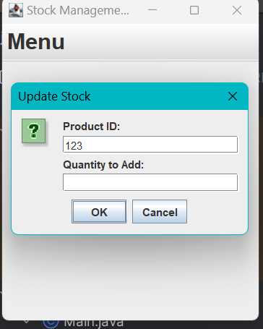
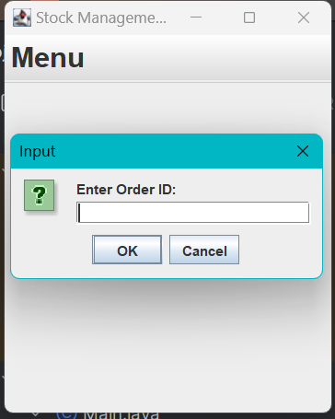
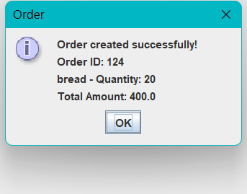
Results
View products
Update stock
Ordering

Slide 14
Conclusion
The Stock Management System leverages OOP principles like Encapsulation, Inheritance, Polymorphism, and Abstraction to ensure a flexible, maintainable, and user-friendly design.
These concepts simplify code management, enhance data security, and allow easy future expansion of the system.
The application is designed to easily accommodate future features and improvements.

Slide 15
Thank You
Any queries???

