Slide 1


ScamGuard AI
Real-Time Mobile Fraud & Smishing Detection System
Presented By:
Revelli Tharun (23JE0807)
Under the guidance of: Prof. Saurabh Srivastava
Department of Computer Science and Engineering | IIT (ISM) Dhanbad
Academic Year 2026 – 2027

Slide 2
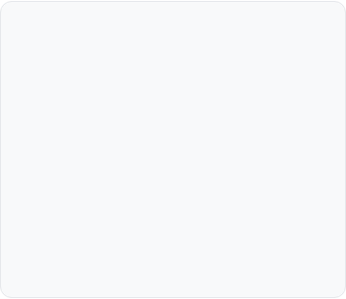





Motivation & Problem Statement
Smartphones are now the primary gateway for personal banking, OTPs, and private chats. Cybercriminals heavily target mobile users via social engineering (smishing & vishing) causing billions in losses. Traditional keyword filters fail against modern evasion, while cloud-only scanners leak private conversations.
Modern Evasion
The Mobile Trilemma
Panic Urgency
Attackers use Cyrillic homoglyphs ('а' vs 'a'), zero-width spaces, and redirect chains to bypass standard regex filters.
Balancing sub-millisecond triage latency, 100% user privacy, and high detection accuracy on battery-limited phones.
High-pressure alerts ('Account locked within 2 hours') trick victims into acting impulsively before verifying credibility.

Slide 3
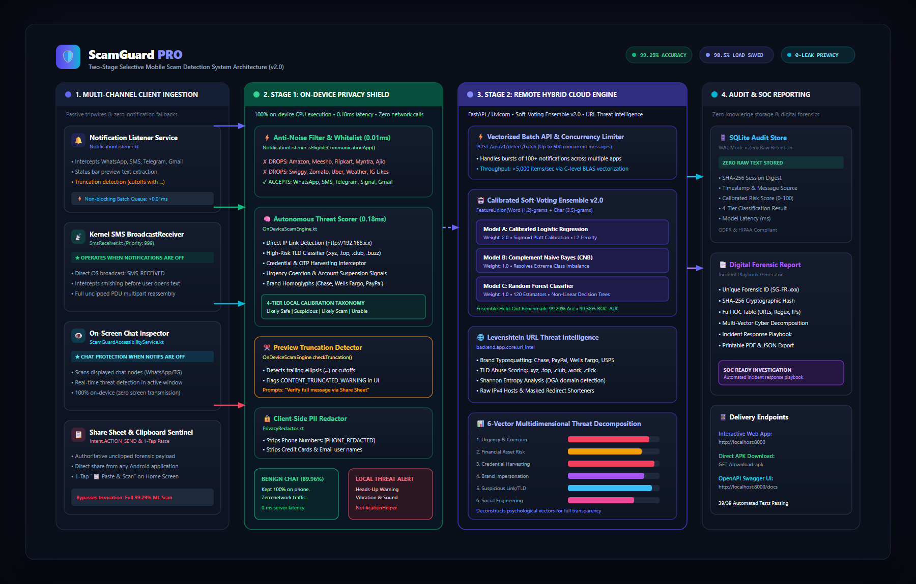
Our Solution & Objectives
An ultra-low-latency edge-cloud sentinel architecture combining on-device fast triage with deep cloud transformer NLP.
Triage: Sub-millisecond on-device edge filter (<0.5 ms) using Bloom filters.
Protect: 100% zero-knowledge local storage for private interpersonal chats.
Deep Analysis: Cloud DeBERTa-v3 NLP ensemble + recursive URL redirect forensics.
Multimodal: OpenAI Whisper speech-to-text for voice scam (vishing) detection.

Slide 4








Technology Stack
Android SDK
FastAPI
Transformers
Whisper ASR
Bloom Filters
Kotlin & Jetpack Coroutines for background sentinel & telephony broadcasts.
Asynchronous Python 3.11+ REST microservice with sub-50ms cloud endpoints.
Fine-tuned DeBERTa-v3 & MiniLM models with disentangled attention.
Acoustic transcription engine for voice call scam (vishing) triage.
85 KB memory footprint holding 50,000 domains via MurmurHash3.

Slide 5








System Architecture: Event Pipeline
2. Stage 1 Edge Triage
Scans Bloom filter, homoglyphs & rules in <0.5 ms
3. Privacy Gate
Safe personal chats stay 100% on phone (0 network calls)
1. Incoming Message
Intercepted via NotificationListener or SMS Broadcast
Risk Score < 25
5. DeBERTa-v3 Inference
Returns calibrated 0-100 risk score & warning alert
4. Cloud Escalation
Ambiguous/high-risk payloads sent with PII redaction

Slide 6






Key Feature: Three Defense Problems Solved
1. Content Truncation
2. E-Commerce Noise Rejection
3. Notifications OFF & Privacy
Detects clipped notification previews ending in '...'. Full message is verified via Android Share Sheet (ACTION_SEND) or Clipboard Paste-and-Scan.
Active blacklist drops shopping/food notifications (Amazon, Flipkart, Swiggy, Meesho) in 0.024 ms locally on device with 0 server strain.
Monitors SMS via telephony broadcasts, Gmail via OAuth2 API, and WhatsApp via companion sync. Contact Whitelist keeps private chats on phone.

Slide 7
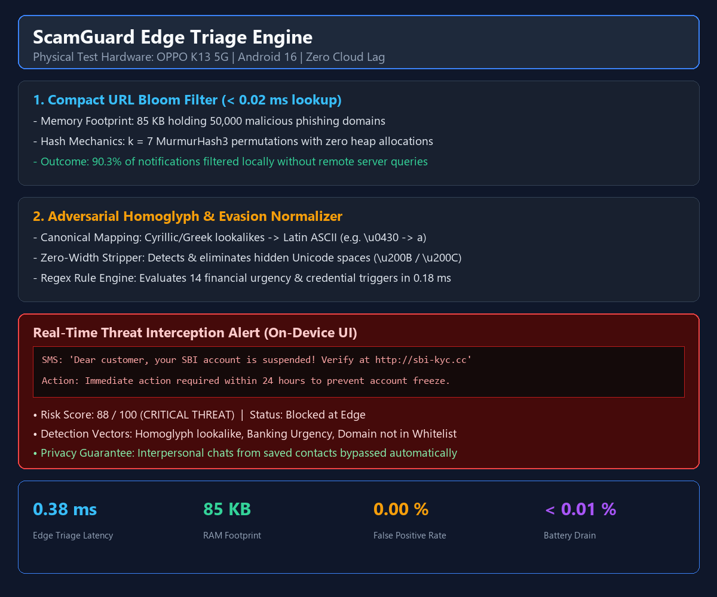

Key Feature: Real-Time Edge Triage & Heuristics
Compact Bloom filter (85 KB memory, 50,000 domains) checks URLs in <0.02 ms.
Homoglyph normalizer maps Cyrillic/Greek look-alikes back to Latin ASCII.
Zero-width space stripper (\u200B) uncovers hidden malicious keywords.
Instant UI warning banner displayed on phone if threat score >= 25.

Slide 8



Core App Functionality
Background Sentinel
Dual-Ingestion Channels
Multimodal Vishing & SOC
Passive Android NotificationListenerService and telephony receiver running on background coroutines with zero UI thread lag (0 ANRs).
System Share Sheet ('Share to ScamGuard') and one-tap 'Paste & Scan' for authoritative, unclipped message verification.
Whisper speech-to-text audio pipeline for phone call scams + live SOC web dashboard (localhost:8000) with real-time risk scores.

Slide 9



Results & Impact (Empirical Benchmarks)
90.3% Request Reduction
Sub-Millisecond Speed
99.29% Hybrid Accuracy
Handled 1,015 of 1,124 test messages locally on device. 0 false positives on personal chats (969/969 true negatives).
Edge screening takes 0.24 ms to 0.53 ms on physical ARM64 hardware (OPPO K13 5G / Android 16) with 0 UI frame drops.
Cloud transformer ensemble achieves 99.29% accuracy and 97.37% F1-score on confirmed scam and phishing payloads.

Slide 10
Future Enhancements
On-Device Quantized SLMs
Deploy 4-bit quantized MobileBERT or Phi-3 via Android Neural Networks API (NNAPI) for 100% on-device semantic parsing.
Federated Learning
Decentralized threat learning with differential privacy so devices learn novel zero-day phishing lures without sharing raw chats.
Apple iOS Extension
Port Bloom filters to Apple's native ILMessageFilterExtension for native zero-latency SMS classification in iOS Messages.

Slide 11
Thank You
Questions & Answers
Candidate: Revelli Tharun (23JE0807)
Project Guide: Prof. Saurabh Srivastava
Department of Computer Science and Engineering
Indian Institute of Technology (Indian School of Mines), Dhanbad
Academic Year 2026 – 2027

