Slide 1
16 POINT DISCRETE COSINE TRANSFORM USING OBC
B.G. Tharun Sai
214102406

Slide 2
Reducing ROM Size
A 16point DCT without reduction requires 16*32*32K bits ROM.
By performing addition and subtraction before computing the DCT we can reduce the ROM size to 1072*32 bits ROM.

Slide 3
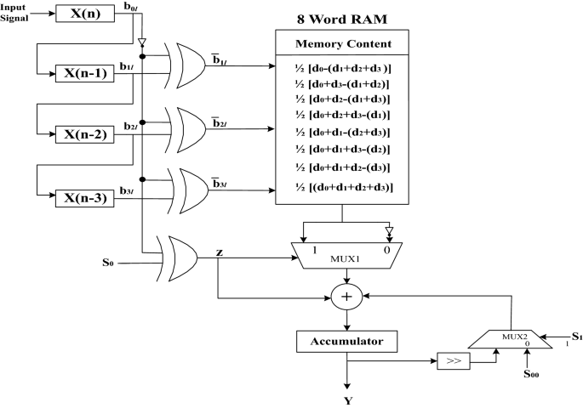
OBC Architecture

Slide 4
Observation
Multipelxer
D Flip Flop with one clock cycle delay
1 bit Shifter
Adder
ROM
Controller to generate signals,Counter.
32 Cycles to get final result

Slide 5
Verilog Implementation
Structural model for multiplexer, D flip flop, Adder, ROM,Counter.
A Controller using state machine to generate clear signal to clear the D flip flop and signals for multiplexers
Memory is filled using $readmemb function from the test bench.
Inputs are given from the test bench.

Slide 6
Test Input Used
X=[0.0025,0.0025,0.0025,0.0025,0.0025,0.0025,0.0025,0.0025,
0.0025,0.0025,0.0025,0.0025,0.0025,0.0025,0.0025,0.0025]

Slide 7
Result
Result=[0.028284266591072083, 0.0, 0.0, 0.0, 0.0, 0.0, 0.0, 0.0, 0.0, 0.0, 0.0, 0.0, 0.0, 0.0, 0.0, 0.0]

