Slide 1

Library Database Management System
Batch No : 460
Tharun Tej Kilari
Abhinav Reddy
Varun Chekuru

Slide 2
Agenda (This should be the PPT flow)
Objective of the Project
ER Diagram and schema explanation
Key analysis questions (use cases)
SQL query results with screenshots or summaries
Final business insights and recommendations
Conclusion (Key finding overall)
Q&A Slide
Your Experience/Challenges working on SQL – Data Analysis Project.

Slide 3
Business Problem Statement
Libraries often struggle to manage book inventory, borrower records, and branch operations efficiently due to manual processes and disconnected systems. This leads to issues such as inaccurate stock tracking, difficulty in monitoring book availability, delayed return management, and limited insights into borrower behavior and branch performance.
There is a need for a centralized Library Management System that can store, manage, and analyze data related to books, borrowers, branches, and loans. The system should provide real-time visibility into inventory, improve circulation management, and support data-driven decision-making to enhance operational efficiency and user satisfaction.

Slide 4
Introduction
In today’s data-driven environment, efficient data management is essential for operational success. This project focuses on designing and analyzing a relational database system for a Library Management System using MySQL.
The goal of this project is to:
Design a structured and normalized database schema
Establish relationships using primary and foreign keys
Store and manage book, borrower, branch, and loan data
Perform SQL-based analytical queries
Extract meaningful business insights from transactional data
Through this system, raw library data is transformed into structured information that supports decision-making, inventory planning, and operational efficiency.

Slide 5
Objective of the Project
To design and implement a relational database for a Library Management System using MySQL.
To establish relationships between books, authors, publishers, borrowers, and branches.
To perform analytical queries on library operations.
To derive insights from loan, inventory, and borrower data.
To understand real-world database normalization and foreign key relationships.

Slide 6
ER Diagram and schema
Entities in the System:
tbl_publisher
  Stores publisher information
  Primary Key: publisher_PublisherName
tbl_book
  Stores book details
  Foreign Key → Publisher
tbl_book_authors
  Maps books to authors
  One book can have multiple authors
tbl_library_branch
  Stores branch information
tbl_book_copies
  Tracks number of copies of each book per branch
  Connects Book ↔ Branch
tbl_borrower
  Stores borrower details
tbl_book_loans
  Tracks issued books
  Connects Book ↔ Branch ↔ Borrower
Relationships:
One Publisher → Many Books
One Book → Many Authors
One Book → Many Copies
One Branch → Many Loans
One Borrower → Many Loans

Slide 7
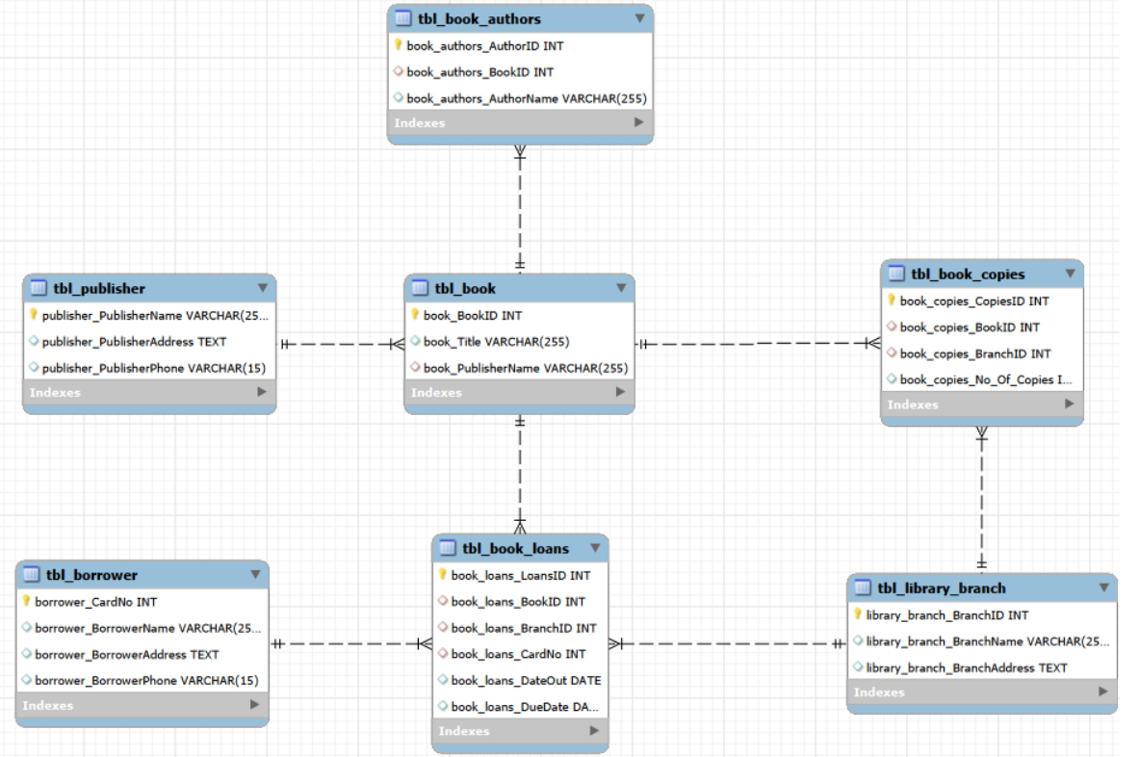
ER Diagram and schema

Slide 8
Key analysis questions (use cases)
How many copies of a specific book are available in a specific branch?
How many copies are available across all branches?
Which borrowers currently have no books issued?
Which books are due on a specific date at a specific branch?
How many books are loaned from each branch?
Which borrowers have more than 5 books issued?
How many copies of Stephen King books are available in the Central branch?

Slide 9
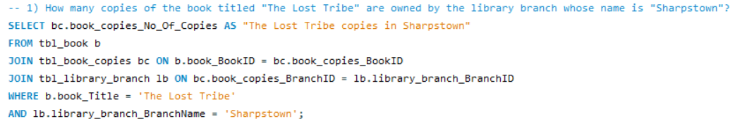

SQL query results
1) Retrieved the number of copies of “The Lost Tribe” available in the Sharpstown branch.
Query:
Result:

Slide 10
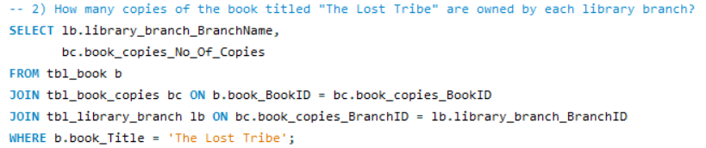
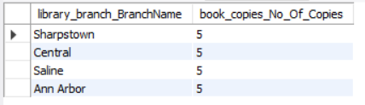
2) Calculated “The Lost Tribe” book copies owned by each library branch.
Query:
Result:

Slide 11
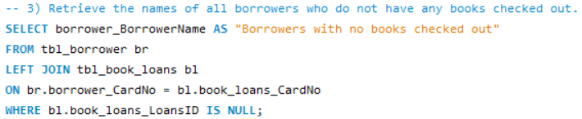

3) Identified borrowers who currently have no books checked out using LEFT JOIN.
Query:
Result:

Slide 12
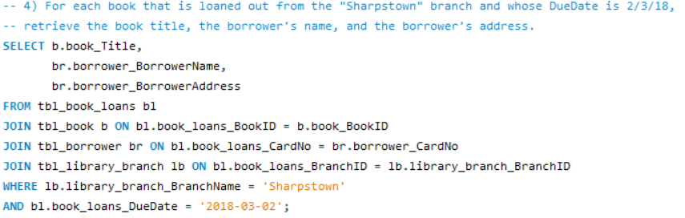
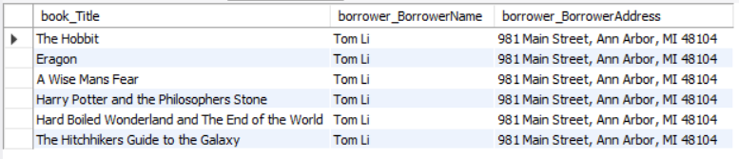
4) Retrieved books due on a specific date from a specific branch.
Query:
Result:

Slide 13
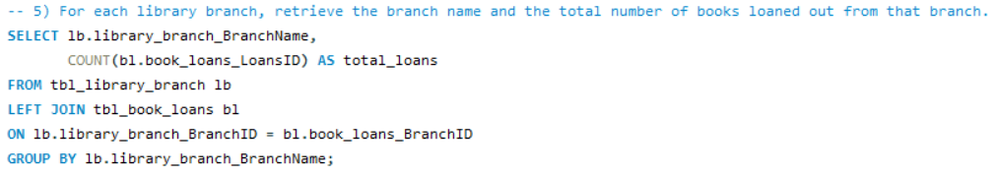
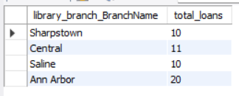
5) Calculated total books loaned from each branch using aggregation functions.
Query:
Result:

Slide 14
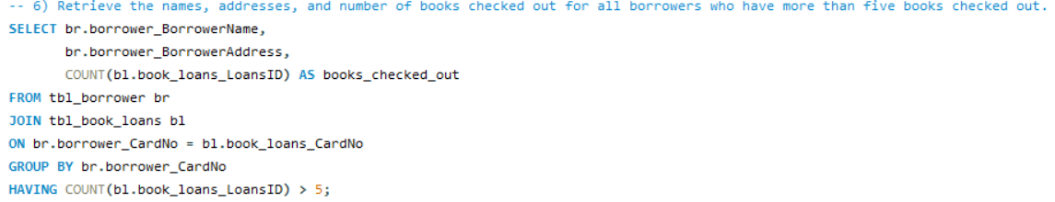
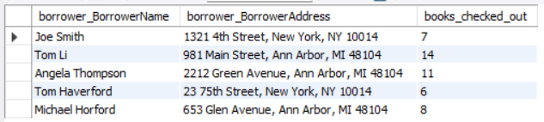
6) Retrieved the details of all borrowers who checked out more than 5 books
Query:
Result:

Slide 15
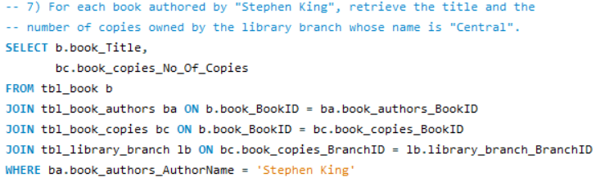

7) Retrieved the number of copies of books authored by Stephen King available in the Central branch.
Query:
Result:

Slide 16
Final business insights and recommendations
Insights:
Management can identify high-performing or underutilized branches and allocate staff and resources accordingly.
Certain borrowers frequently borrow books (power users).
Popular authors (e.g., Stephen King) have higher demand.
The library can detect inactive members, reward loyal readers, and enforce borrowing policies.
Due date tracking helps identify peak return days.
Recommendations:
Implement automated low-stock alerts to prevent book shortages at branch level.
Use branch-wise loan data to optimize staff allocation and operating hours.
Launch engagement campaigns to reactivate inactive borrowers.
Introduce automated due-date reminders to reduce late returns and penalties.
Analyze author and genre trends regularly to guide future procurement decisions.

Slide 17
Conclusion
Successfully designed and implemented a normalized relational database.
Established strong foreign key relationships.
Performed real-world analytical queries.
Demonstrated use of:
JOIN, GROUP BY, HAVING, Aggregation functions, Date filtering
Converted raw dataset into meaningful business insights.

Slide 18
Experience/Challenges working on SQL – Data Analysis Project.
Challenges Faced:
Date format issues during CSV import.
Foreign key constraints preventing table deletion.
Understanding JOIN relationships.
Faced Encoding(UTF-8) issues while importing the CSV files
Handling AUTO_INCREMENT behaviour.
Learning Outcomes:
Strong understanding of relational schema.
Improved debugging skills in SQL.
Practical knowledge of data import issues.
Better understanding of normalization and constraints.

Slide 19
Any Queries?

Slide 20

THANK YOU

