Slide 1
WELCOME
SRI VENKATESWARA COLLEGE OF ENGINEERING AND TECHNOLOGY
NAME :G.THARUN
ROLL NO :22781A3512
BRANCH :CSE(IOT)
SUBJECT :ADVANCED ENGLISH COMMUNICATION SKILLS
TOPIC :BERMUDA TRIANGLE
SUBMITTED TO :S.DEVAYANI MADAM
SUBIMITTED ON :18/11/2024

Slide 2
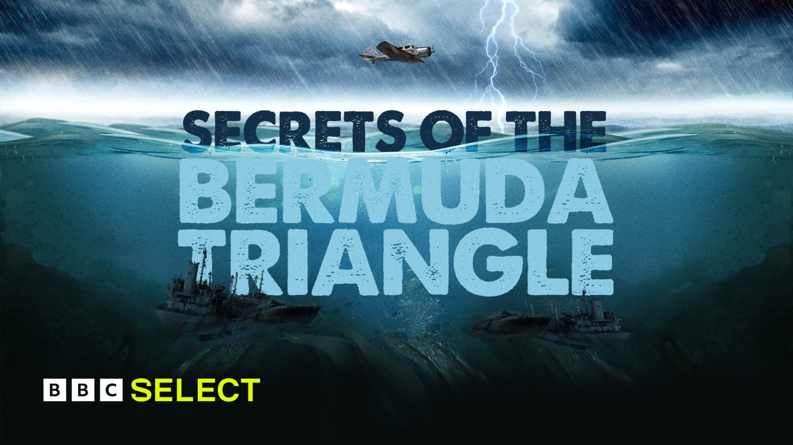

Slide 3
Bermuda Triangle
The Bermuda Triangle, also known as the Devil's Triangle, is a loosely defined region between Florida, Bermuda, and Puerto Rico in the southwestern North Atlantic Ocean where a number of aircraft and ships have disappeared under mysterious circumstances.

Slide 4
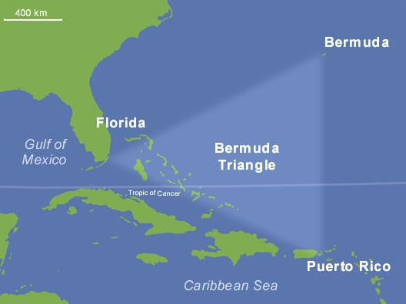

Slide 5
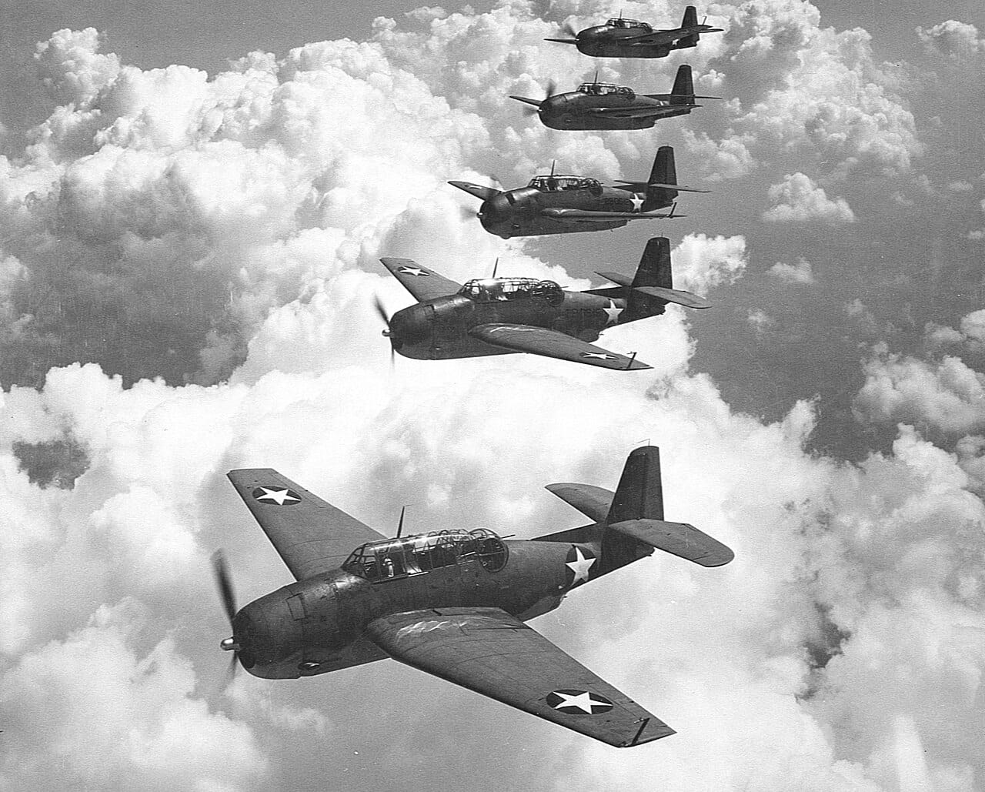
Flight 19
A group of five us navy torpedo bombers on a training mission

Slide 6
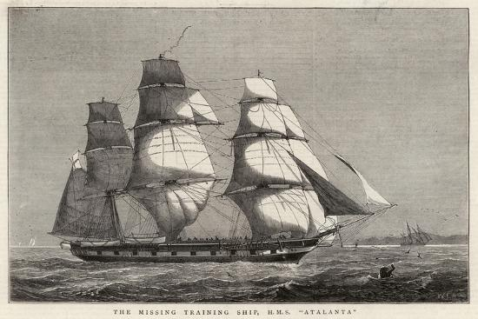
HMS JUNO
Disappeared with her entire crew after setting sail from the royal naval dockyard

Slide 7
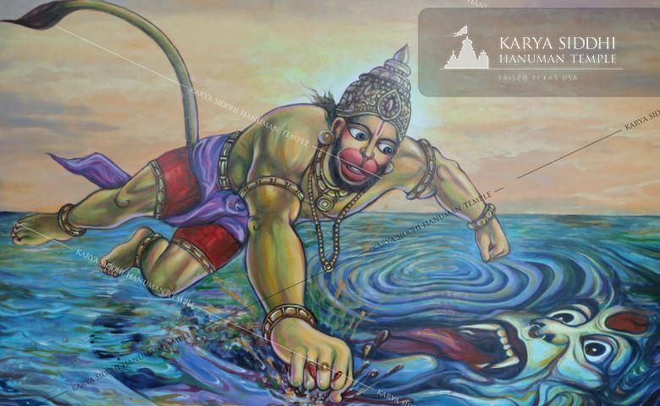

Slide 8


