Slide 1



​
Problem Statement ID - 1655​
Problem Statement Title - Detecting Oil Spills at Marine Environment​
Theme - Smart Automation​
PS Category - Software​
Team ID - 6182​
Team Name - INNOTECHIES​

Slide 2

Proposed Idea:​
Problem:
To detect oil spills, create a system that combines Automatic Identification System (AIS) data with satellite images.
Solution:
Track Vessel Behavior: AIS Data - LSTM, Rule-Based Filtering.
Check Satellite Images: Copernicus Data -DeepLabV3 Model.`
Analyze Data Together: Combined to identify and confirm oil spills effectively.

Slide 3
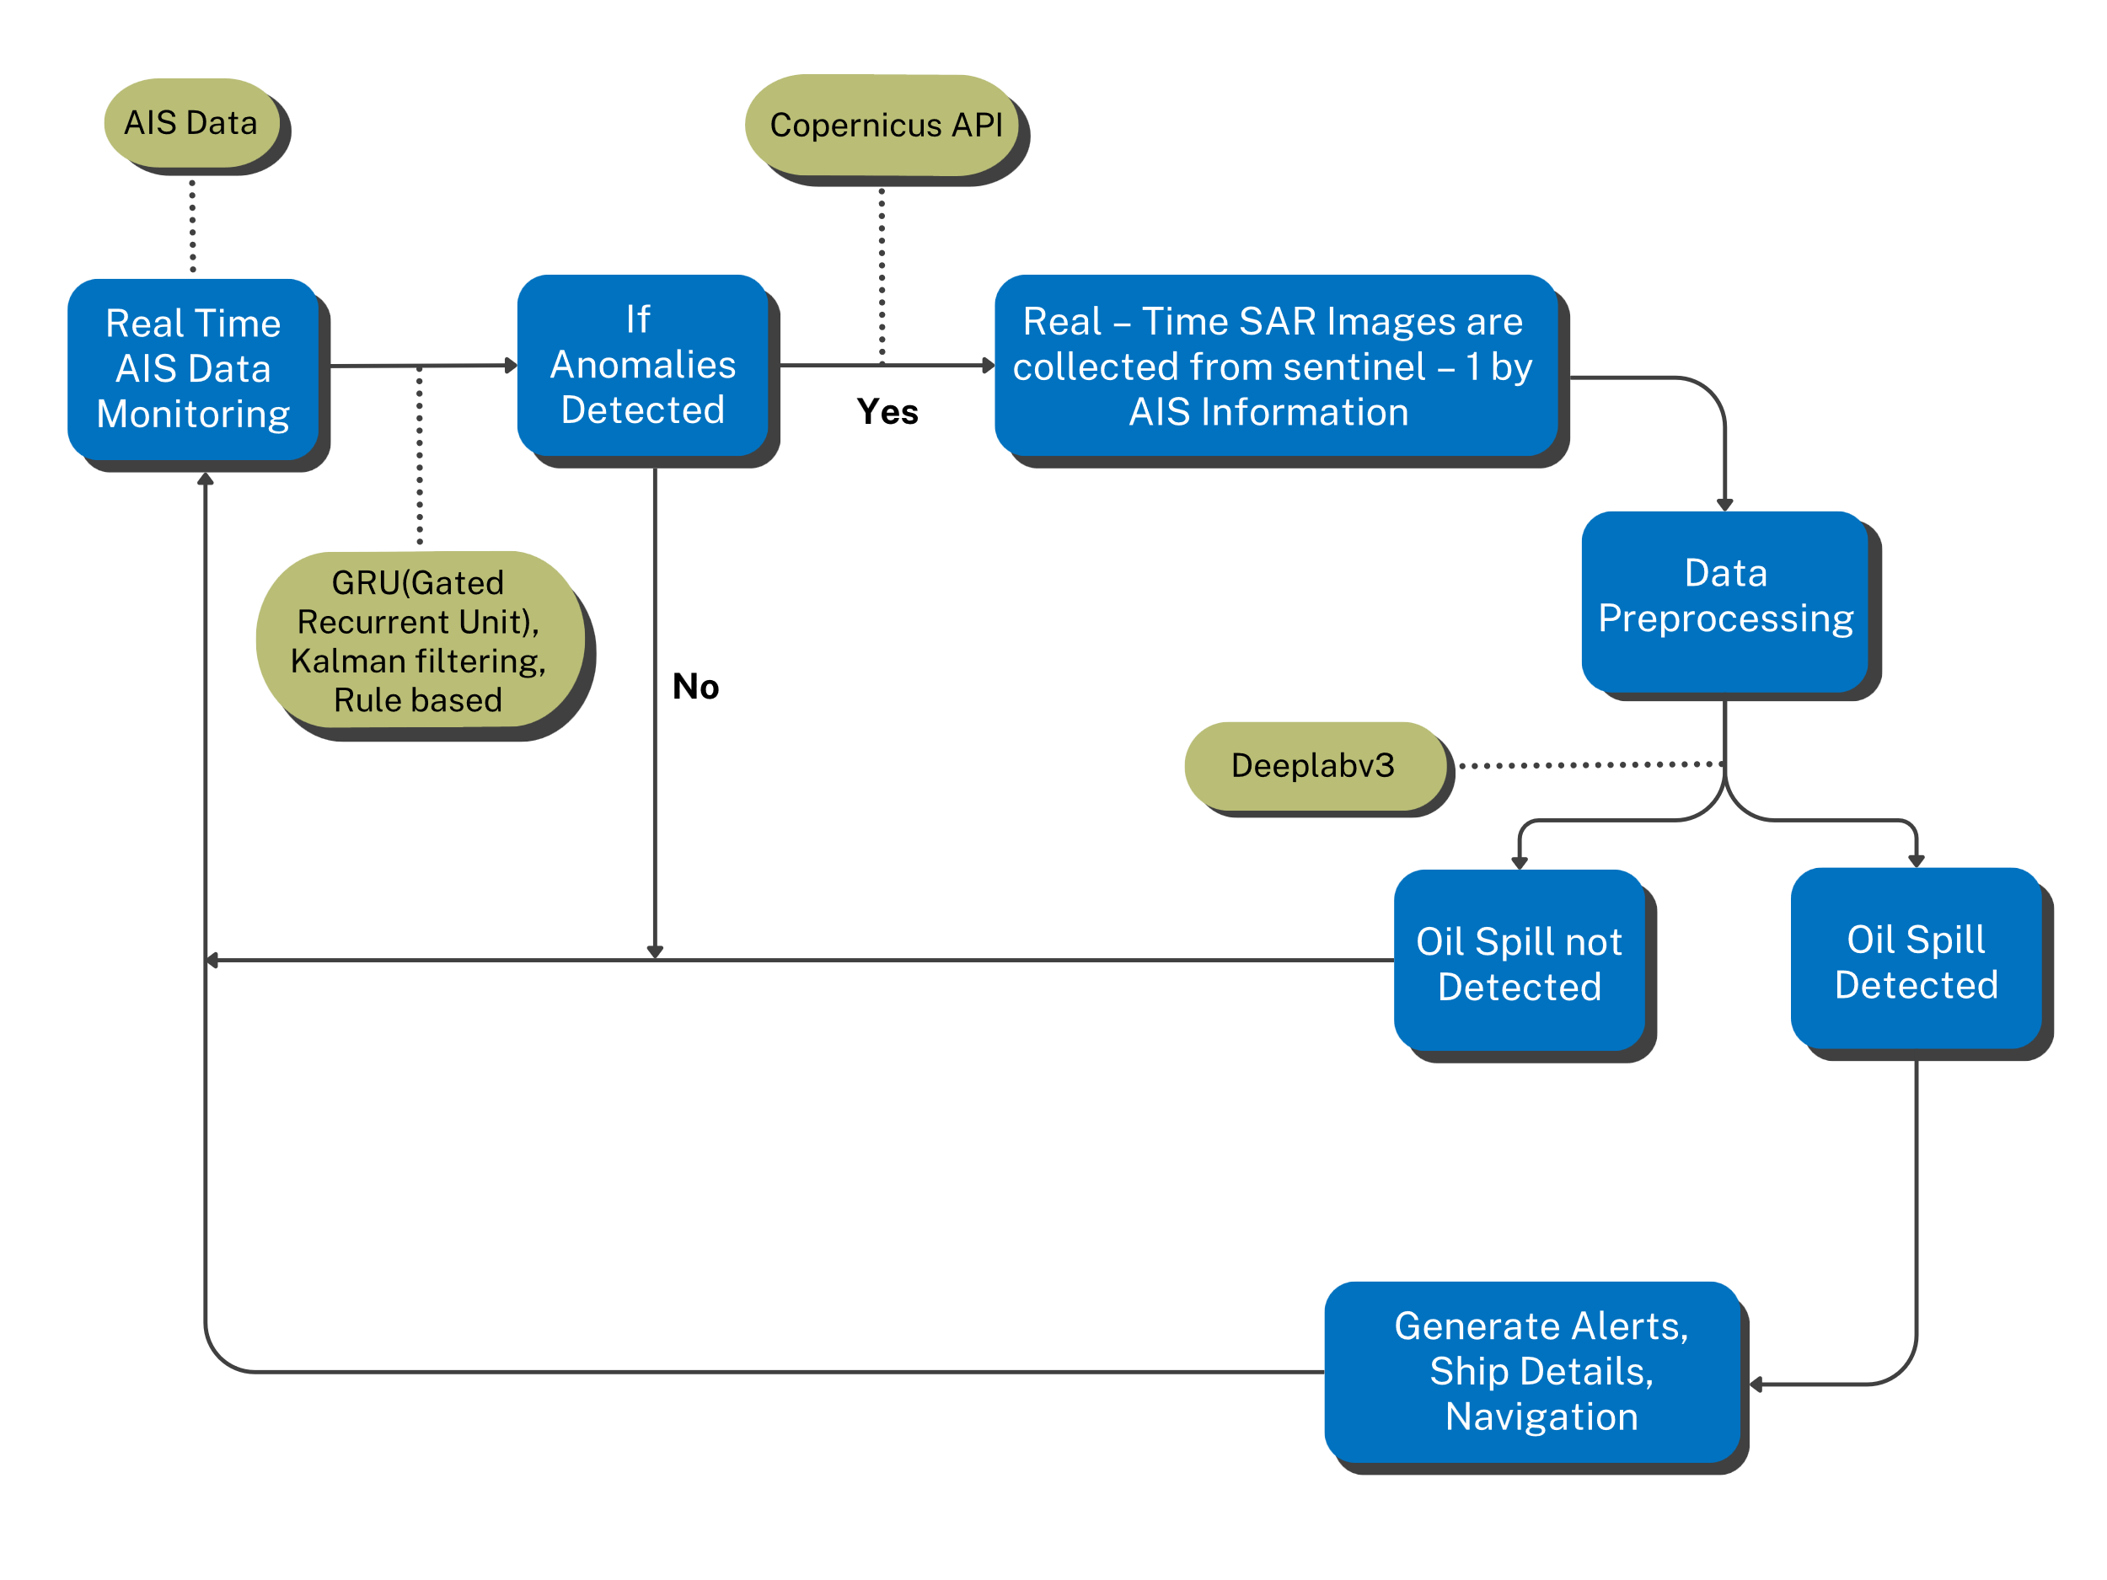





TECHNICAL APPROACH:
TECHNICAL STACK:
Frontend:
Backend:

Slide 4
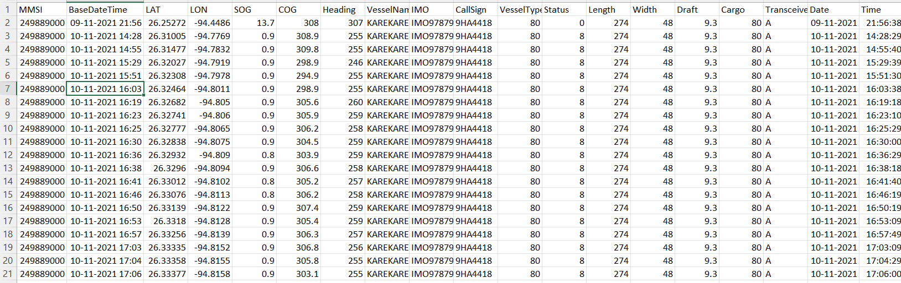
AIS DATA
NOAA (Marine cadastre)

Slide 5
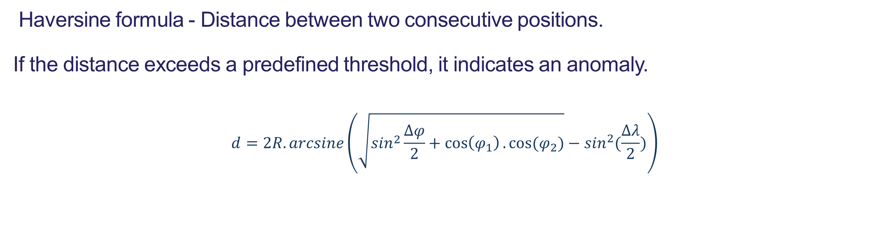
AIS DATA ANAMOLY DETECTION
Path deviation:
Moves off its expected or normal route.
LSTM - time-based data, to predict future paths and find unusual movements.​
Distance:
Haversine formula - Distance between ​two consecutive positions.
If the distance exceeds a predefined threshold, ​it indicates an anomaly.
$$d=2R.arcsine\left(\sqrt{\sin^{2}\frac{Δφ}{2}+\cos\left(φ_{1}\right).cos⁡(φ_{2})}−\sin^{2}(\frac{∆λ}{2})\right)$$

Slide 6
Using the Haversine formula and a boundary box, ships entering at high speed are flagged as anomalies, indicating potential risks like oil spills.
COLLISION:
HAVERSINE FORMULA: a= $\sin^{2}\left(\frac{∆lat}{2}\right)+\cos\left({lat}_{1}\right).\cos\left({lat}_{2}\right).\sin^{2}(\frac{∆lon}{2})$
KALMAN’S FILTER
ALGORITHM:
Kalman Filters detect anomalies by comparing predicted system states with actual measurements. Large differences signal outliers, indicating potential issues like unusual behavior or faults

Slide 7
SATELLITE IMAGE PROCESSING:
Collected data in Copernicus using the history of oil spills.
Preprocessing- Histogram Equalization.
Tiff file processing – Rasterio.
DeepLabv3 Model – Model used for image processing.

Slide 8
Alert System for Environmental Protection:​
SMTP (Simple Mail Transfer Protocol) to send alerts through email to nearby ports and ships.
Conclusion:
By combining AIS data with satellite datasets, our system efficiently detects oil spills in the marine environment.

Slide 9
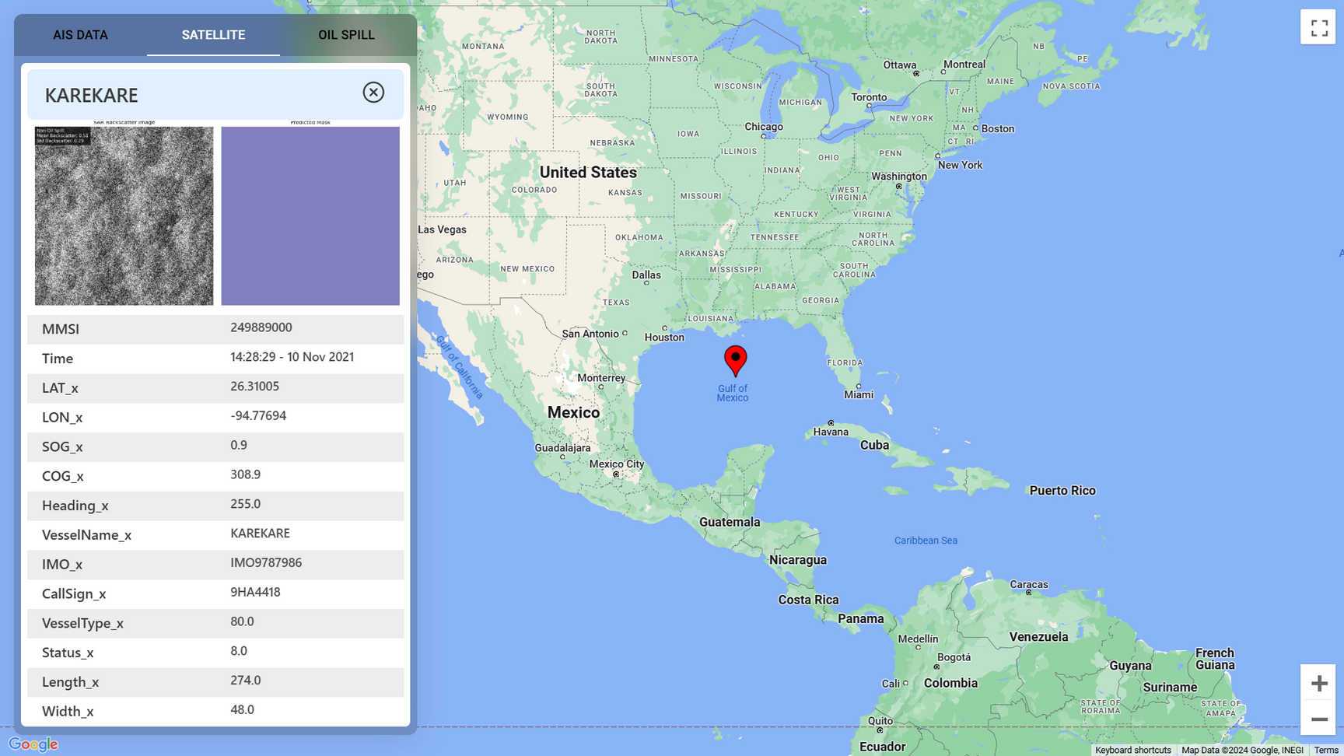
PROTOTYPE:

Slide 10

Thank you
By
INNOTECHIES

