Slide 1


‘25
St. JOSEPH’S
SPRINTATHON’25
A SPRINT TO REVOLUTION
COLLEGE OF ENGINEERING
(An Autonomous Instituion)
1
Problem Statement Number- PSA601
2
Problem Statement – Crop and Soil Management System.
3
Domain - Software
4
Team Name- Innotech
5
Team Members Name – THARUNYA ST, JANANI S, BAHARANIDHARAN, SHARVESWAR S
6
College Name – BANNARI AMMAN INSTITUTE OF TECHNOLOGY

Slide 2


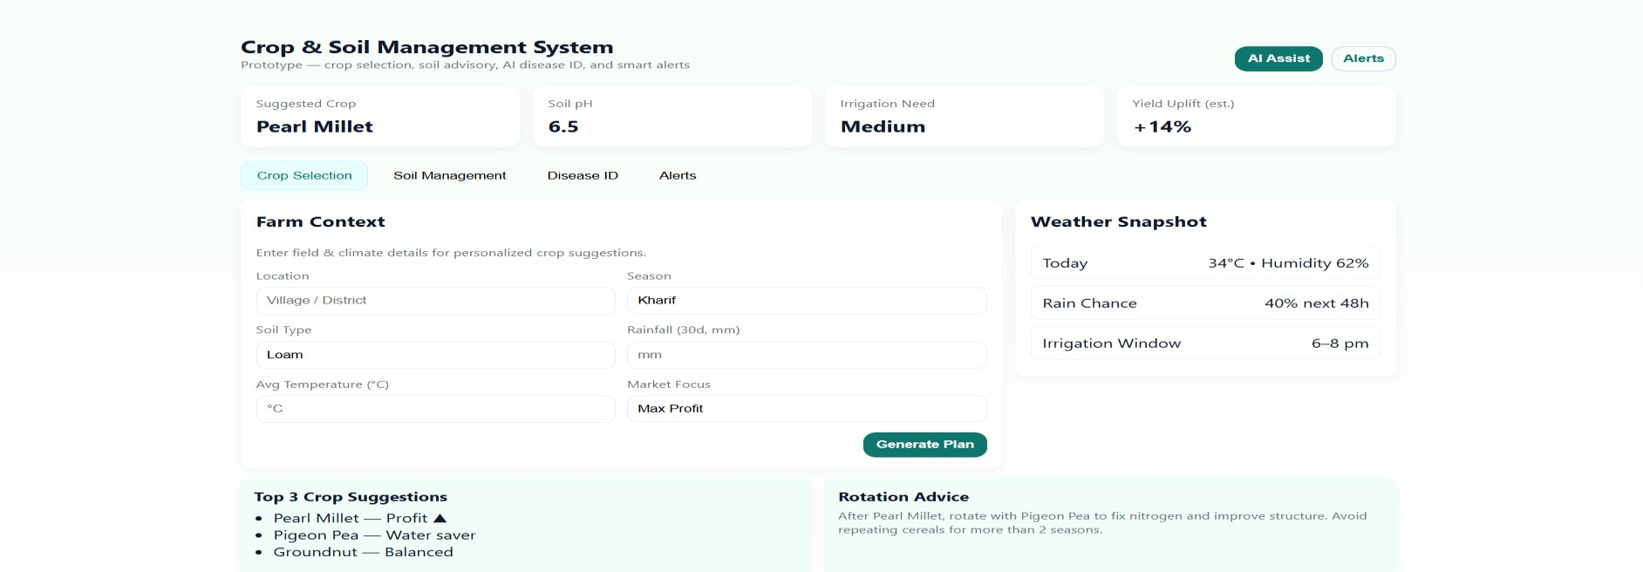
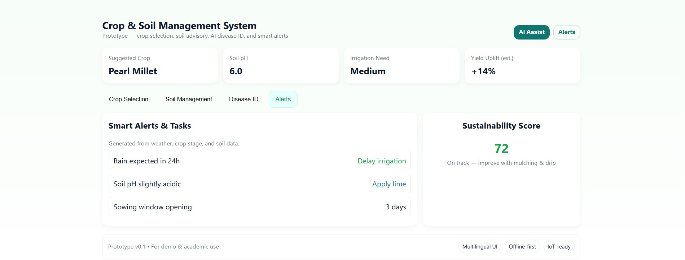
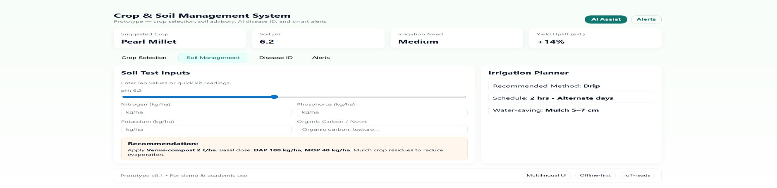
‘25
St. JOSEPH’S
COLLEGE OF ENGINEERING
(An Autonomous Instituion)
Problem Summary
Many farmers struggle to choose the right crops, manage soil health, and detect diseases early. Without access to scientific advice, they often rely on traditional methods. This leads to low crop yields, overuse of fertilizers, soil damage, and high costs. Late detection of pests and diseases causes major crop losses. The lack of real-time, personalized support makes farming less efficient and unsustainable.
PROTOTYPE
Solution
Crop Recommendation – Uses Decision Tree/Random Forest to
suggest best crops from soil, weather & market data.
Soil Advisor – Regression & Fuzzy Logic analyze pH, NPK, moisture for fertilizer advice.
Disease Detection – TensorFlow +CNN models classify leaf images
to detect pests/diseases & suggest remedies.
Dashboard & Alerts – Predictive Analytics provide weather, irrigation & disease alerts.
Link of a prototype: https://github.com/TharunyaST/CROP-RECOMENDATION-SPRINTATHON-PROTOTYPE

Slide 3
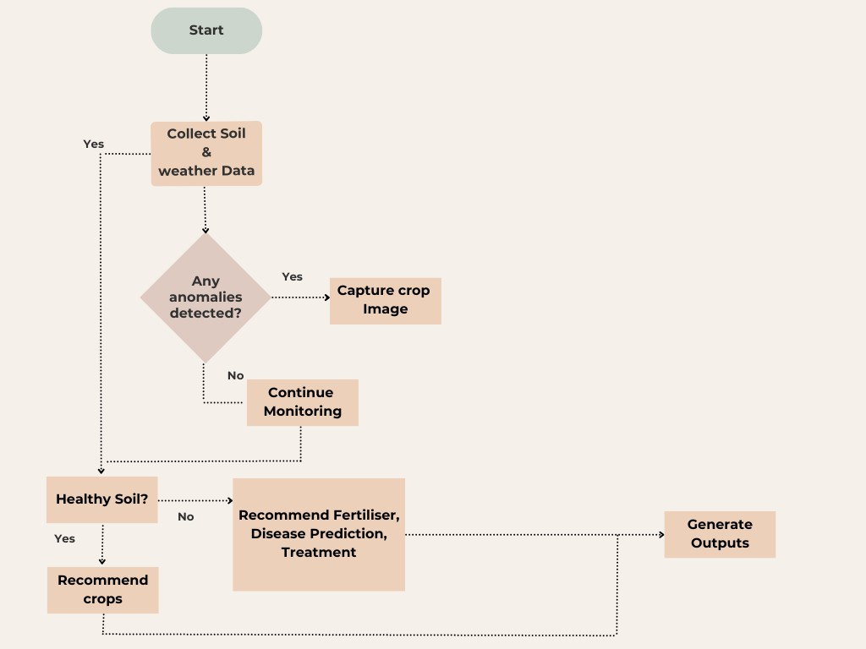










‘25
St. JOSEPH’S
COLLEGE OF ENGINEERING
FLOWCHART
(An Autonomous Instituion)
TECHNICAL STACK
Frontend
Backend
scikit
Database
Firebase

Slide 4
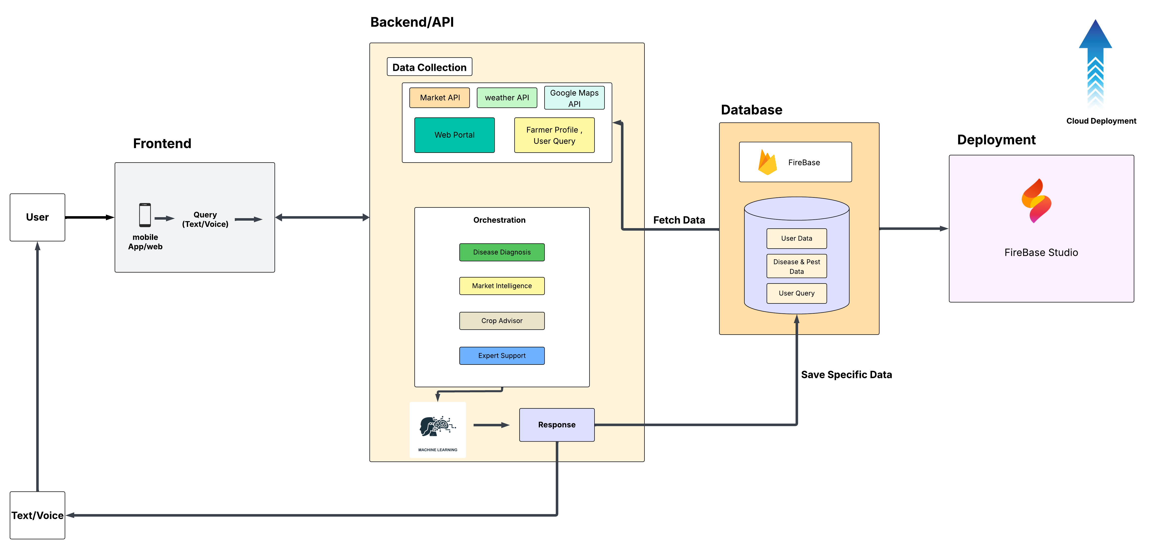
ARCHITECTURE

Slide 5
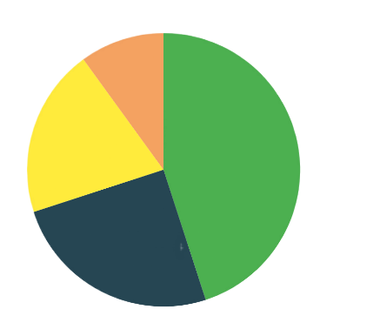

‘25
St. JOSEPH’S
COLLEGE OF ENGINEERING
(An Autonomous Instituion)
TARGET AUDIENCE
Small & Marginal Farmers 45%
Government Agricultural Departments
Researchers and students 25%
Small & Marginal Farmers
Researchers and students
Government Agricultural Departments 20%
Agricultural Cooperatives & Groups 10%

Slide 6
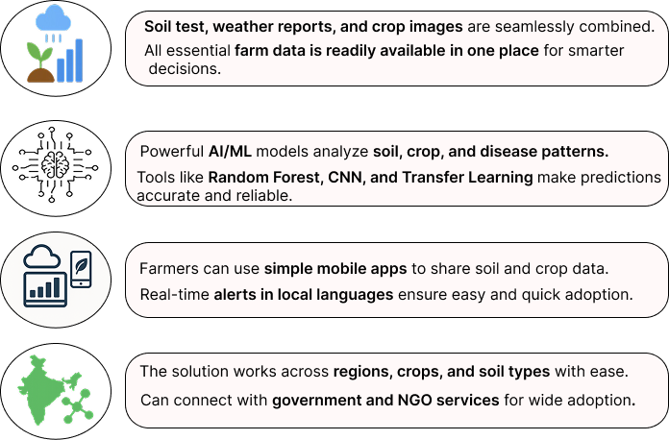
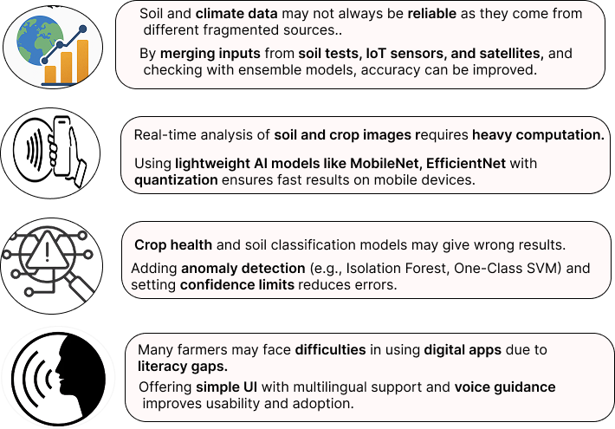
‘25
St. JOSEPH’S
COLLEGE OF ENGINEERING
(An Autonomous Instituion)
FEASIBILITY
VIABILITY

Slide 7
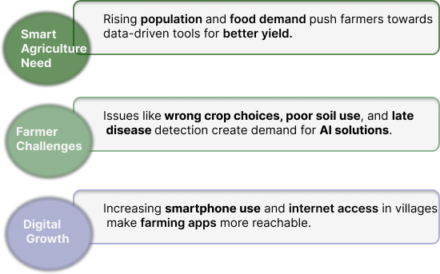
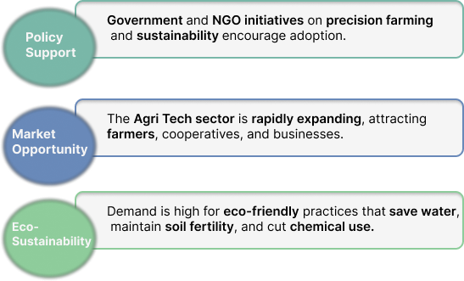
‘25
St. JOSEPH’S
COLLEGE OF ENGINEERING
MARKET DEMAND ANALYSIS
(An Autonomous Instituion)

Slide 8
‘25
St. JOSEPH’S
COLLEGE OF ENGINEERING
(An Autonomous Instituion)
RESEARCH AND REFERENCES
https://ieeexplore.ieee.org/document/10205756/
https://link.springer.com/article/10.1007/s44230-024-00081-3
https://www.researchgate.net/publication/327065422_Plant_Disease_Detection_Using_Machine_Learning
https://bsppjournals.onlinelibrary.wiley.com/doi/10.1111/ppa.14006

