Slide 1

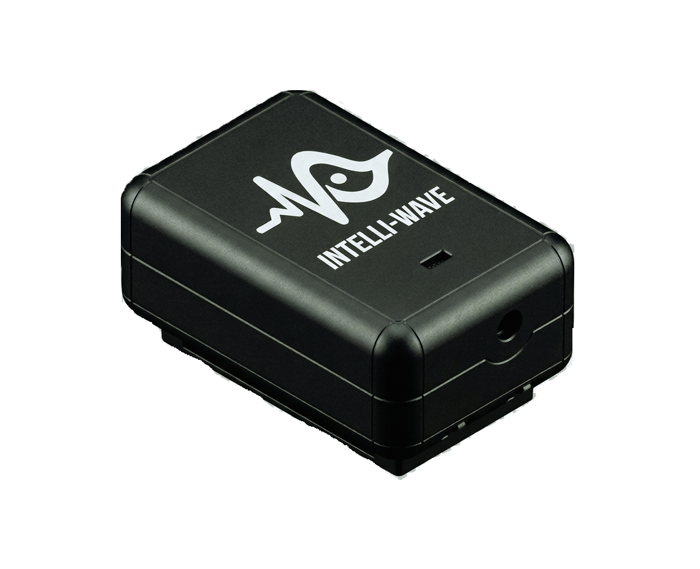
Wearable ECG Monitoring Device
Team Intelliave
Group Members
Dinusha Dissanayaka
Dulith Kavinda
Udara Deshan
Tharusha Nimesh
Senuda Ratnayake

Slide 2
Problem Statement & Motivation
The Problem
  Limited Monitoring Duration: Standard ECG systems record only 5–10 second snapshots, making it difficult to detect intermittent arrhythmias or long-term cardiac changes.
  Risk of Misdiagnosis: Atypical cardiac symptoms can be mistaken for less serious conditions, delaying timely treatment.
  High Clinician Workload: Manual ECG interpretation in busy emergency units increases workload, diagnosis time, and the risk of human error.
  Lack of Real-Time Intelligence: Most affordable portable ECG devices cannot simultaneously provide continuous monitoring and real-time anomaly detection

Slide 3
Proposed Solution: IntelliWave
IntelliWave is an affordable, ultra-portable, battery-powered 3-lead wearable ECG monitoring system designed for continuous cardiac monitoring of high-risk patients. It combines long-term ECG recording with an embedded explainable AI module that detects waveform anomalies in real time, providing intelligent decision support to reduce clinicians' workload and enable earlier diagnosis and intervention.

Slide 4
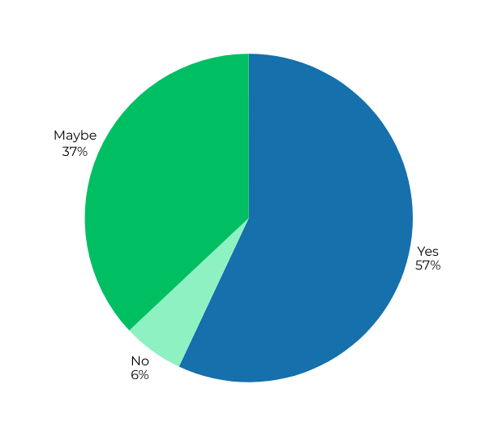
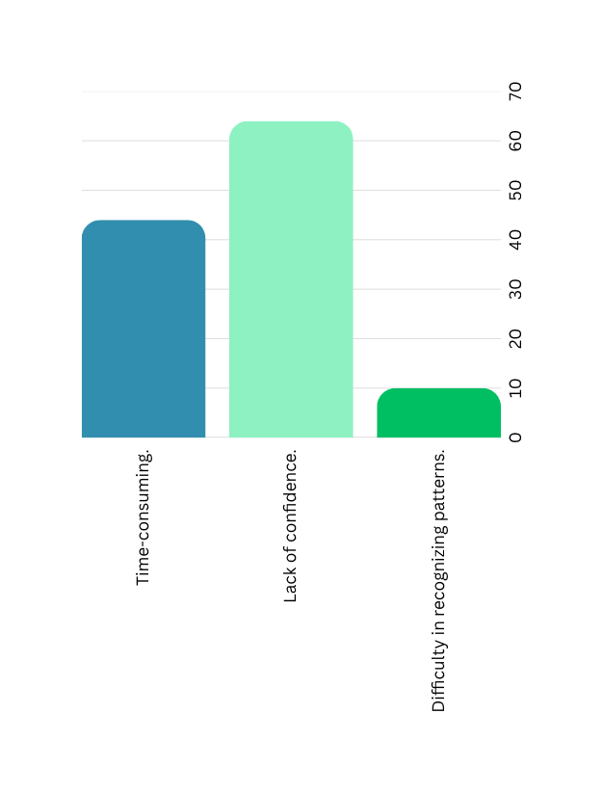
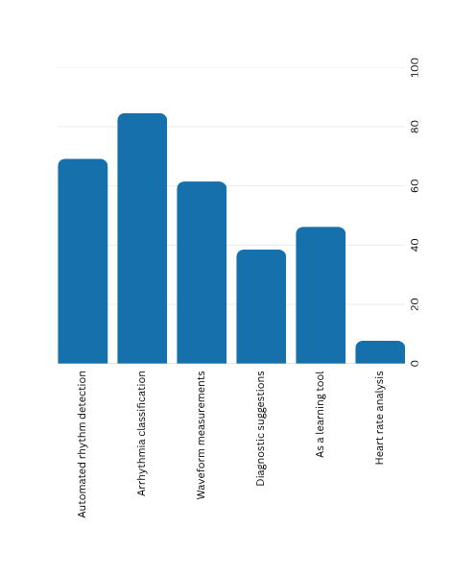
Problem Validation
Would you find it valuable to have a tool that digitize ECGs and provides AI-based diagnostics?
solutions for this challangers
What challenges do you face in interpreting ECGs?

Slide 5




Key Features
Extended battery life of up to 24 hours on a single charge ensures uninterrupted monitoring and peace of mind.
Real-time ECG monitoring with continuous heart rhythm tracking and instant alerts for abnormal patterns.
Seamless wireless connectivity via Bluetooth to mobile.
We aim to keep the cost low while ensuring product quality.
Ultra-compact and lightweight design.

Slide 6
Product Specifications
Physical Specs :
  Dimension : 75mm x 45mm x 26mm
  Weight : 70g
  Pocket friendly & Wearable design.
Signal specs :
  Sample Rate : 250 SPS
  Notch Filter :50Hz (power line rejection, software)
  Baud Rate: 9600
Power specs :
  Supply Voltage : 3.3V regulated
  Rated current : Maximum 60mA, Typical 45mA.
  USB input charging : 5V, 500mA
  Battery : 3.7V 1200mAH LiPo Battery ( 24h Expected battery life)

Slide 7
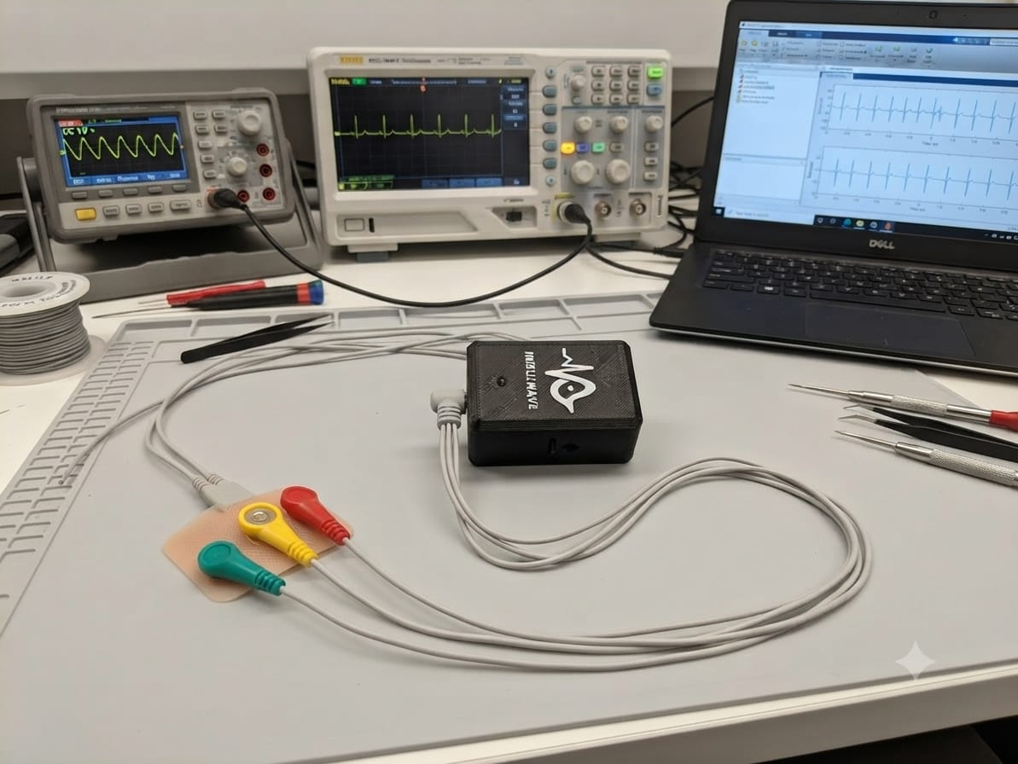
Connetivity:
  Bluetooth 4.0 (Low Energy)
  Band : 2.4GHz ISM band.
  Upto 10m in open space.
Indicators & UI
  Power status (Green)
  BLE connection status (Blue)
Mobile application:
  Platform : Android/IoS compatible software
  Display : Real time ECG waveform (Lead I, II, III)
  Heart Rate : Real time BPM display, Anomaly Notification.
  Recording : Manual trigger / auto 30 second recording
  Capability to send ECG reports to doctor, save ECG reports in PDF format.

Slide 8
System Architecture
Analog Front-end (AD8232)
MCU
(STM32F103C8T6)
Bluetooth Module
(HM-10)
ECG Electrodes
Displaying Real Time Anomaly
Notification
Multi Level Calasification
Mobile
Application
Anomaly Detection

Slide 9
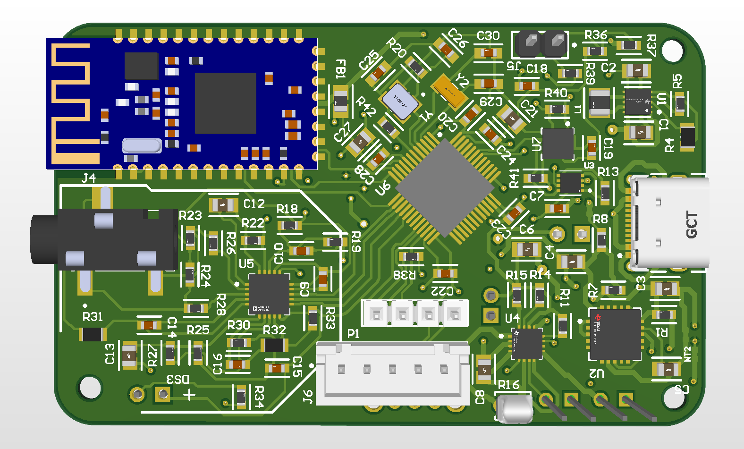
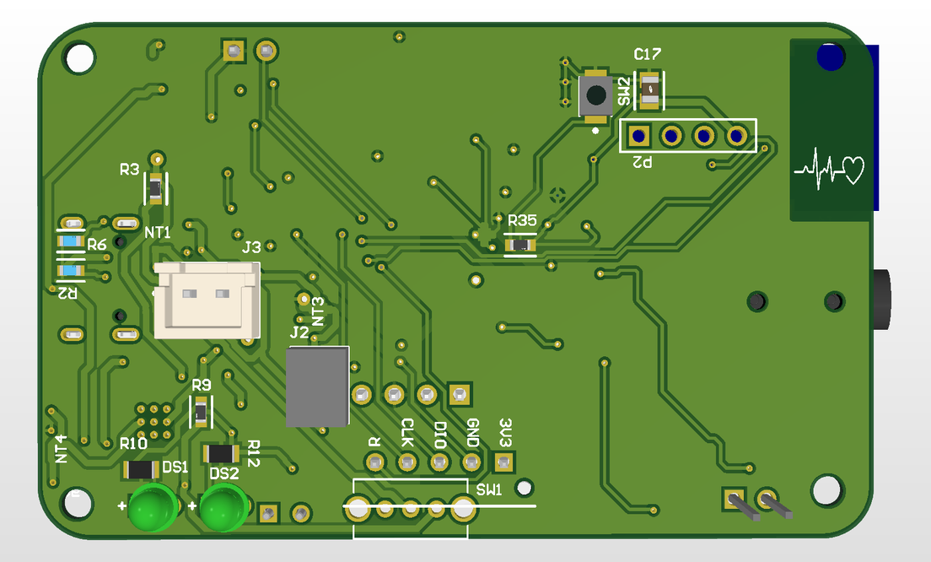
PCB Design

Slide 10
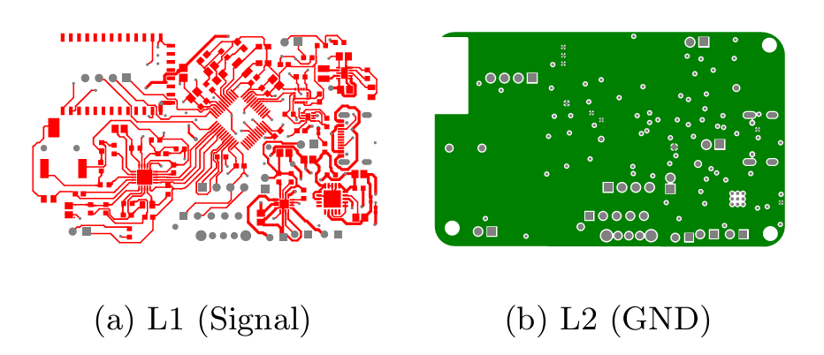
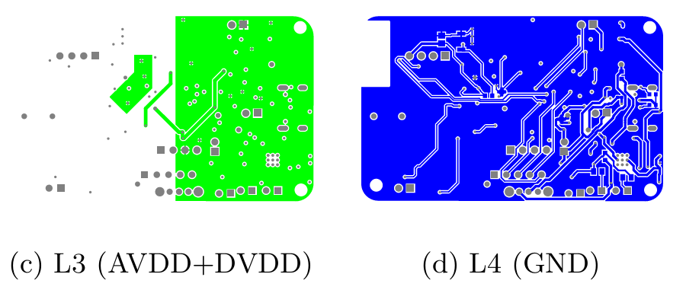
PCB Design - Layers

Slide 11
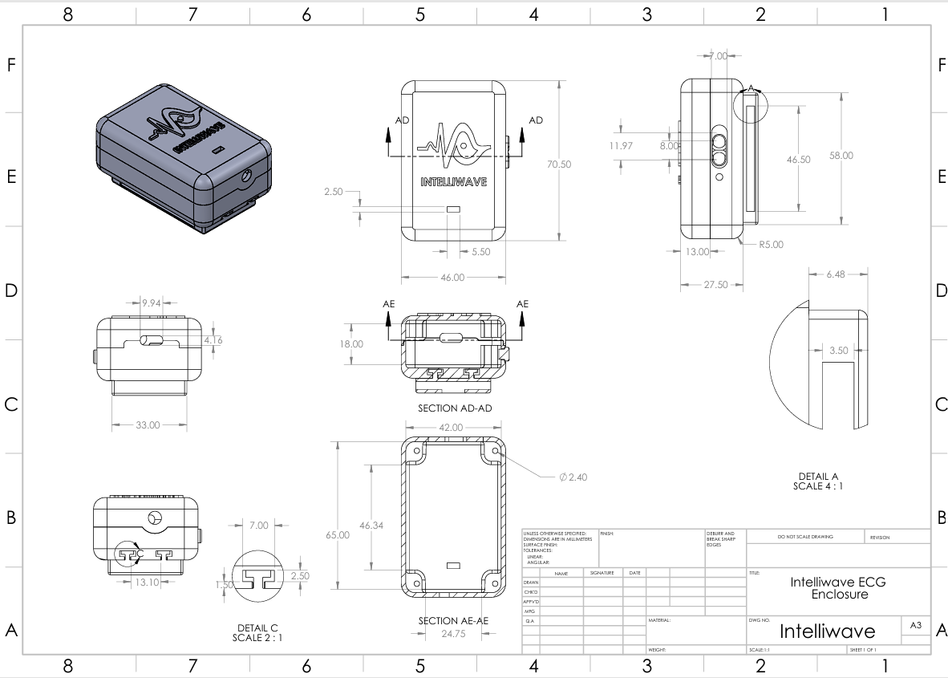
Final Enclosure

Slide 12
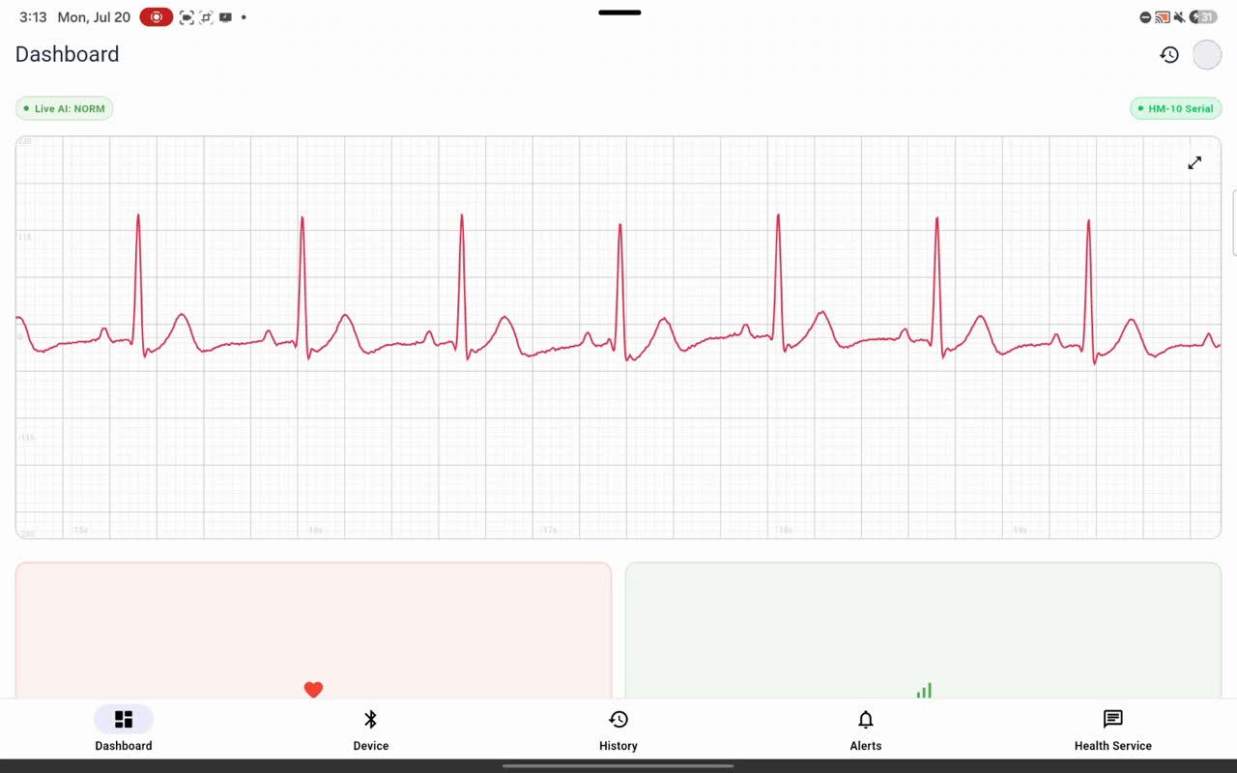
AI & Mobile Application

Slide 13
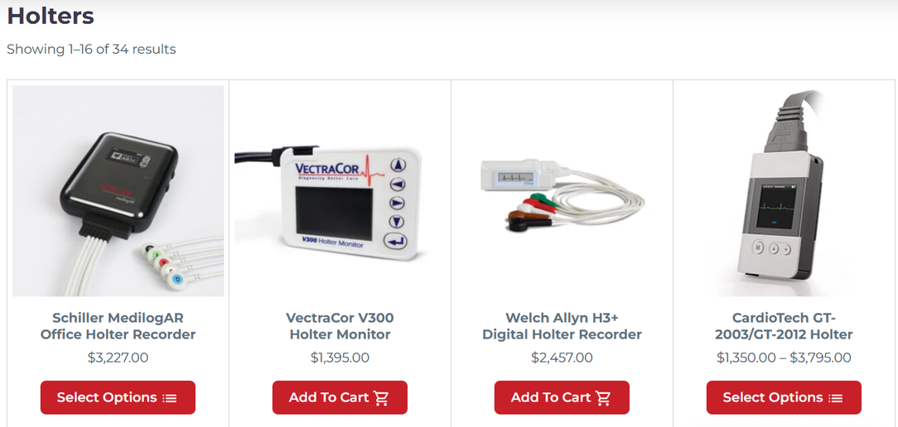
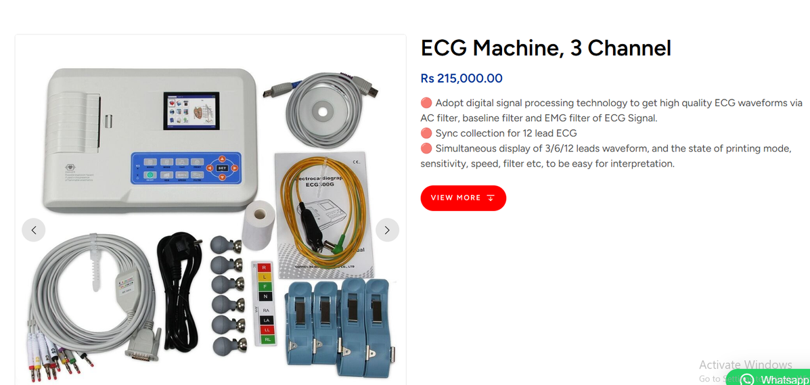
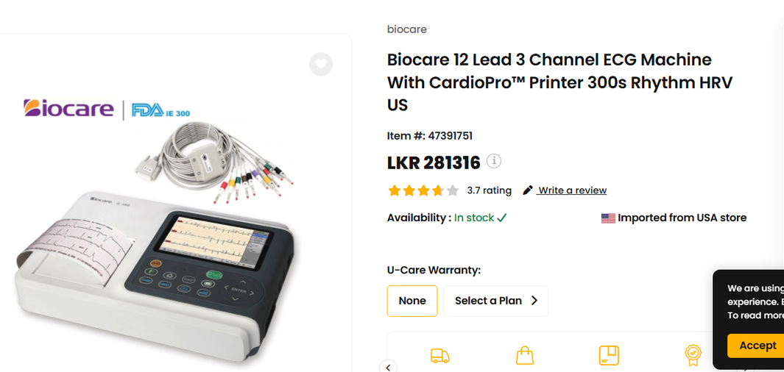
Similar Products in the Market

Slide 14
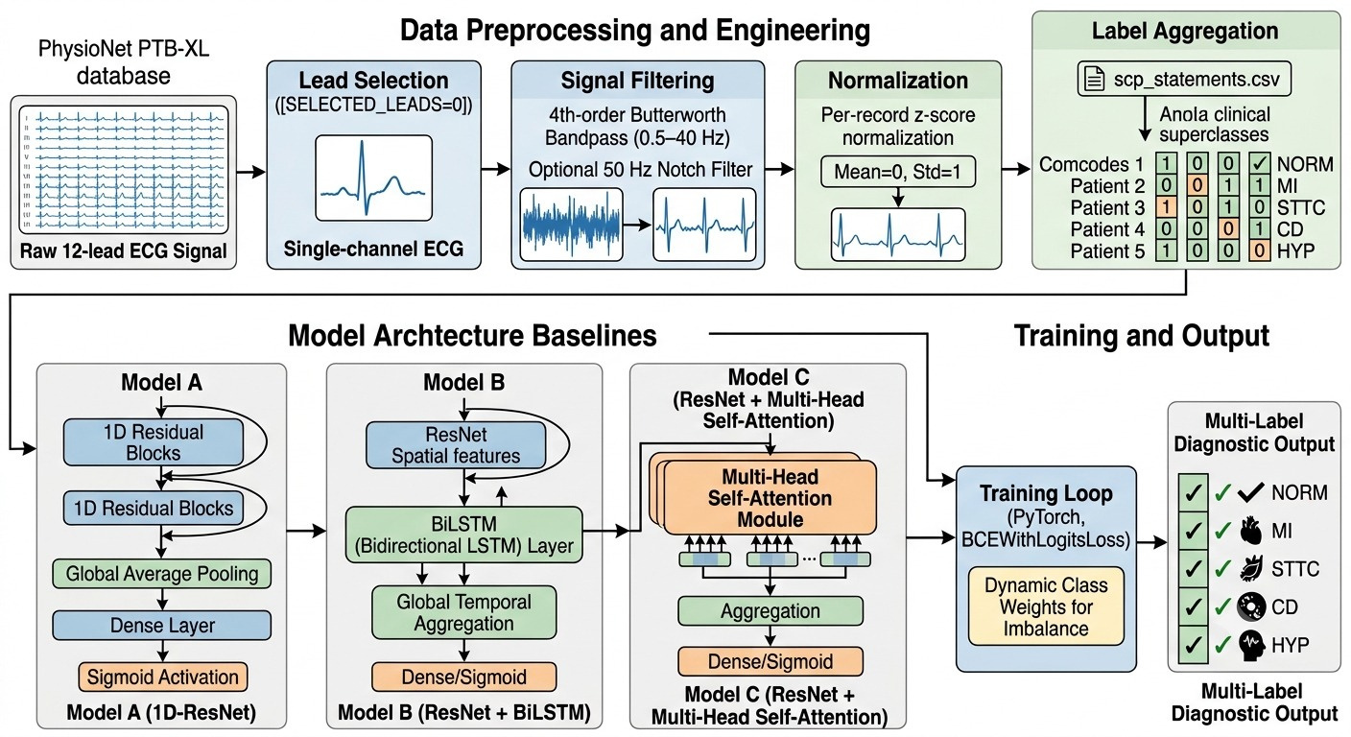
CNN Multi lable Classification Model

Slide 15
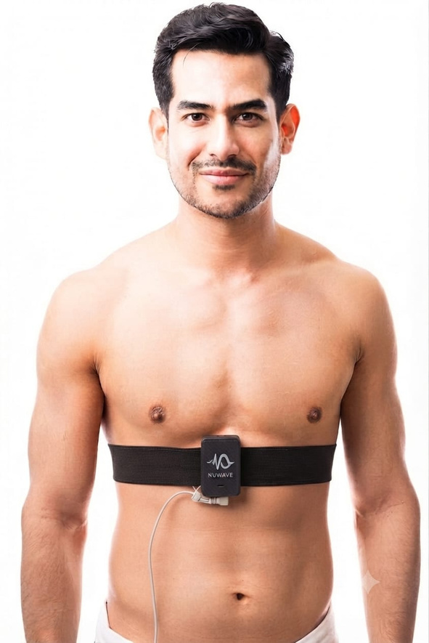
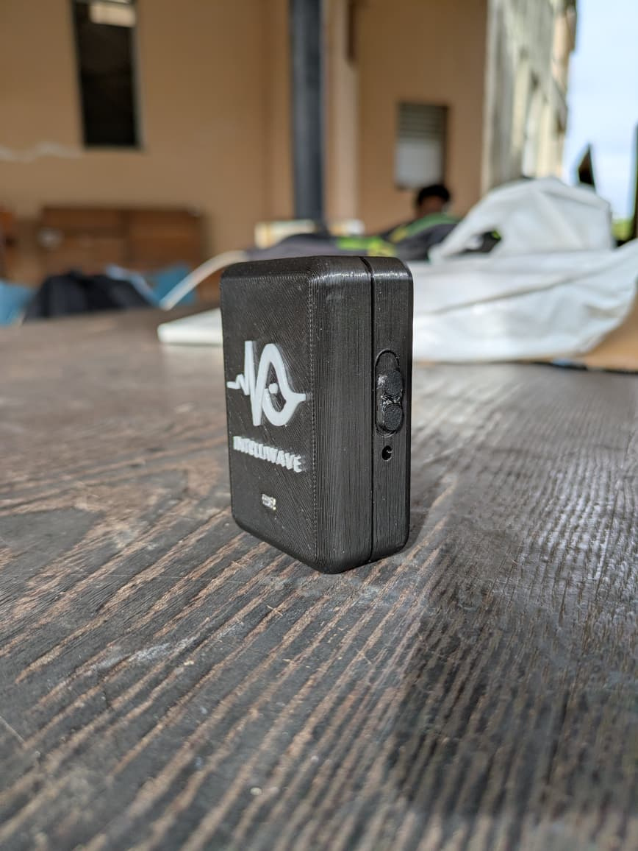
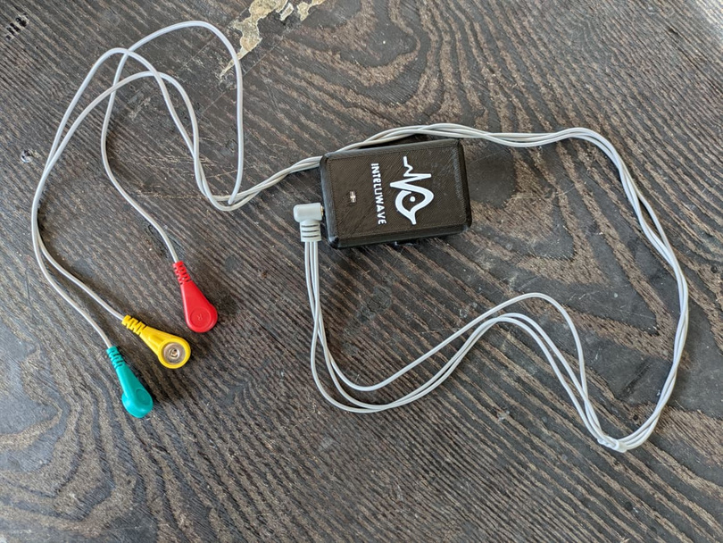
Final product

Slide 16
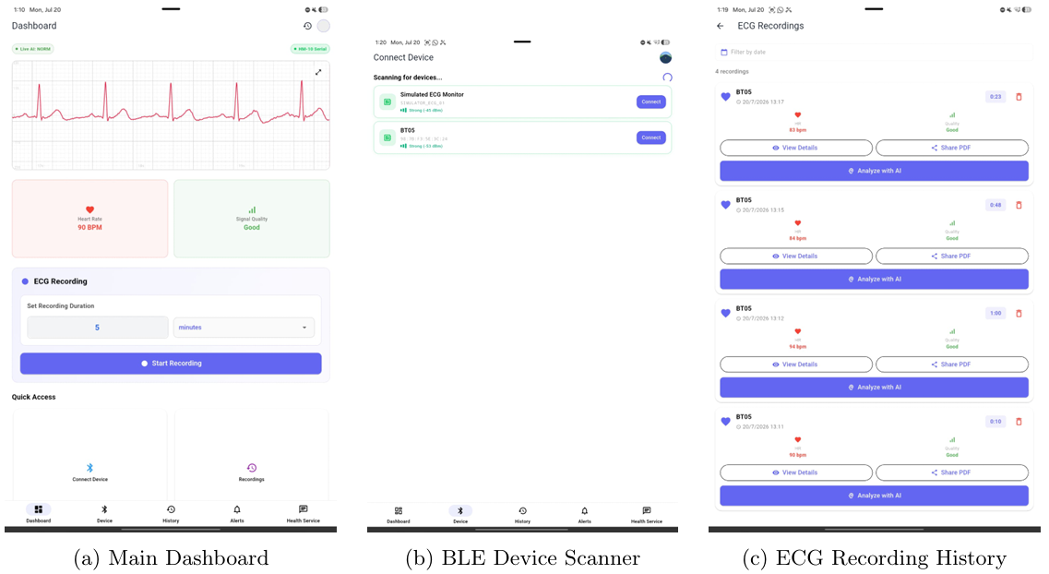
Mobile Application

Slide 17
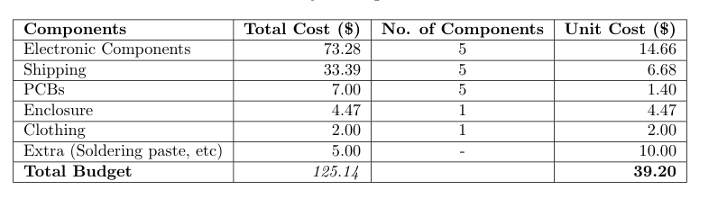
Cost Distribution - For the Project

Slide 18
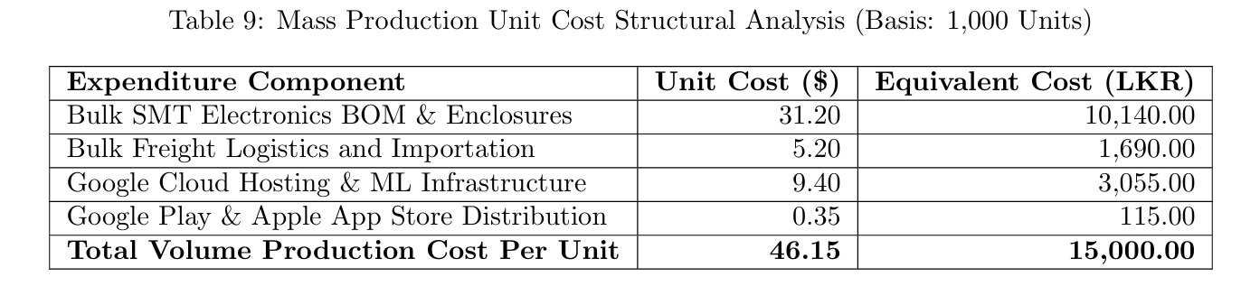
Volume Production Costing and Retail Price
Target Selling price : 30 000 LKR

Slide 19
Business Model for the Product
  B2C market : As a personal health check equipment.(For cardiac patients with high risk, personal health enthusiasts)
  B2B market : For hospitals to monitor patients continously outside home.(Where it need to monitor ECG for longer time (ex: 24h ECG)Expected Sales:
  Hardware sales (one time payment)
  SaaS model for Mobile application (Premium features ex: cloud storage)
  Subscription plan for hospitals.(As cloud storage charge)

Slide 20
Thank You

