Slide 1

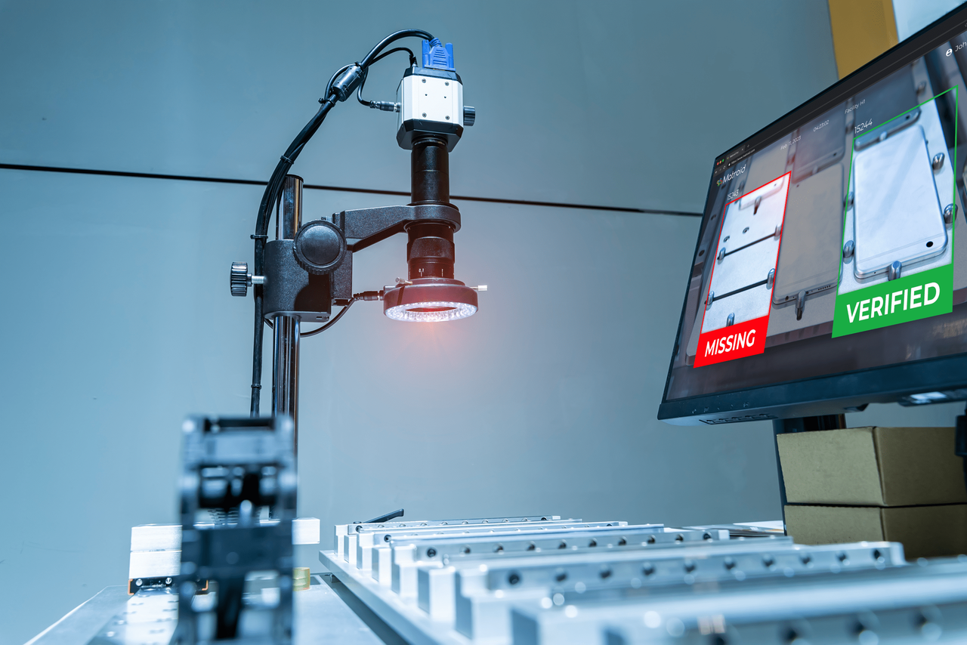
Fully Convolutional Cross-Scale-Flows for Image-based Defect Detection
Authors:Marco Rudolph, Tom Wehrbein, Bodo Rosenhahn, Bastian Wandt
Affiliations:
Leibniz University Hannover, Germany
University of British Columbia, Canada
Udara Desahan
Tharusha Nimesh

Slide 2
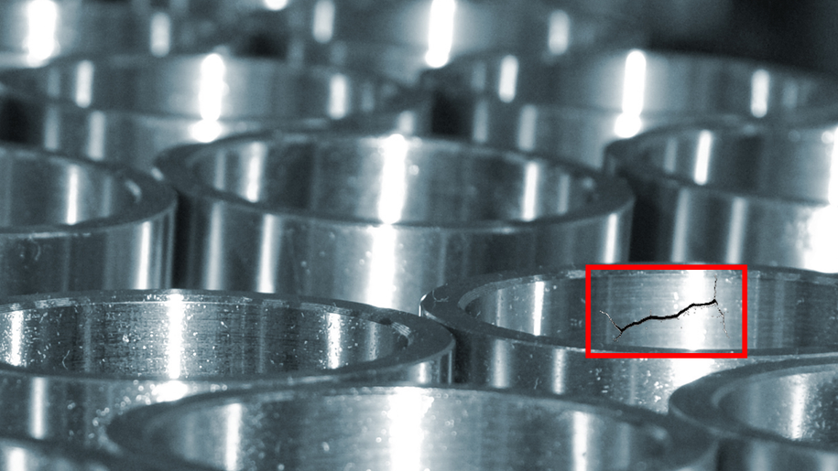
Problem & Motivation
Why Industrial Defect Detection?
The Challenge
  Defects are often unpredictable
  Defective samples may be unavailable during training
  Manual inspection is costly and error-prone

Slide 3
Existing Methods & Limitations
1. Autoencoders / GANs
  Reconstruct normal images
  Use reconstruction error to detect defects
2. Pretrained CNN Features
  Extract useful image features
  Pooled features can lose spatial information
Key Limitation
If spatial information is lost, the model may detect a defect but cannot accurately identify where it is located.

Slide 4
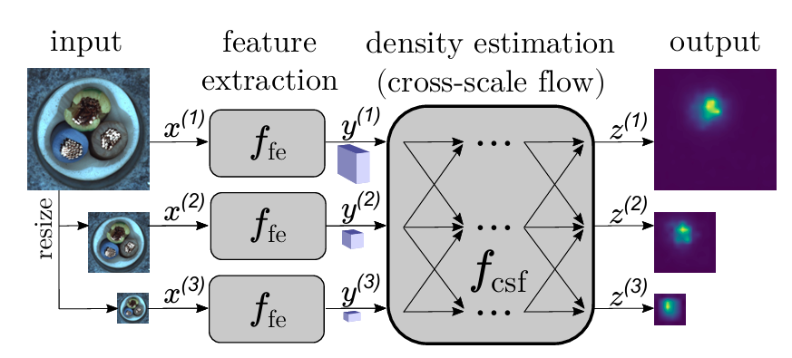
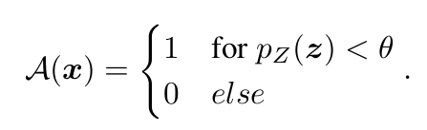
Proposed Method
Overall System Architecture
Detect Defects

Slide 5
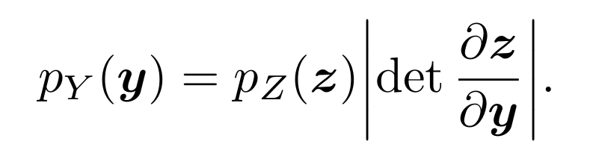
CS-Flow
Learning Objective of
Maximize the likelihood of normal features.
Gaussian Likelihood
Jacobian
Determinant
Equivalently, minimize the negative log likelihood.

Slide 6
Why CS-Flow Is More Efficient
Than Existing Methods
  Multi-scale Feature Extraction
  Preservation of Spatial Information
  Reduced Parameter Count

Slide 7
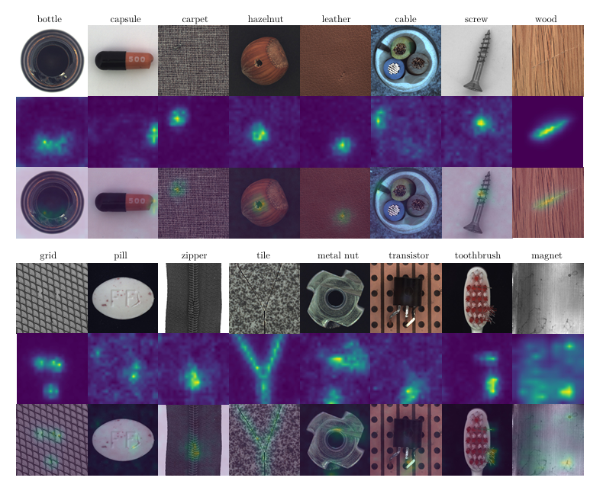
Experiment Setting
  Datasets: MVTec AD and MTD
  Feature Extractor: EfficientNet-B5
  Number of Feature Scales: 3
  Training Epochs:
    MVTec AD: 240 epochs
    MTD: 60 epochs

Slide 8

Questions ?
Thank you!

