Slide 1
5COSC020W DATABASE SYSTEMS – LECTURE 07
Database Querying – Complex queries
Aggregating data with group functions and using subqueries in SQL

Slide 2
Lecture 07 – Outline for part 1: Aggregations
SQL to create and populate tables.
Group functions:
MIN and MAX.
AVG and SUM.
COUNT.
Creating groups of data.
GROUP BY clause with one column.
GROUP BY clause with multiple columns
Restricting group results.
HAVING BY clause
HAVING BY clause vs. WHERE clause.

Slide 3
Lecture 07 – Outline for part 2: Subqueries
Using subqueries to resolve specific problems.
Guidelines for subqueries.
Single-row subquery vs. multiple-row subquery.
Single-row subqueries
Single-row comparison operators and examples.
Using GROUP functions with single-row subqueries.
Grouping data and restricting with a single-row subquery.
Multiple-row subqueries
Multiple-row comparison operators and examples.

Slide 4
SQL Statements and subsets of SQL
SELECT INSERT UPDATE DELETE MERGE | Data Manipulation Language (DML)
CREATE ALTER DROP RENAME TRUNCATE COMMENT | Data Definition Language (DDL)
GRANT REVOKE | Data Control Language (DCL)
COMMIT ROLLBACK SAVEPOINT | Transaction Control

Slide 5
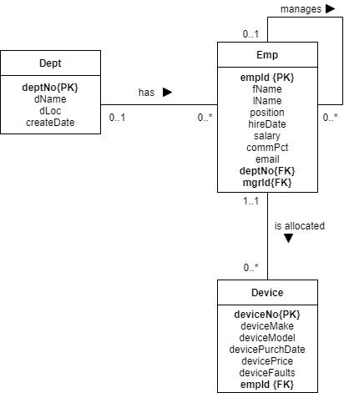
Logical ERD
Emp has a recursive relationship.
Between Dept and Emp
One-to-Many relationship optional on both sides.
Dept is the Parent table, Emp is the Child table.
Child Emp carries a FK deptNo that references the PK deptNo of its parent Dept.
Participations are both 0.
Between Emp and Device
One-to-Many relationship optional on one side.
Emp is the Parent table, Device is the Child table.
Child Device carries a FK empId that references the PK empId of its parent Emp.
Participation is 1 on the Emp side.
Participation is 1 on the Device side.

Slide 6
Creating Dept table
DROP TABLE IF EXISTS Device;
DROP TABLE IF EXISTS Emp;
DROP TABLE IF EXISTS Dept;
CREATE TABLE Dept
(
deptNo INTEGER,
dName VARCHAR(20) UNIQUE NOT NULL,
dLoc VARCHAR(30) NOT NULL,
createDate DATE,
CONSTRAINT d_dno_pk PRIMARY KEY (deptNo)
);

Slide 7
Creating Emp table
CREATE TABLE Emp
(
empId INTEGER,
fName VARCHAR(50) NOT NULL,
lName VARCHAR(50) NOT NULL,
position VARCHAR(50) NOT NULL,
hireDate DATE NOT NULL,
salary DECIMAL(7,2) NOT NULL,
commPct DECIMAL(2,2),
email VARCHAR(100) UNIQUE NOT NULL,
deptNo INTEGER,
mgrId INTEGER,
CONSTRAINT e_eid_pk PRIMARY KEY (empId),
CONSTRAINT e_dno_fk FOREIGN KEY (deptNo) REFERENCES Dept(deptNo),
CONSTRAINT e_mid_fk FOREIGN KEY (mgrId) REFERENCES Emp(empId)
);

Slide 8
Creating Device table
CREATE TABLE Device
(
deviceNo INTEGER,
deviceMake VARCHAR(50) NOT NULL,
deviceModel VARCHAR(50) NOT NULL,
devicePurchDate DATE NOT NULL,
devicePrice DECIMAL(7,2) NOT NULL,
deviceFaults VARCHAR(200),
empId INTEGER NOT NULL,
CONSTRAINT d_dno_pk PRIMARY KEY (deviceNo),
CONSTRAINT d_eid_fk FOREIGN KEY (empId) REFERENCES Emp(empId)
);

Slide 9
Populating Dept tables
INSERT INTO
Dept (deptNo, dName, dLoc, createDate)
VALUES
(10, 'Database Management', 'New Cav', '2021-03-21'),
(20, 'Systems Design', 'Harrow', '2021-01-06'),
(30, 'IT Development', 'New Cav', '2021-04-25'),
(40, 'Project Management', 'Regents', '2021-02-12'),
(50, 'Systems Testing', 'Marylebone', NULL);

Slide 10
Populating Emp tables
INSERT INTO
Emp (empId, fName, lName, position, hireDate, salary, commPct, email, deptNo, mgrId)
VALUES
(101, 'Joe', 'Bloggs', 'Project Manager', '2021-03-01', 5200.00, 0.25, 'jb@it.com', 40, NULL),
(102, 'Jim', 'Marts', 'Database Admin', '2021-03-22', 4400.00, NULL, 'jm@it.com', 10, 101),
(103, 'Jen', 'Fonts', 'Python Developer', '2021-04-28', 4800.00, 0.12, 'jf@it.com', 30, 101),
(104, 'Jon', 'Pop', 'Database Architect', '2021-03-23', 4000.00, NULL, 'jp@it.com', 10, 102),
(105, 'Tom', 'Dogs', 'UI Designer', '2021-01-10', 4000.00, NULL, 'td@it.com', 20, 102),
(106, 'Tek', 'Roggs', 'Project Manager', '2021-01-01', 5200.00, 0.13, 'tr@it.com', 40, NULL),
(107, 'Tim', 'Clogs', 'Java Developer', '2021-04-29', 4300.00, 0.15, 'tc@it.com', NULL, 105),
(108, 'Tam', 'Kelps', 'UX Designer', '2021-06-15', 3900.00, NULL, 'tk@it.com', NULL, 106);

Slide 11
Populating Device tables
INSERT INTO
Device
(deviceNo, deviceMake, deviceModel, devicePurchDate, devicePrice, deviceFaults, empId)
VALUES
(751, 'Pear Phone', 'P Phone 13', '2021-01-12', 976.00, NULL, 106),
(752, 'Pear Tablet', 'P Tablet 04', '2021-01-12', 854.00, NULL, 106),
(753, 'Space Laptop', 'S PC 11', '2021-01-13', 1231.00, 'Scratched', 106),
(754, 'Space Phone', 'S Phone 11', '2021-03-23', 887.00, NULL, 101),
(755, 'Pear Tablet', 'P Tablet 05', '2021-03-23', 1045.00, NULL, 101),
(756, 'Pear Phone', 'P Phone 13', '2021-04-02', 976.00, NULL, 102),
(757, 'Pear Phone', 'P Phone 13', '2021-04-01', 976.00, NULL, 104),
(758, 'Pear Phone', 'P Phone 13', '2021-02-12', 976.00, 'Slow', 105),
(759, 'Space Laptop', 'S PC 54', '2021-02-13', 1143.00, NULL, 105),
(760, 'Space Tablet', 'S Tab 2312', '2021-02-15', 998.00, NULL, 105),
(761, 'Move Phone', 'M Phone 32', '2021-05-07', 1241.00, 'Crashes', 103),
(762, 'Move Laptop', 'M Laptop 3223', '2021-05-08', 1678.00, NULL, 103);

Slide 12
Group Functions
Function | Description
MIN | returns the smallest value in the selected column
MAX | returns the largest value in the selected column
AVG | returns the average of values in the selected column
SUM | returns the sum of values in the selected column
COUNT | returns the number of values in the selected column

Slide 13
Group functions with numeric data
Use MIN, MAX, SUM, AVG.
SELECT MIN(salary), MAX(salary),
SUM(salary), AVG(salary)
FROM Emp;
With rounding.
SELECT MIN(salary), MAX(salary),
SUM(salary), ROUND(AVG(salary), 2)
FROM Emp;

Slide 14
Group functions with numeric data (and additional condition)
Group functions MIN, MAX, SUM and AVG return one value.
The attribute position cannot be retrieved as it contains multiple values.
SELECT MIN(salary), MAX(salary),
SUM(salary), ROUND(AVG(salary),2)
FROM Emp
WHERE position LIKE '%Developer%';

Slide 15
Group functions with strings of characters
MIN retrieves the string that is positioned the earliest alphabetically.
MAX retrieves the string that is positioned the furthest alphabetically.
COUNT retrieves the number of strings in the column.
SELECT MIN(lName), MAX(lName), COUNT(lName)
FROM Emp;

Slide 16
Group functions with dates
MIN retrieves the earliest date.
MAX retrieves the furthest date.
COUNT retrieves the number of dates in the column.
SELECT MIN(hireDate), MAX(hireDate), COUNT(hireDate)
FROM Emp;

Slide 17
COUNT group function – specify column or not
Without specifying a column: use *.
SELECT COUNT(*)
FROM Emp
WHERE deptNo = 10;
With a specific column:
Using the PK is a good idea as it is a unique identifier.
SELECT COUNT(empId)
FROM Emp
WHERE deptNO = 10;

Slide 18
COUNT group function – handling repeated values
It returns the total number of existing values but only including the records that actually contain a value and thus excluding NULL values.
It counts repeated values as separate values.
SELECT COUNT(deptNo)
FROM Emp;
Use DISTINCT to retrieve the total number of different values.
SELECT COUNT(DISTINCT deptNo)
FROM Emp;

Slide 19
Group functions and NULL values
Group functions ignore null values in column.
SELECT AVG(commPct)
FROM Emp;
The IFNULL function (in MySQL) replaces null values with 0s and force the group function to include null values in the aggregation.
SELECT AVG(IFNULL(commPct,0))
FROM Emp;

Slide 20
Creating groups of data
Create groups of data for a specific attribute
For each value of this attribute, use group functions to aggregate data.
For instance, for each department, determine the lowest, the highest and the average of the salaries in that department, along with the sum of salaries in the department and the numbers of earners in the department.
deptNo | MIN(salary) | MAX(salary) | AVG(salary) | SUM(salary) | COUNT(salary)
10 | 3000.00 | 5500.00 | 4200.00 | 14500.00 | 5
20 | 2200.00 | 6500.00 | 4150.00 | 18500.00 | 3
30 | 2800.00 | 5200.00 | 4700.00 | 24500.00 | 6
40 | 3300.00 | 7500.00 | 5500.00 | 22500.00 | 4

Slide 21
GROUP BY clause
Use the GROUP BY clause after the FROM clause to create the groups.
For each selected column, create groups and aggregate data.
All the columns in the SELECT list that are not in group function MUST BE in the GROUP BY clause!
SELECT deptNo, MIN(salary), MAX(salary), AVG(salary), SUM(salary), COUNT(salary)
FROM Emp
GROUP BY deptNo;

Slide 22
GROUP BY clause – include grouped column or not
The grouped column can be in the SELECT list.
SELECT deptNo, AVG(salary), SUM(salary)
FROM Emp
GROUP BY deptNo;
The grouped column does not have to be in the SELECT list.
SELECT AVG(salary), SUM(salary)
FROM Emp
GROUP BY deptNo;

Slide 23
GROUP BY clause – with multiple columns
Use the GROUP BY clause to create nested groups.
Create groups and aggregate data within each nested group.
All the columns in the SELECT list that are not in group function MUST BE in the GROUP BY clause!
SELECT deptNo, position, AVG(salary)
FROM Emp
GROUP BY deptNo, position;

Slide 24
GROUP BY clause – illegal query (1)
A column appears in SELECT list outside the group function but is not in the GROUP BY clause.
SELECT deptNo, lName, AVG(salary)
FROM Emp
GROUP BY deptNo;
WRONG!
ERROR: Expression of SELECT list is not in GROUP BY clause and contains non-aggregated column lName which is not functionally dependent on columns in GROUP BY clause.

Slide 25
GROUP BY clause – illegal query (2)
A column appears SELECT list outside the group function but no GROUP BY clause is included.
SELECT deptNo, AVG(salary)
FROM Emp;
WRONG!
ERROR: In aggregated query without GROUP BY, expression of SELECT list contains non-aggregated column deptNo.

Slide 26
Restricting group results
Create groups of data for a specific attribute
For each value of this attribute, use group functions to aggregate data.
Restrict the results of the grouping of data by specifying a condition.
deptNo | MIN(salary) | MAX(salary) | AVG(salary) | SUM(salary) | COUNT(salary)
10 | 3000.00 | 5500.00 | 4200.00 | 14500.00 | 5
20 | 2200.00 | 6500.00 | 4150.00 | 18500.00 | 3
30 | 2800.00 | 5200.00 | 4700.00 | 24500.00 | 6
40 | 3300.00 | 7500.00 | 5500.00 | 22500.00 | 4
HAVING AVG(salary) > 4500

Slide 27
HAVING clause
Use the GROUP BY clause after the FROM clause to create the groups.
For each selected column, create groups and aggregate data.
Use the HAVING clause (not WHERE!) right at the end to restrict the final output of the grouping of data.
SELECT deptNo, AVG(salary)
FROM Emp
GROUP BY deptNo
HAVING AVG(salary) > 4500;

Slide 28
HAVING clause and WHERE clause
Use WHERE clause to restrict the records
Use the GROUP BY clause to create the groups.
For each selected column, create groups and aggregate data.
Use the HAVING clause (not WHERE!) right at the end to restrict the final output of the grouping of data.
Use ORDER BY to sort the retrieved data.
SELECT deptNo, SUM(salary) AS "Dept Payroll"
FROM Emp
WHERE deptNo IS NOT NULL
GROUP BY deptNo
HAVING SUM(salary) > 8000
ORDER BY SUM(salary);

Slide 29
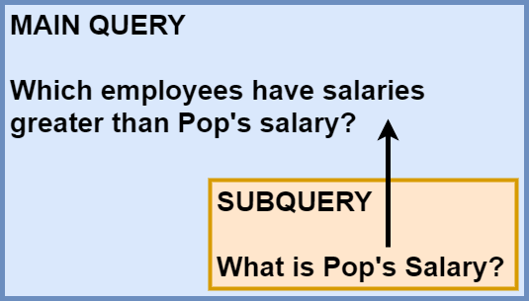
Using subqueries to solve specific problems
Problem: Find out who earns more than Mr Pop.
Embed a subquery within a main query.
Use the output of that subquery as an input of the main query to compare.

Slide 30
Using subqueries – Example
Problem: find out who earns more than Mr Pop.
Embed a subquery (or inner query) within a main query (or outer query) to first find Pop’s salary.
Use the output of the subquery as an input of the main query to retrieve the employees with salaries higher than Pop’s.
SELECT lName, fName, salary
FROM Emp
WHERE salary >
(SELECT salary
FROM Emp
WHERE lName = 'Pop');

Slide 31
Guidelines for subqueries
Enclose the subquery in parentheses.
Indent the subquery to the right of the main query.
Work out the number of rows returned by the subquery.
If the subquery returns one row, use single-row comparison operators.
If the subquery returns multiple rows, use multiple-row comparison operators.

Slide 32
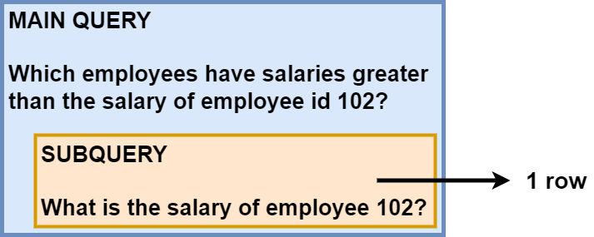
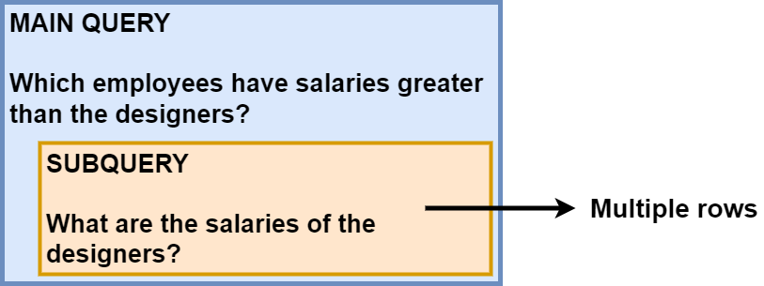
Single-row subquery vs. multiple-row subquery
Use single-row operator!
Use multiple-row operator!

Slide 33
Single-row comparison operators
If subquery returns ONE ROW, use these operators:
Operator | Description
= | Equal to
> | Strictly greater than
>= | Greater than or equal to
< | Strictly less than
<= | Less than or equal to
<> | Not equal to

Slide 34
Single-row subqueries – Example (1)
Problem: find out who is not in the same department as employee 103.
Embed a subquery (or inner query) within a main query (or outer query) to first find the department of employee 103.
Use the output of the subquery as an input of the main query to retrieve the employees whose department is not the one of employee 103.
SELECT lName, fName, deptNo
FROM Emp
WHERE deptNo <>
(SELECT deptNo
FROM Emp
WHERE empId = 103);

Slide 35
Single-row subqueries – Example (2)
Problem: find out who has the same position as employee 104 and at the same time has the same manager as employee 108.
SELECT lName, fName, position, mgrId
FROM Emp
WHERE position =
(SELECT position
FROM Emp
WHERE empId = 104)
AND mgrId =
(SELECT mgrId
FROM Emp
WHERE empId = 108);

Slide 36
Using GROUP functions with single-row subqueries
Find out who earns the same as the lowest salary in department 10.
SELECT lName, fName, deptNo, salary
FROM Emp
WHERE salary =
(SELECT MIN(salary)
FROM Emp
WHERE deptNo = 10);
Find out who earns the same & more than the average salary in the firm.
SELECT lName, fName, deptNo, salary
FROM Emp
WHERE salary >=
(SELECT AVG(salary)
FROM Emp);

Slide 37
Grouping data and restricting with a single-row subquery
List the departments and their lowest salaries, only for the departments for which the lowest salary is higher than the lowest salary in department 10.
SELECT deptNo, MIN(salary)
FROM Emp
GROUP BY deptNo
HAVING MIN(salary) > (SELECT MIN(salary)
FROM Emp
WHERE deptNo = 10);

Slide 38
Illegal single-row subquery
Subquery returns multiple rows but single-row operator is used
Single-row comparison operator with multiple-row subquery is illegal! 
ERROR: Subquery returns more than 1 row!
SELECT lName, fName, salary
FROM Emp
WHERE salary =
(SELECT MIN(salary)
FROM Emp
GROUP BY deptNo);
WRONG!

Slide 39
Multiple-row comparison operators
If subquery returns MULTIPLE ROWS, use these operators:
Operator | Description
IN | Matches any member of the list.
ANY | Compare value to each value returned by subquery. Condition verified if it compares favourably with AT LEAST ONE of the returned values.
ALL | Compare value to each value returned by subquery. Condition verified if it compares favourably with ALL of the returned values.

Slide 40
Using < ANY in multiple-row subquery
Problem: find out who earn LESS THAN ANY of the database staff.
The inner query retrieves multiple rows, here 4400 and 4000
The outer query retrieves the values that are in fact less than the maximum value, here 4400, but only for the non database staff
SELECT lName, fName, position, salary
FROM Emp
WHERE SALARY < ANY
(SELECT salary
FROM Emp
WHERE position LIKE '%Database%')
AND position NOT LIKE '%Database%';

Slide 41
Using < ALL in multiple-row subquery
Problem: find out who earn LESS THAN ALL of the database staff.
The inner query retrieves multiple rows, here 4400 and 4000
The outer query retrieves the values that are in fact less than the minimum value, here 4000, but only for the non database staff
SELECT lName, fName, position, salary
FROM Emp
WHERE SALARY < ALL
(SELECT salary
FROM Emp
WHERE position LIKE '%Database%')
AND position NOT LIKE '%Database%';

Slide 42
Using > ANY in multiple-row subquery
Problem: find out who earn MORE THAN ANY of staff in department 10.
The inner query retrieves multiple rows, here also 4400 and 4000
The outer query retrieves the values that are in fact more than the minimum value, here 4000, but only for the staff not in department 10.
SELECT lName, fName, position, salary
FROM Emp
WHERE SALARY > ANY
(SELECT salary
FROM Emp
WHERE deptNo = 10)
AND deptNo <> 10;

Slide 43
Using > ALL in multiple-row subquery
Problem: find out who earn MORE THAN ALL of staff in department 10.
The inner query retrieves multiple rows, here also 4400 and 4000
The outer query retrieves the values that are in fact more than the maximum value, here 4400, but only for the staff not in department 10.
SELECT lName, fName, position, salary
FROM Emp
WHERE SALARY > ALL
(SELECT salary
FROM Emp
WHERE deptNo = 10)
AND deptNo <> 10;

Slide 44
References and Essential Readings
Reading List: https://rl.talis.com/3/westminster/lists/2CAA7D6B-DCAD-AB71-C97B-7FEFCB499C28.html
Connolly, T. & Begg, C. E. (2015). Database systems: a practical approach to design, implementation and management. 6th Edition (Global Edition). Pearson Education.
Elmasri, R. & Navathe, S. (2017). Fundamentals of Database Systems. 7th Edition (Global Edition). Pearson Education.
W3Schools (2022). SQL Tutorial. Available from https://www.w3schools.com/sql/ [Accessed 15 September 2022]
W3resource (2022). SQL Subqueries. Available from https://www.w3resource.com/sql/subqueries/understanding-sql-subqueries.php [Accessed 15 September 2022]

