Slide 1

MATHSMATE
INTERACTIVE LEARNING TOOL FOR DYSCALCULIA KIDS
R26-IT-138

Slide 2

Overview
1.
Work load Contribution
Commercialization
7. ^{P}G^{la}a^{n} nt Chart
Work Breakdown Structure
6.
2. Problem, It’s Impact/Gravity
3.
Who will be benefited by the
^{S}Dºe^{lu}s^{t}i^{i}gºn^{n} Excellence of the Overall
Solution
Description of Individual
Components
8.
4.
5.
R26-IT-138

Slide 3

Work load Contribution
Member
Component
Main Contribution
Technologies / Methods
Collect learner interaction data, analyze cognitive behavior, generate cognitive profiles
Random Forest, Feature Extraction, Real-time Behavioral Analysis
IT22136206
Cognitive Skill Profiling System
Personalized Math Learning Engine
Create adaptive learning paths, adjust difficulty levels, provide real-time hints
Bayesian Knowledge Tracing (BKT), Adaptive Learning, API-based Hint Generation
IT22224316
Develop gamified learning environment, adapt gameplay and rewards based on performance
Reinforcement Learning (RL), Gamification, Behavioral Adaptation
Adaptive Game-Based Learning Engine
IT22117878
Predict learning risks, generate intervention recommendations, develop dashboards
Random Forest Classification, Predictive Analytics, Rule-based Recommendation System
Learning Insight & Early Warning System
IT21275524
R26-IT-138

Slide 4


Interactive Learning Tool for Dyscalculia kids

Slide 5

Interactive Learning Tool for Dyscalculia kids
Problem Statement
Dyscalculia affects children’s ability to understand arithmetic problems, and process mathematical concepts.
numbers,
solve
Key Issues
Weak number sense and memory
Slow processing speed
Poor attention and concentration
Math anxiety and low confidence
Limited personalized learning support
Impact
Existing System Limitations
Focus only on correct/incorrect answers
No cognitive behavior analysis
Lack of adaptive learning mechanisms
No early warning support for teachers
Dyscalculia causes poor math performance, anxiety, and difficulty in identifying learning weaknesses. The proposed AI-powered system provides adaptive learning, cognitive analysis, and early intervention support to improve educational outcomes.
R26-IT-138

Slide 6

Interactive Learning Tool for Dyscalculia kids
Who Will Benefit from the Solution?
Primary Beneficiaries
Students with Dyscalculia
Teachers
Parents
Schools & Educational Institutions
Design Excellence of the Overall Solution
AI-Powered Intelligent Learning Ecosystem
The system integrates:
Cognitive Analysis
Personalized Learning
Adaptive Gaming
Predictive Analytics
Teacher Dashboards
R26-IT-138

Slide 7

Interactive Learning Tool for Dyscalculia kids
IT22136206 | Navodya K.M.I.G.T
Cognitive Skill Profiling System
Specialization: BSc(Hons) in Information Technology
IT22136206 | Navodya K.M.I.G.T | R26-IT-138

Slide 8


Cognitive Skill Profiling System
How the Solution Addresses
the Sub-Problem
Existing systems only evaluate correct or incorrect answers
The system collects real-time learner interaction data
Captures accuracy, response time, and number of attempts
Uses a Random Forest machine learning model for analysis
User Requirements Addressed
Real-time learner data collection
Cognitive behavior analysis
AI-based cognitive profiling
Personalized learning support
Early identification of learning difficulties
Secure and scalable educational system
Identifies cognitive abilities such as:
o Memory
o Attention
o Number sense
o Processing speed
Generates dynamic cognitive profiles for each learner
Supports personalized learning
experiences
IT22136206 | Navodya K.M.I.G.T | R26-IT-138

Slide 9

Cognitive Skill Profiling System
Design Excellence / Contribution
Uses AI-driven real-time cognitive analysis
Combines accuracy, response time, and attempts for deeper insights
Generates dynamic cognitive profiles for each learner
Uses interpretable Random Forest models for educators
Key Contribution
Bridges the gap between performance-
based learning systems and cognitive-level analysis.
User Feedback on Prototype
Teachers found the system
useful for identifying student learning difficulties
Students found activities engaging and easy to use
Parents appreciated insights into
cognitive strengths and weaknesses
Feedback showed improved
support for personalized learning and early intervention
IT22136206 | Navodya K.M.I.G.T | R26-IT-138

Slide 10
Interactive Learning Tool for Dyscalculia kids
IT22224316 | Dhananjani G.A.U.
Personalized Maths Learning Engine
Specialization: BSc(Hons) in Information Technology
IT22224316 | Dhananjani G.A.U. | R26-
IT-138

Slide 11
Personalized Maths Learning Engine
How the Solution Addresses the Sub-Problem / Prototype
Adaptive learning system for dyscalculia students
Uses BKT to estimate skill mastery
Tracks accuracy, time, attempts, and errors
Adjusts difficulty based on performance
Provides personalized activities and real-time hints
User Requirements Addressed
Simple and child-friendly interface
Personalized learning support
Real-time feedback and hints
Fast and secure system
Adaptive activities based on student ability
IT22224316 | Dhananjani G.A.U. | R26-IT-138

Slide 12

Personalized Maths Learning Engine
Design Excellence / Contribution
Independent adaptive learning engine without external cognitive profiling.
Combines:
￭ Real-time behavioral analysis
  Probabilistic learner modeling
  Intelligent feedback system
Improves engagement through interactive and personalized activities
Supports SDG 4 – Quality Education.
Scalable and modular system architecture
.
Key Contribution - This research introduces an adaptive learning system
User Feedback on Prototype
Students found activities engaging and easier to understand.
Teachers appreciated adaptive difficulty adjustmen.t.
Visual learning support improved student interaction.
Real-time hints helped students correct mistakes effectively.
Positive feedback on simple and child-friendly UI design.
that provides personalized learning and
^{real-time feedback fo}I^{r}T^{d}2^{y}2^{s}2^{c}2ª4^{lc}3^{u}1^{l}6^{ia}| Dhananjani G.A.U. | R26-
students.

Slide 13
Interactive Learning Tool for Dyscalculia kids
IT22117878 | Alwis L.P.M
Adaptive Game-Based Learning Engine
Specialization: BSc(Hons) in Information Technology
IT22117878 | Alwis L.P.M | R26-IT-138

Slide 14
Adaptive Game-Based Learning Engine
How the Solution Addresses the Sub-Problem / Prototype
Provides interactive math learning through adaptive educational games.
Dynamically adjusts difficulty based on student
performance and response time.
Uses gamification features such as points, badges, rewards, and levels to improve motivation.
Reduces boredom and frustration by personalizing learning
activities.
User Requirements Addressed
Personalized learning experience for children with dyscalculia.
Real-time feedback and hints for incorrect answers.
Adaptive game progression according to learner skill level.
Engaging and stress-free learning environment.
IT22117878 | Alwis L.P.M | R26-IT-

Slide 15
Adaptive Game-Based Learning Engine
Design Excellence / Contribution
Uses Reinforcement Learning (RL)
Real-time adaptive difficulty adjustment
Combines adaptive learning with gamification
Tracks learner engagement and behavior
Personalized rewards and level progression
Key Contribution
Bridges the gap between static educational games and intelligent adaptive learning systems for children with dyscalculia.
User Feedback on Prototype
Students found the games engaging
Adaptive difficulty improved motivation
.
Teachers liked personalized learning features
Parents appreciated the supportive environment
Reduced frustration during math learning
IT22117878 | Alwis L.P.M | R26-IT-

Slide 16

Interactive Learning Tool for Dyscalculia kids
IT21275524 | Rakeesha Learning Insight & ^{M}Ea^{.G}rl.y^{N}Warning System
Specialization: BSc(Hons) in Information Technology
IT212755224 | Rakeesha M.G.N | R26-IT-138

Slide 17
How the Solution Addresses the Sub-Problem / Prototype
Provides a centralised analytics dashboard that monitors student learning performance over time.
Uses a Logistic Regression model to predict student risk levels (Low / Moderate / High) based on behavioural indicators such as accuracy rate, response time, attempt count, and error patterns.
Aggregates session-level data from peer components (Adaptive Game Engine and Personalised Math Learning Engine) into a unified longitudinal learner profile.
Generates early warning alerts for teachers and parents when a student shows signs of persistent difficulty.
User Requirements Addressed
Longitudinal performance monitoring for children with dyscalculia beyond simple correct/incorrect tracking.
Risk prediction and early warning alerts for educators and caregivers.
Separate dashboard views tailored for teachers and parents with actionable insights.
Generates early warning alerts for teachers and parents when a student shows signs of persistent difficulty.
IT21275524 | Rakeesha M.G.N | R26-

Slide 18
Design Excellence / Contribution
Uses Logistic Regression for interpretable student risk classification
Applies Gaussian Mixture Model (GMM) for learner difficulty profiling
Aggregates multi-engine behavioural data into a unified analytics pipeline
Tracks longitudinal performance trends across sessions
Delivers stakeholder-specific dashboards for teachers and parents
Key Contribution
Bridges the gap between isolated adaptive learning components and a unified intelligent analytics layer — enabling early identification of at-risk dyscalculia learners through interpretable machine learning, longitudinal profiling, and actionable stakeholder dashboards.
User Feedback on Prototype
Teachers found the risk alerts easy to understand and act on
Parents appreciated the simplified progress view and pla.in-language warnings
Students showed no added stress as monitoring happens passively in the background
Supervisors noted the value of aggregating data from multiple components
Dashboard performance tracking helped identify struggling students earlier than expected
IT21275524 | Rakeesha M.G.N | R26-

Slide 19
Interactive Learning Tool for Dyscalculia kids
Commercialization / Sustainability of Solution
1.Customer Persona
Grade 2–3 students with Dyscalculia
Teachers and special education educators
Parents seeking learning support tools
Primary schools and educational institutions
Ed₁u_{.M}ca_{a}t_{r}i_{k}o_{e}n_{t}a_{S}l t_{iz}h_{e}erapists and EdTech
platforms
Dyscalculia affects approximately 3%–7% of children globally
Increasing demand for AI-powered personalized education systems
Growing EdTech market in Sri Lanka and internationally
High potential for integration into schools, learning centers, and online learning platforms
R26-IT-
138

Slide 20
Interactive Learning Tool for Dyscalculia kids
1.What is Unique in Our Solution?
Combines:
  Cognitive profiling
  Personalized learning
  Adaptive gaming
  Early warning prediction
Uses real-time behavioral analysis instead of only correct/incorrect answers
AI-driven adaptive learning using:
  Bayesian Knowledge Tracing
⚬ Reinforcement Learning
⚬ Random Forest
Provides explainable and interpretable outputs for teachers and parents
Supports early detection and inter^{R}v²e⁶n⁻t^{I}i^{T}on⁻ for dyscalculia learners
138

Slide 21
Interactive Learning Tool for Dyscalculia kids
1.How Will the Cost Be Recovered?
Subscription plans for schools and educational institutions
Institutional licensing for learning centers and special education programs
Integration services for existing EdTech platforms
Tier-based pricing model:
  Basic Plan
  Standard Plan
  Enterprise Plan
Long-term sustainability through scalable cloud-based deployment and educational partnerships
R26-IT-
138

Slide 22
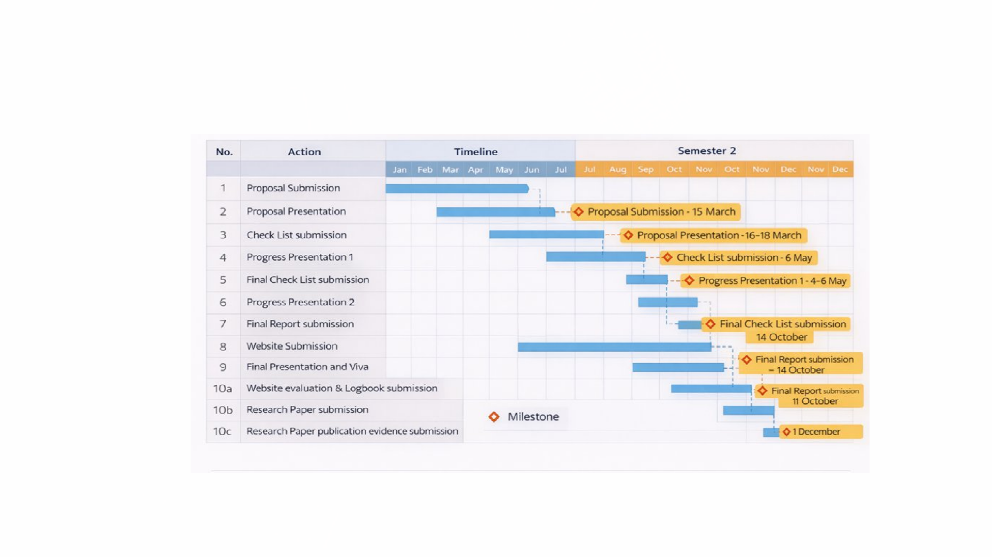
Gantt Chart
R26-IT-138

Slide 23
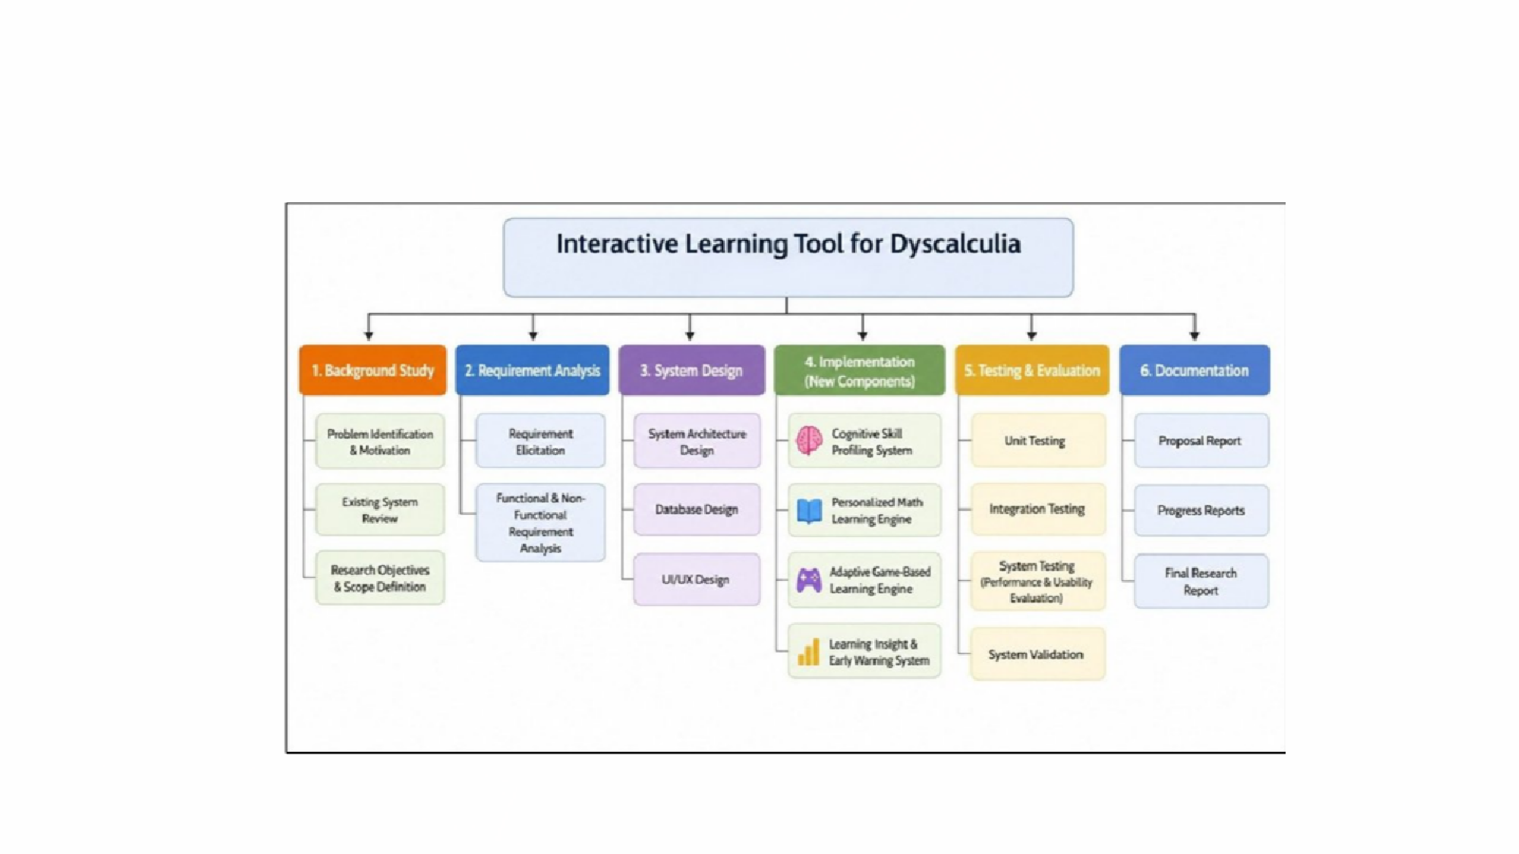
Work breakdown structure
R26-IT-138

Slide 24




THANK YOU

