Slide 1

MathsMate
Interactive Learning Tool for Dyscalculia kids
R26-IT-

Slide 2

R26-IT-

Slide 3
Problem and Stakeholders
The Problem
Children with dyscalculia experience difficulties in understanding and learning mathematical concepts. They may struggle with areas such as:
Remembering mathematical information
Maintaining attention during learning activities
Understanding numbers and quantities
Processing mathematical information efficiently
Traditional mathematics learning methods often provide the same learning content and difficulty level to every student, without considering individual cognitive abilities and learning performance.

Slide 4
Target Users and Stakeholders
Primary Users
Grade 2–3 students with mathematics learning difficulties
Secondary Users
Teachers – to monitor student progress and identify learning difficulties
Parents – to understand their child's learning progress and areas requiring support
Why Is This Problem Important?
Early identification and personalized support can help children receive learning activities appropriate to their individual needs.
Children have different cognitive abilities and learning needs, but traditional learning approaches may not provide personalized and adaptive support.
R26-IT-

Slide 5

Research Gap and Objectives
Research Gap
Based on the identified problem, existing approaches may have limitations such as:
Limited early identification of different cognitive difficulties
Learning content that is not sufficiently personalized
Limited use of adaptive learning based on student performance
Lack of continuous monitoring and early warning mechanisms
Learning systems that do not combine cognitive profiling, personalization, adaptive gameplay, and learning analytics into one solution
Main Research Objective
To develop an integrated intelligent learning system that identifies cognitive skill levels and provides personalized and adaptive mathematics learning support for children with dyscalculia.
R26-IT-

Slide 6


Research Gap and Objectives
Specific Objectives
Identify students' cognitive skill levels related to mathematics learning.
Personalize learning activities according to individual learning progress.
Adapt game-based learning experiences based on student performance.
Analyze learning patterns and provide insights or early warnings for potential learning difficulties.
The research aims to move from a one-size-fits-all learning approach toward an integrated, personalized, and adaptive learning system.

Slide 7
Proposed Solution & System Architecture
Comprehensive Integrated Platform
The proposed system is an integrated Dyscalculia Interactive Learning Tool designed for Grade 2–3 students.
The system combines four intelligent components to provide:
Cognitive skill assessment
Personalized mathematics learning
Adaptive game-based learning
Learning analytics and early warning insights

Slide 8
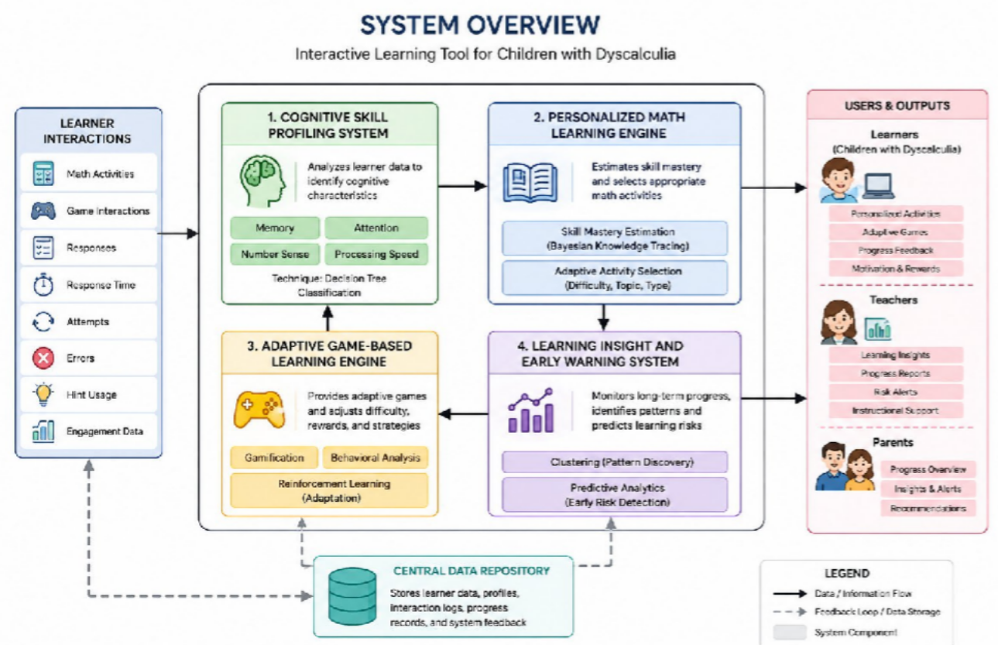
Architecture & Data Flow Between Modules
R26-IT-

Slide 9
Four Integrated Components
The maths app is built as one unified, integrated platform
— not a collection of separate tools. Each component works in concert with the others to deliver a seamless, personalised learning experience for children with dyscalculia.
Cognitive Skill Profiling System
Personalised Math Learning Engine
These four components share data in real time, enabling the system to continuously adapt to each learner's progress. Together, they form a comprehensive support ecosystem for students, teachers, and parents.
Adaptive Game-Based Learning Engine
Learning Insight & Early Warning System
R26-IT-

Slide 10
Integration and System Completion
Integrated all four components into one learning platform.
Connected cognitive profiling, personalized learning, adaptive gaming, and learning analytics.
Integrated the frontend, backend, database, and machine learning models.
Data Flow & Workflow
Integration Progress Working Features
Assessment data from the Cognitive Profiling System feeds into the Learning Engine, which dynamically adjusts content difficulty.
Output from learning sessions is passed to the Early Warning System, enabling continuous feedback loops across all modules in real time.
All four core components are successfully integrated via a shared data layer. Module-to-module communication is fully operational. API endpoints are stable, user session management is complete, and cross-component data synchronisation has been validated through internal testing.
Adaptive learning paths adjust in real time based on student performance. Real-time alert notifications flag at-risk learners for teachers and parents. Game-based exercises respond to proficiency levels, and the dashboard displays live progress metrics for all stakeholders.
Learner → Data → Four Components → Personalized Support
R26-IT-

Slide 11
Integration and System Completion
Completed the development and integration of all four components. Implemented the required AI and machine learning models.
Tested the overall system and its main functionalities.
Final Outcome:
A unified intelligent learning system to support children with dyscalculia.

Slide 12
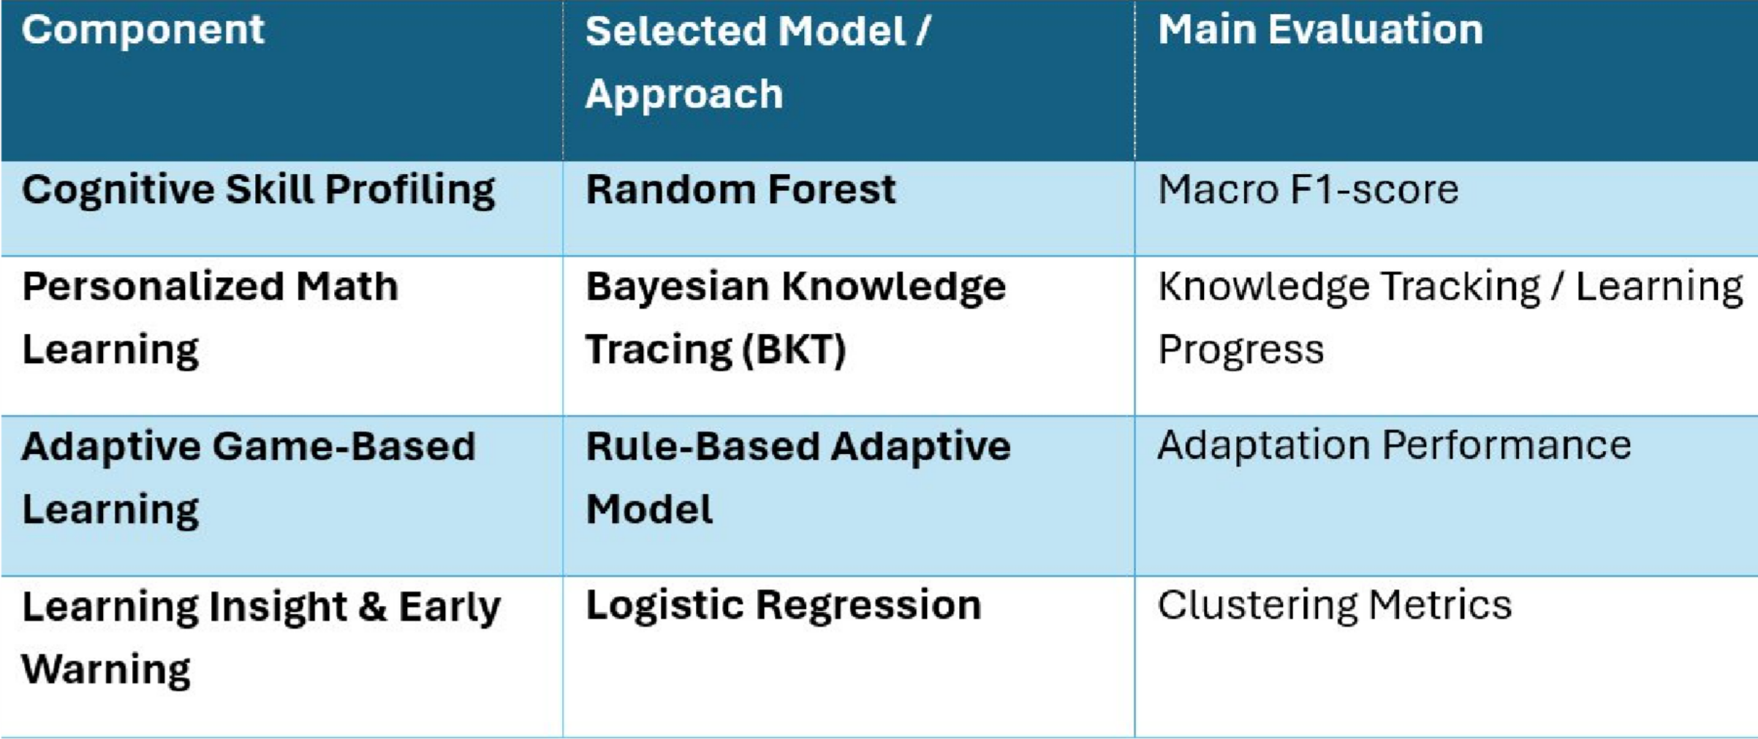

Evaluation Results & NFRs
Component Evaluation Results

Slide 13
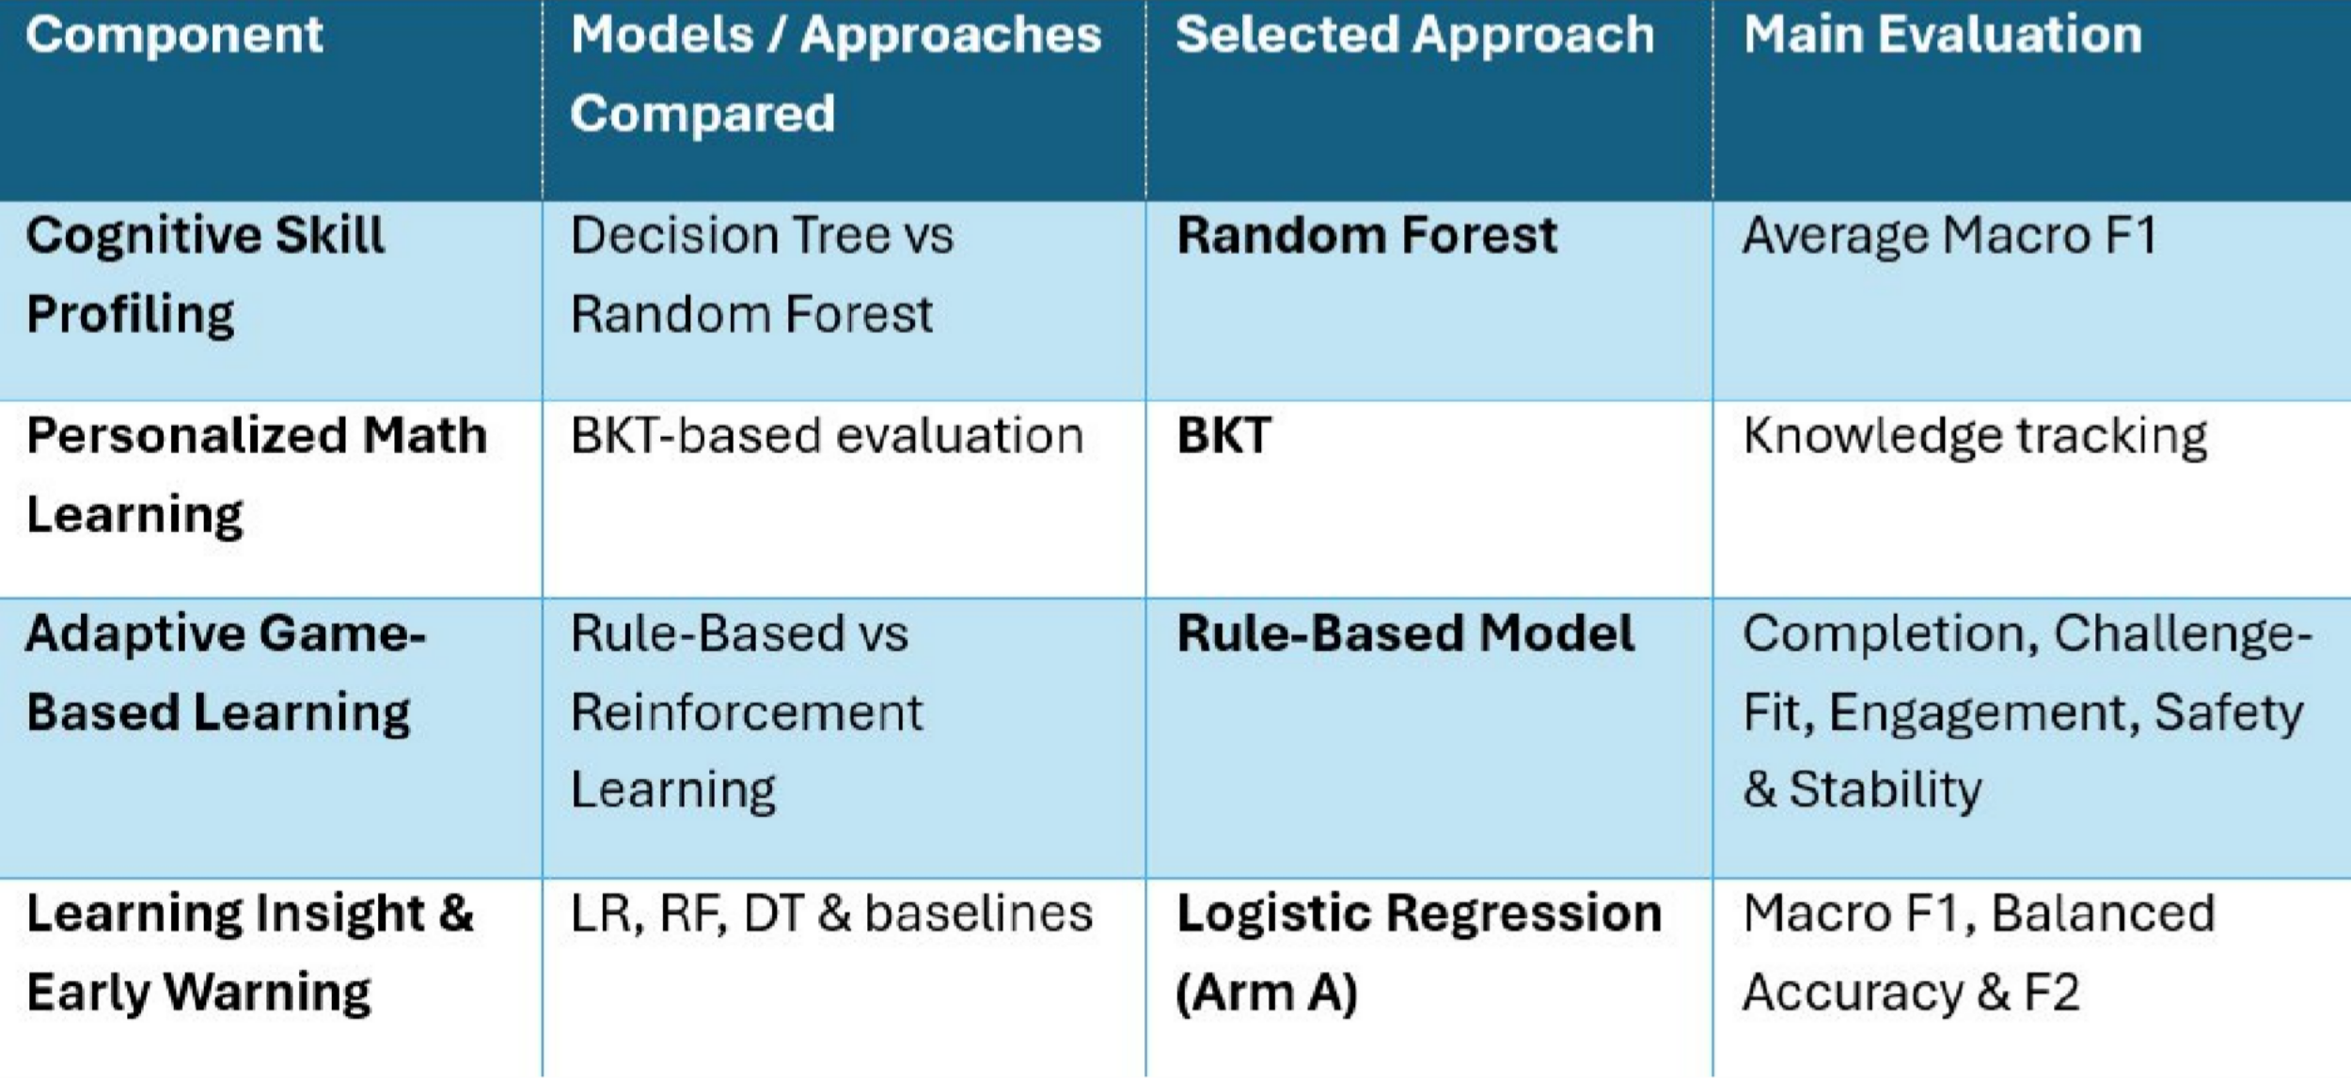
Baseline / Comparison Results

Slide 14
Testing & NFRs
Show evidence for important Non-Functional Requirements such as:
Performance
System response time
Ability to handle user interactions
Usability
Simple and child-friendly interface
Easy navigation
Reliability
Stable system behavior
Reduced runtime errors
Security
User authentication
Data protection
Secure handling of student information
The system was evaluated not only for functional correctness but also for performance, usability, reliability, and other relevant quality requirements.

Slide 15

Commercialization
Customer Persona
Grade 2–3 students with Dyscalculia Teachers and special education educators Parents seeking learning support tools Primary schools and educational institutions Educational therapists and EdTech platforms
Market Size
Dyscalculia affects approximately 3%–7% of children globally Increasing demand for AI-powered personalized education systems Growing EdTech market in Sri Lanka and internationally High potential for integration into schools, learning centers, and online learning platforms

Slide 16
THANK YOU.

