Slide 1





MathsMate
Interactive Learning Tool for Dyscalculia kids
R26-IT-138

Slide 2



R26-IT-138

Slide 3

Research Problem
Some primary school students with dyscalculia, affecting number and arithmetic understanding.
Difficulties occur in number sense, place value, and basic operations.
Traditional teaching and apps lack personalized support and misconception detection.
Evidence
About 3–7% of school-aged children are affected by dyscalculia.
It can impact academic performance, confidence, and daily tasks (time, money).
R26-IT-138

Slide 4



Users and Stakeholders
Primary Users
Grade 2–3 students with dyscalculia needing personalized math support. Stakeholders
Teachers – monitor progress and provide support.
Parents/Guardians – assist learning at home.
Schools/Educational institutions – support inclusive education.
Therapists/Researchers – analyze learning patterns and interventions.
Impact of the Problem on Users and Society
Students with dyscalculia may develop low confidence and math anxiety.
Lack of early support can increase the academic gap with peers.
Teachers may find it difficult to identify learning difficulties in large classrooms.
Poor numeracy skills can affect future education, jobs, and daily decisions.
R26-IT-138

Slide 5


Existing Solutions and Their Limitations
Existing systems such as Calcularis, ST Math, and Dynamo Math provide digital math learning activities.
Limitations
Limited personalization for dyscalculia-specific difficulties.
Provide simple right/wrong feedback instead of identifying misconceptions.
Lack real-time adaptive hints and feedback.
Limited support for connecting school learning with home practice.
Proposed Solution
  An intelligent adaptive learning system designed for students with dyscalculia. Key Features
  Personalized learning paths based on student progress.
  Machine learning–based misconception detection.
  Real-time hints and feedback during problem solving.
  Learning analytics for teachers and home practice support for parents.
R26-IT-138

Slide 6
Individual Students’ Components
The system includes four main components developed by team members:
Personalized Math Learning Engine – Generates adaptive math activities based on student progress.
Personalized Hint & Feedback Engine – Detects misconceptions and provides personalized hints using machine learning.
Learning Insight & Early Warning System – Analyzes learning data to identify student learning risks.
Parent Support & Home Practice Portal – Provides home learning activities and progress updates for parents.
R26-IT-138

Slide 7

IT22224316 |DHANANJANI G.A.U.
Personalized Math Learning Engine
Contribution of your component to the overall solution
Focuses on the Personalized Math Learning Engine
Analyzes student interactions with math learning activities
Adapts task difficulty based on student learning progress
Models student knowledge and identifies weak math skills
Generates personalized learning paths for each student
Helps students practice weak areas and gradually improve
Supports the system by enhancing learning effectiveness for children with dyscalculia

Slide 8
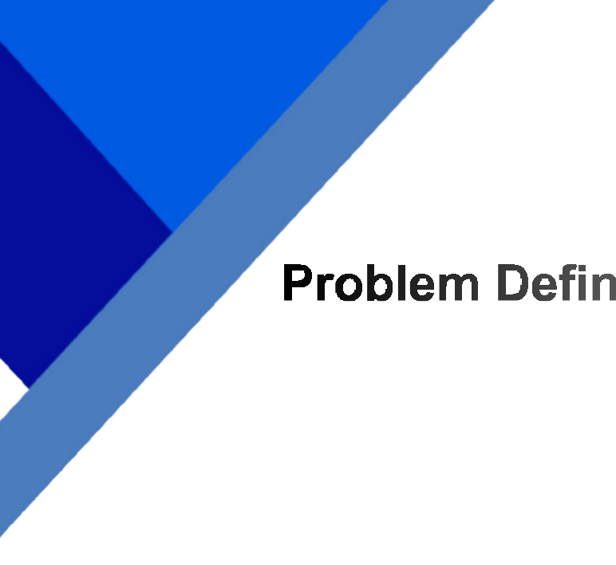
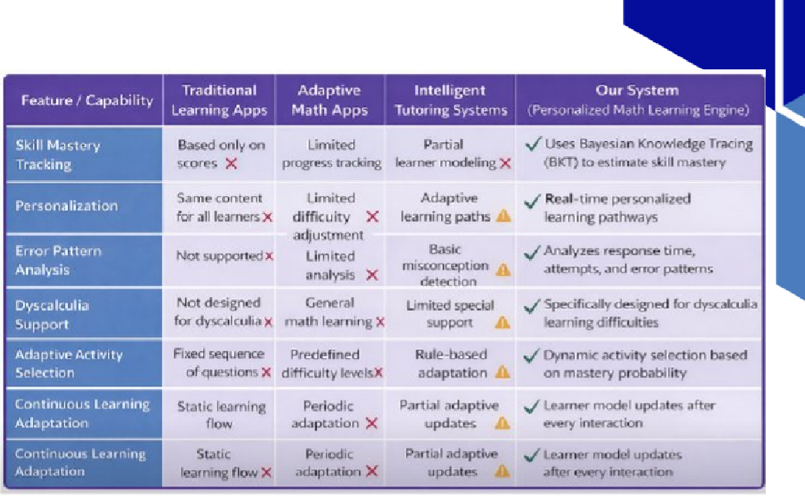





























































































































































































Personalized Math Learning Engine
IT22224316 | Dhananjani G.A.U. | R26-IT-138

Slide 9

















































































































































































































































Personalized Math Learning Engine
IT22224316 | Dhananjani G.A.U. | R26-IT-138

Slide 10

































































































































































































Personalized Math Learning Engine
IT22224316 | Dhananjani G.A.U. | R26-IT-138

Slide 11





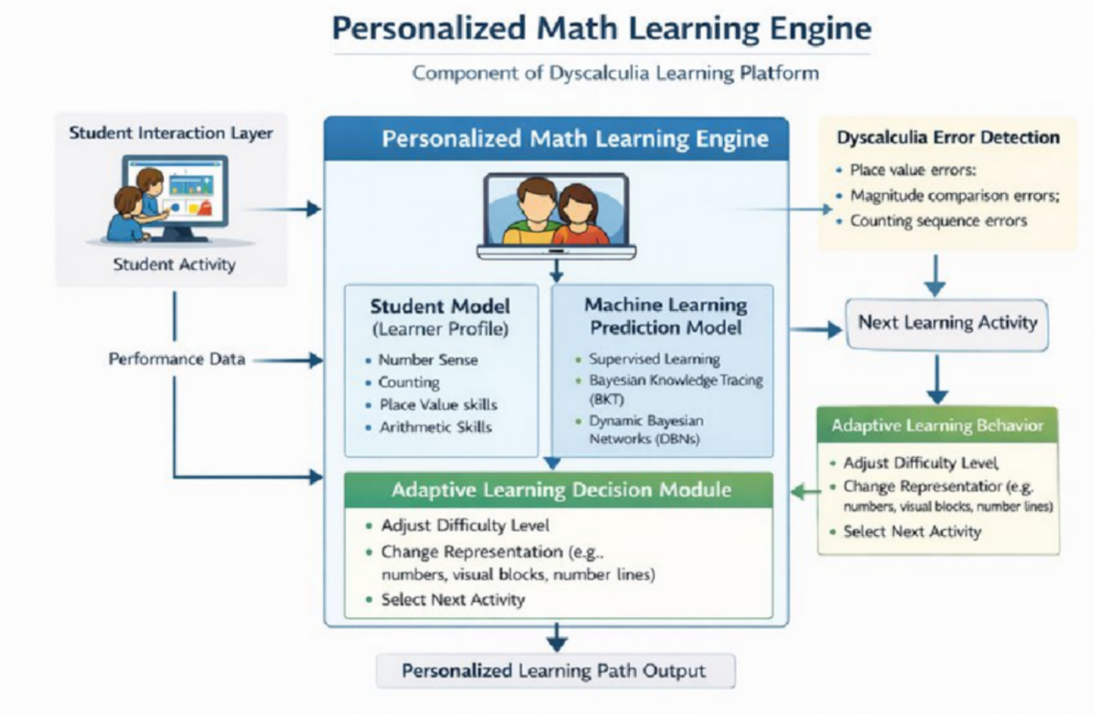






























































































Personalized Math Learning Engine
IT22224316 | Dhananjani G.A.U. | R26-IT-138

Slide 12


IT22136206 |NAVODYA K.M.I.G.T
Personalized Hint & Feedback Engine
Contribution of my component to the overall solution
Focuses on the Personalized Hint & Feedback Engine
Analyzes student errors and problem-solving steps
Identifies misconceptions such as place value or operation mistakes
Generates personalized hints based on student needs
Provides real-time feedback during problem solving
Helps students understand mistakes and improve step-by-step
Supports the system by enhancing learning accuracy and confidence for students with dyscalculia

Slide 13

Personalized Hint & Feedback Engine
Problem Definition
Some students with dyscalculia struggle with number and arithmetic concepts.
Traditional systems do not analyze the reasons behind mistakes.
Most apps only mark answers as right or wrong without explaining misconceptions.
Research Objective
Develop a Personalized Hint & Feedback Engine that analyzes student mistakes and provides real-time personalized hints to improve conceptual understanding.
Sub-Objectives
Analyze student interaction data (answers, response time, attempts).
Use machine learning (Decision Tree / Random Forest) to detect misconceptions.
Provide real-time personalized hints with visual and audio feedback.
Novelty
Uses machine learning to detect misconceptions and error patterns in real time.
Provides personalized multimodal hints (visual + audio) for students with dyscalculia.
IT22136206 | Navodya K.M.I.G.T |
R26-IT-138

Slide 14

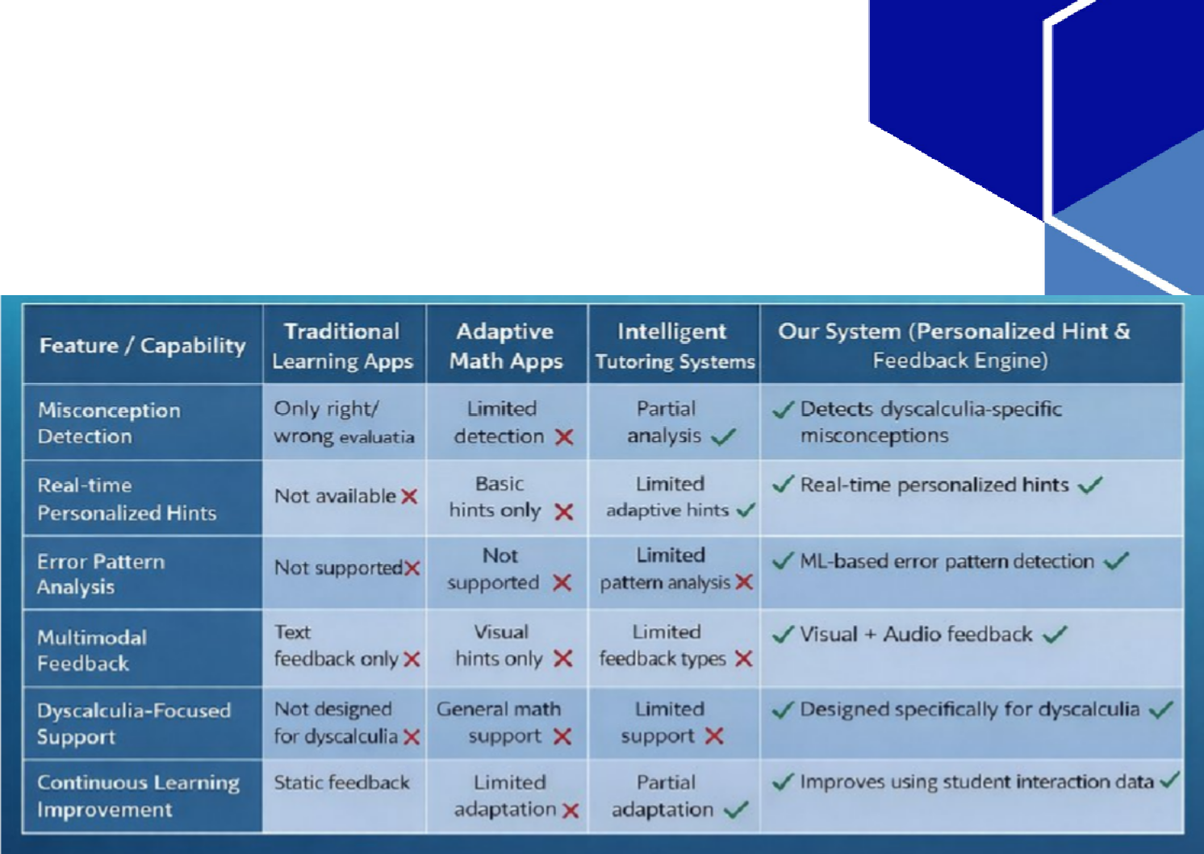


Personalized Hint & Feedback Engine
Knowledge Domain
Educational Data Mining
Machine Learning for Error Pattern Detection
Intelligent Tutoring Systems and Adaptive Feedback Research Methodology
System development and evaluation approach
Collect student interaction data from math learning activities
Analyze error patterns using machine learning models
Generate personalized hints based on detected misconceptions Latest Technologies Used
Decision Tree / Random Forest – classify dyscalculia-related error patterns
MongoDB – store learner interaction data and feedback history
React Native – mobile learning application Spring Boot – backend services and APIs
IT22136206 | Navodya K.M.I.G.T |
R26-IT-138

Slide 15


Personalized Hint & Feedback Engine
Validation and Evaluation
Measure improvement in student accuracy after hints
Evaluate ML model using accuracy, precision, recall, and F1-score
Analyze reduction in repeated mistakes
Data Availability
Student answers to math questions
Response time for each activity
Number of attempts per question
Error and feedback records
Security
HTTPS secure communication
Role-based user authentication
Secure data storage in MongoDB
Ethical Clearance
Parental consent required for student participation
Student data anonymized for privacy
Data used only for academic research
IT22136206 | Navodya K.M.I.G.T |
R26-IT-138

Slide 16


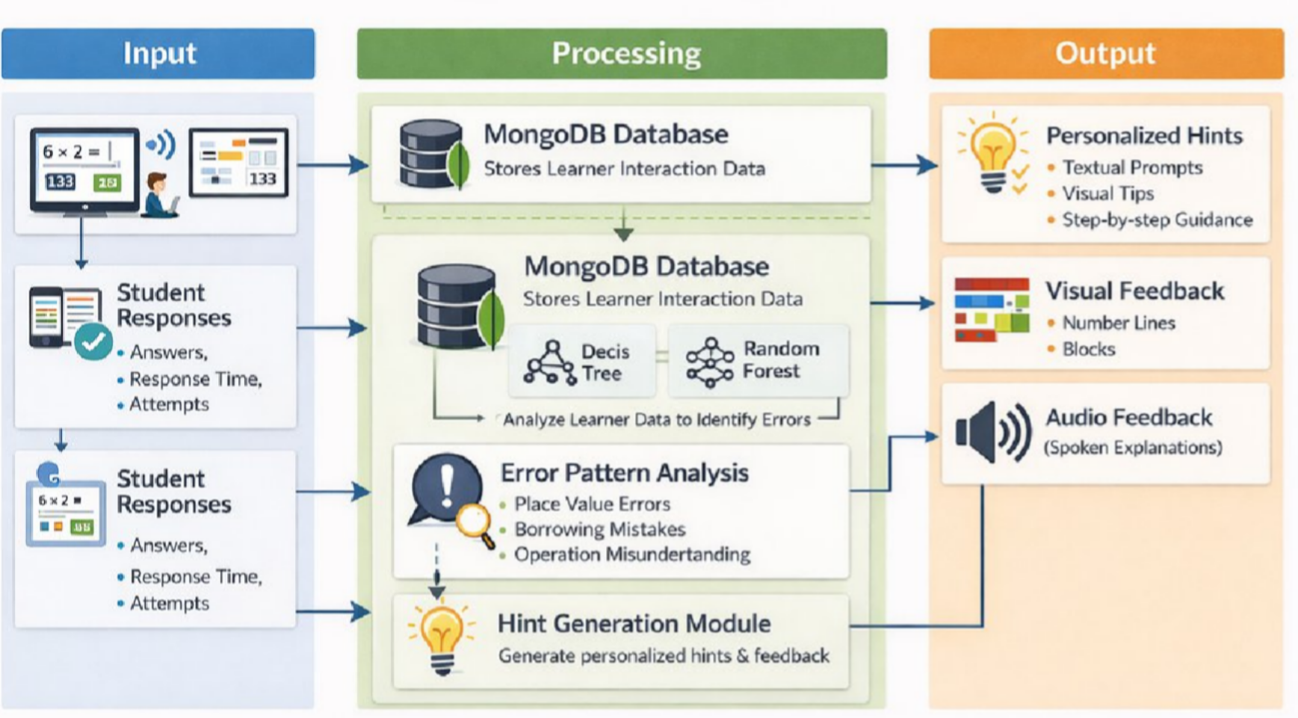

Personalized Hint & Feedback Engine
System Overview
Dependencies
Student Learning Interface – sends student answers and interaction data.
Learning Engine / Backend System – processes learner data and triggers feedback generation. Common Components
MongoDB Database – stores learner interaction data and feedback records.
Machine Learning Models – classify error patterns and detect misconceptions.
IT22136206 | Navodya K.M.I.G.T |
R26-IT-138

Slide 17

IT21275524 |RAKEESHA M.G.N
Learning Analytics & Early Warning Prediction Module

Slide 18






















































































































































































































































Learning Analytics & Early Warning Prediction Module
IT21275524 | Rakeesha M.G.N |
R26-IT-138

Slide 19
Learning Analytics & Early Warning Prediction Module
IT21275524 | Rakeesha M.G.N |
R26-IT-138

Slide 20
Learning Analytics & Early Warning Prediction Module
IT21275524 | Rakeesha M.G.N |
R26-IT-138

Slide 21
Learning Analytics & Early Warning Prediction Module
System Overview
Dependencies
Learning interaction dataset from mathematics learning application
Machine learning libraries for clustering and prediction
Common Components
Shared student learning dataset
Central database
IT21275524 | Rakeesha M.G.N |
R26-IT-138

Slide 22
IT22117878 |ALWIS L.P.M.
Parent Support & Home Practice Portal
Contribution of your component to the overall solution
Focuses on the Parent Support & Home Practice Portal
Connects school learning with home practice for continuous learning
Uses student data (progress, errors, engagement) to recommend personalized home activities
Provides simple, parent-friendly guidance using visual aids, audio, and step-by-step instructions
Helps parents identify and support children’s weak areas in mathematics
Collects home practice feedback and updates the main learning system
Enhances parental involvement in the learning process
Supports the overall system by reinforcing learning outside the classroom

Slide 23
Parent Support & Home Practice Portal
Problem Definition
Children with dyscalculia require consistent practice beyond the classroom
Many parents lack knowledge or resources to help children with math difficulties
Existing learning tools do not provide personalized home support
Research Objectives
Develop a Parent Support Portal that recommends personalized home practice activities based on student learning progress
Sub-objectives
Improve learning outcomes through continuous practice at home
Help parents support children with clear instructions and guidance
Novelty
Support for parents to assist children with dyscalculia at home
Parents receive visual guidance, simple instructions, and audio explanations
The system connects school learning with home practice
IT22117878 | ALWIS L.P.M | R26-IT-138

Slide 24
Parent Support & Home Practice Portal
Knowledge Domain
Learning Analytics in Educational Systems
Machine Learning–Based Recommendation Systems
Dyscalculia Intervention and Support Technologies
Research Methodology
Analyze student progress, error patterns, and response time
Generate personalized home practice recommendations using learning analytics
Integrate home learning activities with the main student learning system
Latest Technologies Used (with Justification)
Machine Learning Recommendation System – recommends personalized home practice activities based on student weaknesses
React / React Native – develops the interactive parent portal interface
Spring Boot – provides backend services and APIs to connect the learning system and parent portal
MongoDB – stores student learning data, activity results, and parent interaction data
Cloud-Based Data Synchronization – synchronizes school learning data with home practice activities
IT22117878 | ALWIS L.P.M | R26-IT-138

Slide 25
Parent Support & Home Practice Portal
Validation and Evaluation
Measure improvement in student performance after completing home practice activities
Track student learning
Security
HTTPS encrypted communication between parent portal and main learning system
Role-based user authentication for parents
and teachers
Evaluate parent engagement with the home practice portal
Secure storage of learning data in database
Ethical Clearance
Parental consent required for student participation
Student personal information anonymized for research analysis
Data used only for educational and
Data Availability
Home practice activity completion records
Student response time and activity
attempts
Error patterns and learning progress history
academic research purposes
Compliance with ethical guidelines for
research involving children
IT22117878 | ALWIS L.P.M | R26-IT-138

Slide 26
Parent Support & Home Practice Portal
System Overview
Dependencies
Machine Learning Recommendation Engine – generates personalized home practice activities
User Authentication System – manages secure login for parents and teachers
Common Components
Cloud / Backend Server – Manages data storage, processing, and synchronization between system modules.
Mobile Interface – Provides an accessible platform for parents to interact with the portal.
IT22117878 | ALWIS L.P.M | R26-IT-138

Slide 27
Ability of Commercialization
Investment / Cost
Target Market
Primary schools and special education centers
EdTech platforms
Parents of Grade 2–3 students with dyscalculia
Customer Profile
Teachers identifying learning difficulties early
Parents supporting math learning at home
Value Proposition
AI-based system for misconception detection and personalized hints
Improves student confidence outcomes
Development Cost
Labour (software and ML development)
Cloud hosting and database
System maintenance
Revenue / Pricing Model
Subscription for schools
Freemium model for parents
Institutional licensing
Intellectual Property (IP)
ML models and algorithms
System design and architecture
Software copyright protection
and learning

Slide 28
Interactive Learning Tool for Dyscalculia kids
Gantt Chart

Slide 29
Interactive Learning Tool for Dyscalculia kids
•Work breakdown structure

Slide 30
THANK YOU

