Slide 1

PROGRAMMIG INDIVIDUVAL PROJECT
Web Application For Salon Management System
ANU/IT/2021/F/11
M.T.T.M.Sewwandi
2nd Year 2nd Semester

Slide 2

Content
Introduction
Aim & Objectives
Tools & Technologies
Modules
Achievement

Slide 3
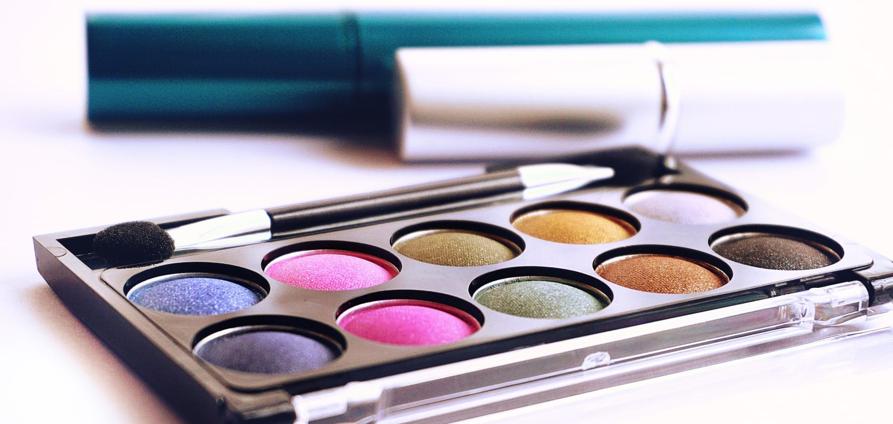
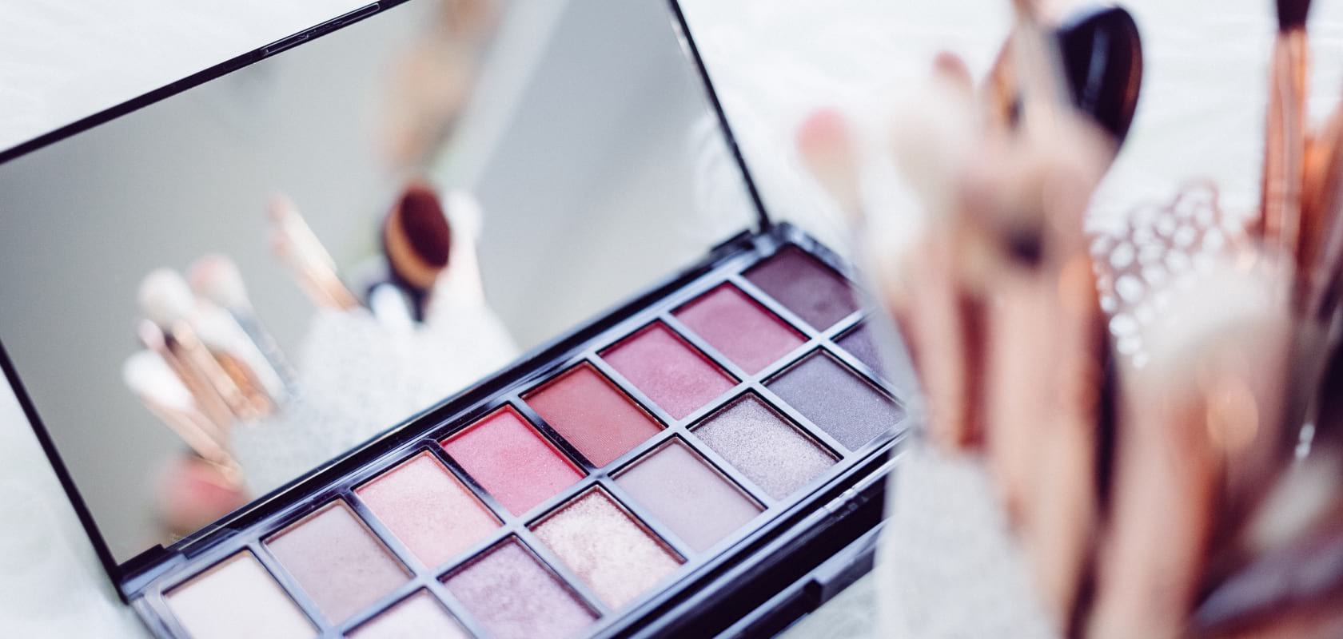
Introduction
This Beauty Salon Management System is a web based application. It is a dynamic and responsive website for Beauty culture business Indestry .

Slide 4

The aim of this project is to design and implement a user-friendly salon management system that
addresses the inefficiencies of traditional appointment booking methods and enhances overall
operational effectiveness in the beauty industry.
Objectives
Attract potential customers
Provide customer support
Ensure website security

Slide 5

Tools & Technologies
Using Technology
HTML
CSS
Java Script
PHP
Mysql
Used Tools
Sublime Text
Xampp server
Web Browsers

Slide 6
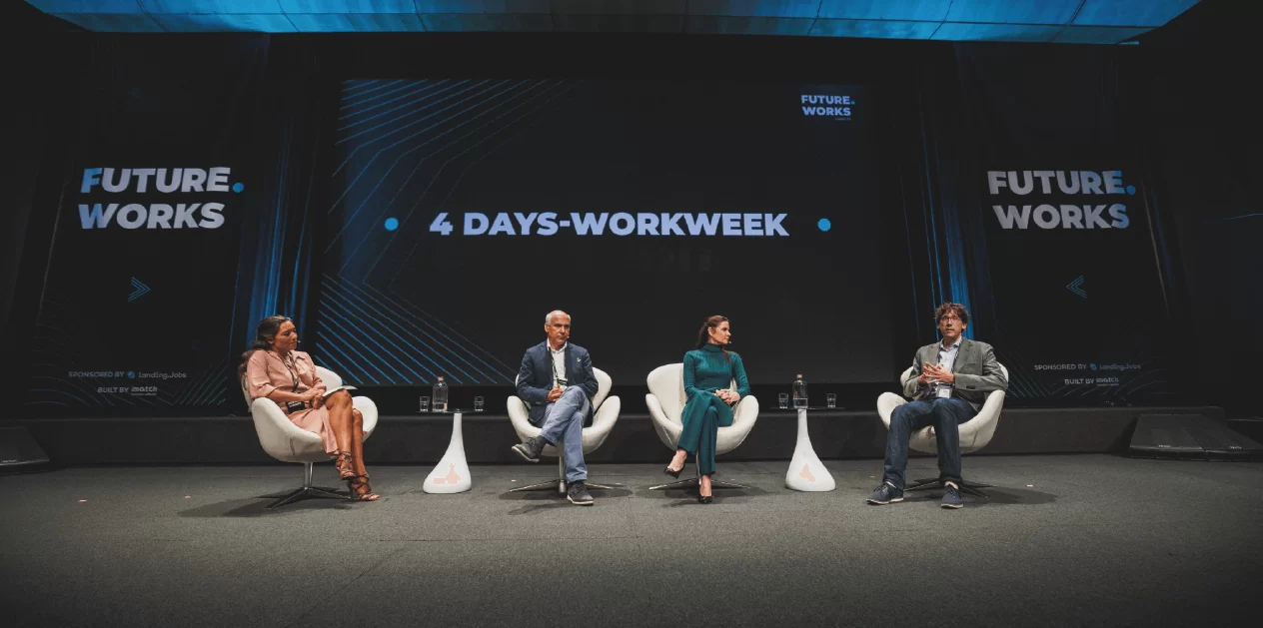
Achievement
Complete the project successfully

