Slide 1

B.TECH MINOR PROJECT
FINAL REVIEW
15/10/2026
SAINTGITS
COLLEGE OF ENGINEERING
(AUTONOMOUS)
LEARN . GROW . EXCEL

Slide 2
KINETIQ
SAINTGITS
COLLEGE OF ENGINEERING
(AUTONOMOUS)
RTOS-Based IoT Healthcare Assistant with Sensor-Grounded Voice AI
‘Mirror, Mirror’ — the wellness mirror that sees, listens and answers
PRESENTED BY:
Sidharth Sajith
Tharun Oommen Jacob
Shahazad Abdulla
SUPERVISOR:
Er. Jittu George Eapen
Assistant Professor
Department of Electronics Engineering
LEARN . GROW . EXCEL

Slide 3
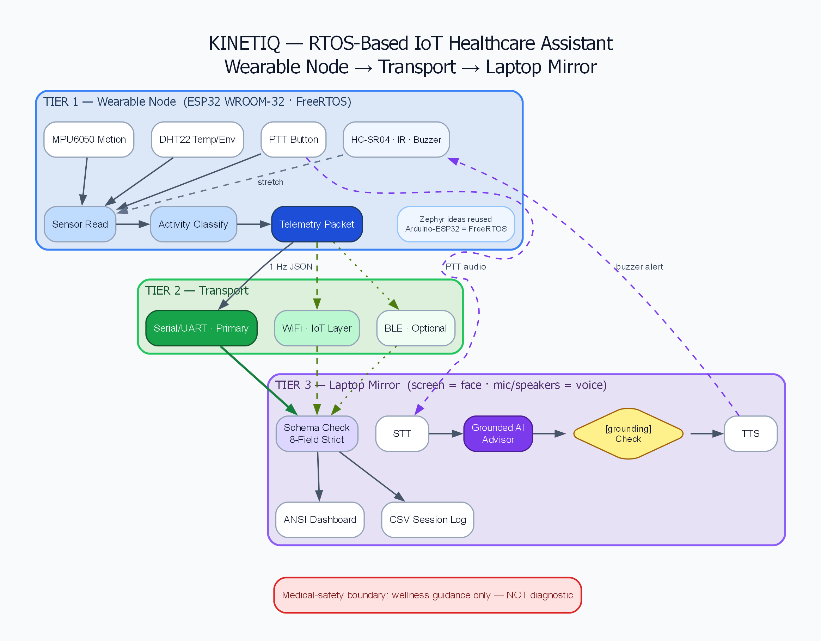
PROBLEM STATEMENT
Limited access to live data: Health and activity information is often difficult to integrate into custom applications.
Generic AI responses: Voice assistants may provide advice without considering the user's current sensor data.
Poor posture awareness: Prolonged sitting and incorrect posture may go unnoticed during study or work.
Lack of integration: A practical solution must combine embedded sensing, real-time processing, IoT communication and voice interaction.
Our approach: Develop a wellness assistant that uses sensor data to provide contextual feedback and simple posture reminders.
Scope: Wellness assistance only, not medical diagnosis.
System at a glance — sensing node to mirror. Full diagram in METHODOLOGY.
LEARN . GROW . EXCEL
SAINTGITS COLLEGE (AUTONOMOUS)

Slide 4
OBJECTIVES
1. Real-Time Embedded System
Implement FreeRTOS tasks and queues for organised sensor processing on the ESP32.
2. Sensor Integration
Combine motion, distance and environmental sensors to observe activity and surrounding conditions.
3. IoT Data Communication
Transfer structured telemetry to a laptop dashboard for live monitoring and data logging.
4. Sensor-Grounded Voice Assistant
Integrate speech recognition, an AI language model and speech synthesis, with a check that responses are supported by available sensor data.
5. User Feedback
Provide posture reminders and contextual wellness information through voice and visual feedback.
LEARN . GROW . EXCEL
SAINTGITS COLLEGE (AUTONOMOUS)

Slide 5
METHODOLOGY
SENSE
MPU6050·DHT22·sonar·cam
➔
PROCESS
queues·validate
➔
INFER
posture·rules
➔
COMMUNICATE
serial·WiFi·CSV
➔
ASSIST
voice·buzzer
1. SENSE
Collect motion and environmental data using sensors connected to the ESP32. Webcam-based posture analysis is an additional laptop-side component.
2. PROCESS
Use FreeRTOS tasks and queues to organise sensor processing and prepare structured telemetry.
3. INFER
Apply activity and posture rules to interpret sensor readings and identify conditions that may require attention.
4. COMMUNICATE
Send telemetry to the laptop dashboard for monitoring and CSV logging.
5. ASSIST
Use speech recognition and an AI language model to generate a response, verify its grounding in the available telemetry, and provide feedback through speech or a buzzer.
Processing split: The ESP32 handles embedded sensing and real-time tasks, while the laptop handles the dashboard and computationally intensive voice AI.
LEARN . GROW . EXCEL
SAINTGITS COLLEGE (AUTONOMOUS)

Slide 6
DEMO — WHAT WORKS
$ dashboard --source stdin
dashboard: received=75 dropped=0
$ assistant "how am I doing?"
[grounding] PASS — cites live HR + posture
[llm] reply via ollama (gemma2:2b) — grounding PASS
$ ble bridge
ble: packets_routed=30 schema_rejected=0
$ voice pipeline
voice: stt→llm→tts pipeline OK
1. Live Dashboard
Displays incoming telemetry and records session data in CSV format.
2. AI Assistant
Answers user queries using available telemetry as context.
3. Response Verification
Checks whether an answer is supported by the available data. Unsupported responses are rejected.
4. Voice Pipeline
Integrates speech-to-text, AI response generation and text-to-speech.
5. RTOS Simulation
Demonstrates FreeRTOS-based firmware and structured telemetry output in a simulated ESP32 environment.
Demonstration flow: Telemetry → Dashboard → User Query → Grounding Check → Response
Note: Laptop-side features and firmware simulation are demonstrated separately; full physical sensor-to-assistant integration remains under development.
LEARN . GROW . EXCEL
SAINTGITS COLLEGE (AUTONOMOUS)

Slide 7
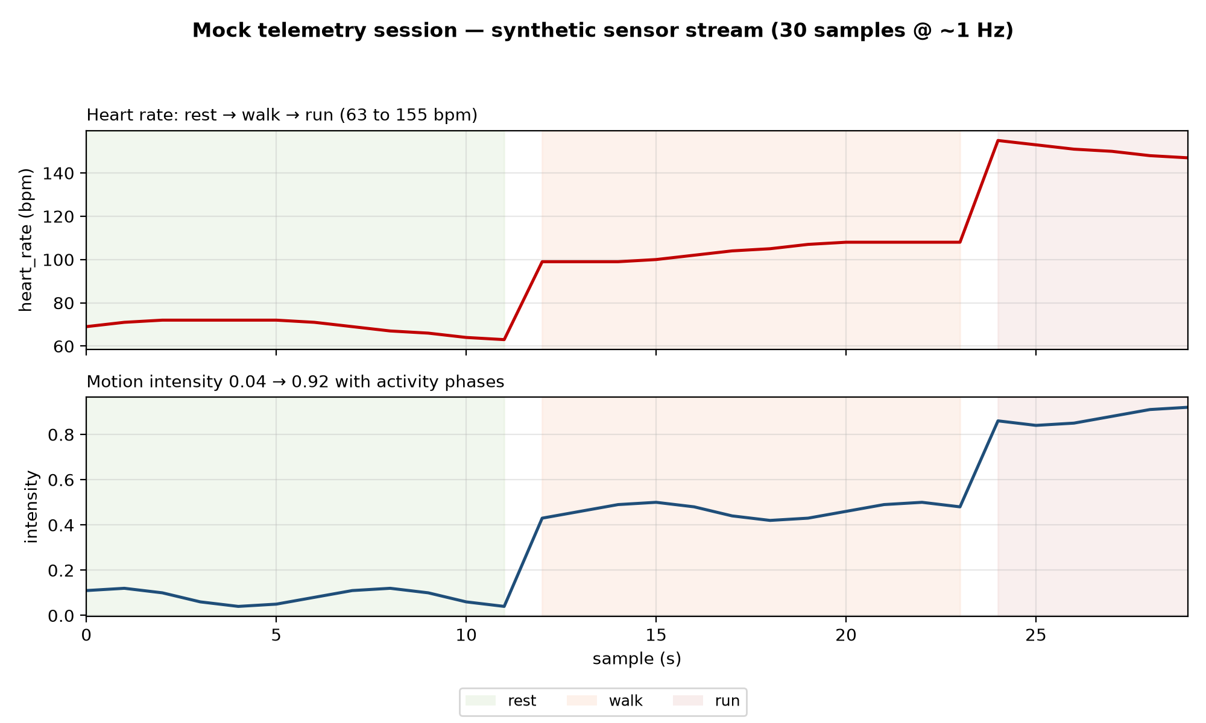
RESULTS
Telemetry Simulation
Processed 30 simulated samples at approximately 1 sample per second.
Heart-rate values varied from 63 to 155 BPM across simulated activity stages.
Motion intensity increased from 0.04 to 0.92.
Data Validation
Implemented strict validation of an eight-field telemetry format.
Invalid packets are rejected with logged reasons.
Communication and Logging
Dashboard tracks received and dropped frames.
The mock BLE client tracks routed and rejected packets.
Voice Assistant
Measured speech-recognition time: 0.48 seconds per synthetic audio clip.
Grounding verification rejects unsupported responses before they are spoken.
Result: The laptop-side software pipeline and simulated telemetry workflow have been demonstrated. Physical sensor validation is a remaining development step.
LEARN . GROW . EXCEL
SAINTGITS COLLEGE (AUTONOMOUS)

Slide 8
HARDWARE & BOM
# | ITEM | QTY | ₹ | STATUS
1 | ESP32 DevKit V1 WROOM-32 (headers pre-soldered) | 2 | 998 | Ordered
2 | Micro-USB data cables (drawer check first) | 2 | 0–300 | Ordered
3 | 830-pt breadboard + M-M jumper kit | 1 | 499 | Ordered
4 | MPU6050 + HC-SR04 + IR combo (headers soldered) | 1 | 470 | Ordered
5 | DHT22 module (built-in pullup) | 1 | 309 | Ordered
6 | F-F jumper 20-pack + tact buttons + caps + buzzer | — | 205 | Ordered
 | TIER-A TOTAL |  | ≈1,950 | Design-complete
Software and development tools
FreeRTOS on ESP32
Wokwi for firmware simulation
Python for the dashboard and data logging
Speech recognition, local language model and speech synthesis for voice interaction
Current status: Hardware design and pin mapping are prepared. Components have been ordered; physical hardware bring-up and sensor validation are pending.
Safety: Sensor values are wellness estimates, not clinical measurements.
LEARN . GROW . EXCEL
SAINTGITS COLLEGE (AUTONOMOUS)

Slide 9
ROADMAP & THANK YOU
DAY | GATE | STATUS
12 Oct | Idea confirmed · order placed · Wokwi blink tonight | ✓ done
13 Oct | Firmware hardware-agnostic · bridge · backup video | ✓ done
14–15 | Board arrives · serial JSON to dashboard | → next
16 | I2C sensors live · figures + wiring | → next
17–18 | WiFi layer (soft-AP fallback ready) | → next
19–20 | Audio cut/go · serial demo FROZEN | → next
21–22 | Report · rehearse · PRESENT | → next
Completed
Laptop dashboard and CSV logging
Mock telemetry processing and validation
Sensor-grounded AI assistant
Speech recognition and response pipeline
FreeRTOS firmware simulation
In Progress
Physical ESP32 setup and sensor integration
Serial telemetry connection to the dashboard
End-to-end system testing
Next Steps
Verify real sensor readings and communication reliability
Integrate the physical sensing node with the laptop
Test posture alerts and voice responses using live data
Complete system validation, documentation and final demonstration
Expected outcome: An integrated prototype demonstrating embedded sensing, real-time processing, IoT data transfer and sensor-grounded voice interaction.
LEARN . GROW . EXCEL
SAINTGITS COLLEGE (AUTONOMOUS)

Slide 10

THANK YOU
LEARN . GROW . EXCEL

