Slide 1



Know Your Pet
Neural Networks
Individual Project

Slide 2



Topic Outline
INTRODUCTION TO CNN
CODE DEMOSTRATION
CONCLUSION

Slide 3

Introduction

Slide 4
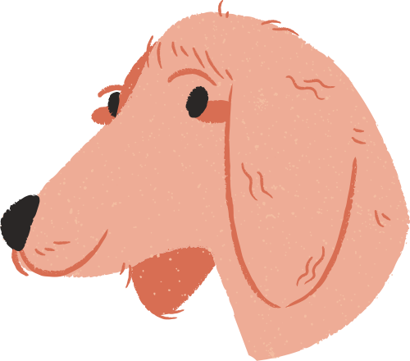
Introduction
This CNN model contains a basic classification of real images of cats and dogs. Real-world images contain more sophisticated information, and their aspect ratios and different shapes will be taken into account when creating the model and data set.

Slide 5
Methodology
1.First, build the CNN, prepare the images with ImageGenetrator
2.calculate or examine the results.
3.Then Build and train the neural network to classify between two pets. After that training, check the validation accuracy.

Slide 6
Dataset Details
The data set that was used is the Cats and Dogs data set, which is a subset of the Dogs vs. Cats dataset available on Kaggle. The used data set includes 2000 of the total data set. However, the original data set contains 25000 images; due to training time constraints, only taken a subset of them

Slide 7
Data Preprocessing Techniques
1.Rescaling pixel values
2.Generating batches of images and labels
3.Resizing images to a specified size.

Slide 8
Hyperparameters Used &Why ?
This model is using the fit method to train the model on the training data using the train_generator and the validation data using the validation_generator. The fit method has several hyperparameters that can be set, including
Epochs
Batch size
Verbosity
Class mode

Slide 9
Result &Findings

Slide 10
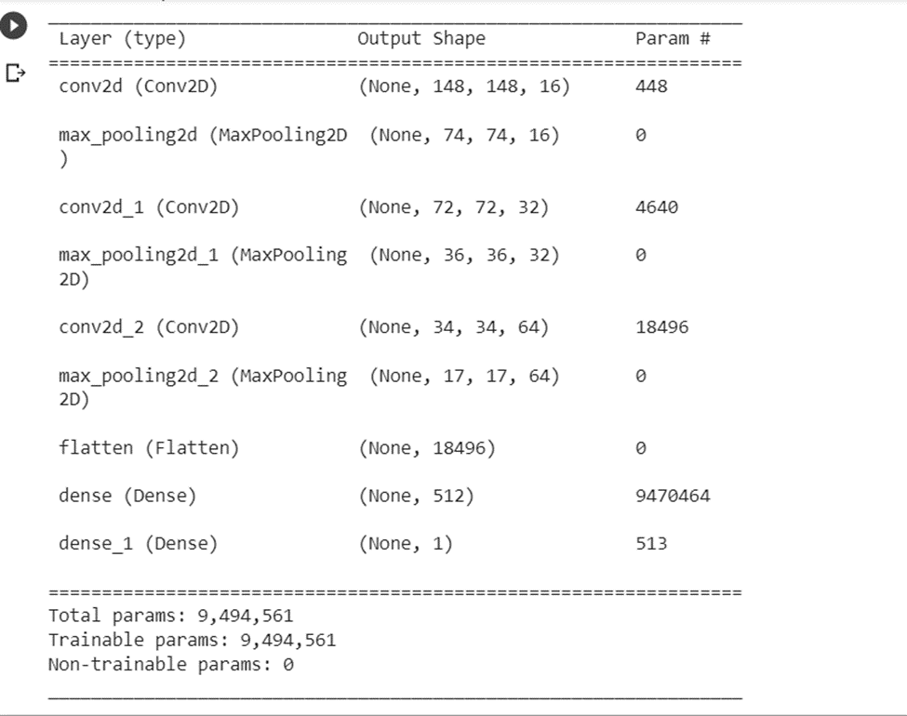

Slide 11
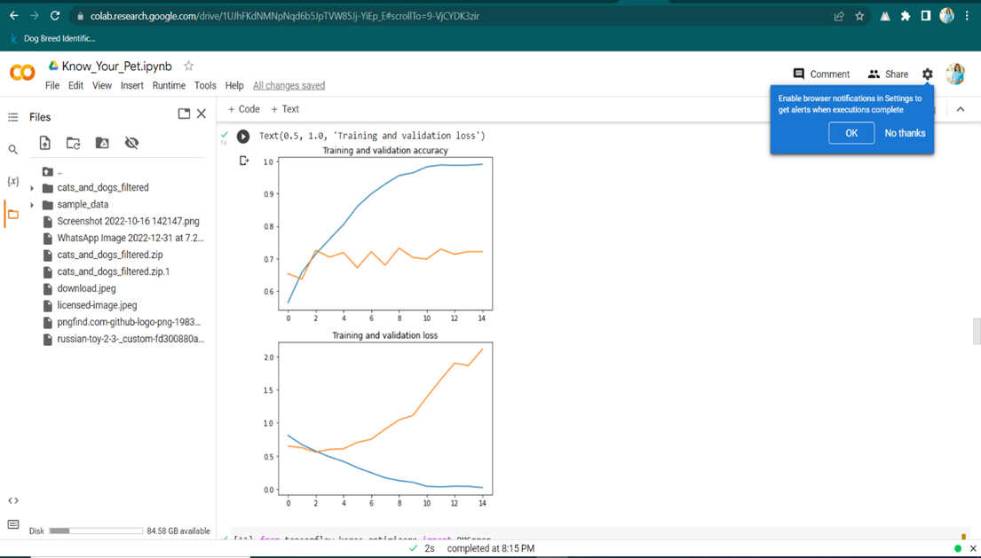

Slide 12

Demostration

Slide 13
Conclusion
Based on the plots of training and validation accuracy and loss, it appears that the model is performing well, as the training and validation metrics are relatively close to each other and show an upward trend over the course of the training epochs. This suggests that the model is not overfitting to the training data, and is able to generalize to unseen data. However, it may be worthwhile to explore further techniques, such as adding more data or using regularization, to see if the model can be further improved
Vaccine No. 1
Vaccine No. 2

Slide 14
Thank you
LET'S KNOW YOUR PET

