Slide 1
AUDIO CLASSIFICATION BY ARTIFICIAL NEURAL NETWORKS
THASNEEM FATHIMA M
2021503055
MADRAS INSTITUTE OF TECHNOLOGY

Slide 2
AGENDA
Problem Statement
Project Overview
Who are the End users?
Solution
Proposed Model
Results

Slide 3
PROBLEM STATEMENT
Many deaf people suffer a lot as they cannot interact with the outside world and their relationship with the environment is not like we all have.
So, there is a need for deaf individuals to comprehend the sounds around them and obtain a summary of voices and sounds in their environment.
In the field of music, there is a need to classify the music clips to identify the genre of the music for good composition.
It could also be used for classifying short utterances by a set of speakers to identify the speaker based on the voice.

Slide 4
PROJECT OVERVIEW
The dataset contains 8732 labelled sound excerpts (=4s) of urban sounds from ten categories: air for audio prediction, car horns, children playing, dog barking, drilling, engine idling, gunshots, jackhammers, sirens, and street music are used for audio prediction.
Basic data preprocessing and feature extraction on audio signals is done.
Model training is done using ANN and evaluated based on accuracy.
Prediction is performed using a sample audio.

Slide 5
END USERS
Deaf people – To know what is the voice around them.
Musicians – To identify the genre of the music.
Speakers – To identify the speaker based on the voice.
Healthcare Professionals – To diagnose hearing conditions of patients and to know their progress.

Slide 6
SOLUTION
Feature extraction and preprocessing is performed in the audio file dataset to create a data frame and a pickle file which ensures easier and faster analysis.
Model training by ANN for improved accuracy and faster execution.
An audio file is given as input to the trained model.
The application is able to predict the class of the audio at lesser time (4s).

Slide 7
PROPOSED SYSTEM
Artificial neural networks -> ANNs are made up of node layers, each of which has an input layer, one or more hidden layers, and an output layer. Each node, or artificial neuron, is linked to another and has its own weight and threshold. If the output of any individual node exceeds the specified threshold value, that node is activated and begins sending data to the network's next layer. Otherwise, no data is passed to the next network layer.
Importing the Dataset, Data Preprocessing
The dataset is obtained from UrbanSound8K, which contains over 8500 data files containing various audios such as a baby crying, birds sound, dog bark, and many others in the form of .wav files.
It is divided into ten folders, indicating that the dataset has ten classes as described in the dataset section. Libraries that are required are added, as well as Librosa for feature extraction.

Slide 8
PROPOSED SYSTEM
Feature Extraction and Database Building
Data obtained by using librosa is used because we require data in numeric format.
Features extractor function is defined and passed in the path to the audio file as a parameter, after which we will extract the audio features using librosa.
The feature_extractor function is applied to all rows, and the results are stored in a dataframe with features and class columns for further calculations.
Building, Training, Compiling ANN
Dataframe's feature is used and class columns to x and y arrays, respectively.
The y array is then converted to categorical values using the Labelencoder() method.
The data was then divided into test and training sets.
Based on the architecture diagram, model is designed, compiled, and fit the ANN model.

Slide 9
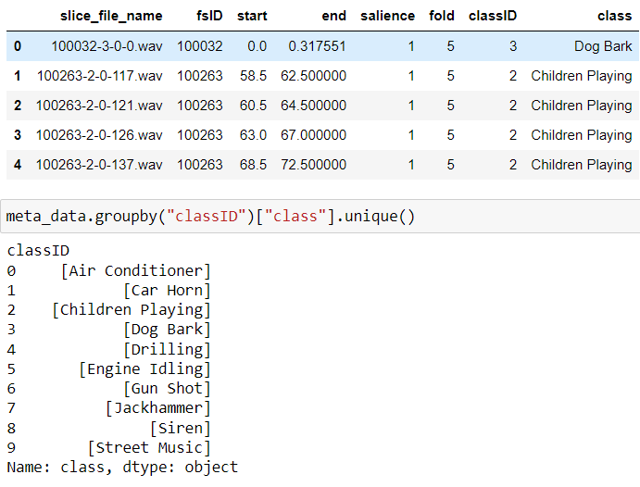
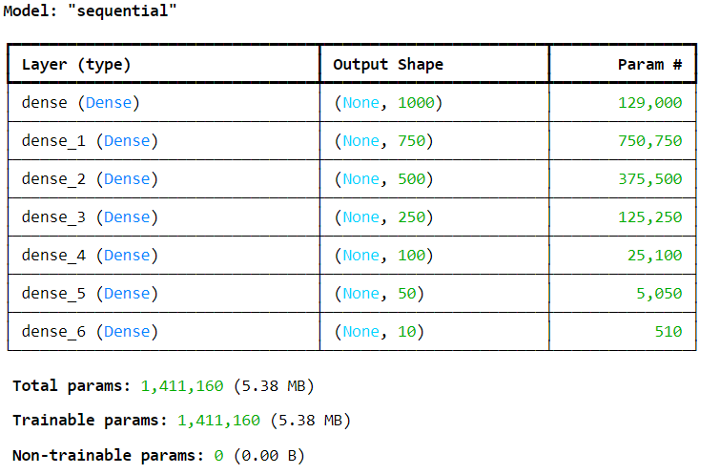
RESULTS
Data
Constructed ANN Model

Slide 10
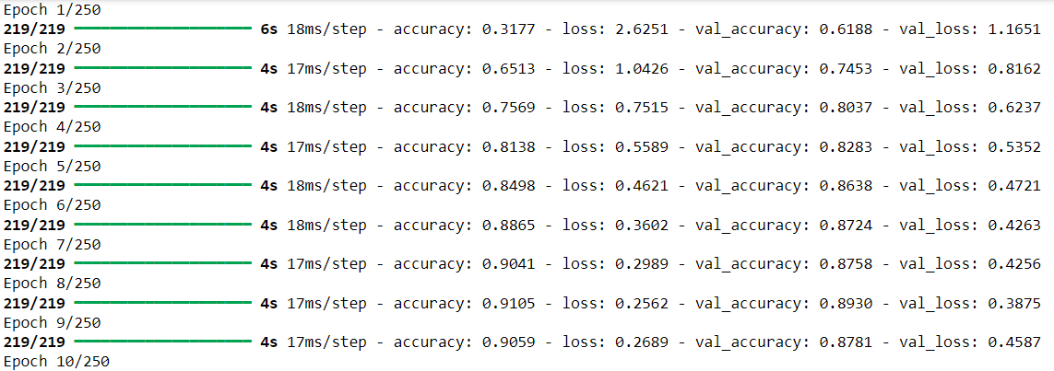
RESULTS
Model Training

Slide 11
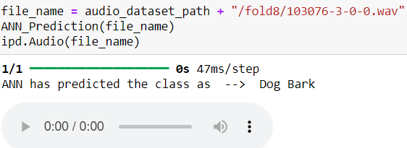
RESULTS
Sample prediction

