Slide 1
DEPRESSION DETECTION USING SOCIO-DEMOGRAPHIC FACTORS AND PSYCHOSOCIAL FEATURES.
Thasneem Vazim

Slide 2
Objectives of Study 1
Extract the most important PSYCHO-SOCIAL FACTORS that contribute to depression.
To detect how feature extraction methods can increase the accuracy of the classifiers.
The main focus of this work is not only to correctly classify users into depressed or non-depressed, we were also able to predict the level of depression the users belongs to. ie,
No depression
Borderline depression
Mild depression
Moderate depression
Severe depression

Slide 3
Dataset description
The responses are scaled between 1 and 4 and are coded as:
Number
Coded as:
Number | Coded as:
0 | Not at All
1 | Somewhat
2 | Moderately
3 | A lot
This questions for the survey was collected with an on-line version of Burns Depression Scale[1]
In total, 218 instances were collected through the questionnaires distributed via google forms.
The dataset consists of 15 questions taken from the Burns Depression Scale.
The data has been taken from the students in TKM College of Engineering from an age group of 18-25.
The classes were assigned as per the total score as given below:
Total score | Degree of depression
0-4 | Minimal or no depression
5-10 | Borderline depression
11-20 | Mild depression
21-30 | Moderate depression
31-45 | Severe depression

Slide 4
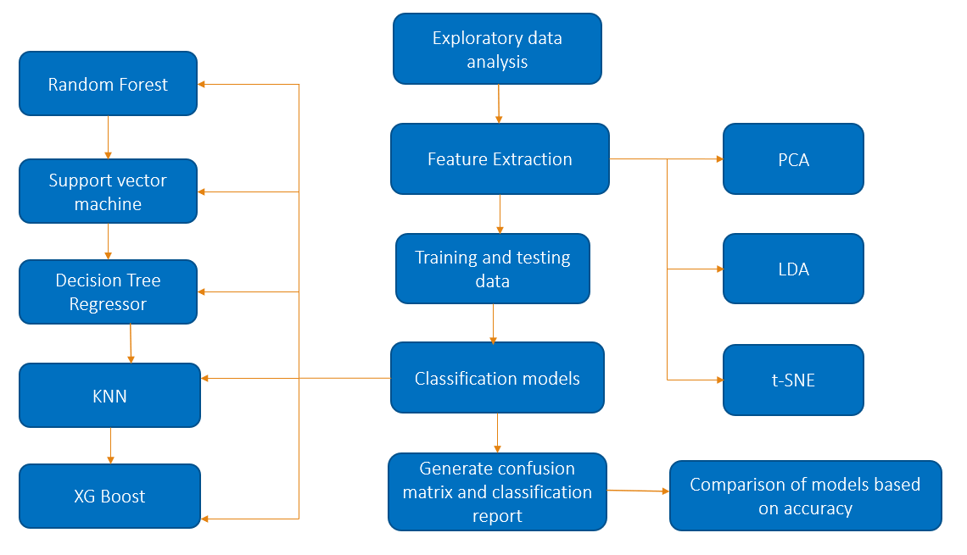
Framework

Slide 5
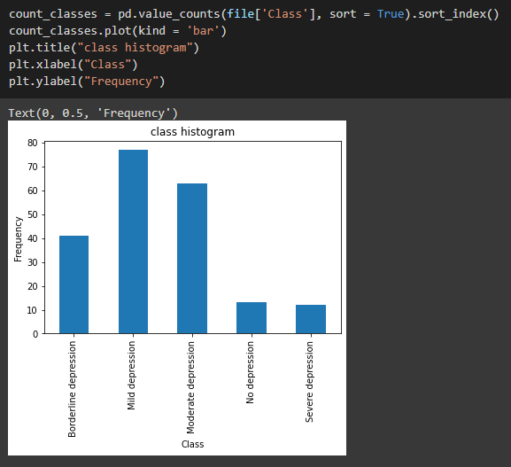
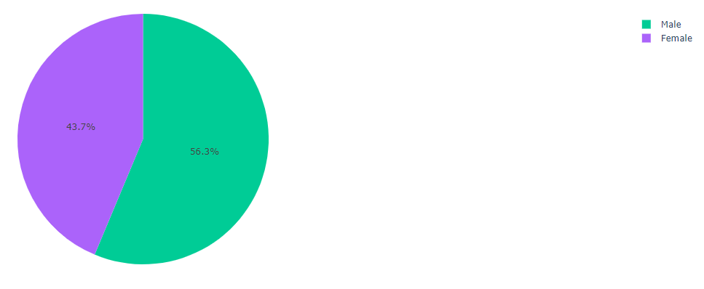
Implementation
Class distribution
Gender distribution

Slide 6
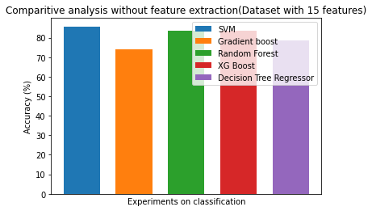
Without feature extraction

Slide 7
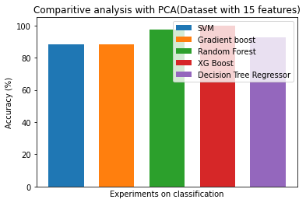
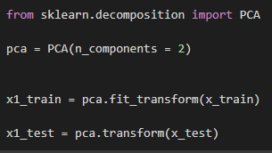
Principal component analysis

Slide 8
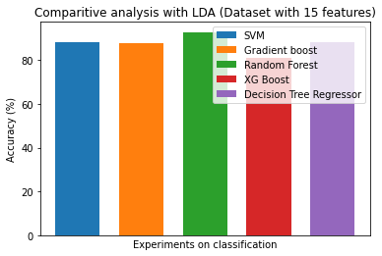
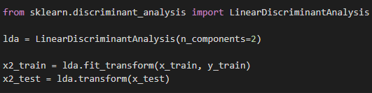
Linear discriminant analysis

Slide 9
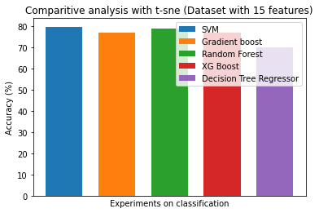
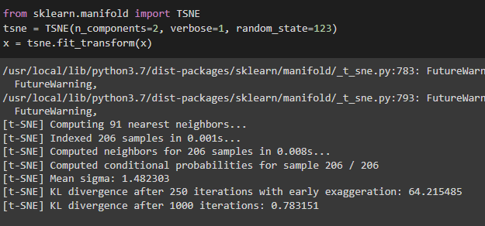
T-distributed Stochastic Neighbor Embedding (t-SNE)

Slide 10
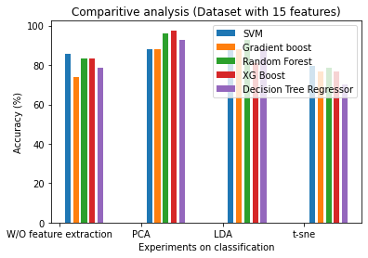

Slide 11
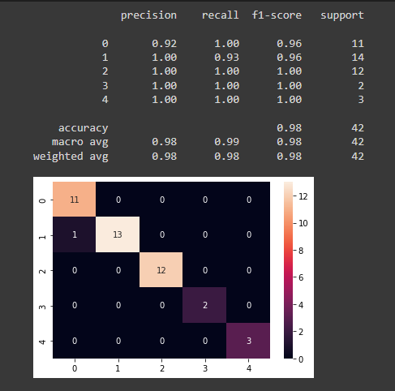
Conclusion
This study has not only categorized a person as depressed or non depressed but also assigned the level of depression.
The XG Boost with PCA dimensionality reduction technique showed the best performance with an accuracy of 97.61%.

Slide 12
Limitations
This study has only considered psychosocial factors responsible for forming depression.
Different Sociodemographic features play a significant role in predicting depression in an individual.
By including these biological factors, the model could predict depression more efficiently.
The participants felt somewhat reluctant to give the required information of this study to detect depression.

Slide 13
Objectives of study 2
Extracting the most important socio-demographic and psychosocial factors responsible for forming depression.
Generation of a dataset including the socio-demographic and the psychosocial information of the persons to predict depression.
Exploring different machine learning and feature selection algorithms to screen the existence of depression efficiently.
To make the suspected depressed person feel less hassle to give the required information of this study to detect depression.

Slide 14
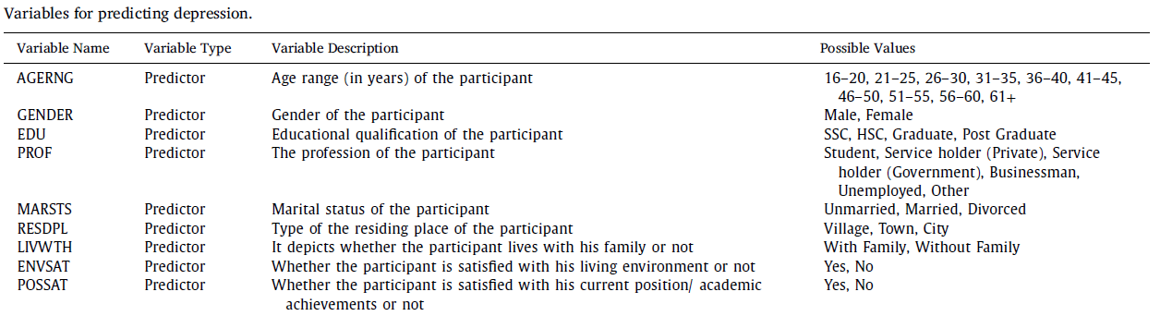
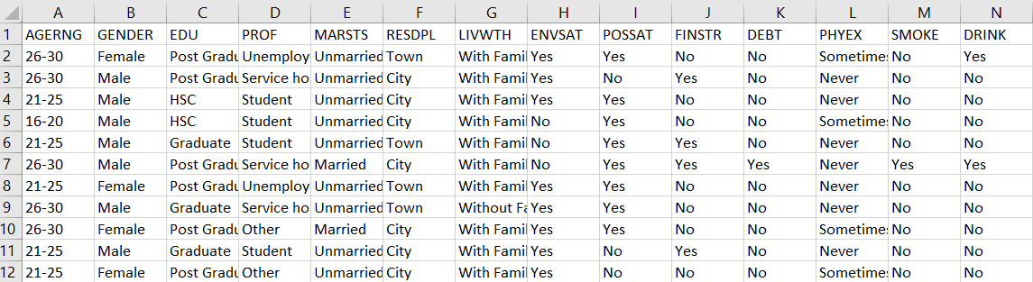
Dataset description
The dataset[1] is taken from: https://github.com/ Sabab31/Depression-Repository.git
Responses for 55 questions were collected.
The first 30 questions were designed for collecting psychosocial, and socio-demographic data of the participants.
The last 25 questions were taken from the Burns Depression Checklist (BDC).
Table 1: Variables for predicting depression.
Table 2: Screenshot of the Depression repository dataset

Slide 15
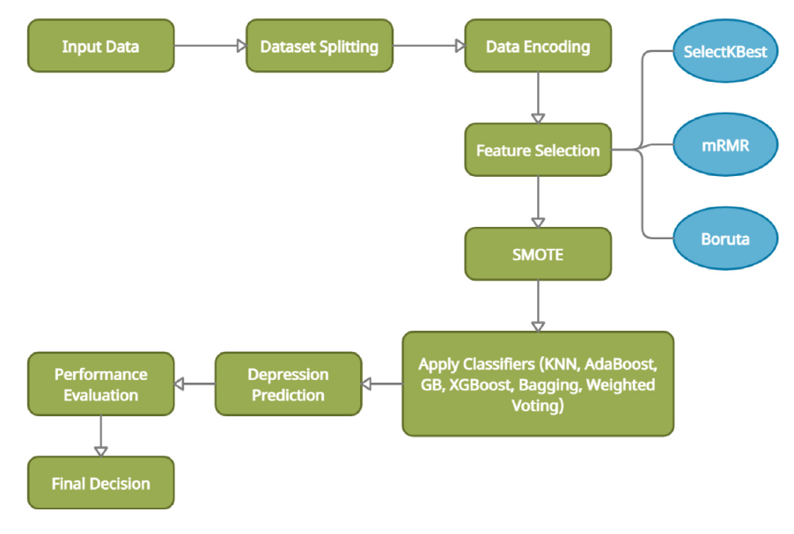
ARCHITECTURE

Slide 16
Implementation
a) Dataset splitting
Firstly, the obtained dataset has been split into training and test data.
This work has used 80% data of the dataset as training data and the rest 20% data of the dataset has been used for testing purposes.
b) Data encoding
In the Data Encoding step, the categorical data of the training and test datasets have been converted into their numeric counterpart using the Label Encoder of the Scikit-learn library.

Slide 17

Apply Synthetic Minority OverSampling Technique(SMOTE) on training data
Training a classifier with an imbalanced dataset leads to biased and inaccurate predictions.
In the training datasets, the percentages of de- pressed and not depressed participants are 66.87% and 33.13%, respectively.
As the training datasets are highly imbalanced, SMOTE has been used to remove their class imbalance problem.
Scenario | Depressed(%) | Not depressed(%) | Total(%)
Before SMOTE | 66.87 | 33.13 | 100
After SMOTE | 50.00 | 50.00 | 100

Slide 18
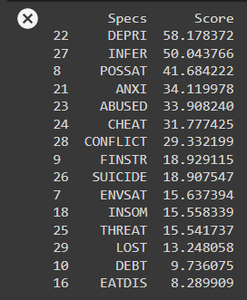
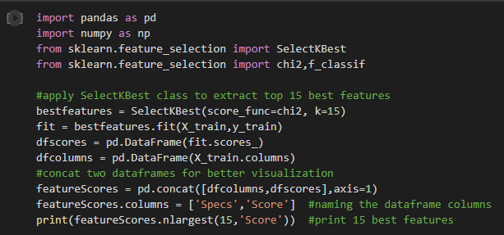
Select K-Best
Select K-Best (SelectKBest) feature selection technique is univariate in nature.
Using different univariate statistical tests, it selects K-best features from the feature set.
This study used chi-square ( 𝜒2 ) test-based method to select K-best features.

Slide 19
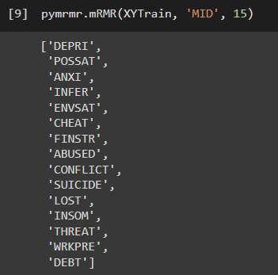
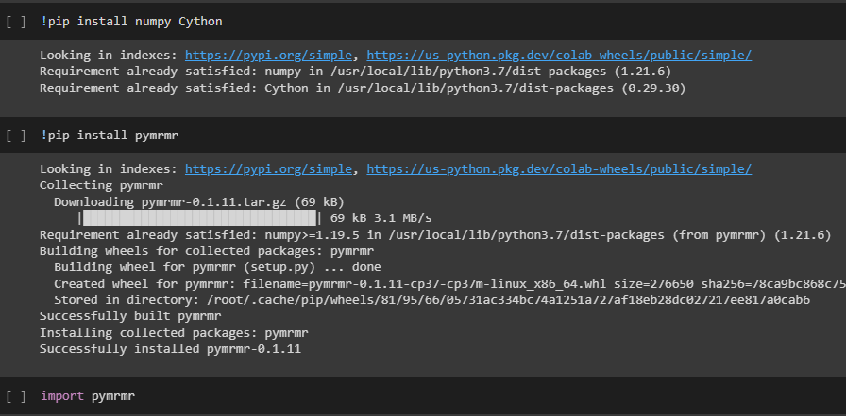
MRMR
This algorithm tends to select a subset of features having the most correlation with the class (output) and the least correlation between themselves .
It ranks features according to the minimal-redundancy-maximal-relevance criterion which is based on mutual information.
(Minimum redundancy maximum
relevance)

Slide 20
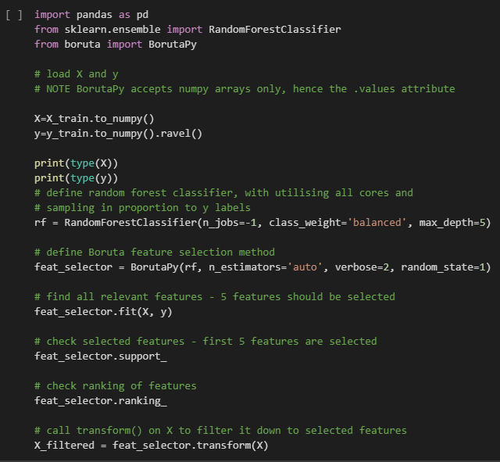

Boruta Algorithm

Slide 21
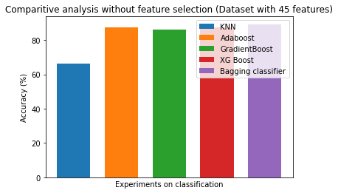
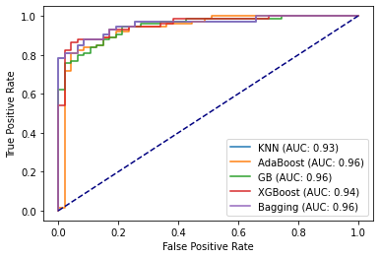
Without feature selection

Slide 22
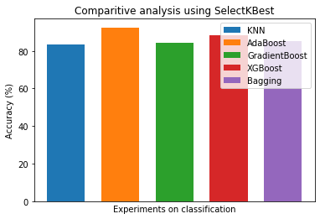
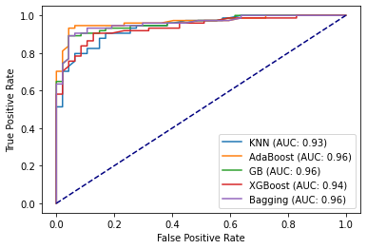
Comparative analysis using SelectKBest

Slide 23
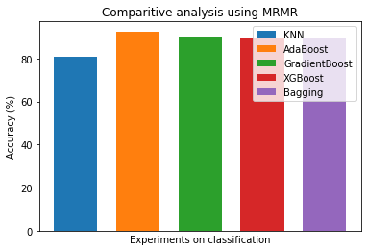
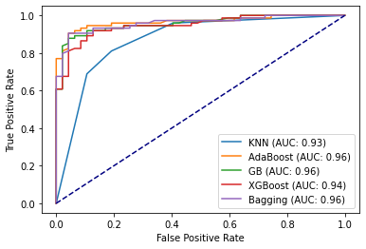
Comparative analysis using MRMR

Slide 24
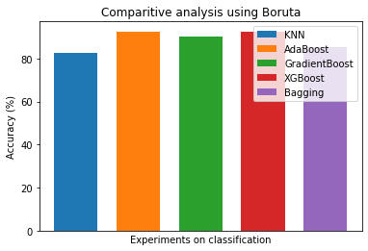
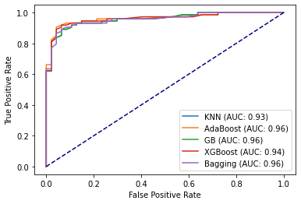
Comparative analysis using Boruta

Slide 25
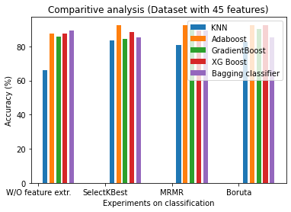

Slide 26
Conclusion
This study has taken data from Bangladesh citizens.
It has tried to find out the most common factors that cause depression.
Different feature selection techniques have extracted the most important demographic, and psychosocial factors responsible for forming depression.
These feature selection techniques have not only boosted the training speed of the classifiers but also helped the classifiers to screen depression more precisely.
Adaboost classifier with SelectKBest feature selection technique has shown the highest accuracy of 92.56%.
This model has also attained the highest AUC value of 0.96.

Slide 27
Limitations
This work has only predicted the presence of depression in individuals.
In the future, this study can be extended to identify the severity of depression in a person.
As various biological factors have a remarkable impact on forming depression among the persons, different biological aspects of the participants can be included in the latter study.
Several studies indicate that using different dimensionality reduction algorithms on the data preprocessing steps improves the models’ performances.

Slide 28
Objective of study 3
To experiment the previous models with dataset obtained from keralites.
To check whether the model can be generalised to citizens of Kerala.
To check whether the socio-demographic and psychosocial factors used to detect depression among the Bangladesh citizens be generalized.

Slide 29
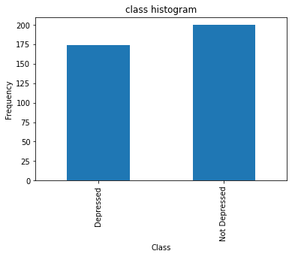
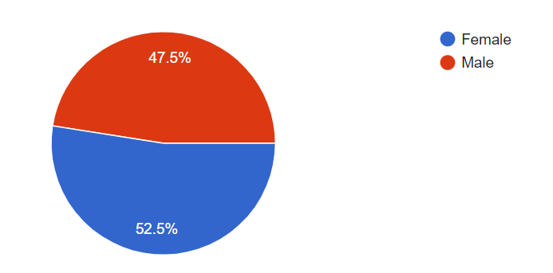
Exploratory data analysis
Class distribution
Gender distribution

Slide 30
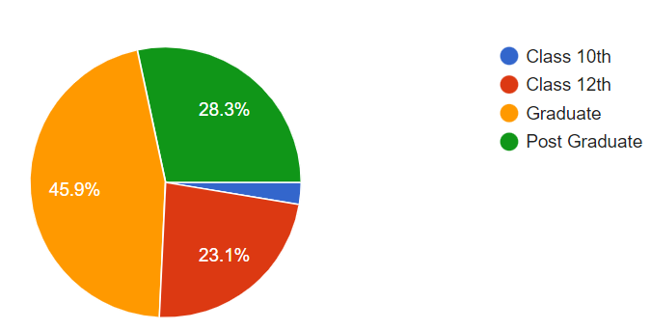
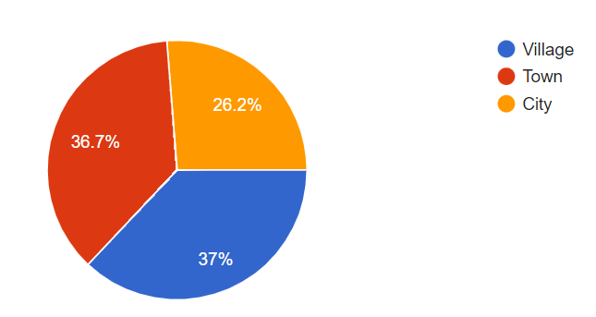
Educational qualification
Type of residing place

Slide 31
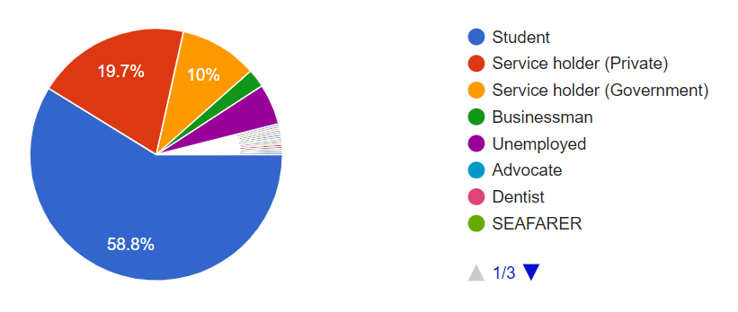
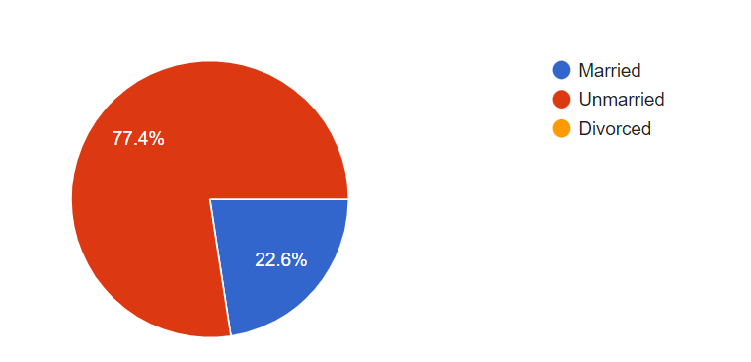
Profession distribution
Marital status

Slide 32
Implementation
a) Dataset splitting
Firstly, the obtained dataset has been split into training and test data.
This work has used 80% data of the dataset as training data and the rest 20% data of the dataset has been used for testing purposes.
b) Data encoding
In the Data Encoding step, the categorical data of the training and test datasets have been converted into their numeric counterpart using the Label Encoder of the Scikit-learn library.

Slide 33
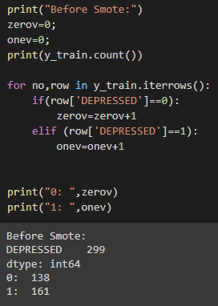
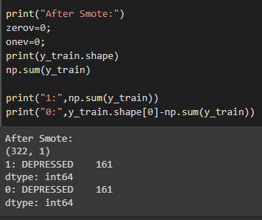
c) Apply SMOTE on training data
Before SMOTE
After SMOTE

Slide 34
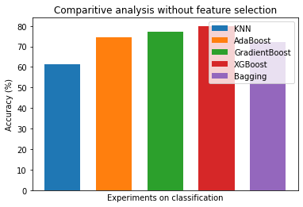
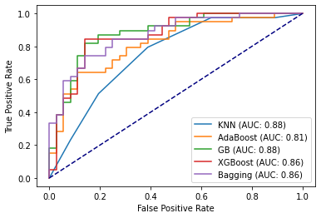
Without feature selection

Slide 35
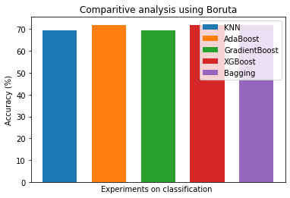
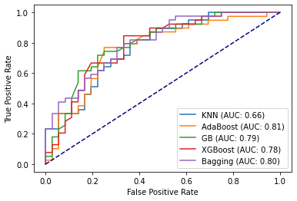
SelectKBest

Slide 36
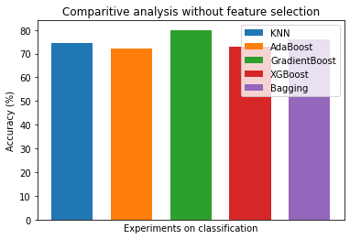
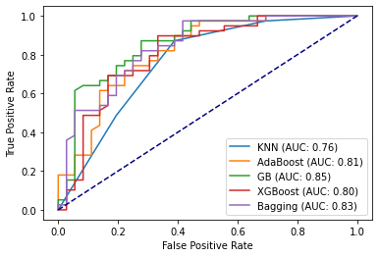
MRMR

Slide 37
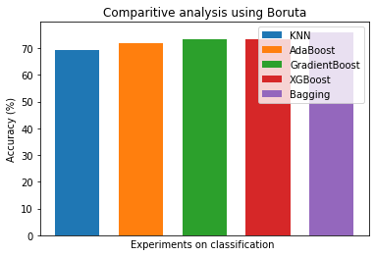
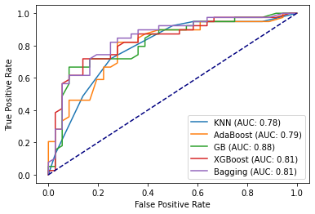
Boruta

Slide 38
Conclusion
This study has taken data from Kerala citizens.
It has tried to find out the most common factors that cause depression.
Different feature selection techniques have extracted the most important demographic, and psychosocial factors responsible for forming depression.
Gradient Boost classifier with MRMR feature selection technique has shown the highest accuracy of 80%.
So it can be concluded that tree based classifiers can better study the features of the dataset.

Slide 39
THANK YOU

