Slide 1




The Agile Approach
SCRUM-AGILE AS A MINDSET AND IMPLEMENTATION
Presented by Ryan Rieth

Slide 2
Abstract
Title Card (1)
Abstract (2)
What is Scrum? (3)
Scrum Roles (5)
SDLC Phases in Agile (9)
Agile VS Waterfall (12)
Recommendation (17)
Title Card (22)
References (23)
More References (24)

Slide 3


What is Scrum?
An agile Agile mindset

Slide 4
Scrum
(SNHU, SDLC Methodologies)
Empirical process derived from observing and experimenting.
Adaptive, flexible, well-suited for projects difficult to predict.
(Schwaber, K., & Sunderland, J., 2020)
Consists of Product Owner, Scrum Master, Scrum Team that Increment work during Sprints in which complex problems are developed for a Product Backlog that the Team and stakeholders analyze and inspect before each subsequent Sprint.

Slide 5
Scrum Roles
A Hive Mind

Slide 6
Developer(s)
Tasks
Importance
Scrum Team members committed to creating any aspect of the project within each Sprint.
Communicate with team members in open-air discussions focused on goals.
Create Sprint Backlog, meet Sprint Goal, uphold accountability amongst team members.
(Schwaber, K., & Sunderland, J., 2020)
The driving force for a workflow.
The first and final force in making aspects of desired product reality.
Main defense in upholding Scrum ideals/maintaining accountable and successful environment/
(Schwaber, K., & Sunderland, J., 2020)

Slide 7
Scrum Master
Tasks
Importance
Help team members understand Scrum theory and practice.
Coach team members in self-management.
Ensure Scrum Events are successful and positive in atmosphere.
Communicates between Team, Product Owner, organization, clients, etc.
(Schwaber, K., & Sunderland, J., 2020)
Responsible for team’s effectiveness and efficiency.
True leader in Scrum Team and liaison to larger organization.
Ensures connectivity between departments/members.
(Schwaber, K., & Sunderland, J., 2020)

Slide 8
Product Owner
Tasks
Importance
Develops and communicates Product Goal.
Creates and communicates Product Backlog transparently.
Orders Product Backlog items.
(Schwaber, K., & Sunderland, J., 2020)
Is, technically, final say on matters pertaining to project.
Represents client and stakeholders.
Keeps an account on changes made, requested, or considered.
Lays out project track.
(Schwaber, K., & Sunderland, J., 2020)

Slide 9
SDLC Phases in Agile
What’s adjusted for modernity?

Slide 10
SDLC Phases
Foundational
Agile Methodology
Planning
Define Requirements
Design & Prototyping
Software Development
Testing
Deployment
Operations & Maintenance
(Jevtic, G., 2019)
Plan
Design
Develop
Test
Deploy
Review
Launch
(SNHU, SDLC Methodologies)

Slide 11
SDLC Phases
Agile treats each project differently.
At planning, tasks are divided into small time frames to visualize the project at hand.
In designing, iterative steps are taken to complete facets individually and to avoid weighty pressure.
Developing the iterations focuses purely on the iterations at hand and makes no changes that would threaten these iterations.
Testing happens alongside the development to ensure working goals, in fact, work.
If not, the cycle can restart at the Design phase to loop back to testing. This is arguably the most important step.
When deployment begins, clients are shown finalized renditions of the project facets for more in-depth resting..
If deployment is accepted, reviewing occurs to finalize the finalization and go over importance milestones as well as areas for improvement.
Finally, the product is launched to the world to showcase the success that Agile can achieve.
(Tutorials Point, SDLC Tutorial)

Slide 12
Agile VS Waterfall
Key Differences

Slide 13
Main Facets
Agile
Waterfall
Modern |
Continuous |
Flexible |
User-/client-driven |
Not dependent on prior documentation |
| Traditional
| Linear
| Sequential
| Plan-driven
| Dependent on prior documentation

Slide 14
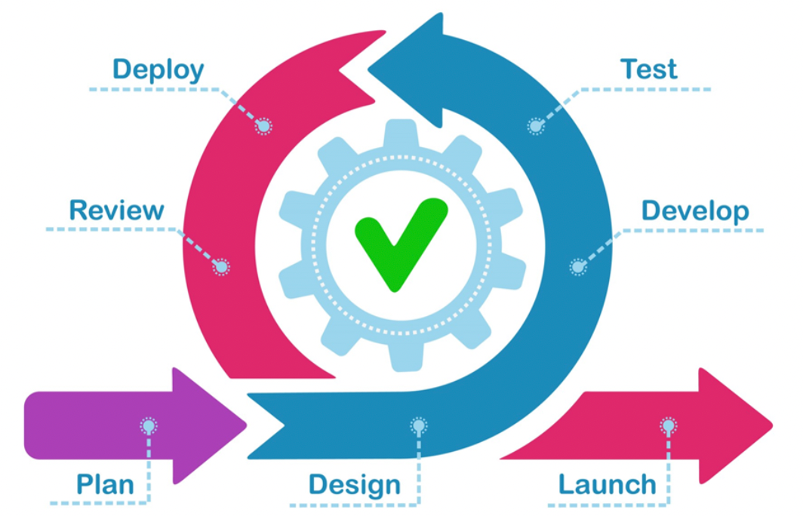
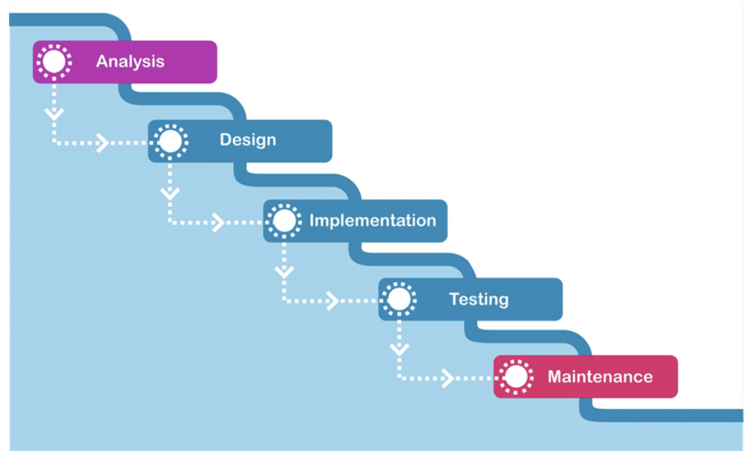
Models & Methodologies
Agile (SNHU, SDLC Methodologies)
Waterfall (SNHU, SDLC Methodologies)

Slide 15
Pros
Agile
Waterfall
Implements iterative bursts to spark creativity and curb fatigue.
Flexible and adaptable to sudden and even immense changes in project.
Realistic.
Promotes teamwork.
Rapid functionality improvements.
(Tutorials Point, SDLC Tutorial)
Extremely simple to understand and implement.
Easy to manage due to rigidity.
Clearly defined stages in life cycle.
Results of process are well-documented.
Sequential completion of phases.
(Tutorials Point, SDLC Tutorial)

Slide 16
Cons
Agile
Waterfall
Poor support for complex dependencies.
Less stability/more risk.
Lack of customer interaction and clarity can sink a project.
Steep learning curve, particularly for those deep in traditional SDLC models.
(Tutorials Point, SDLC Tutorial)
Working software comes late in life cycle.
Incredible uncertainty at times.
Not suitable for long-term projects.
Requires strict rigidity in what’s being requested (no room for changes).
Scope almost impossible to adjust mid-project.
(Tutorials Point, SDLC Tutorial)

Slide 17
Recommendation
Which SLDC environment suits you?

Slide 18
Factors to Consider
Is the project long-term or short-term?
Is the timeframe vast or condensed?
Does the client thoroughly know what they want?
Will they change their requests/desires at any time?
How “stubborn” as your workforce?
At what level would they embrace an entirely new environment of completing a project?

Slide 19
Further Factors to Consider
Are team members/departments disconnected in their functionalities?
Would they be able to successfully work together to perform important steps?
How accountable are individual team members?
Will they hold themselves and each others accountable for their successes and failures?
How complex is the project at hand?
Well… how complex is the project at hand?
How involved would each step of the development life cycle be for the project at hand?

Slide 20
Agile and its Adaptability
SNHU Travel was a product riddled with mid-project changes that forced the team to find successful ways to work together to overcome obstacles and meet client requests.
Had the project been run under a waterfall methodology, the mid-project request change would have sunk the entire operation as the team was already struggling with keeping up with an Agile shift in mindset.
Waterfall demands sequential, separated development on a tight schedule, whereas Agile allows a “throw it all away, start from scratch” methodology that is fueled by creative, consensual discussion amongst peers.
Agile was a successful and important mindset in approaching SNHU Travel. In particular, the direct Developer communication with Product Owner ensured no miscommunication between the development team and the client without relying on a middle-man for instigation.
Waterfall does not contain this nor endorses this, while Agile can thrive on this productivity.

Slide 21
Overall…
Keeping this factors in consideration as well as the real-world example of success with an Agile approach, it should be noted that Scrum-agile is a modern, flexible environment to handle a project under that can easily make or break a project’s success depending on the project’s underlying conditions and criteria.
Agile should be embraced more so than it is, but it is not and end-all-be-all mindset to operate under.
Some projects may require Agile while others would be destroyed by it, much like Waterfall finds it place in some projects but would devastate others.

Slide 22
The Agile Approach
Presented by Ryan Rieth
Prof. Konishi — CS 250 — SNHU

Slide 23


References
SNHU. (n.d.). SDLC Methodologies. CS250 - Module One: SDLC Methodologies. Retrieved August 10, 2022, from http://snhu-media.snhu.edu/files/course_repository/undergraduate/cs/cs250/storyline/mod1/story_html5.html.
Tutorials Point. (n.d.). SDLC Tutorial. Retrieved August 10, 2022, from http://www.tutorialspoint.com/sdlc/index.htm.

Slide 24
More References
Jevtic, G. (2019, May 15). What is SDLC? Phases of Software Development & Models. phoenixnap.com. Retrieved August 10, 2022, from https://phoenixnap.com/blog/software-development-life-cycle.
Schwaber, K., & Sunderland, J. (2020, November). The 2020 Scrum Guide. Scrum Guide | Scrum Guides. Retrieved August 10, 2022, from https://scrumguides.org/scrum-guide.html#team.

