Slide 1

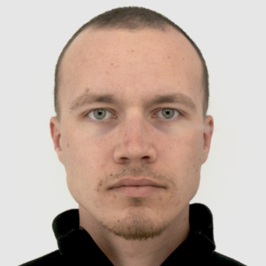
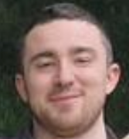

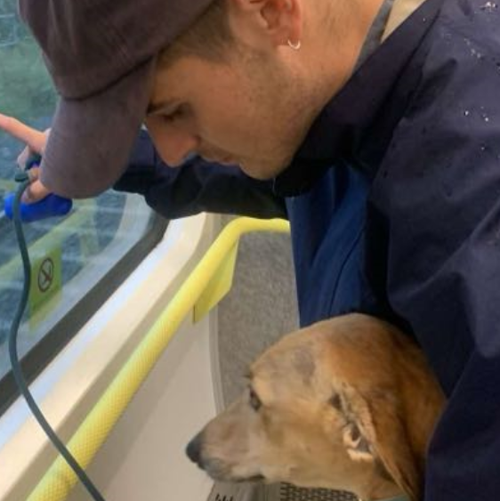
ST302 – GROUP A
4 questions exploring the gradMS dataset

Slide 2
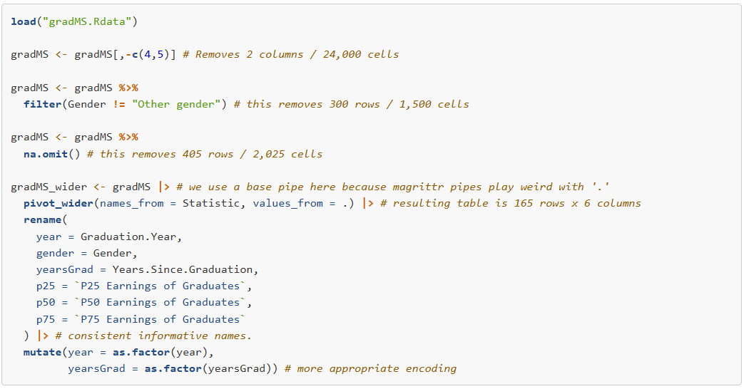

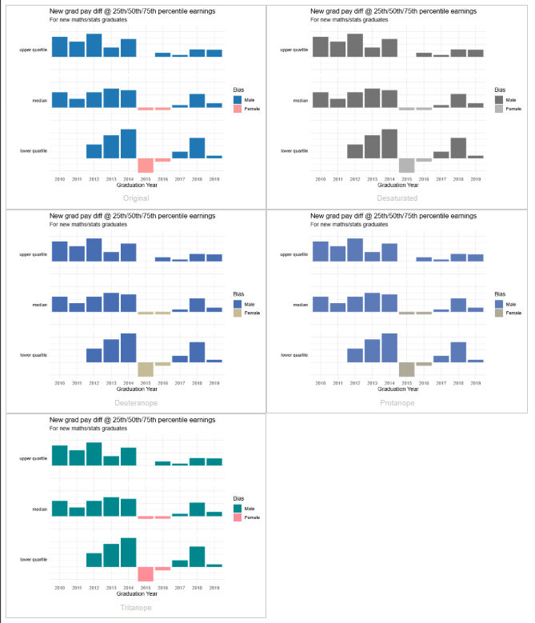
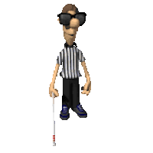
BUT FIRST - ADJUSTMENTS
We'd made a number of adjustments initially to make the data easier to work with.
We also chose consistent color-blind friendly coloring,
and a minimal theme throughout

Slide 3
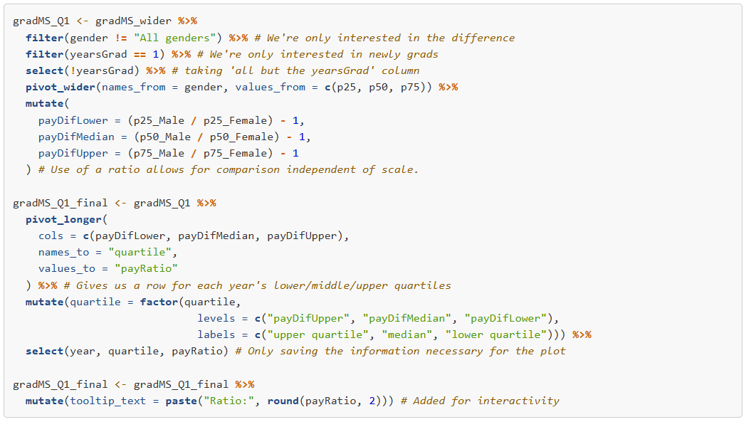
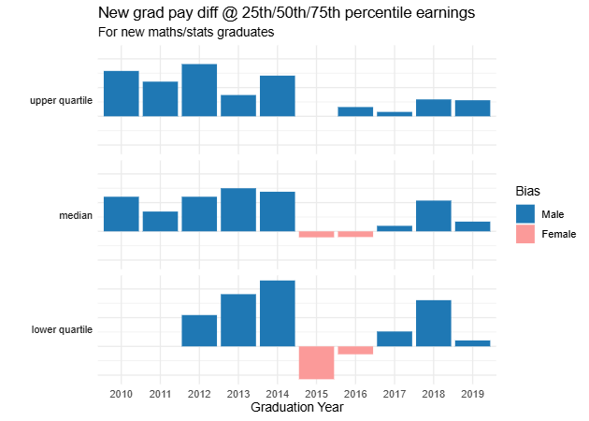
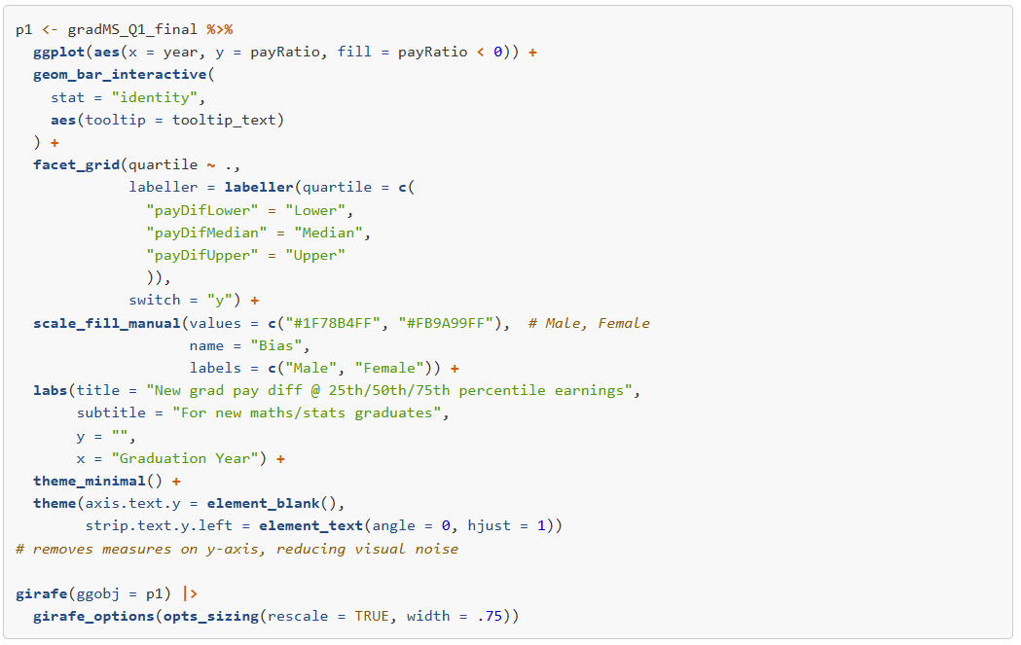
SPECIFIC ADJUSTMENTS
PLOT 1
PLOT CODE

Slide 4
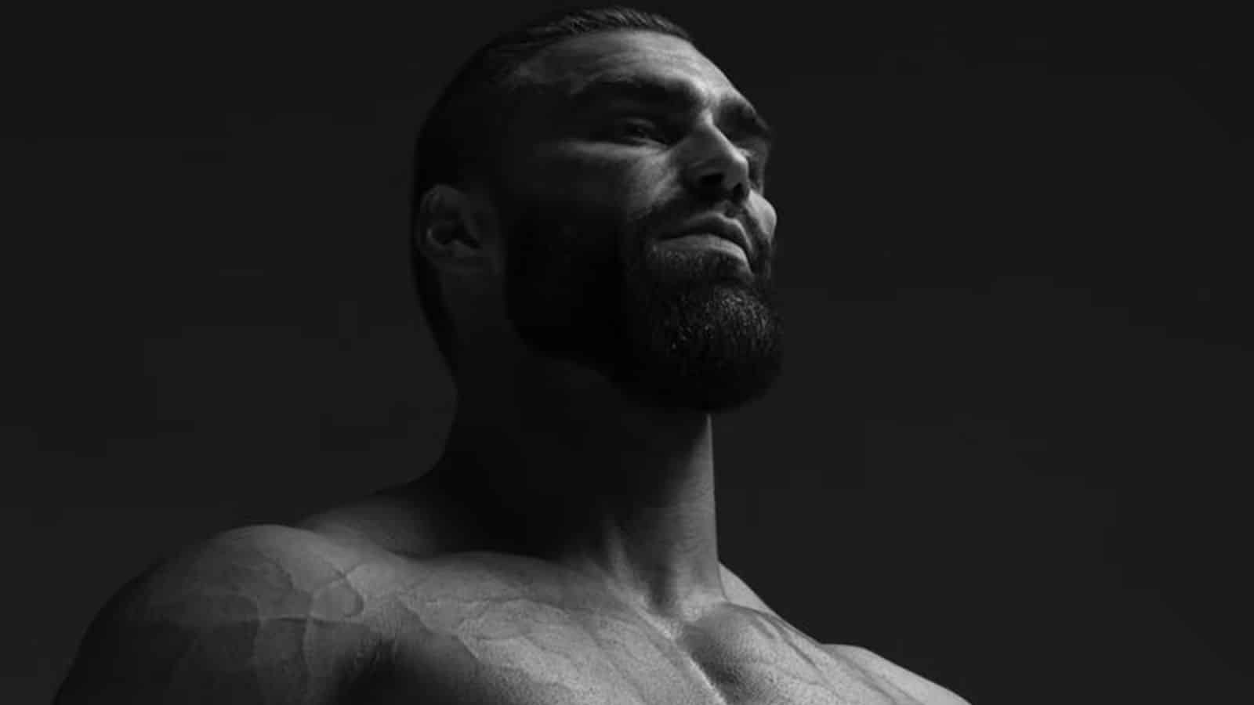
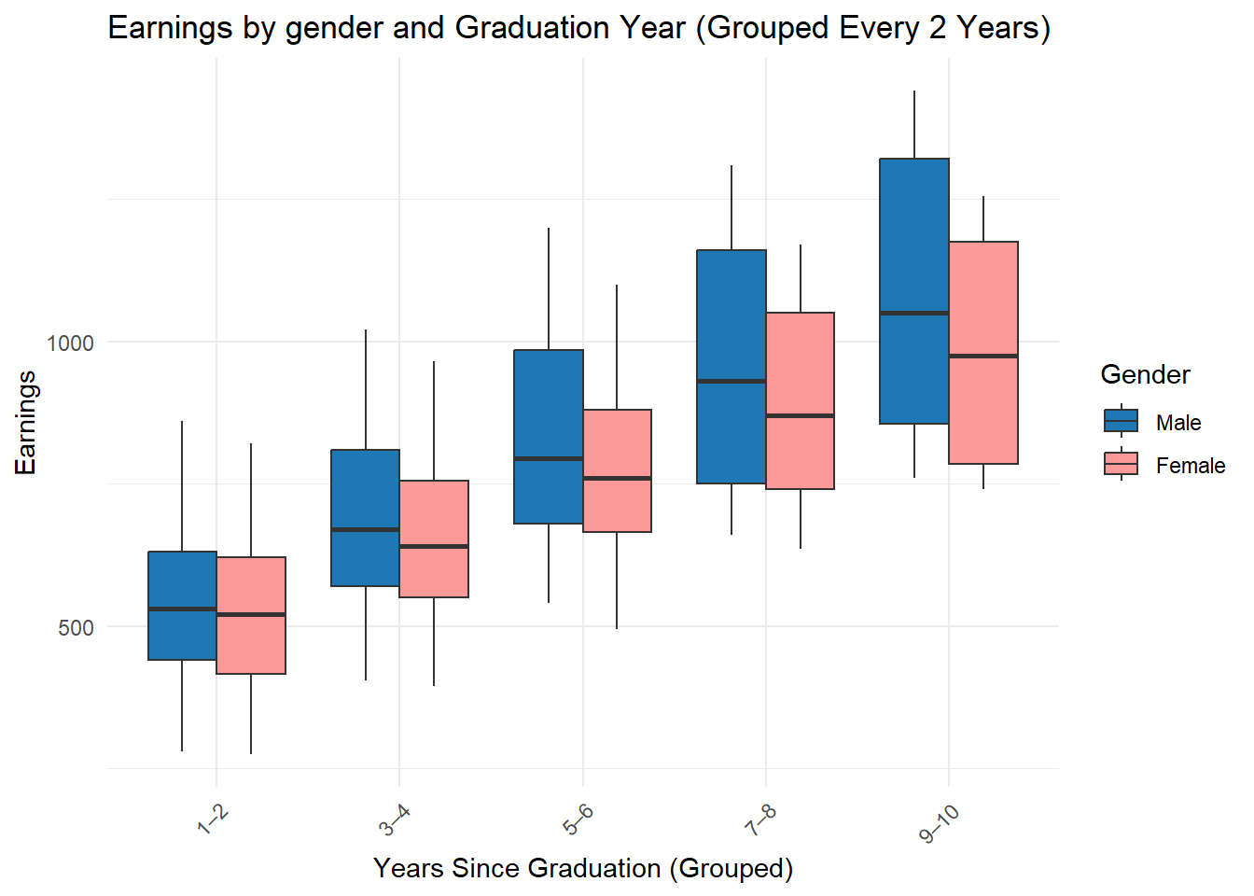
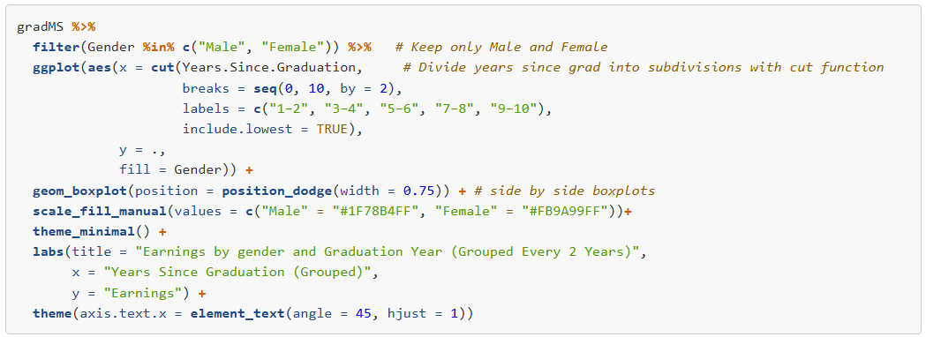
NO SPECIFIC ADJUSTMENTS NEEDED
PLOT 2
PLOT CODE

Slide 5
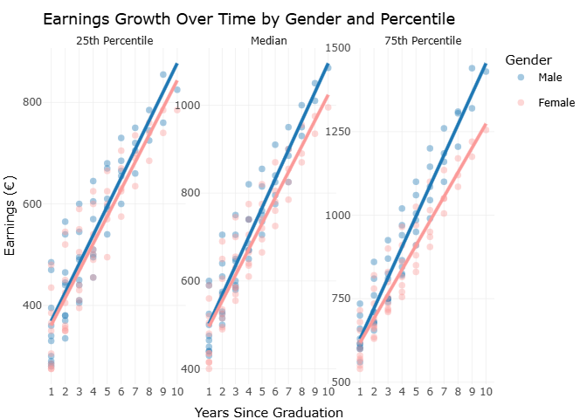
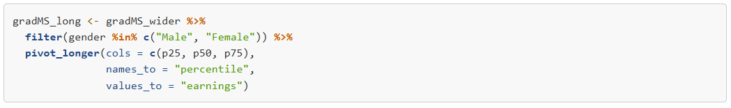
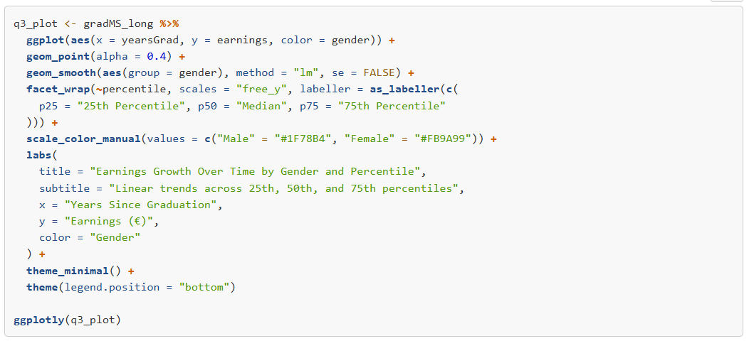
SPECIFIC ADJUSTMENTS
PLOT 3
PLOT CODE

Slide 6

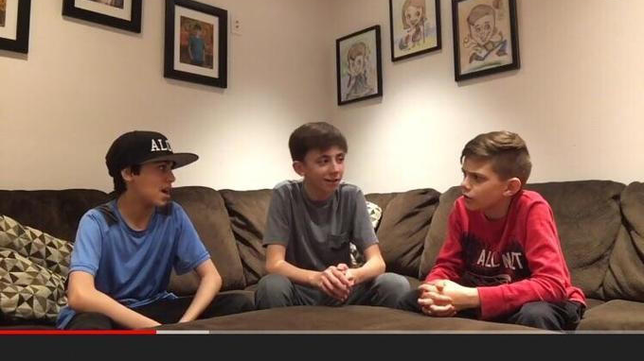
THE GREAT DEBATE
There are advantages to both these different approaches to exploring salary change over time
– which do you think is superior? WHY?
WHO DID IT BETTER – DAVID OR WARREN?

Slide 7
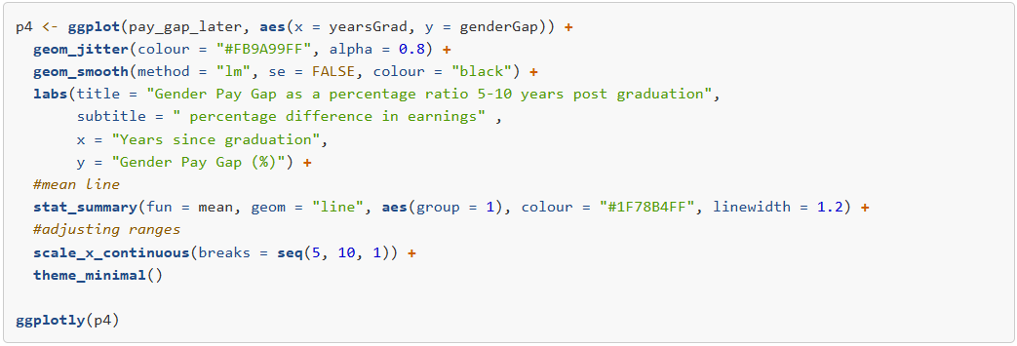
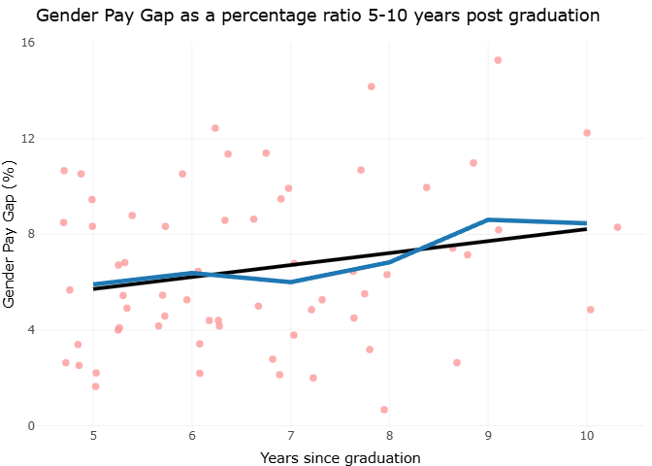
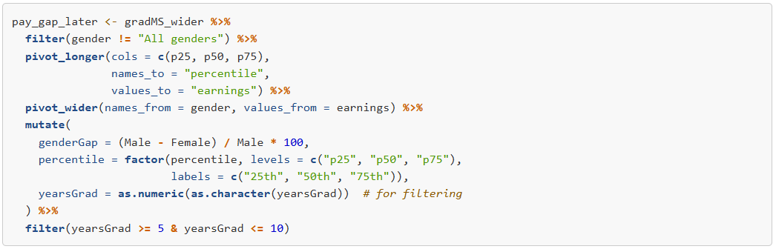
SPECIFIC ADJUSTMENTS
PLOT 4
PLOT CODE

Slide 8

THANKS FOR YOUR TIME
We're excited to see the rest of what's in store!
++ Github is available upon request – show's all stages of project from very beginning

