Slide 1

GlassQuill
-
Case Study
-
SIT Pune 2026
GlassQuill
Explainable detection of AI-generated text
Applications and Use Cases of Machine Learning (TE7483) · AIML, SIT Pune
Ranjan Verma (24070126149) · Rahul Narkhede (24070126146)
Priyansh Johri (24070126142) · Priyansh Pandey (24070126143)
Notes:
Introduce the team and the one-line idea: GlassQuill says whether a text reads as human or AI-written, and shows the evidence behind every verdict.

Slide 2
GlassQuill
-
Case Study
-
SIT Pune 2026
Agenda
12 minutes, then questions and a live demo
01
Problem and use case
why explainable detection, who needs it, scope
2 min
02
Data and preprocessing
4 public datasets, cleaning, 18 features
3 min
03
Methodology
pipeline, four models, verdict rule, validation
2 min
04
Implementation
code structure, reproducibility, the web app
2 min
05
Results and analysis
metrics, comparison, robustness, explanations
2 min
06
Conclusion
SWOT, findings and future scope
1 min
Notes:
Roughly 12 minutes in six parts, then the live demo and questions. Each part maps to one part of the evaluation: problem, data, method, implementation, results, conclusion.

Slide 3
The problem
SIT Pune 2026
Colleges, newsrooms and hiring teams use AI-text detectors, but most return a bare score. A student who is wrongly flagged has no way to question it.
Liang et al. (2023) found popular detectors flagged over half of essays by non-native English writers as AI. GlassQuill labels English text as human or AI, explains why, and treats a low false positive rate as the main goal.
-
01
GlassQuill
Notes:
A false positive accuses a real person of cheating. That is the costly error, so we report the false positive rate (FPR) next to accuracy everywhere.

Slide 4
RQ1 Which simple signals (perplexity, sentence rhythm, vocabulary, punctuation) separate human and AI text?
01.
Research questions
RQ2 How close can explainable models (XGBoost + SHAP) get to a black box (DistilBERT)?
02.
Build an explainable human-vs-AI classifier for English text (50 to 400 words), keep humans wrongly flagged as AI low, and test it on unseen generators and paraphrased text.
02
RQ3 How well do the detectors hold up on unseen LLMs and on paraphrased AI text?
03.
Notes:
Domain: education and content moderation, NLP text classification. Stakeholders: teachers, students, platforms and researchers. A fourth question compares SHAP and LIME explanations.

Slide 5
GlassQuill
-
Case Study
-
SIT Pune 2026
Use case, scope and refinement
Domain: education and content moderation · Task: binary NLP text classification (0 = human, 1 = AI)
Stakeholder | What they need
Teachers, universities | a second opinion with reasons, not a verdict
Students, writers | a fair way to question a flag
Platforms, newsrooms | screening at scale with an audit trail
Researchers | a transparent baseline for detectors
Phase I plan | Final project
HC3 only (ChatGPT 2022) | + HAP-E and M4GT: 2024 models, 17 domains
Raw HC3 text | shortcut cleaning (99.3% was fake accuracy)
XGBoost as the verdict | mean of XGBoost + LR: FPR 6.6% to 2.0%
Gradio demo in Colab | React + FastAPI app, 28 tests, script pipeline
In scope: English text, 50 to 400 words, many genres (Q&A, essays, news, fiction, academic, Reddit, Wikipedia).
Out of scope: other languages, source code, texts that mix human and AI writing, naming which LLM wrote a text.
Notes:
Phase I trained on HC3 only; that model called a modern ChatGPT paragraph 100% human, so we added two corpora of 2024 models. A first run above 99% exposed formatting shortcuts, which we removed.

Slide 6
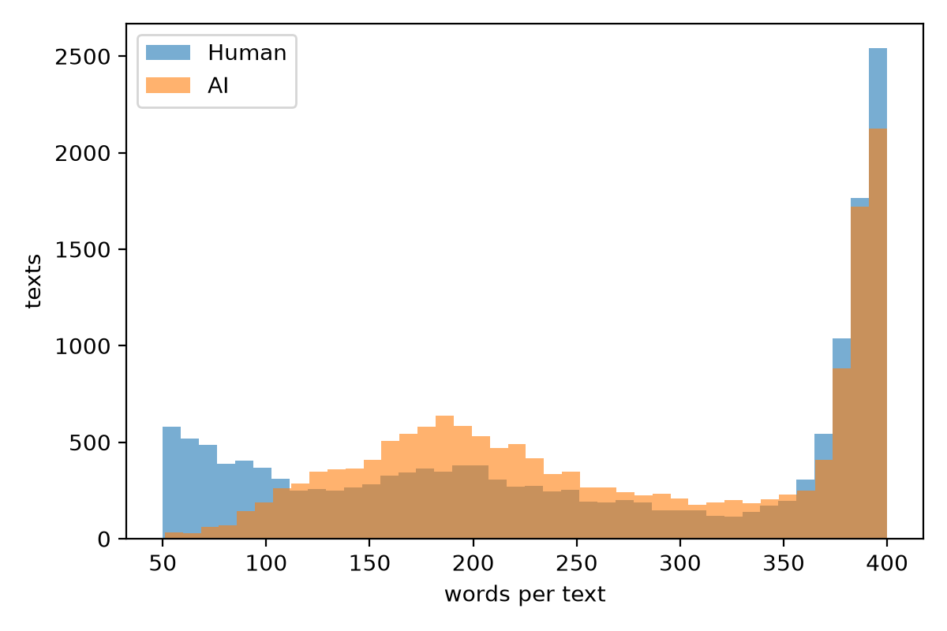
SIT Pune 2026
Datasets
-
HC3 (ChatGPT vs human answers to the same questions), HAP-E (GPT-4o, Llama-3; 6 genres) and M4GT (GPT-4, Mixtral, Gemma, Cohere): 31,984 texts in 17 domains, 50% human and 50% AI in each.
Target: label (0 = human, 1 = AI), no missing values after cleaning. Split 70/15/15 by question or document. MAGE (27 generators, 2,000 texts) is held out as the out-of-domain test.
03
GlassQuill
Notes:
Why three training corpora: with HC3 alone, the model called a modern ChatGPT paragraph 100% human. HAP-E and M4GT add 2024 models and 12 more genres. The chart shows text lengths per class.

Slide 7
GlassQuill
-
Case Study
-
SIT Pune 2026
Attributes, target and validation
One row per text after cleaning: 31,984 texts, 0 missing values
Column | Type | Meaning
text | string | the passage: model input
label | int 0/1 | target: 0 = human, 1 = AI
qid | string | question / document id, for splitting
source | category | one of 17 domains
generator | category | human or the model name
corpus | category | HC3, HAP-E or M4GT
n_words | int | words after cleaning (50 to 400)
Split | Texts | Share AI
Train (70%) | 22,371 | 0.500
Validation (15%) | 4,784 | 0.500
Test (15%) | 4,829 | 0.501
MAGE (unseen) | 2,000 | 0.500
Missing values: empty and duplicate texts dropped; features divide by max(words, 1), so none are missing.
Validation: GroupShuffleSplit by question or document, 5-fold GroupKFold for tuning, test set used once.
Notes:
The model inputs are either the raw text (TF-IDF, DistilBERT) or 18 numeric features computed from it (XGBoost). qid is never a feature: it only keeps a question's answers in one split.

Slide 8
04
01
03
Tokenizer leftovers: 34% of HC3 human texts had “do n't” vs 0.02% of AI texts, plus “( x )” and URL_0.
Markdown bold and headings in AI text, curly quotes and literal “\n” were normalised for every source.
02
04
Balanced per domain: open_qa had 20 human vs 764 AI texts, so the topic predicted the label.
Split by question or document and tuned with GroupKFold, so no topic is in both train and test.
Data cleaning
GlassQuill
-
Case Study
-
SIT Pune 2026
Notes:
Before cleaning, accuracy was 99.3%: the models were spotting formatting, not writing style. After removing the shortcuts it fell to a believable level, which proves the shortcuts were real.

Slide 9
The 18 features
6 from GPT-2: how predictable each word is (log perplexity, its spread and maximum, top-1 and top-10 guess rates, entropy). AI text is easier to predict: perplexity is the strongest signal (-1.4 SD).
12 on writing style: sentence length and burstiness (humans 0.53 vs AI 0.38), vocabulary richness, word length, punctuation, first-person words, contractions and readability.
GlassQuill
-
Case Study
05
Notes:
Perplexity = exp of the mean negative log-probability of each token under GPT-2. LLMs pick likely words, so another language model finds their text easy to predict. Burstiness = std / mean sentence length.

Slide 10
GlassQuill
-
Case Study
-
SIT Pune 2026
The ML pipeline
run_pipeline.py: eight cached stages, seed 42, reproducible with one command
1 Load
HC3, HAP-E, M4GT
2 Clean
remove shortcuts
3 Balance
50/50 per domain
4 Split
by group 70/15/15
5 Features
18 + raw text
10 Explain
SHAP, word weights
9 Evaluate
test, MAGE, paraphrase
8 Verdict
rule chosen on val.
7 Tune
5-fold GroupKFold
6 Train
4 models
Every stage saves its output, so any stage can be rerun alone. python run_pipeline.py --quick reproduces all stages on a sample in about 10 minutes.
Notes:
Read it as a snake: top row left to right, then the bottom row right to left. The dark box is the key design choice: the verdict rule was chosen on the validation set, never on the test set.

Slide 11


Perplexity threshold on GPT-2 log perplexity alone; cut-off chosen on validation. Zero-shot baseline.
DistilBERT fine-tuned for 2 epochs. Most powerful, but a black box: kept for comparison.
01
04
  Four models
TF-IDF + logistic regression on 1-2 word features; C tuned by 5-fold GroupKFold. Glass box on words.
Verdict = mean of XGBoost and TF-IDF + LR, chosen on validation. Unclear band: 35 to 65%.
02
05
and one verdict
XGBoost on the 18 features, monotone constraints where theory and data agree. Explained with SHAP.
Evaluation: test set used once, MAGE for unseen generators, a T5 paraphrase attack.
03
06
06
Notes:
The models go from simple and transparent to powerful and opaque, so we can measure what explainability costs. Monotone constraints stop rules like 'very even sentences mean human'.

Slide 12
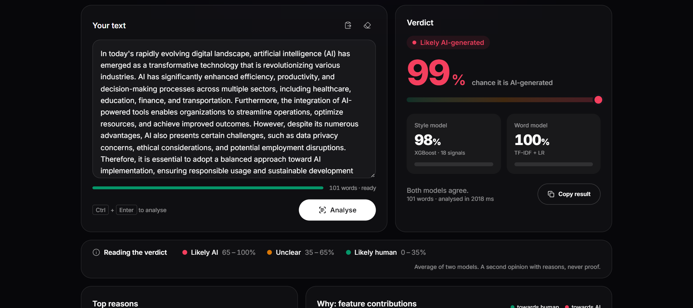
GlassQuill
-
Case Study
-
SIT Pune 2026
Implementation
Complete, tested and reproducible: code, pipeline and a working web app
Layer | Tools | Code
Data, features | pandas, GPT-2, textstat | src/data.py, features.py
Models | scikit-learn, XGBoost, DistilBERT | src/models.py
Explanations | SHAP, LIME | src/explain.py
Pipeline | 8 cached stages, seed 42 | run_pipeline.py
Web app | FastAPI + React | server.py, web/
Quality | 28 tests, lint, types | tests/
The detector page: verdict, both model scores and the evidence below it.
Python 3.11, PyTorch 2.11 on an RTX 3050 laptop GPU. Full run about 1.5 h; the app answers in about 0.1 s per text.
Notes:
Everything is in the GitHub repository. Trained models are committed, so the app runs without retraining. The API validates input, rate-limits each IP and never stores the text.

Slide 13
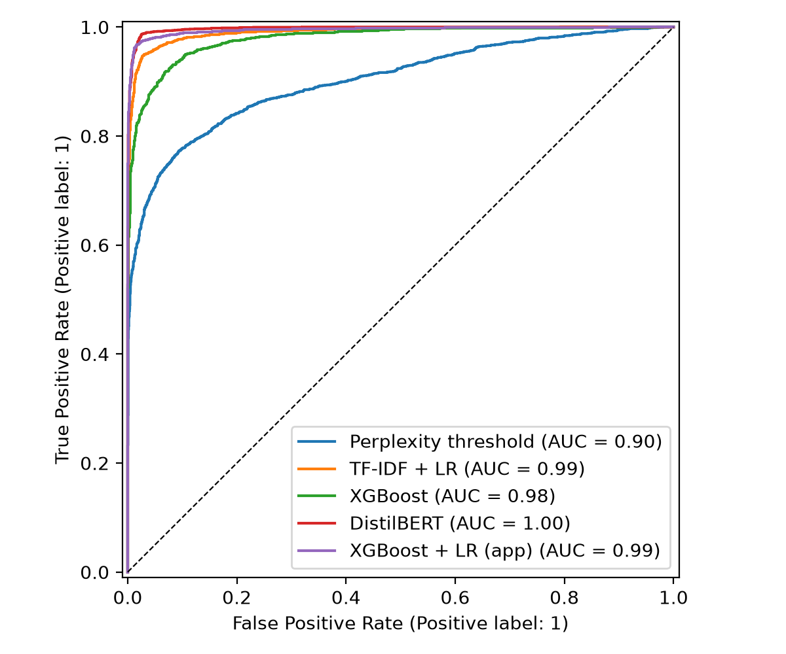
97.4%
SIT Pune 2026
Test accuracy
On 4,829 unseen test texts the verdict beats every single model and wrongly flags only 2.0% of human texts.
-
Model | Acc. | Prec. | Recall | F1 | FPR
GlassQuill verdict | 97.4% | 0.980 | 0.968 | 0.974 | 2.0%
DistilBERT | 96.1% | 0.934 | 0.993 | 0.963 | 7.1%
TF-IDF + LR | 95.9% | 0.970 | 0.948 | 0.959 | 3.0%
XGBoost | 92.3% | 0.933 | 0.912 | 0.923 | 6.6%
Perplexity threshold | 83.9% | 0.892 | 0.771 | 0.827 | 9.3%
07
GlassQuill
Notes:
The verdict rule was picked on the validation set, not the test set. DistilBERT is close on accuracy but flags 3.5 times as many humans. ROC-AUC of the verdict is 0.995.

Slide 14
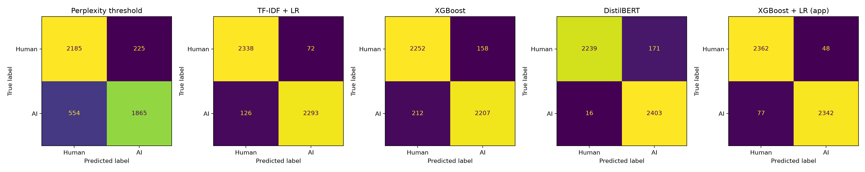
GlassQuill
-
Case Study
-
SIT Pune 2026
Comparative analysis
Same metrics for every model, in-domain, on unseen generators and under attack
MAGE (27 unseen generators) | Acc. | F1 | FPR
GlassQuill verdict | 66.4% | 0.542 | 6.8%
Perplexity threshold | 65.6% | 0.551 | 11.1%
DistilBERT | 65.5% | 0.585 | 17.6%
XGBoost | 63.4% | 0.532 | 14.9%
TF-IDF + LR | 60.6% | 0.426 | 7.9%
Paraphrase attack (recall) | Before | After
GlassQuill verdict | 98% | 93%
DistilBERT | 100% | 100%
XGBoost | 100% | 95%
Perplexity threshold | 100% | 93%
TF-IDF + LR | 93% | 77%
Notes:
Top: confusion matrices on the test set. Bottom left: every model drops on unseen generators, but the verdict keeps the lowest false positive rate. Bottom right: paraphrasing hurts the word model most.

Slide 15
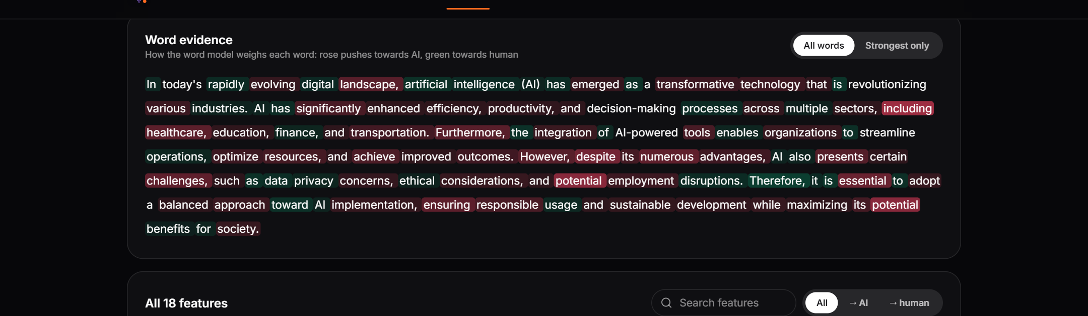
Showing the evidence
SIT Pune 2026
SHAP shows how much each of the 18 signals moved the style model; low perplexity pushes hardest towards AI. The word model's weights are exact, so every word is coloured towards human or AI.
The same view, live in the app:
-
08
GlassQuill
Notes:
Live demo here: paste a ChatGPT example and a human paragraph. LIME recovered only half of the logistic regression's true top-10 words, so the app uses SHAP and exact weights instead.

Slide 16
09
Weaknesses
Threats
66.4% on 27 unseen MAGE generators. Small open models (OPT, BLOOM, GPT-J) go undetected.
Paraphrasing (98% to 93% caught), plain writing by non-native writers, and new LLMs.
SWOT
Strengths
Opportunities
97.4% accuracy and 2.0% false positives on the test set. Every verdict comes with reasons.
A modern reader model or Binoculars, sentence-level detection, calibrated probabilities.
Notes:
Results honestly: chat models like GPT-4 are still caught 91% of the time on MAGE, but small base models sample surprising words, so their perplexity looks human to every detector we tested.

Slide 17
GlassQuill
-
Case Study
10
Conclusion
and next steps
Two explainable models, averaged, beat a fine-tuned DistilBERT (97.4% vs 96.1%) with under a third of its false positives, and every verdict can be checked. Removing dataset shortcuts mattered most.
Next: a threshold for a fixed 1% FPR, sentence-level detection for mixed texts, the RAID benchmark and Indian languages. A detector score is a second opinion, never proof.
Notes:
Answer to RQ2: explainable models matched the black box. The biggest lesson was data quality: shortcuts in the dataset made early results look far better than they were.

Slide 18
GlassQuill
-
Case Study
-
SIT Pune 2026
Thank You
Questions?
Notes:
Code, report and results: github.com/ThatOneRahul/glassquill

