Slide 1

The Cinderella Problem
By: Anton, James, Aaron
This Photo by Unknown Author is licensed under CC BY-ND

Slide 2

Motivation and Hypothesis
Motivation:
The Goal: Predict March Madness “Cinderella” Upsets
The Problem: Traditional models typically over-rely on official seeding
The Solution: Focus on a team’s statistical DNA using regular season advanced metrics.
Hypothesis
- Integrating unsupervised anomaly scores into supervised classification models will significantly improve the predictive accuracy of NCAA tournament upsets.

Slide 3
The Data
Dataset Origin & Scope
Source: Kaggle 2026 March Madness Competition
Timeline: 1984-1985
Target Variable: CinderellaFlag
Teams with seed >= 10 and tournament wins >= 2.
Key Features:
- Ranking Metrics: SeedNum,
Performance: WinPct
Efficiency: AvgScoreDiff, AvgPointsFor, AvgPointsAgainst, MasseyRankMean

Slide 4
Reframing the Data (The "Expectation Gap")
The Problem (Raw Stats): A +5.0 scoring margin is terrible for a 1-seed, but incredible for a 13-seed. Raw stats lack context.
The Solution (Tournament Averages): Calculate the mean metrics for only the teams that made the tournament that specific year.
The Formula: Candidate Stat - Tournament Average = Expectation Gap
The Impact: Allows the model to identify 13-seeds that possess the statistical DNA of a top-tier powerhouse.

Slide 5
Methodology
Phase 1: Unsupervised Learning
Evaluated all division I teams to map out statistical DNA
Models Tested: Isolation Forests & Gaussian Mixture Models (GMM)
Phase 2: Supervised Classification
Filtered dataset strictly to Cinderella candidates (Seed 10-16, N = 680)
Models Tested: Random Forest vs. XGBoost

Slide 6
The Prediction Task & The “Small Data” Trap
The Pool: Strictly “Cinderella Candidates (seed 10 through 16).
The Target: Reaching the Sweet 16
The Challenge: Extreme Class Imbalance (Only ~45 true Cinderellas out of 680 candidates = ~6.6%
The Metrics: Precision-Recall AUC (PR-AUC) and F1 Score

Slide 7
XGBoost Vastly Outperforms Random Forest
Metric | Random Forest | Regularized XGBoost
Recall | 24.3% | 66.8%
F1-Score | 0.206 | 0.296
PR-AUC | 0.117 | 0.157

Slide 8
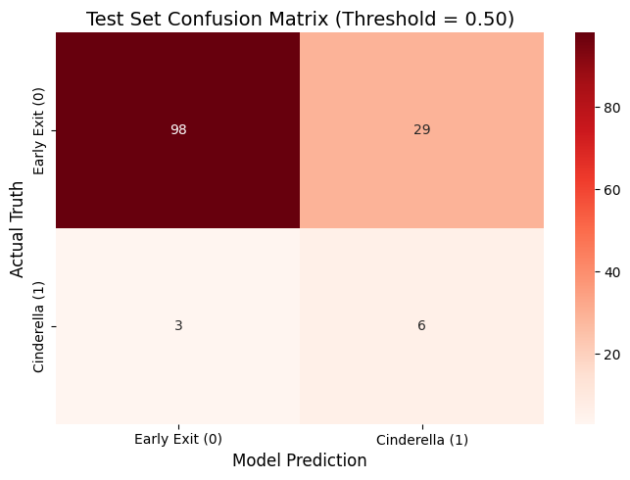
Despite Performing Better, the Model Still Performed Poorly

Slide 9
Decoding the XGBoost Hyperparameters
Three Key Callouts:
The Imbalance Fix: scale_pos_weight: ~11.3 (Penalizes missed Cinderellas 11x more).
Breaking Reliance: colsample_bytree: 0.5 (Forces the model to look at advanced stats, not just the Seed Number).
Preventing Memorization: max_depth: 2 (Uses shallow "stumps" instead of deep trees to prevent overfitting).

Slide 10
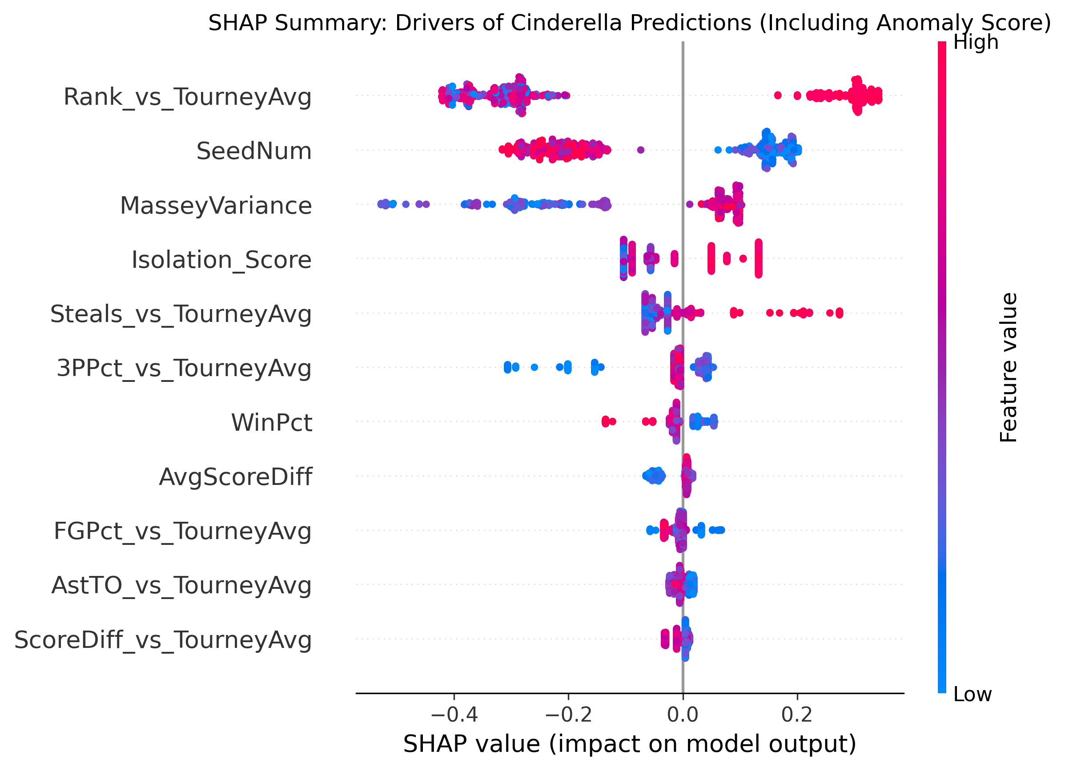
Feature Importance
Rank_vs_TourneyAvg was our top predictor with SeedNum being a close second. Showing that although the teams seed number was low by the tournament committee their underlying Massey Ratings metric mathematically placed them above.

Slide 11
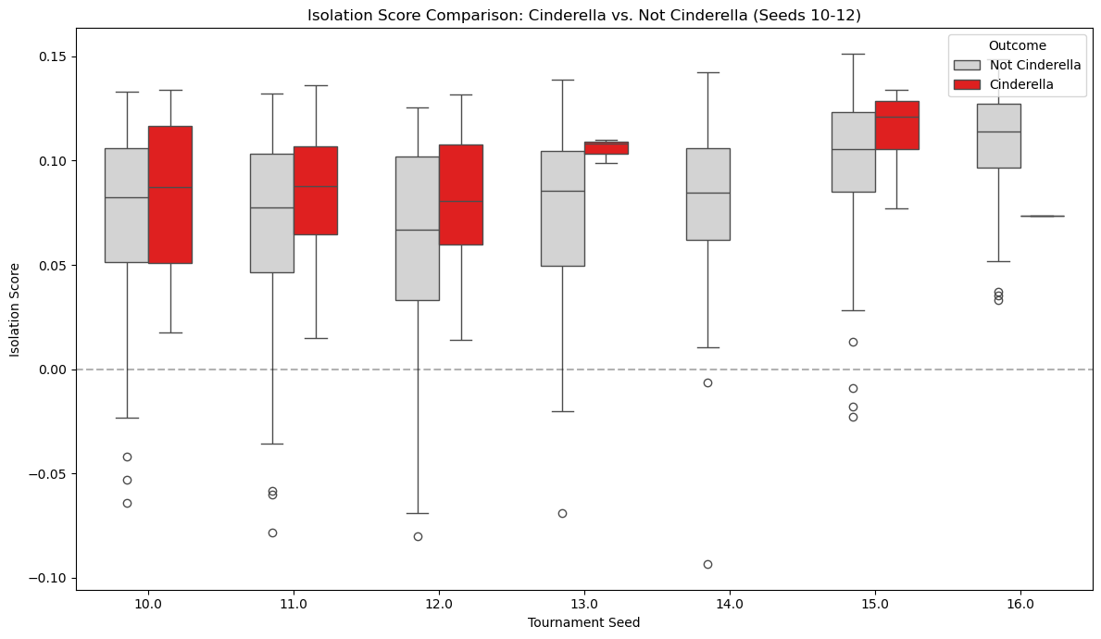
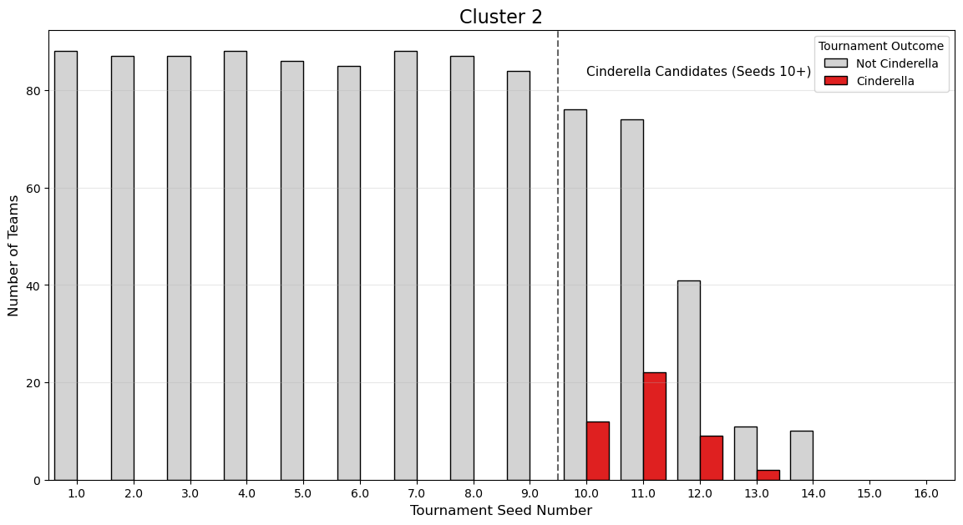
Unsupervised Anomaly Detection
Hypothesis: Cinderellas would be identified as distinct outliers among other low seeded teams.
Reality: Isolation Forest showed that Cinderellas were mostly statistically normal to other lower ranked seeds and lacked significant variance.
However, the Gaussian Mixed Model (GMM) was able to group teams into 4 distinct archetypes. It successfully grouped 82% of historical Cinderella teams into a high performing archetype (Cluster 2) where many higher ranked teams are. This suggests that they distinct enough to be identified as different from the average lower seed.

Slide 12
Model Results & Performance
Ultimately, despite our hypothesis, our XGBoost model still struggled to consistently identify Cinderella teams.
While it performed better than a random guess, it wasn’t drastically better.

Slide 13
Demonstration
https://stat486final.streamlit.app/

Slide 14
Conclusion and Takeaways
We proved our hypothesis that unsupervised metrics could improve our supervised upset predictions over a baseline model (guess 50-50 model).
Statistically, Cinderella runs are uncommon and thus difficult to work with due to imbalanced data.
However, by looking at efficiency profiles, ball security, and team consistency, we can find teams that are better teams than their seed might suggest.

