Slide 1
z1ppie – Peer-to-Peer File Sharing
TY CSAI-B, GRP 11?

Slide 2
Problem Statement
Challenges in Traditional File Sharing:
Email attachment size limits (≤25 MB)
Cloud services require upload → download (slow, bandwidth-heavy)
Centralized servers = single point of failure & privacy risk
No real-time collaboration during transfer
NAT/firewall blocks direct P2P in most cases
Goal: Build a direct, fast, private alternative using browser-native P2P

Slide 3
Objective
Primary Objective:
Develop a decentralized, real-time file sharing platform using WebRTC and Socket.IO for signaling
Secondary Objectives:
Eliminate central server dependency for file storage and transfer
Enable instant peer connection via token-based matchmaking
Provide real-time chat during file transfer
Ensure cross-platform compatibility (mobile & desktop)
Maintain user privacy by avoiding file uploads

Slide 4
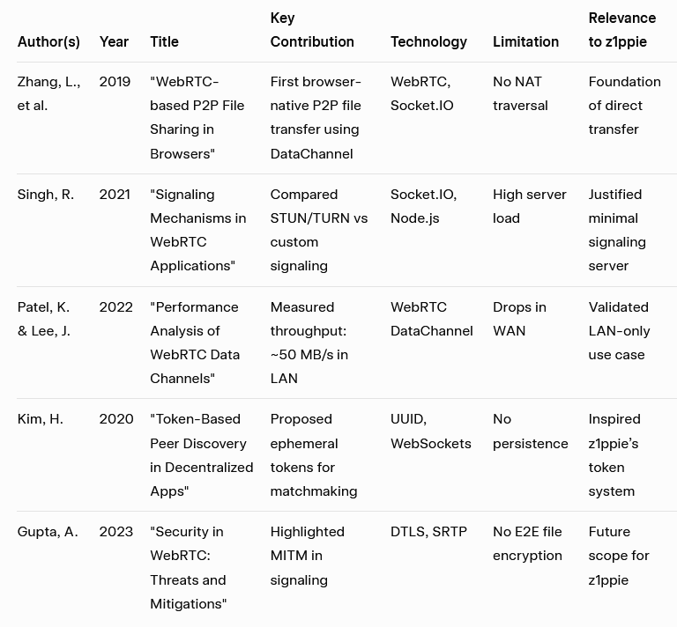
Literature Review
Gupta, A. (2023). Security in WebRTC: Threats and Mitigations. Journal of Network Security, 12(3), 45–60.
Kim, H. (2020). Token-Based Peer Discovery in Decentralized Apps. IEEE Transactions on Decentralized Systems, 8(2), 112–119.
Patel, K., & Lee, J. (2022). Performance Analysis of WebRTC Data Channels. ACM Web Conference Proceedings, 320–328.
Singh, R. (2021). Signaling Mechanisms in WebRTC Applications. International Journal of Web Engineering, 15(4), 201–215.
Zhang, L., et al. (2019). WebRTC-based P2P File Sharing in Browsers. Proceedings of IEEE INFOCOM, 890–898.

Slide 5
Tech Stack
Frontend:
Framework: Next.js (React SSR)
Language: TypeScript
Styling: Tailwind CSS
UI Components: Aceternity UI, Shadcn UI
P2P Layer: WebRTC (RTCPeerConnection, RTCDataChannel)
Signaling Client: Socket.IO Client
Backend (Signaling Server):
Runtime: Node.js
Framework: Express.js
Real-time Engine: Socket.IO
CORS: Restricted to localhost:3000, z1ppie.vercel.app

Slide 6
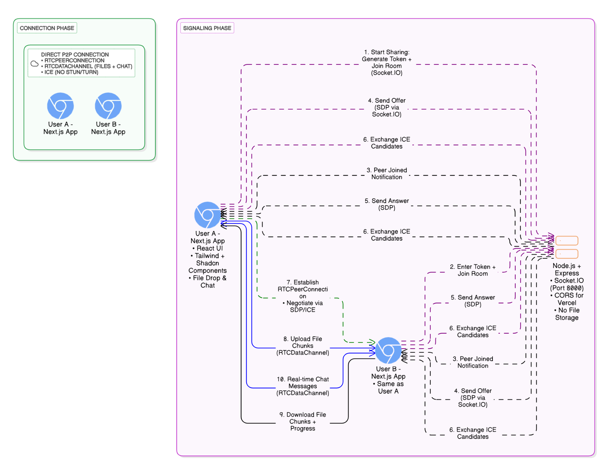
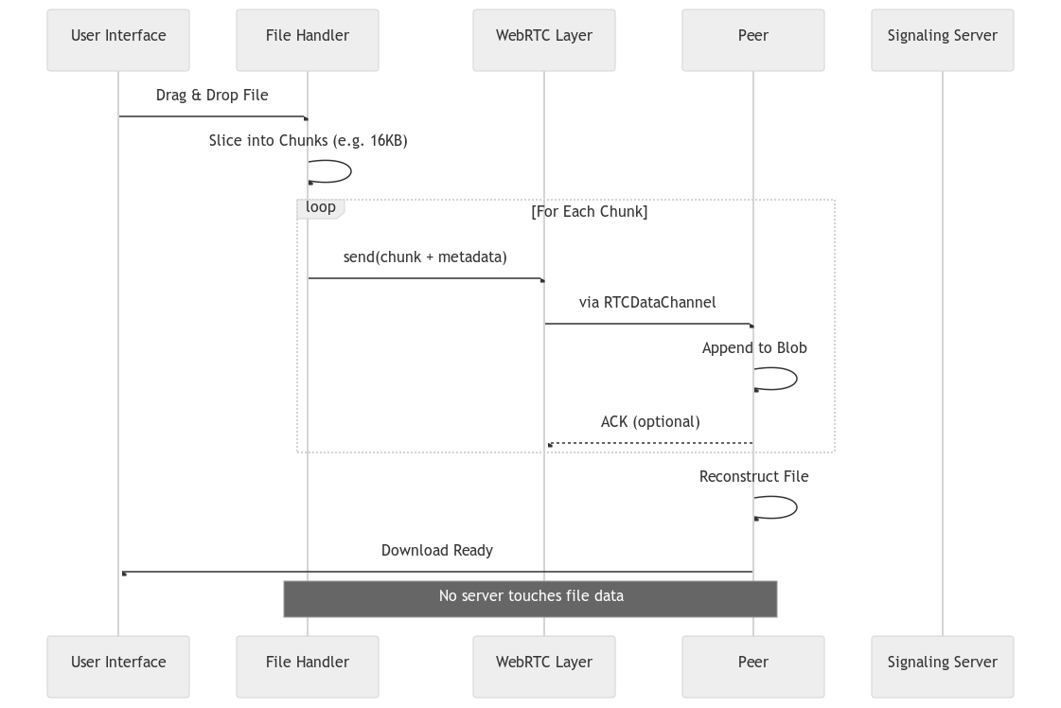
Methodology

Slide 7
Future Scope and Conclusion
Future Enhancements:
Integrate STUN/TURN servers (e.g., Twilio, Metered)
Add end-to-end encryption (AES-256 over DataChannel)
Support resumable transfers
Add PWA (offline install, push notifications)
Enable multi-peer rooms (group sharing)
Conclusion:
Successfully built a fully functional P2P file sharing app
Proves WebRTC + Socket.IO is viable for real-world use
Open-source, extensible, and privacy-first

