Slide 1
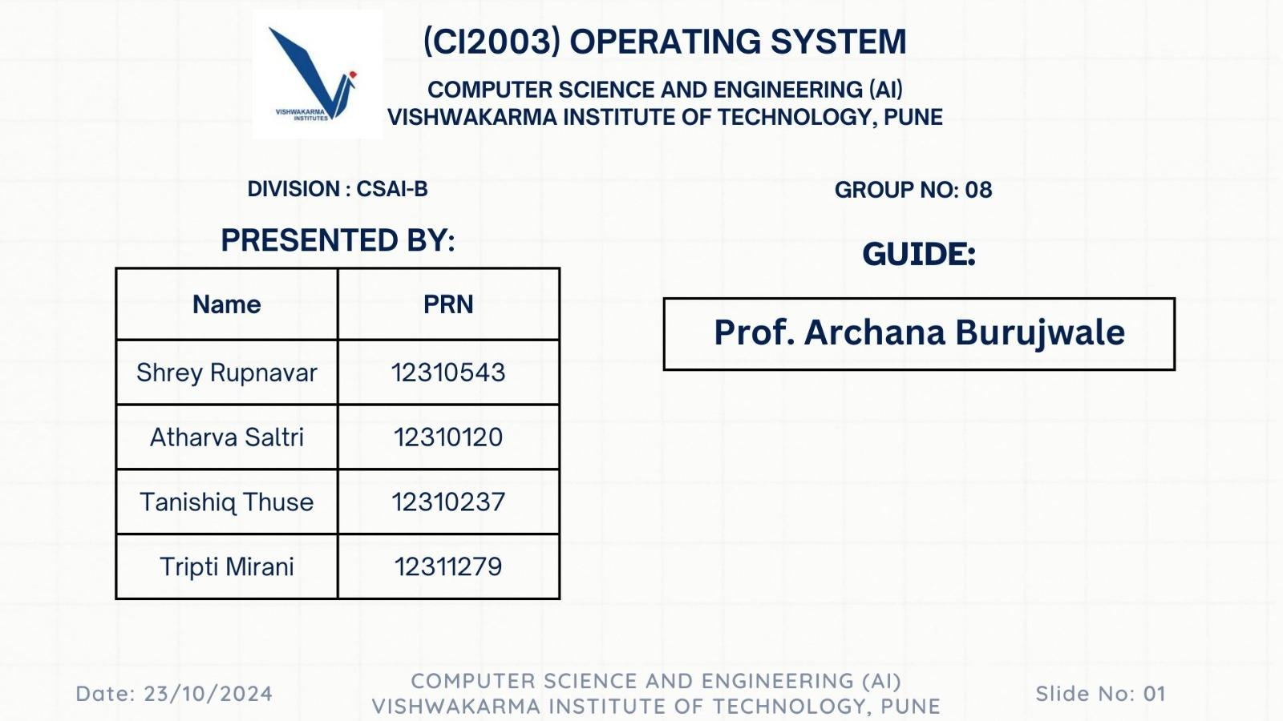

Slide 2
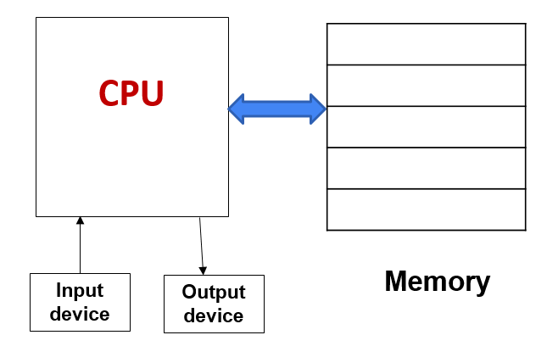
PROJECT OVERVIEW
Purpose of the Project:
To develop a simulation of a simple memory management system that executes instructions and manages data storage.
To demonstrate how instructions interact with memory and how data is read and written effectively.

Slide 3
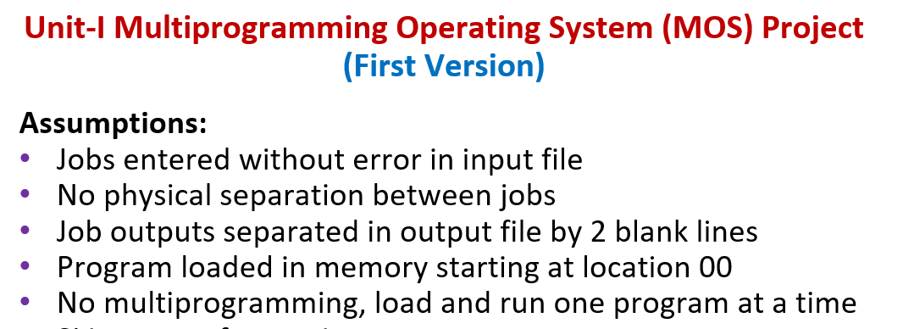
PHASE 1

Slide 4
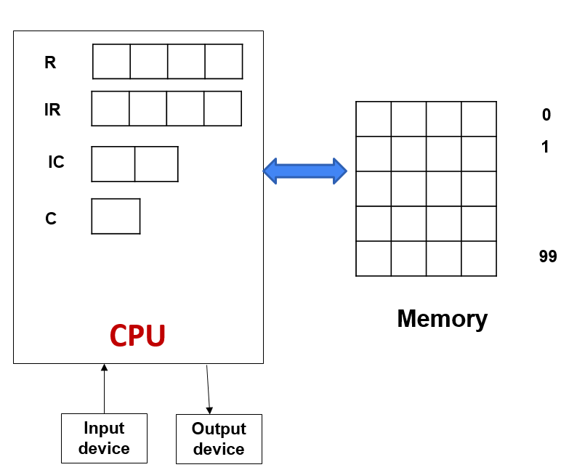
High-Level Architecture Diagram
Description of Each Component
Input File: Source of instructions
Memory: Storage for instructions and data
Register (R): Temporary storage for data being processed.
Instruction Register (IR): Holds current instruction
Instruction Counter (IC): Tracks address of next instruction execution
Toggle (C): Indicates the result of comparisons, influencing control flow.
Control Logic: Executes instructions

Slide 5
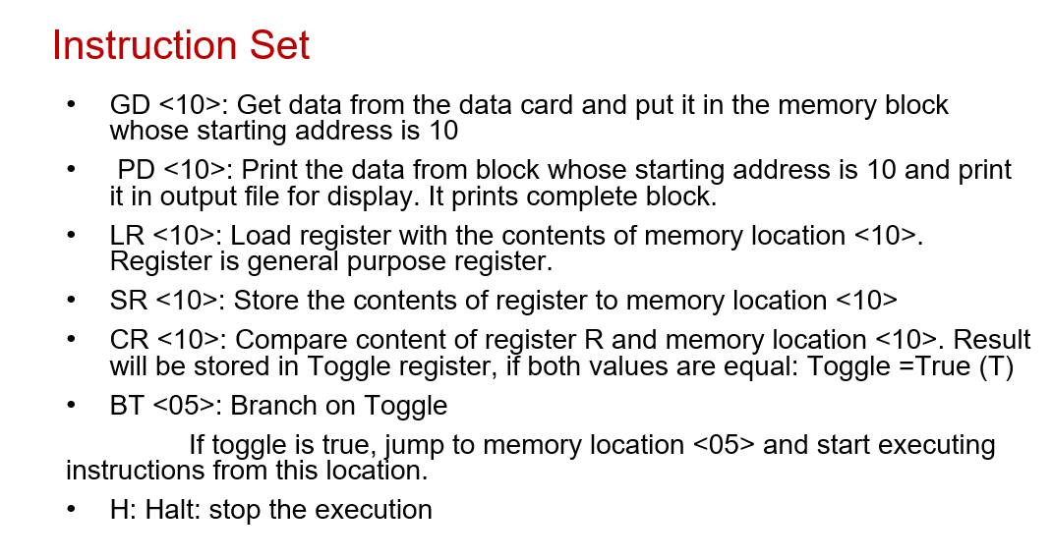
INSTRUCTION SET & EXECUTION
Simulate Instruction Execution:
Implement a system that can read, execute, and manage various types of instructions (e.g., read, write, load, store).

Slide 6
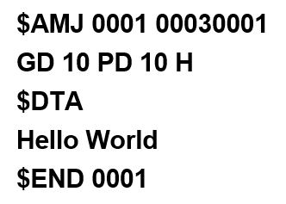
FIRST PROGRAM
Job Control Card ($AMJ): Initiates a new job with parameters, setting up the execution environment for subsequent instructions.
Program Card(GD10PD10H):
GD10: Get data from block 10. (READ)
PD10: Put data to block 10. (WRITE)
H: Halt execution. (TERMINATE)
Data Card ($DTA): Contains the string "Hello World!" to be processed, followed by an end card ($END) indicating job completion.

Slide 7
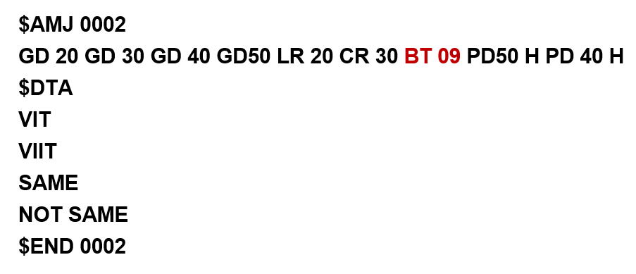
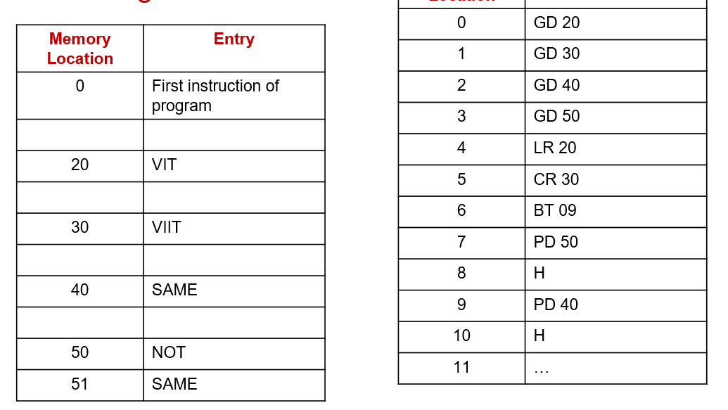
SECOND PROGRAM
Influence of "LR20CR30BT09"
Load Register (LR20): Loads data from memory block 20 into a register for manipulation.
Compare Register (CR30): Compares the loaded register's value with data in memory block 30, setting a condition flag.
Branch on True (BT09): If the comparison is true, control transfers to instruction block 09, enabling conditional execution.

