Slide 1
Fid’Lin: Sprint 3
Team 2
Jakob Beckleheimer, Dylan Brownell, Tanner Groll, Derek Pendleton, & Phil Snider
Notes:
We are team 2, our project is the app that assists a player who wishes to play the fiddle or violin.

Slide 2
UML Diagrams and Updated Documents

Slide 3
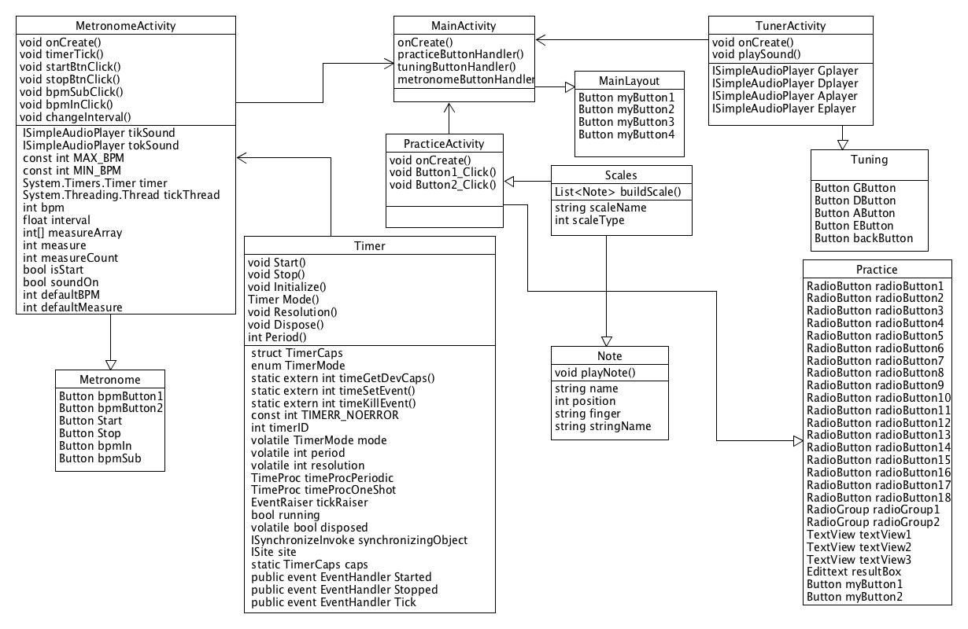

Slide 4
User Interface
Leavin this one for Tanner

Slide 5
Scaling

Slide 6
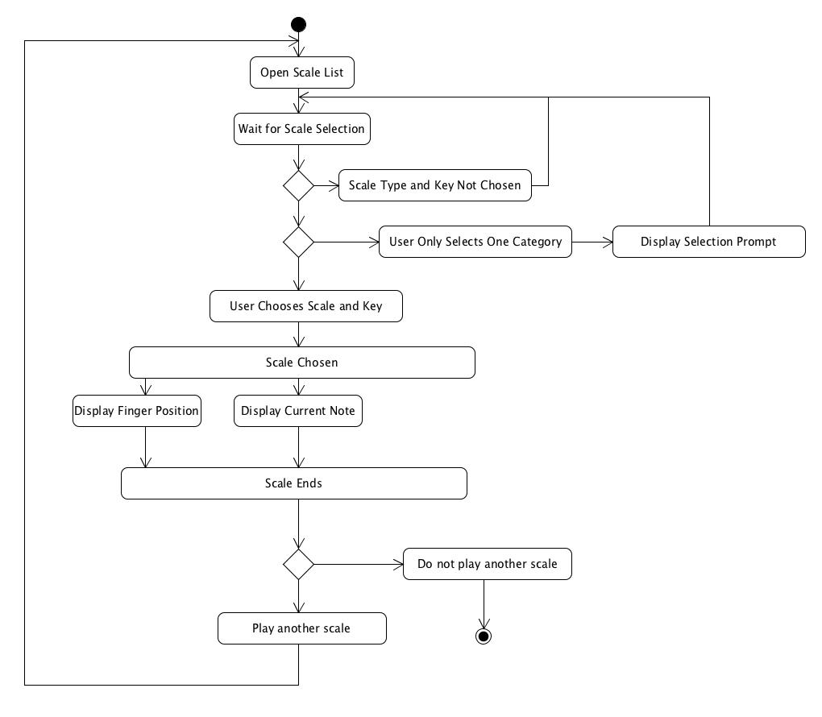

Slide 7
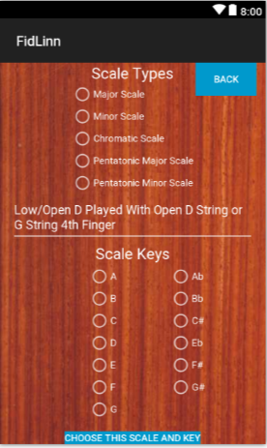
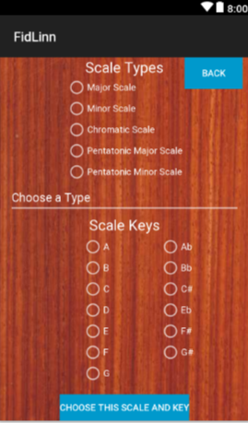
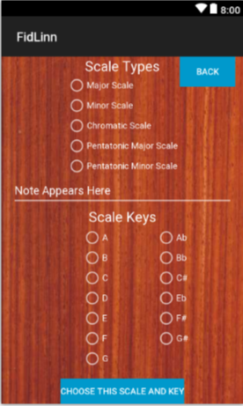
User selects scale type and key, one of each otherwise error
App builds the scale
Displays each note name and finger position for 3 seconds in screen center
Good Input
Bad Input
Default

Slide 8
Metronome

Slide 9
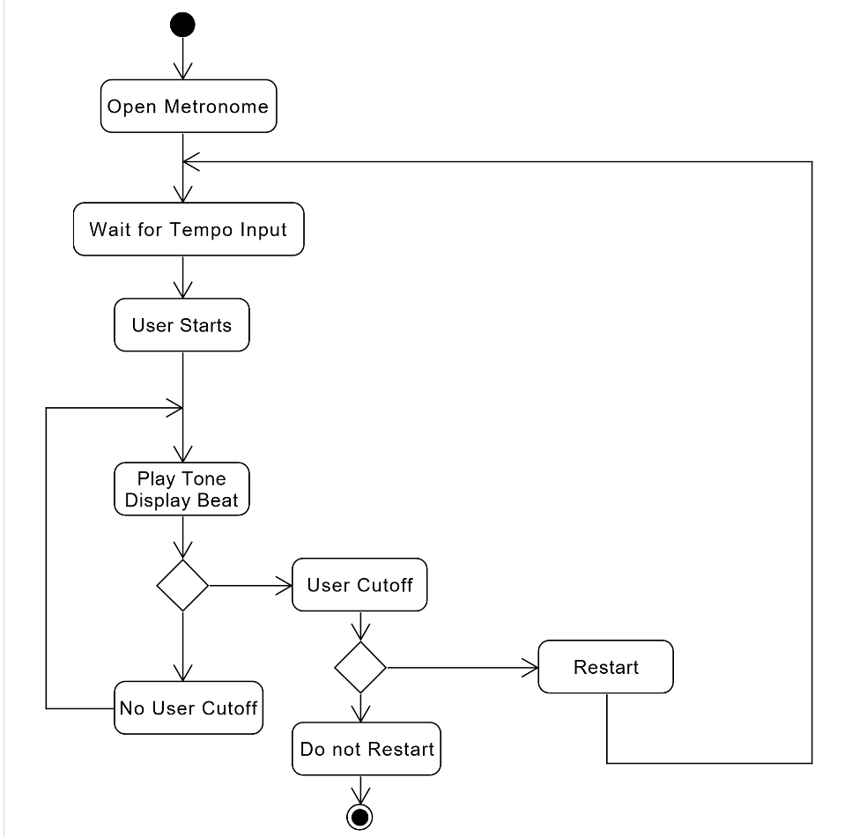

Slide 10
Tuning (the beast)
Vocal Processor Demonstration
The Challenge of Adding it to the Program

Slide 11
