Slide 1
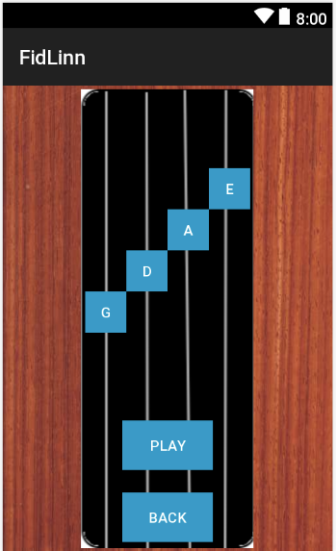
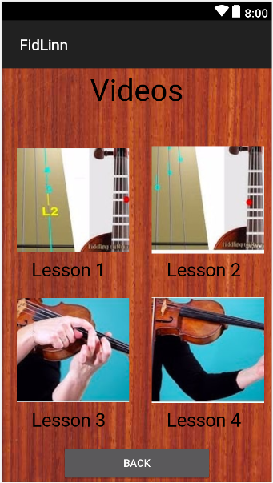
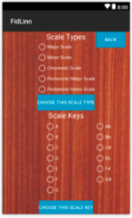
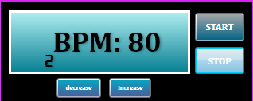
Fid’Lin
Jakob Beckleheimer, Dylan Brownell, Tanner Groll, Derek Pendleton, & Phil Snider
Team 2
Summary
Project Description
Methods & tools used
Fid’Lin, the fiddle / violin player practice app, is an application intended to aid fiddle or violin players in learning how to play and practice their instrument. The app shall assist with tuning, intonation, scales, tempo, etc.
A functioning mobile app in which its purpose is to assist the user in various ways for the fiddle or violin. It allows the user to create a profile and keep up with progression on learning their instrument. It additionally helps the player tune their instrument by recording the pitch of the instrument and notifying the user to tune the instrument to a higher or lower pitch. This app also helps the user learn basic scales and keeps up with tempo using a metronome. The app has built in support for all major and minor scales, both major and minor, as well as chromatic scales in first position. It covers two octaves.
The application was written entirely in C#. It was built using Visual Studio Community 2017 using Xamarin forms for Android development. Source control for the project what done with GitHub. Communication for the project was done primarily through Discord. Project assignments and team organizations was handled using a standard Trello board.
Motivation
Learning to play a musical instrument can be a difficult and time consuming process. Regular practice is an important part of learning an instrument. Thus, in order to effectively learn an instrument, practice must be done in an efficient manner. For a stringed instrument such as a fiddle or violin, this means checking if the open strings are tuned correctly as well as checking if the fiddler’s fingers are in the correct position. Our application, FidLin, is created to help fiddle, and violin players alike practice properly in order to get the most effective usage of their time rehearsing. Thus, FidLin will include a profile system to help the user keep up with their progress as they practice their instrument. FidLin allows the user to properly tune their open strings. Additionally, our application gives the user feedback while they play to allow them to determine where they need more practice. By including a metronome, our application also assists musicians to keep a tempo. In order to assist with finger positions and intonation, our application provides practice scales for the user to play along with while providing feedback on what the fiddle player plays. By providing these abilities our application assists fiddle players to make the most of their time practicing.
Results
Metronome Window
(UI not finalized)
Tuning Menu
Scale Menu
Video Menu

