Slide 1
Finishing up Fid’Lin
Team 2
Jakob Beckleheimer, Dylan Brownell, Tanner Groll,
Derek Pendleton, & Phil Snider

Slide 2
This iteration we…
Cleaned up the brain tuning function
Updated use case, sequence, and state diagrams
Created a new class diagram to align with final product
Created a lessons learned document
Cleaned up application UI for all three features as well as the main menu
Updated all documents to align with final product deliverable
Developed future plans and strategies for implementing wanted features
Reduced Inefficient Code

Slide 3
C# and Xamarin Forms
Not your average .NET project.
Plug-ins necessary to do many normal tasks.
System specific tasks such as timers
Large number of additional libraries to support mobile development.

Slide 4
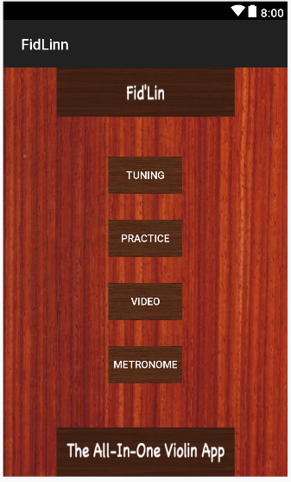
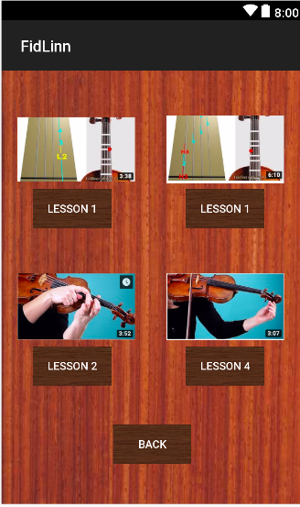
Menu UI / Video Ui

Slide 5
Tuning
Brain Tuning
Push button system
Stop button for convenience
Only one sound at a time

Slide 6
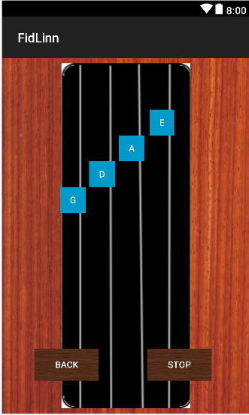
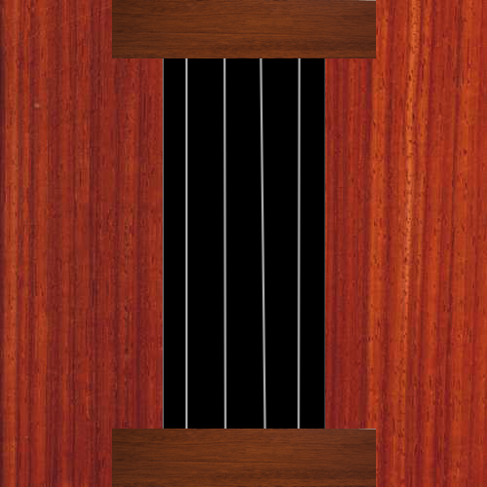
Tuning UI

Slide 7
Scales
User selects a scale type and a key (limited to one selection)
App builds the scale
Displays each note name and finger position for 3 seconds in screen center
Supports Diatonic Major/Minor, Pentatonic Major/Minor, Chromatic scales
Each scale covers a single octave
2 total octaves are covered by the provided scales, first position notes
Changes? Expanded list layout, redesign to one selection grouped by type

Slide 8
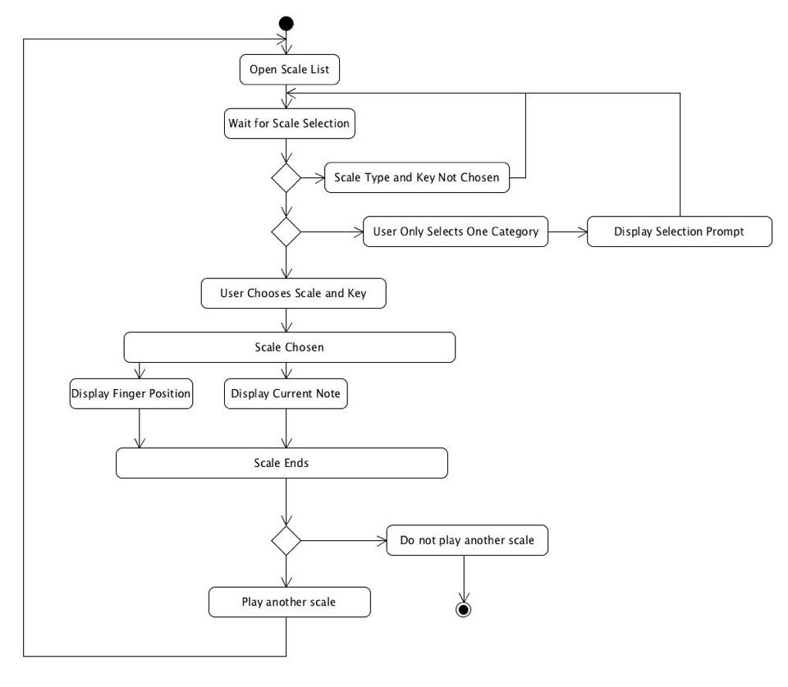

Slide 9
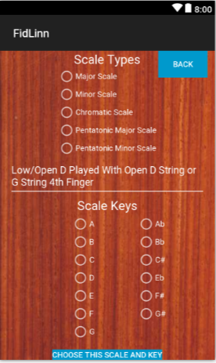
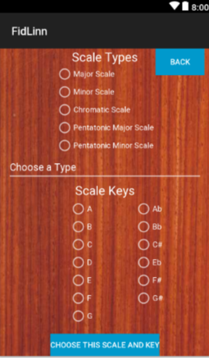
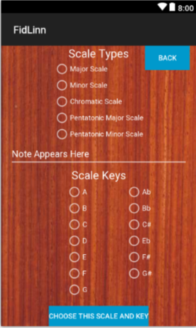
Scales UI
Good Input
Bad Input
Default

Slide 10
Metronome
Measured in beats/minute (ranging from 30 - 280)
Adjustable bpm, using an increase/decrease function
Utilizes contrasting tik/tok sounds to replicate traditional metronomes

Slide 11
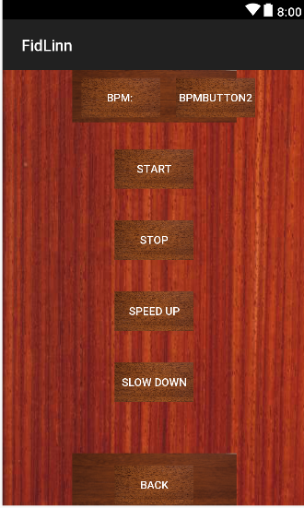
Metronome UI

Slide 12
Documentation
Project Document’s user documentation completed, management and design subsections edited heavily to reflect our final work
Key documents are embedded within document within the appropriate sections as well: BRS, Product Backlog, Project Milestones, Test Plan
Project Milestones and Product Backlog were updated most frequently as these were a key part to our implementation strategy and change management
System Diagrams included within Project Document to provide insight into our system architecture as well

Slide 13
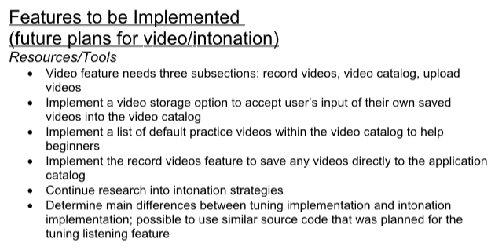
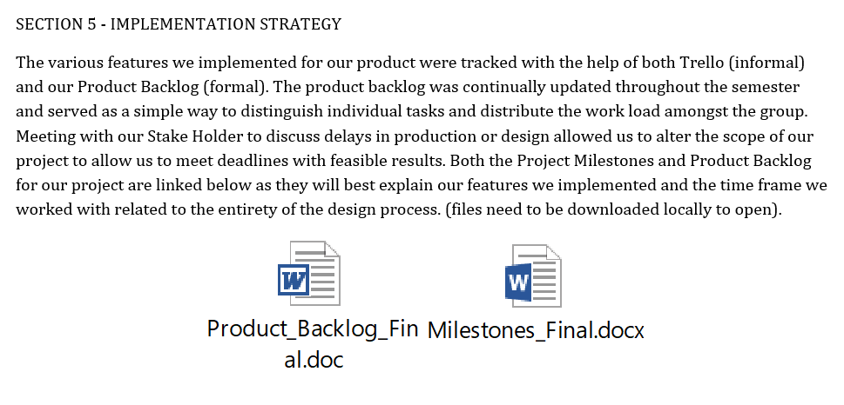
Documentation cont...
Product backlog and Project Milestones updated to include our future goals and strategy implementing future features
Test Plan includes sections related to these features as well as some test cases
Use Case diagram reflects the scope of the project with these features in mind as well
These recent additions provide a good outline for the strategy needed to implement these features
All other documentation and parts of these documents reflect the current, final product

Slide 14
Improvements from Last semester
(Software engineering)
Prioritized documentation, not only the initial documents but also updating documents throughout entire project
Constant communication throughout the semester
Remote Desktop
Team Coding
Have a functional product
Didn’t get (too) behind

Slide 15
What we could have done better as a team
Should have gotten a lot more code completed during Sprint 2 than we did.
Better game plan to take care of all functional requirements
Making sure things aren’t getting completed last minute
Time management

Slide 16
What we have learned from this course
The more communication between the team, the better.
The earlier things get completed, the better.
Procrastination is not your friend.

