Slide 1
Fid’Lin: Sprint 3
Team 2
Jakob Beckleheimer, Dylan Brownell, Tanner Groll, Derek Pendleton, & Phil Snider
Notes:
We are team 2, our project is the app that assists a player who wishes to play the fiddle or violin.

Slide 2
UML Diagrams and Updated Documents

Slide 3
User Interface
Leavin this one for Tanner

Slide 4
Intonation Game

Slide 5
Scaling

Slide 6
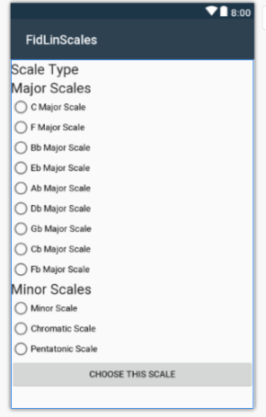

Slide 7
Metronome

Slide 8
Tuning (the beast)
Vocal Processor Demonstration
The Challenge of Adding it to the Program

