Slide 1
Fid’Lin to Sprint 2
Team 2
Jakob Beckleheimer, Dylan Brownell, Tanner Groll, Derek Pendleton, & Phil Snider
Notes:
We are team 2, our project is the app that assists a player who wishes to play the fiddle or violin.

Slide 2
UML Diagrams and Updated Documents
New Gantt Chart (bye excel)
Updated Project Plan
Updated Project Document
New test cases

Slide 3
Slide for dat gantt bro

Slide 4
Project Document
Added a little terminology
Updated a few sections

Slide 5
Test Cases

Slide 6
User Interface
Leavin this one for Tanner

Slide 7
Workload Distribution
Derek – Tuning
Phil, Dylan, and Jakob – Intonation, Scaling, Metronome

Slide 8
Intonation Game

Slide 9
If things go right..

Slide 10
Plan b

Slide 11
Scaling

Slide 12
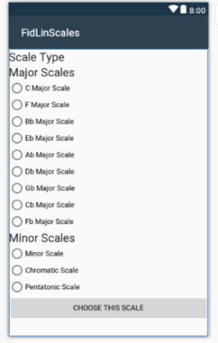

Slide 13
Metronome

Slide 14
Tuning (the beast)
Vocal Processor Demonstration
The Challenge of Adding it to the Program

Slide 15
Plan B
“Brain Tuning” – Essentially playing the sound as it should be and expecting the user to match it.

Slide 16
Updated Plan For Sprint 3
Functioning build of all features connected to the user interface.

