Slide 1
Fid’Lin: Sprint 3
Team 2
Jakob Beckleheimer, Dylan Brownell, Tanner Groll, Derek Pendleton, & Phil Snider
Notes:
We are team 2, our project is the app that assists a player who wishes to play the fiddle or violin.

Slide 2
Since Sprint 2…
Reviewed, updated, and created new UML Diagrams and documents.
Got Brain Tuning, Scales, and metronome functioning and ready to be presented.
Poster document completed.

Slide 3
UML Diagrams and Updated Documents
Updated Test Plan, Project Milestones, and Product Backlog
Created a new, updated Class Diagram that better reflects our current product

Slide 4
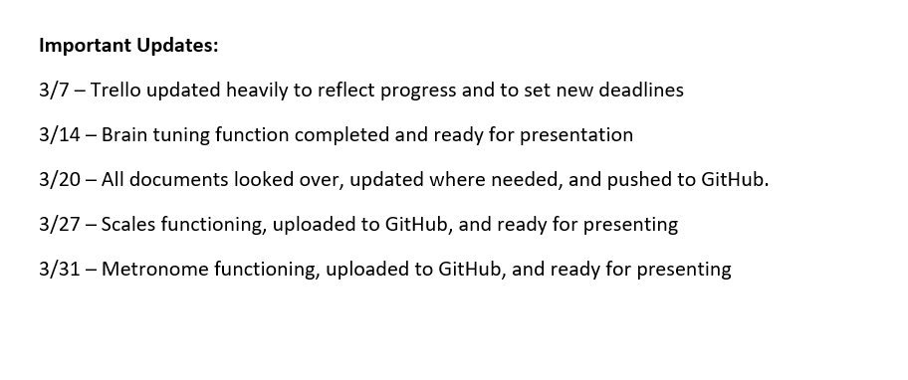
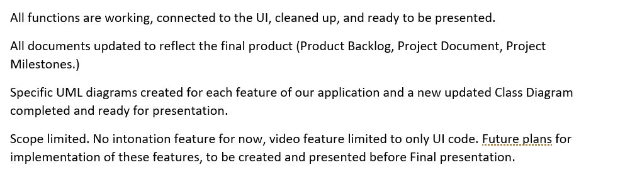
Preview of recent additions to our Milestones
Project Milestones heavily updated to better reflect our actual progress.
Included goals that we wanted to meet by this sprint, as well as by the final presentation.
Test plan changed to include only test cases we have completed/plan to complete.
Change to scope has forced us to omit some previously planned test cases in order to make time for the necessary testing of core features.

Slide 5
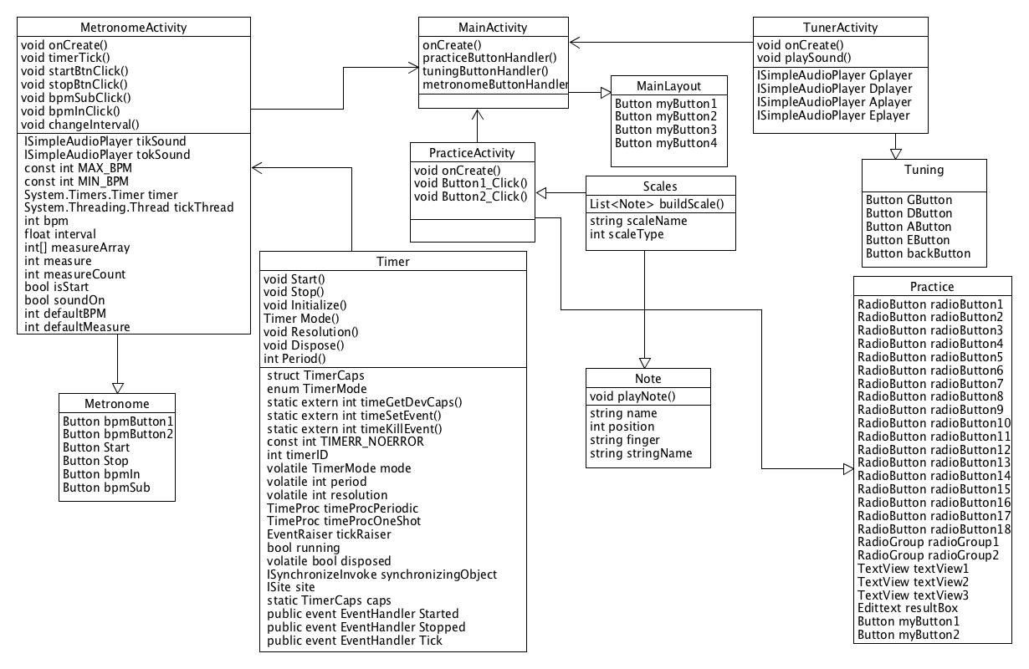

Slide 6
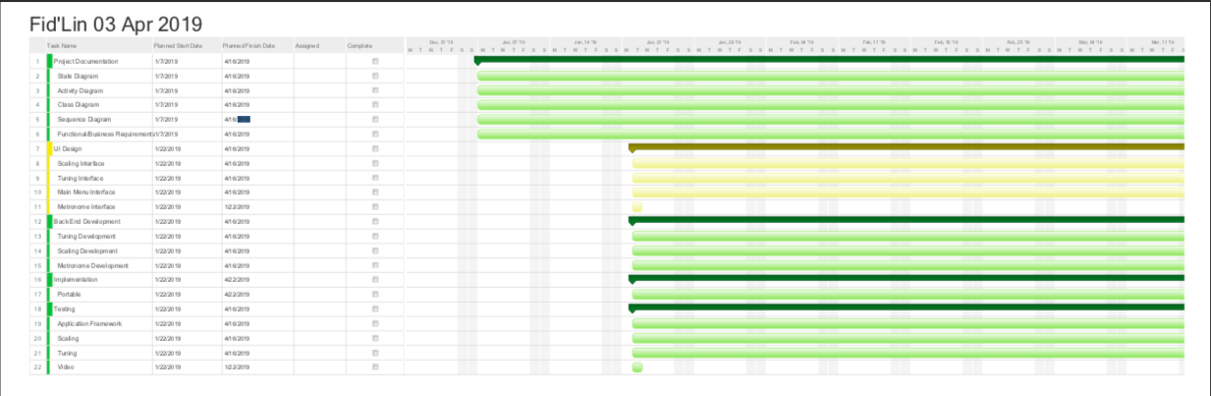
Gantt

Slide 7
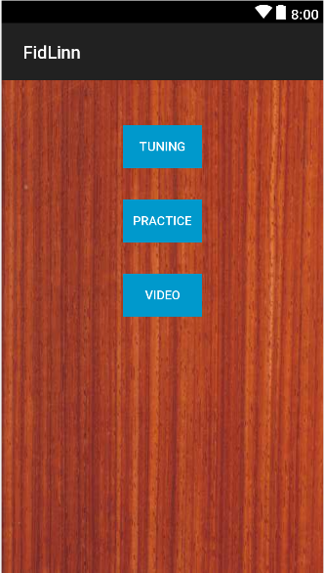
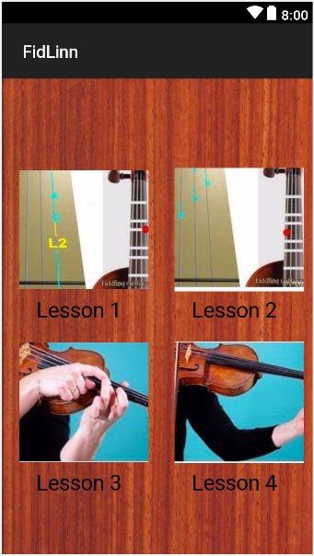
User Interface
Current:
Simple/Basic
Ensuring Button / Features work
PortraitMode
Future:
Considerably better visuals
More “violin/fiddle” themed
Possibly ability to change layout

Slide 8
Scaling

Slide 9
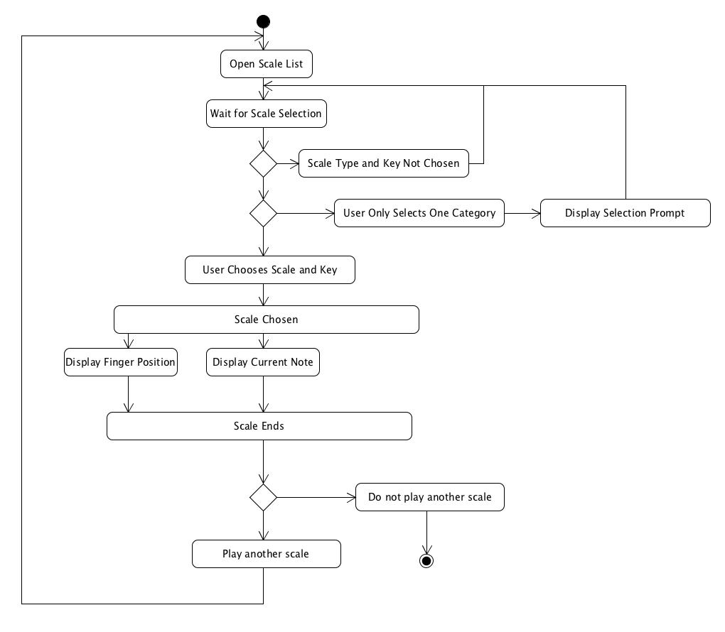

Slide 10
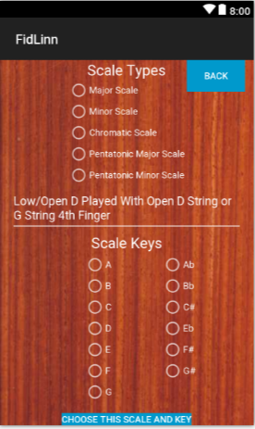
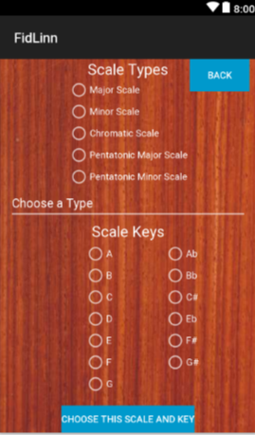
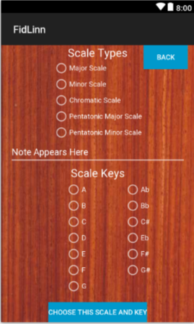
User selects scale type and key, one of each otherwise error
App builds the scale
Displays each note name and finger position for 3 seconds in screen center
Good Input
Bad Input
Default

Slide 11
Metronome

Slide 12
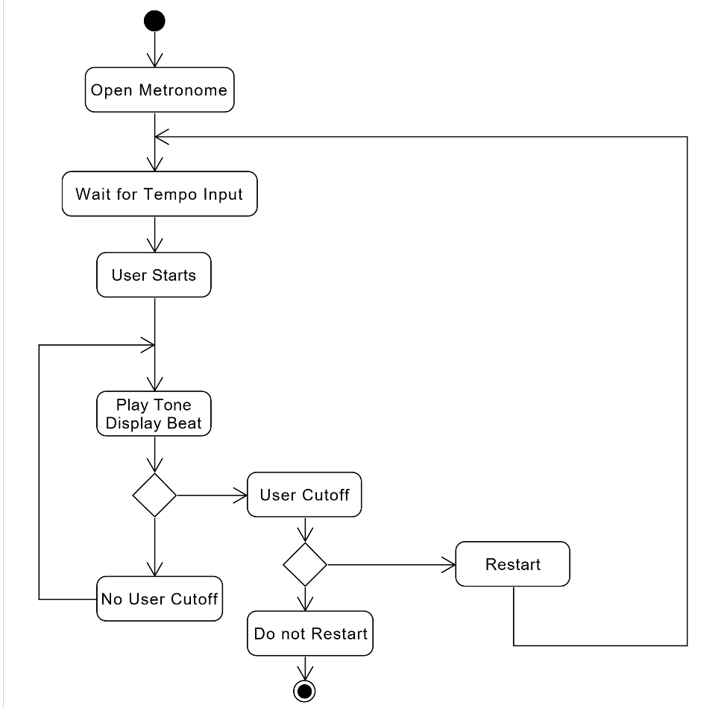

Slide 13
Tuning
Brain Tuning Functionality
Smart Play – Only One String at a Time

Slide 14
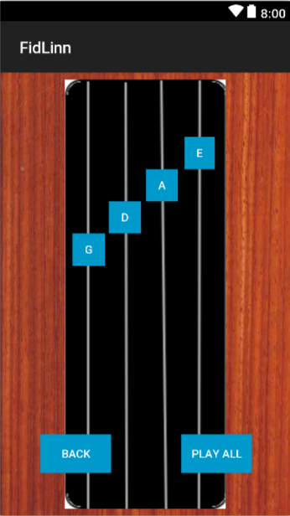

Slide 15
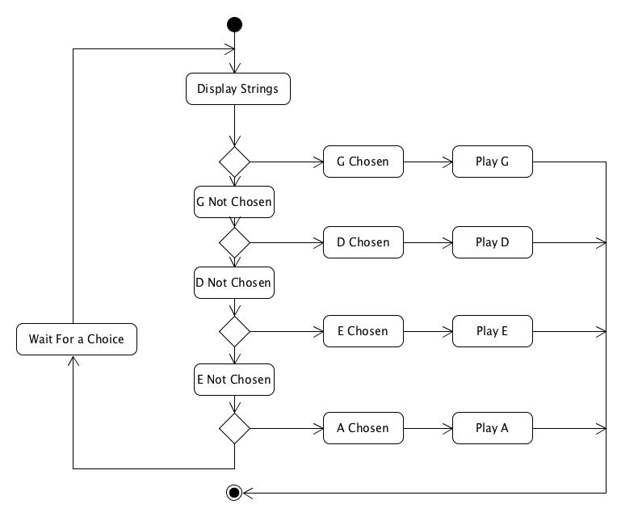

Slide 16
Plan for Final Sprint
Review the working functions and clean them up where needed.
Finish up any diagrams / documents needed
Prepare for the symposium

