Slide 1
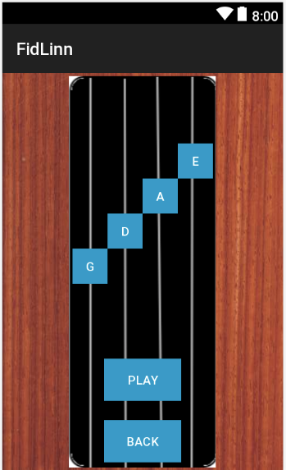
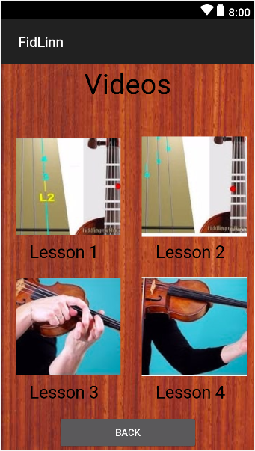
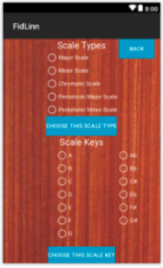
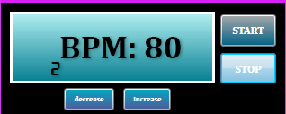




Fid’Lin
Jakob Beckleheimer, Dylan Brownell, Tanner Groll, Derek Pendleton, & Phil Snider
Team 2
Summary
Project Description
Methods & tools used
Fid’Lin, the fiddle / violin player practice application, is an application intended to aid fiddle or violin players in learning how to play and practice their instrument. In order to aid musicians in both tuning their open strings and keeping specific tempos, our application provides tuning support as well as a metronome feature. Additionally, this application allows the user to play various scales to get a broader idea of how their instrument should sound. The features within Fid’Lin are designed in a manner to aid the user in as many areas as possible while minimizing application startup/setup time, and also remaining compact and easy to navigate so that our users can utilize their practice time to the fullest.
Developed a functioning, mobile application with the goal of providing a range of tools related to practicing the fiddle or violin. The application aims to be an all-inclusive musical aid so that users can maximize their time spent practicing. Some of our features include a tuning aid to help the player tune their instrument by playing back recordings of the instrument’s specified note. The user can also learn basic scales and keep up with tempo using our metronome, which allows for any tempo between 30-210 bpm (allowing for all tempi, anywhere between Grave and Prestissimo.) The app has built in support for all major and minor scales, both pentatonic major and pentatonic minor, as well as chromatic scales in first position. It covers two octaves.
The application was written entirely in C#. It was built using Visual Studio Community 2017 using Xamarin forms for Android development. Source control for the project what done with GitHub. Communication for the project was done primarily through Discord. Project assignments and team organizations was handled using a standard Trello board.
Results
Motivation
Learning to play a musical instrument can be a difficult and time consuming process. Regular practice is an important part of learning an instrument. Thus, in order to effectively learn an instrument, practice must be done in an efficient manner. For a stringed instrument such as a fiddle or violin, this means checking if the open strings are tuned correctly as well as checking if the fiddler’s fingers are in the correct position. The current market lacks an application that aids in all of these fields while also maintaining ease of use. We set out to create an all-inclusive fiddle / violin practice app that would remain simplistic in nature as to allow first time users to hop right into their practice without wasting time learning the intricacies that many modern application come with.
Metronome Window
Application being all-inclusive means that we also provide our users with a metronome feature to keep a desired tempo while they practice
Tuning Menu
This feature allows users to tune their instrument which is the first step to practice.
Video Menu
Menu that hosts practice videos for the user to follow.
Scale Menu
Key feature that provides users with feedback while they play various scales

