Slide 1
Markov Chain and Hidden Markov Chain Models
Ji-Ping Wang
Department of Statistics
Northwestern University

Slide 2
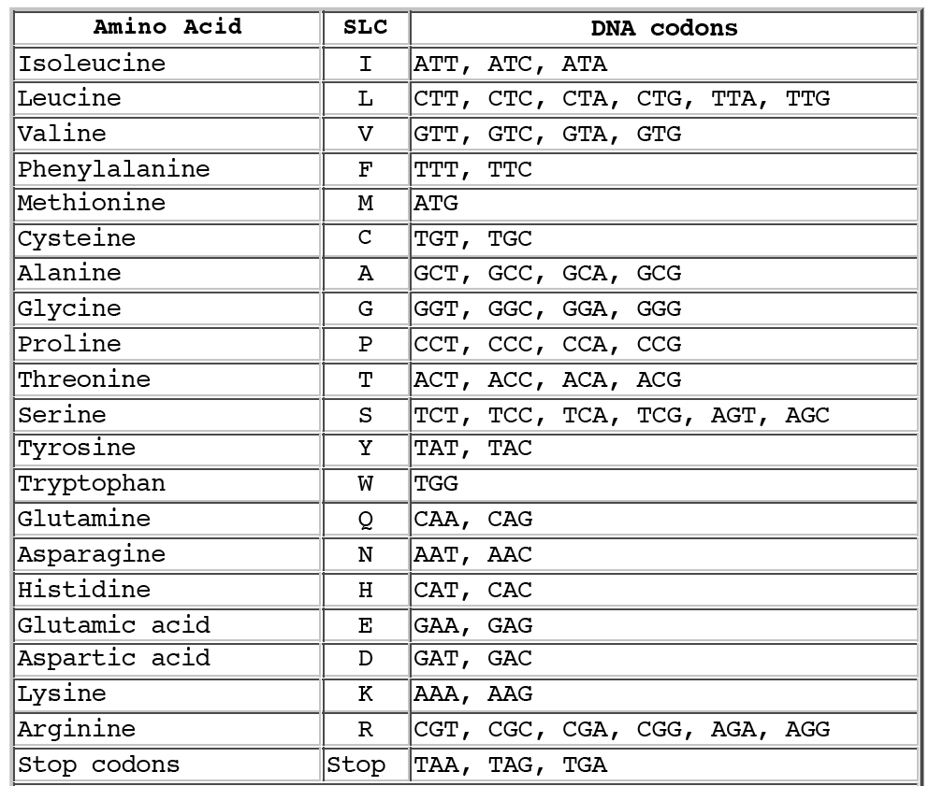
Codons

Slide 3
Non-randomness of DNA and protein sequences
Codon bias: amino acids favor different codons in different scenarios, causing bias in nucleotide frequency.
Base composition bias: ACGT may have genome wide unbalanced, eg. G, C content can vary, coding vs non-coding.
Sequential dependence bias: eg. CpG island, di-nucleotides, or tri-nucleotide frequencies vary across different regions of genome or by functionsl.

Slide 4
Markov chain model
A Markov chain describes the probability of the occurrence of a run of events if they are sequentially dependent.
A discrete-time markov chain is defined by a set of states associated with probabilities for sequential transition from one state to the other (transition probabilities).

Slide 5

Markov Chain Model
Suppose observe a sequence x of length L, ie: x₁x₂x₃x₄…x_{L,}
P(x) =P(x_{L}, x_{L-1}….x₁)
= P(x_{L}|x_{L-1}….x₁)P(x_{L-1}….x₁)
= P(x_{L}|x_{L-1}….x₁)P(x_{L-1}|x_{L-2}….x₁)…..P(x₁)
A first order Markov Chain assumes that probability observing x_{i} only depends on the previous state x_{i-1,} and hence
    P(x)=P(x_{L}|x_{L-1})P(x_{L-1}|x_{L-2})…P(x₁)
    P(x_{L}|x_{L-1}) is called transition probability from x_{L-1} state to x_{L} state.

Slide 6
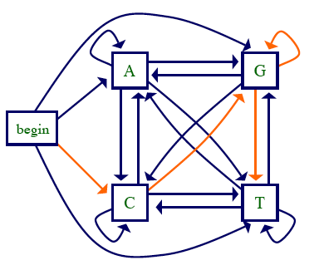
Homogeneous Markov model for DNA
The transition probabilities is constant across all i=1,…L for a sequence of length L.
e.g., P(G|C)=constant at different positions
P(CGGTCG)= P(C)P(G|C)P(G|G)P(T|G)P(C|T)P(G|C)

Slide 7
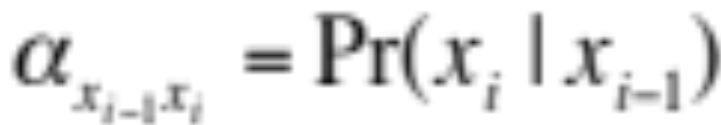
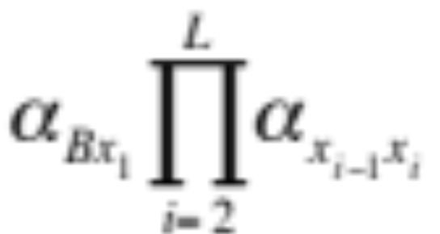
Markov Chain Models
Beginning state can be added, because often the
probability distribution at the beginning of a sequence
is different. For example, Start codon always is ATG
(corresponding to amino acid M).
Beginning state is a “silent” state.
Define the transition probability
The probability observing a sequence x is:

Slide 8
Example--CpG island
In the genome where CpG appears, G tends to be modified by methylation such that G has a high chance to mutate to T.
Dinucleotide CG appears with a higher frequency in biologically important regions.
How would we decide whether a given sequence is from CpG island or not?

Slide 9
Idea
CpG frequency measures the sequential
dependence of C and G, a Markov model seem to
meet this needs.
If we can find the difference of probability
distribution for CpG island and the sea, then
we can construct the contrast of likelihood under
the two models.

Slide 10
Maximum likelihood estimation in model training
If you have training sequence from CpG island
  ACGTAGTCGGCTACGACGAC
  the maximum likelihood estimate for
  P(x_{i}=G|x_{i-1}=C)=#(CpG)/Total # of transitions from
  C to any other letter
  i.e. P(CpG)=4/19 P(G|C)=4/6
If one has a whole set of training sequences from both the island and the sea, two transition matrices can be trained.

Slide 11
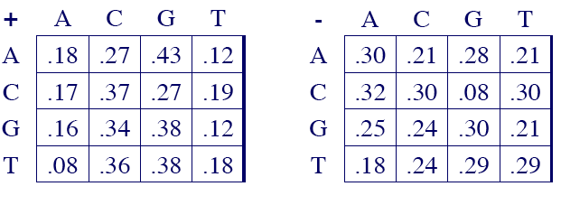
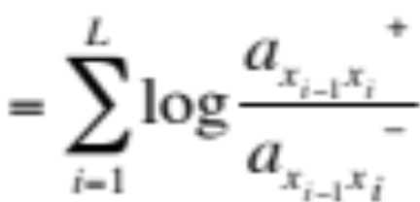
Markov Chain for discrimination
Transition matrix for Island and sea:
Likelihood ratio score:
S(x)=log(P(x|+)/P(x|-))
where + means island, - means sea

Slide 12
CpG island Discrimination
Given a sequence(like chromosome) containing both island and sea, one could construct a moving window of size 100.
For each window, construct the likelihood ratio score S.
Plot S versus location of the window would show the prediction of CpG islands.

Slide 13
Question remains
Can CpG island have a sharp boundary?
Window construction can unsatisfactory if so.
If so, can we find most probably boundary of the island and sea?
This require a different model

Slide 14
High order Markov Chain
The first order Markov Chain defines that the probability of current state only depends on the previous one, ie. P(x_{i}|x_{i-1})
A second order model define the transition probability based on previous two states, ie P(x_{i}|x_{i-2}x_{i-1})
Under this model, TA-->C, GA-->C can have different transition probabilities.
This makes perfect sense because codon requires three nucleotides!

Slide 15
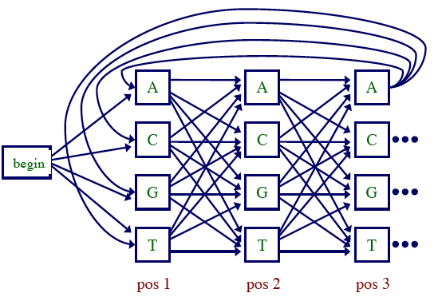
Inhomogeneous Markov Chain
A markov chain is inhomogeneous if the the transition probabilities depend on the position of the sequence.
Example: A markov
chain of the first order
with two different
transition matrices.

Slide 16
Intro to Hidden Markov Model
A e₁(A)
C e₁(C)
G e₁(G)
T e₁(T)
A e₂(A)
C e₂(C)
G e₂(G)
T e₂(T)
Emission
α₁₂
π₁
π₂
α₂₁
Observe: GCGATGCAGTACATGC GCGTATATGTCACTAC
Hidden:
π₁π₁π₁…………………π₁π₁π₂π_{2………………………………} π₂

Slide 17
HMM
HMM contains the two parts: observed emissions and hidden states.
Transition of states from k to l according to
α_{kl}=P(π_{i}=l | π_{i-1}=k)
        Σ_{l} α_{kl}=1.
Emission of A, C, G, T is conditioning on the current state.
e_{k}(A)=P(x_{i}=A | π_{i}=k)

Slide 18
HMM
HMM was first used successfully in speech recognition by Rabiner (1989).
HMM is extremely useful for identifying the functional regions (hidden states) in genomic sequences using the observed sequences.
  e.g., CpG island and sea can be treated as two states, the emission difference can be used to infer states.
  Intro, exons, inter-genetic regions can be classified as different states.

Slide 19
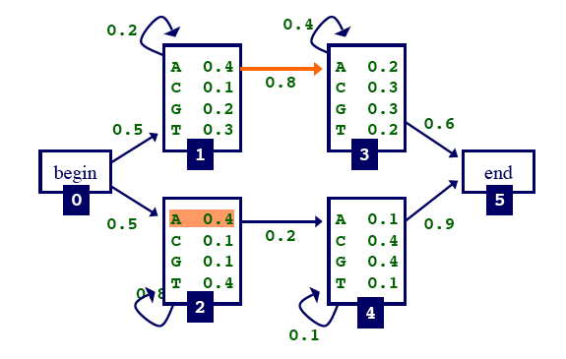
Beginning and end states
Beginning and end states are designed for possibility that the first
or last letter(s) prefer particular states. eg. 1 and 2 for beginning,
and 3 and 4 for end.
Beginning and ending states do not have emission. They are
called “Silent states”.

Slide 20
Algorithms in HMM
Calculate P(x) for an observed sequence
  Forward algorithm
Find the most probable “path” (π) for the hidden states.
  Viterbi algorithm
Learn HMM parameters given sequences.
  Forward-backward(Baum-Welch) algorithm

Slide 21
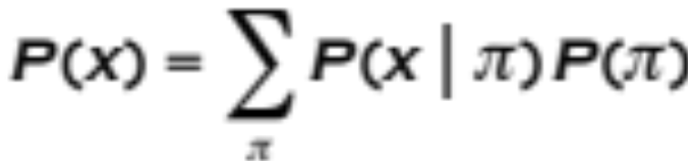
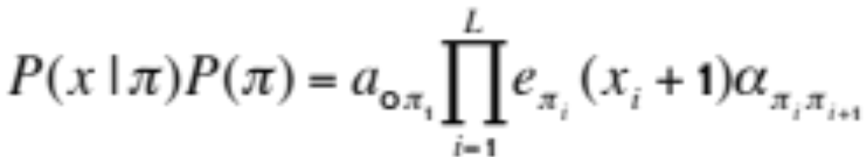
How likely is a given sequence?
The probability to observe x over all possible paths is:
where for each path p, the joint probability P(x,π) is
Note: π=(π₁,π₂,π₃,…π_{L})

Slide 22
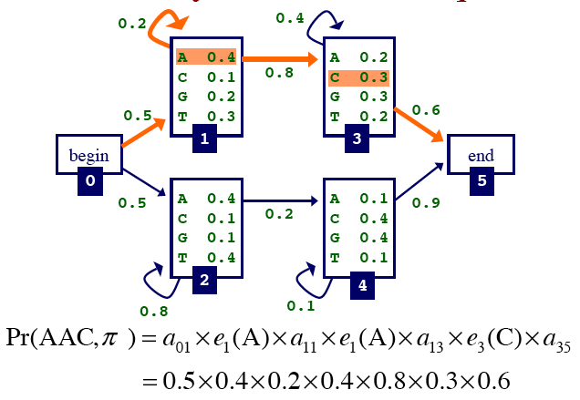
An example

Slide 23
Finding the most probable path--decoding by Viterbi algorithm
We want to find
  π = arg Max_{π} P(x, π)
Define v_{k}(i) to be the probability that under most probable path, that x_{i} ends in state k , then
v_{l}(i+1)=e_{l}(x_{i+1})Max_{k}{v_{k}(i)α_{kl}}

Slide 24
Viterbi algorithm
Initialization
  v₀(0)=1, v_{k}(0)=0
Recursion
v_{l} (i+1)=e_{l} (x_{i+1}) Max_{k} {v_{k}(i)α_{kl}}
ptr_{i} (l)= arg Max_{k} {v_{k}(i)α_{kl}}

Slide 25
Viterbi algorithm
Termination
P(x,π*)= Max_{k} {v_{k}(L)α_{k0}}
π_{L}∗= arg Max_{k} {v_{k}(L)α_{k0}}
Trace back, π_{i-1}∗=ptr_{i}(π_{i}∗)

Slide 26
Comments about Viterbi algorithm
Viterbi algorithm is very similar to dynamic programming in the pairwise alignment, where the path giving the optimal score in each step is recorded.
The v value calculated in the termination step by P(x,π*)= Max_{k} {v_{k}(L)α_{k0}} actually is the maximum likelihood.
The path decoded π = (π_{i}∗, π_{i-1}∗,...π_{1∗}) is the
maximum likelihood estimate of the path.

Slide 27
Forward algorithm for P(x)
Define
      f_{k} (i)=P(x₁,..x_{i},π_{i}=k)
P(x₁,..x_{i} )=Σ_{k} f_{k}(i)
Initialization
f₀ (0)=1, f_{k} (0)=0 for k>0

Slide 28
Forward algorithm for P(x)
Recursion:
        f_{l} (i+1)=e_{l} (x_{i+1})Σ_{k} f_{k}(i)α_{kl}
Termination
      P(x)=Σ_{k} f_{k}(L)α_{k0.}
      α_{k0} is the transition from k to the end state.
      α_{0k} is the transition from the beginning to kth state

Slide 29
Casino example
1 1/6
2 1/6
3 1/6
4 1/6
5 1/6
6 1/6
1 1/10
2 1/10
3 1/10
4 1/10
5 1/10
6 1/2
Emission
0.95
0.9
α₁₂
0.05
π₁
π₂
α₂₁
0.1
Fair
Loaded

Slide 30
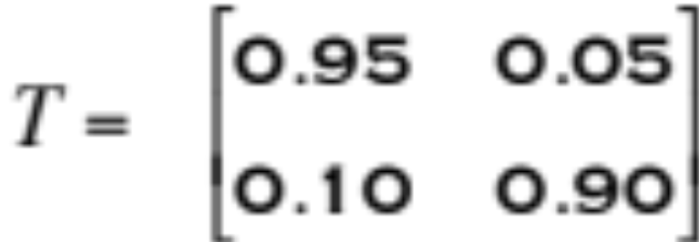
Transition matrix
0
1
0
1
Stationary probabilities: (limit distributions)
P(a random letter is in state 0)=2/3
P(a random letter is in state 1)=1/3
I use these probabilities as beginning and ending transition probabilities.

Slide 31
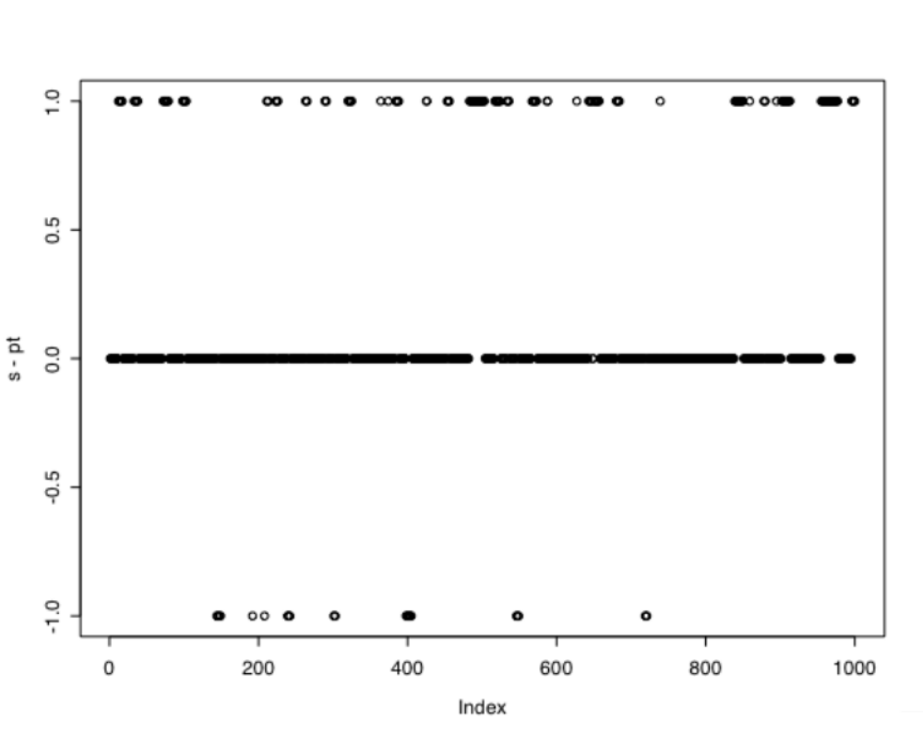
Viterbi algorithm results
State: 0, 1
s: true path
pt: predicted
plot(s-pt)

