Slide 1
HMM Learning
Ji-Ping Wang
Department of Statistics
Northwestern University

Slide 2
The learning problem
Given
  a model
  a set of sequences (training set)
How to
  fit the model to the sequences
  estimate the parameters in the model
  apply model to new sequences, make prediction

Slide 3
Model training
Example
  In the CpG island example, sequences with classification “+” and “-” are available.
  One can define “+” and “-” as two states, associated with transition matrices T₁, T₂.
  For “+”, one can find p_{AC}=P(A transit to C) by maximum likelihood estimation i.e.,
  p_{AC} =#(AC)/#transitions from A to C,G,T
  Given a new sequence, one can infer the probable path, i.e. each nucleotide will be associated with either “+” or “-”.

Slide 4
Gene finding problem
Initial
Exon
Internal
Exon
Internal
Exon
Terminal
Exon
A gene can be fragmented into different functional regions, e.g. coding regions: initial exon, internal exons, terminal exon; Non-coding regions: introns
A genomic sequence contains both gene regions and inter-genetic regions.

Slide 5
Gene finding problem cont’d
Have a set of annotated genes
Define each region as a HMM state
Estimate the Parameters including transitions by mle
One can predict genes for un-annotated sequences, I.e. where gene starts, what regions correspond to exon, etc.

Slide 6
Questions remain
Viterbi and forward algorithms give most probable path, but without association with probabilities, i.e. P(π_{i}=k|x)?
If the model is not built, parameters must be estimated before applying the model to new sequences.

Slide 7
Backward algorithm
Define: b_{k} (i) = P (x_{i+1},…x_{L} |π_{i}=k)
Initialization: b_{k} (L) = α_{k0}
Recursion:
    b_{k} (i) = Σ_{l} a_{kl} e_{l} (x_{i+1}) b_{l} (i+1)
Termination:
p(x) = Σ_{l} α_{0l} e_{l} (x₁) b_{l} (1)

Slide 8
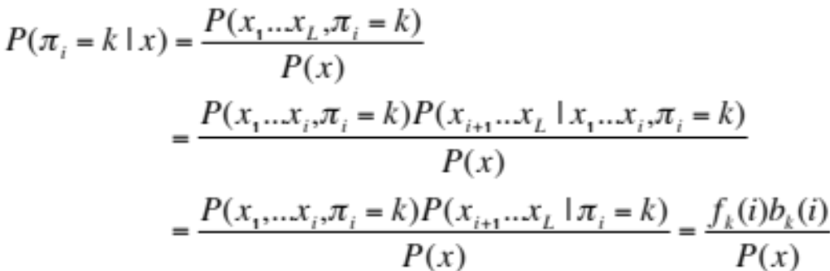
Posterior decoding

Slide 9
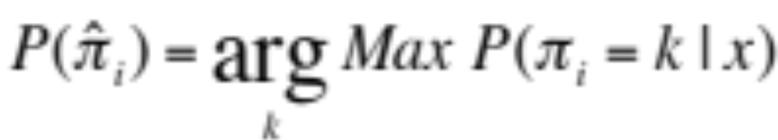
Posterior decoding
Bayesian rule
Is the most probable way under Bayesian prediction the same as that from Viterbi?

Slide 10
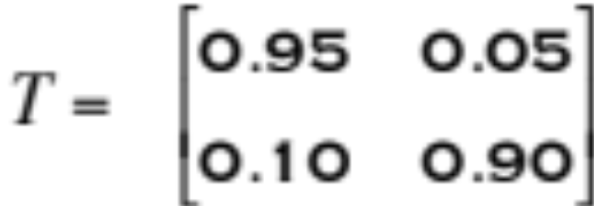
Casino example
1 1/6
2 1/6
3 1/6
4 1/6
5 1/6
6 1/6
1 1/10
2 1/10
3 1/10
4 1/10
5 1/10
6 1/2
Emission
0.95
0.9
0
1
α₁₂
0.05
π₁
π₂
0
1
α₂₁
0.1
Fair
Loaded

Slide 11




True path
Viterbi
prediction
correct=776/1000
Posterior probability
Posterior
decoding
correct= 781/1000

Slide 12
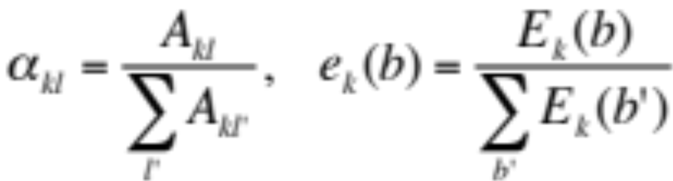
Parameter estimation in HMM
When the sequence path is known in the training data,
where A_{kl} is the total number transitions from state k to l;
E_{k}(b) is the total number b emissions at state k.

Slide 13
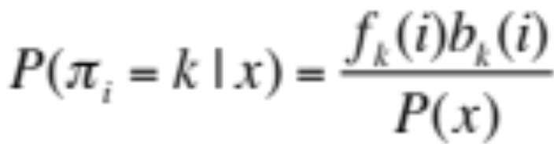
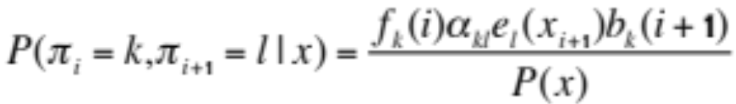
When the path is unknown--EM algorithm (Baum-Welch)
We treat the state sequence π₁π_{2….} as missing
π₁
π₂
π₃
π₄
π_{L}
By posterior decoding-- Expectation step:

Slide 14
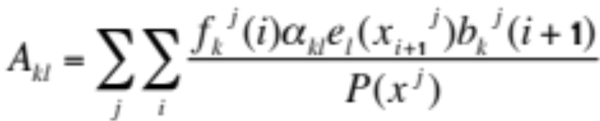
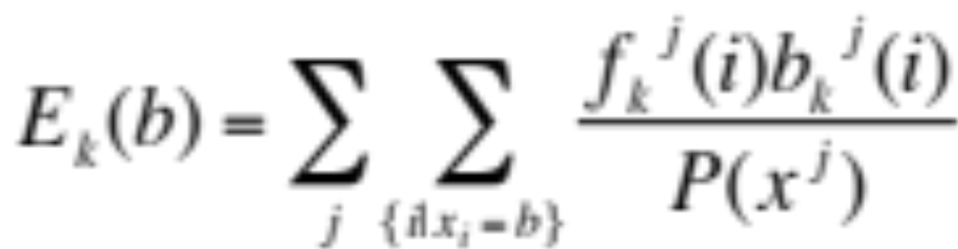
EM algorithm--Maximization step
where superscript j indexes the sequence in the training set.
E_{k}(b) is essentially a count of emission of b weighted by the
probability that the emission is from state k.

Slide 15
EM-M step
Updating HMM by
Initialize the algorithm by setting parameter values tentatively
E step finds the posterior probability given the current
parameter values
M step updates the parameter based on expectation
Run E-M steps iteratively until convergence, I.e., the likelihood
does not increase by a threshold value.

Slide 16
EM
if not converge
Find posterior
probability
Update HMM
parameters θ
HMM|θ₀
E-step
M-step
model specification
Sequences
x^{j,} j=1,…
stop if
converged

Slide 17
Viterbi training
Viterbi training follows a similar procedure as Baum-Weltch (EM).
The expectation step in BW is replaced by viterbi prediction. i.e. states path is explicitly predicted.
Based on path, updates of parameters are obtained.
Iterate between viterbi and parameter updating until convergence.

Slide 18
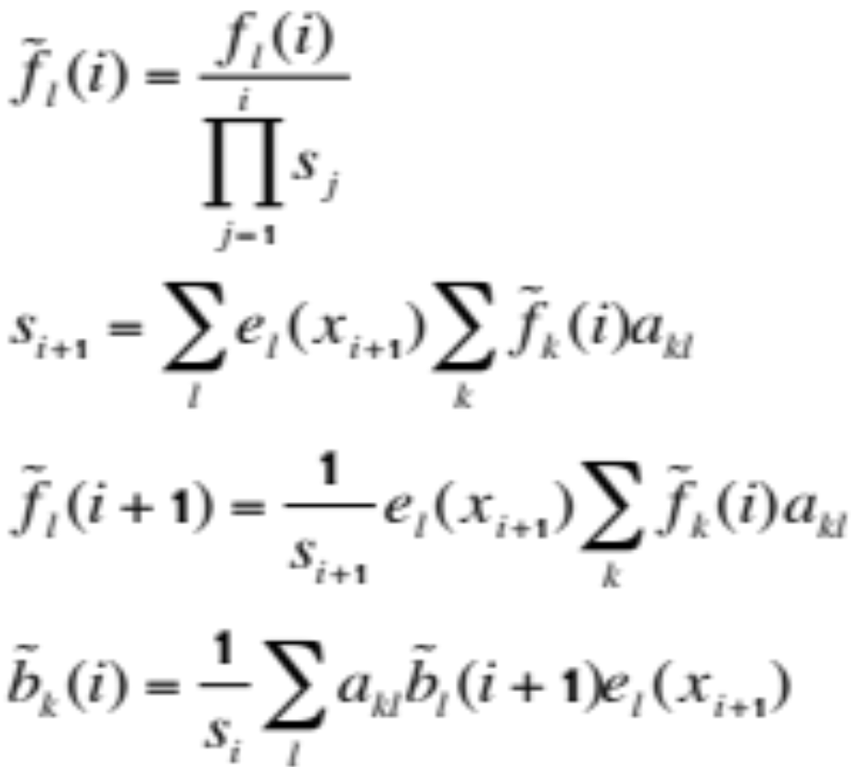
Numerical stability issue
log transformation: viterbi algorithm
Scaling the probabilities:

Slide 19
Duration of states
Under HMM, once the sequence runs in to step k, then the duration n in this state is
    d(k)=α_{kk}^{n-1}(1-a_{kk})
This implies the duration is geometric (or exponential).
The duration modeling by an geometric distribution often is inappropriate.

Slide 20
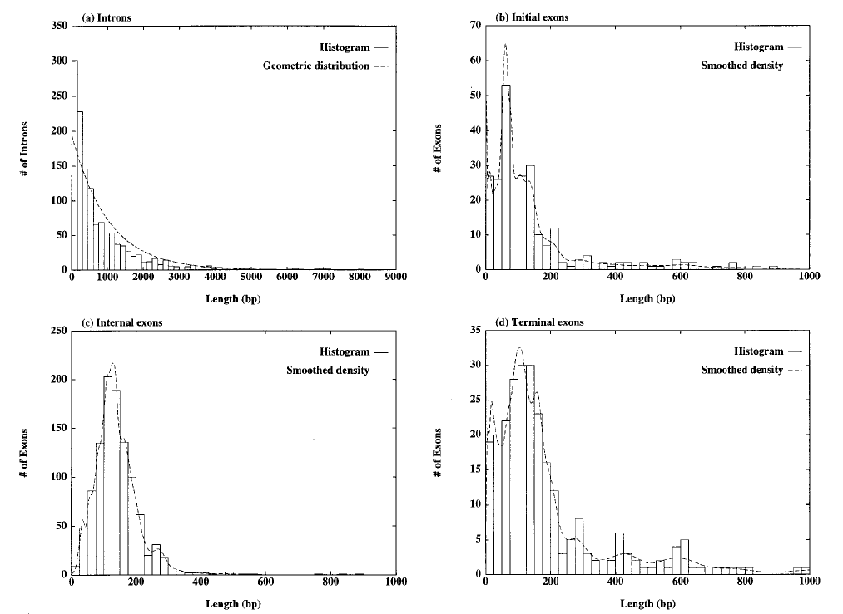
GENSCAN (Burge and Karlin1997)

Slide 21
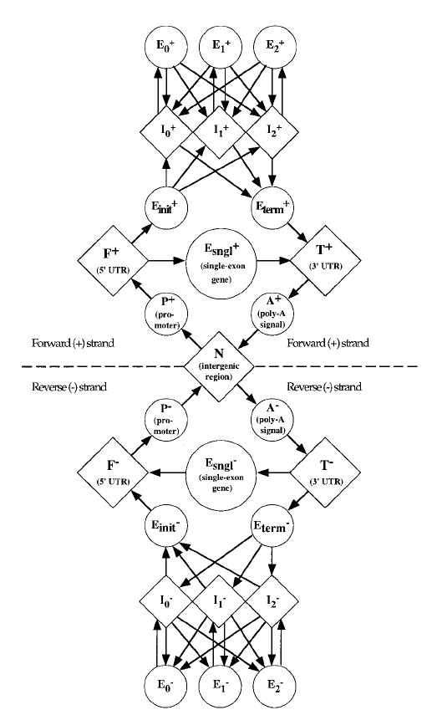
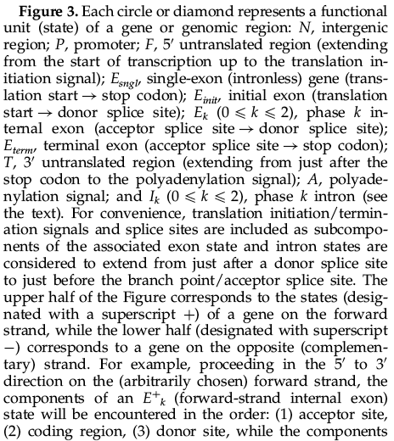
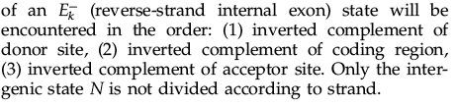
GENSCAN--gene structure prediction

Slide 22
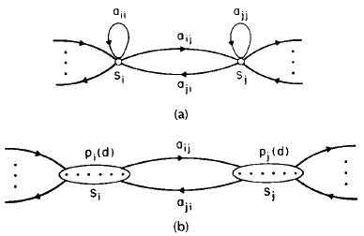
Explicit State Duration HMM (Rabiner 1989)
Regular HMM
Duration HMM
p_{k}(d) models the length
of state k.

Slide 23
Within state modeling
Since the duration is modeled, one could use different models for individual states.
Weight-matrix-method(WMM) : p₁(x₁)p₂(x₂).. where p_{i} stands for the probability distribution at the ith position(column) of the state.
pos:
1
2
A
C
G
T
p₁(x₁)

Slide 24
Other models
Markov chain model:
  First order: weight array model (WAM)
  higher order model: 5th order was used in Genscan for exon model.
  higher order model requires estimation too many parameters, often lack of information for good estimates.
DNA pos
1
2
3
Protein Pos
1
2
3
A
C
G
T
W
C
S
p(x1)p(x₂|x₁)..
p(x1)p(x₂|x₁)..
First order protein sequence
model-->5th order DNA model
WAM model

Slide 25
http://genes.mit.edu/GENSCAN.html

