Slide 1
L5-Differentiation Analysis of Gene Expression
Ji-Ping Wang
Department of Statistics
Northwestern University

Slide 2
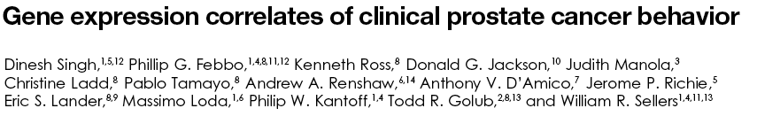
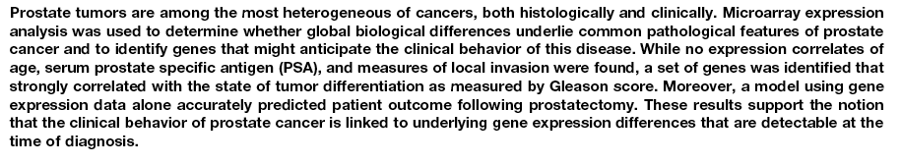
Examples: Prostate cancer by Signh et al 2002
Cancel Cell .
Compare two conditions, each condition
has biologically replicate samples.

Slide 3


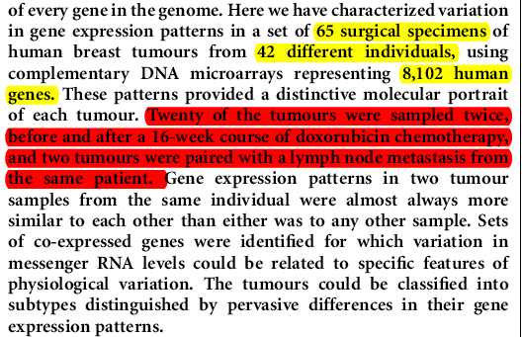
Perou et al 2000 Nature
20 tumors from the same individuals were sampled twice. Did they show difference after treatment?
-- Paired samples.

Slide 4
Kim et al 2001 Science
A gene expression map for Caenorhabditis elegans
Kim SK, Lund J, Kiraly M, Duke K, Jiang M, Stuart JM, Eizinger A, Wylie BN, Davidson GS.
We have assembled data from Caenorhabditis elegans DNA microarray experiments involving many growth conditions, developmental stages, and varieties of mutants. Co-regulated genes were grouped together and visualized in a three-dimensional expression map that displays correlations of gene expression profiles as distances in two dimensions and gene density in the third dimension. The gene expression map can be used as a gene discovery tool to identify genes that are co-regulated with known sets of genes (such as heat shock, growth control genes, germ line genes, and so forth) or to uncover previously unknown genetic functions (such as genomic instability in males and sperm caused by specific transposons).
Multi-sample or conditions.

Slide 5
Outline
Statistical methods to be discussed:
  conventional statistical methods: two-sample t test, paired t test, ANOVA, Wilcoxon rank based test.
  Permutation test.
  multiple testing, Type I error control or FDR control.

Slide 6
Data structure--direct comparison in cDNA array
Geneid Condition 1 vs 2 1 e₁₁ , e₁₂ , e₁₃ … 2 e₂₁ , e₂₂ , e₂₃ …
3 e₃₁ , e₃₂ , e₃₃
4 e₄₁ , e₄₂ , e₄₃ …
5 e₅₁ , e₅₂ , e₅₃ …
e_{ij} is the log ratio directly measured of ith gene and jth subject.

Slide 7
Data structure 2
In a reference design where each condition is compared with a reference sample:
Geneid Condition 1 Condition 2
1 e₁₁₁ e₁₁₂ e₁₁₃ … e₁₂₁ e₁₂₂ e₁₂₃ …
2 e₂₁₁ e₂₁₂ e₂₁₃ … e₂₂₁ e₂₂₂ e₂₂₃ …
3 e₃₁₁ e₃₁₂ e₃₁₃ … e₃₂₁ e₃₂₂ e₃₂₃ …
4 e₄₁₁ e₄₁₂ e₄₁₃ … e₄₂₁ e₄₂₂ e₄₂₃ …
e_{ijk} : expression (in the log ratio form) of ith gene, jth condition and kth replicate(array). If e_{ijk} is paired with e_{i(j+1)k,} Then the design is Paired design.
… … …

Slide 8
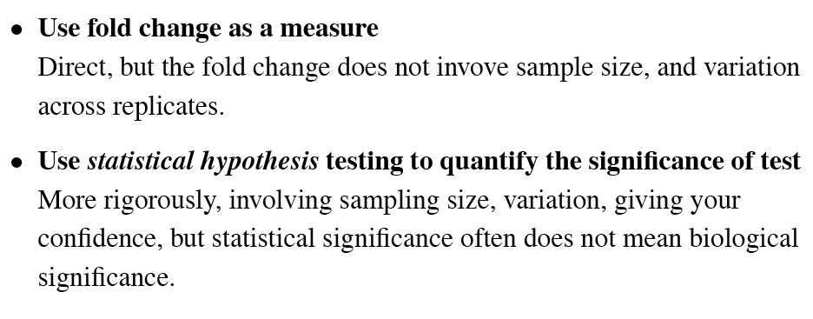
Ways to measure differential expression
Fold change method is unreliable (chen et al 1997)

Slide 9
Statistical tests
Test for two conditions:
--parametric: two-sample t test; paired t test
--nonparametric: Wilcoxson test, Wilcoxon signed rank test (paired)
--permutation based test.
Test for more than two conditions:
--ANOVA/general linear model

Slide 10
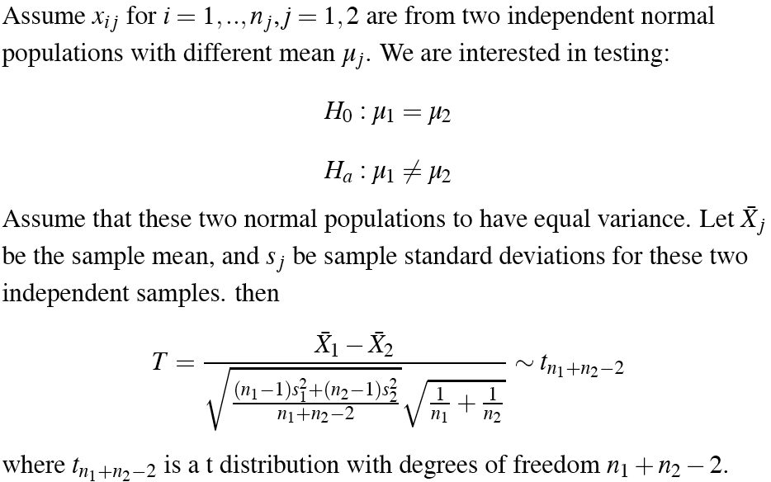
Two sample t test-- equal variance
These another version of two-sample t test called “Welch” two sample t-test, not assuming equal variance, where the denominator is replace by sqrt(s₁²/n₁+s₂²/n₂).

Slide 11
Significance level and p-value
P-value measures how extreme to observe the test statistics. For a two sided test
p-value=2*prob (T>|T₀ | given H0)
For one sided hypothesis testing, i.e., H1: μ1>μ2 or H1: μ1<μ2, the p-value is:
p-value=prob (T>T₀ given H0) or
        prob (T<T₀ given H0)

Slide 12
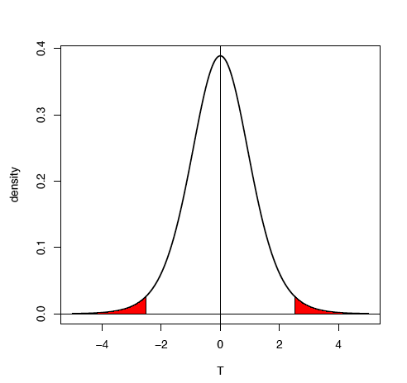
Calculate p-value
>2* pt(T₀,df)
>pt(0,20)
[1] 0.5
T

Slide 13
Significance level
We reject a hypothesis if the p-value is smaller than the pre-specified significance level α. α is often set as 0.05.
A smaller α means more stringent rejection criterion.
The significance level α is the probability of false rejection in hypothesis testing, it measures false positive rate when the null hypothesis is true.

Slide 14
Example--prostate cancer(singh et al 2002) data
N1 N2 N3 N4 N5 N6 T1 T2 T3 T4 T5 T6
1000_at 7.70 7.67 7.58 7.56 7.39 7.55 7.20 7.32 7.40 7.10 7.32 7.42
> t.test(x[1:6],x[7:12],var.equal=T)
Two Sample t-test
data: x[1:6] and x[7:12]
t = 4.2038, df = 10, p-value = 0.001818
alternative hypothesis: true difference in means is not equal to 0
95 percent confidence interval:
0.1323740 0.4309594
sample estimates:
mean of x mean of y
7.575000 7.293333
> t.test(x[1:6],x[7:12])
Welch Two Sample t-test
data: x[1:6] and x[7:12]
t = 4.2038, df = 9.875, p-value = 0.001869
alternative hypothesis: true difference in means is not equal to 0
95 percent confidence interval:
0.1321164 0.4312169
sample estimates:
mean of x mean of y
7.575000 7.293333
EXCEL can do two-sample t-test too.

Slide 15
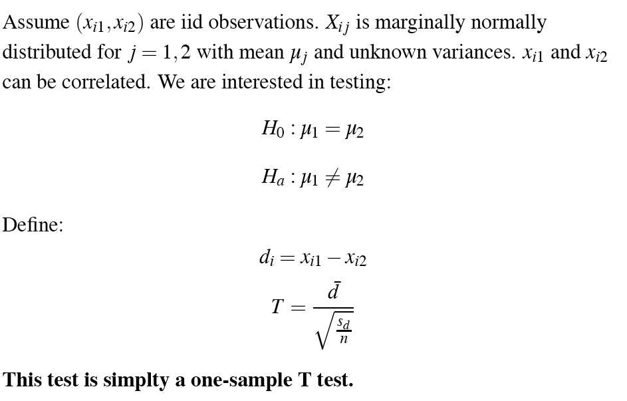
Paired t test
When samples are repeatedly colleted from the same subject (e.g. patients), then the expression at two conditions of two time points are not independent.

Slide 16
Wilcoxon test -- Mann-Whitney Test
Wilcoxon test: Nonparametric version of two-sample t test.
Test for distribution of two populations, no requirement of normal distribution.
Samples must be independent. Sensitive for test equivalence of means. i.e., u₁=u_{2.}
Suppose x_{i} and y_{j} are from two samples. If we rank x and y observations together, the sum of rank T for X will follow certain distribution.
> wilcox.test(data[1,2:5], data[1,6:9])
Wilcoxon rank sum test
data: data[1, 2:5] and data[1, 6:9]
W = 14, p-value = 0.1143
alternative hypothesis: true mu is not equal to 0

Slide 17
Wilcoxon signed rank test
Nonparametric version of paired t-test,
No assumption of normal distribution. But require the distribution of d_{i} to be symmetric.
Pairs of (xi,yi) are observed. Rank (xi-yi) and assigned a positive sign if xi>yi, and a negative sign otherwise.
The test statistic T is the sum of positive ranks.
For signed rank test: use
>wilcox.test(x,y,paired=T)

Slide 18
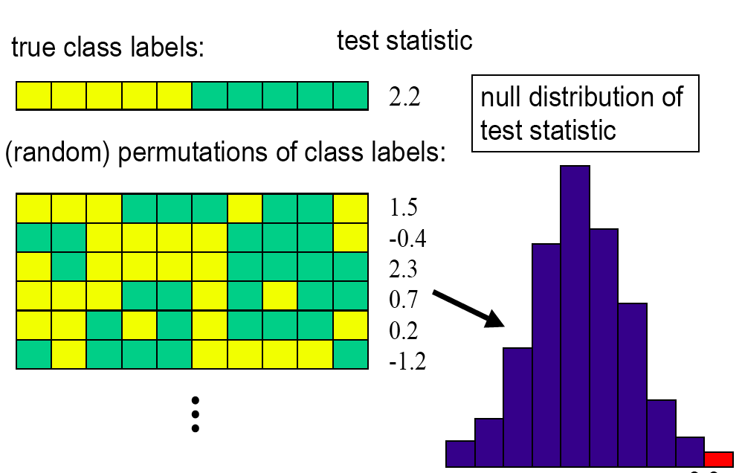
Permutation test

Slide 19
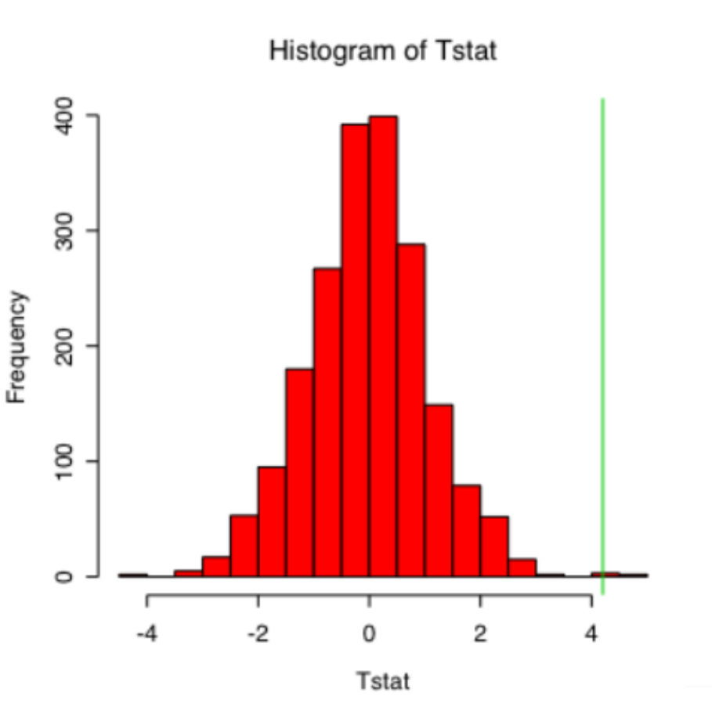
Permutation test for the example
N1 N2 N3 N4 N5 N6 T1 T2 T3 T4 T5 T6
1000_at 7.70 7.67 7.58 7.56 7.39 7.55 7.20 7.32 7.40 7.10 7.32 7.42
Permutation test based on 2000 permutations:
p-value=2*#(T>4.2)/2000=5/2000*2=0.005
Advantage: no distribution constraint.
Disadvantage: Each gene must have a permutation test, to determine corresponding p-value

Slide 20
Multiple testing issue
Type I error: α = P(reject H₀|H₀ is true), false positive rate
When testing multiple hypotheses, family wise type I error:
FWER=(reject at least one Hypothesis |given all H₀ are true)
If we control hypothesis-wise type I error at 0.05 individually, what’s the FWER?
-- e.g. If test two hypotheses, α₁=0.05 α₂=0.05
  0.05∗0.95+0.05∗0.95+0.05∗2=0.0975 (assume independent)
  When testing 10,000 hypotheses (10,000 genes), if α₁=0.05, given H0, you would expect falsely reject 500 hypotheses (given independence assumption).

Slide 21
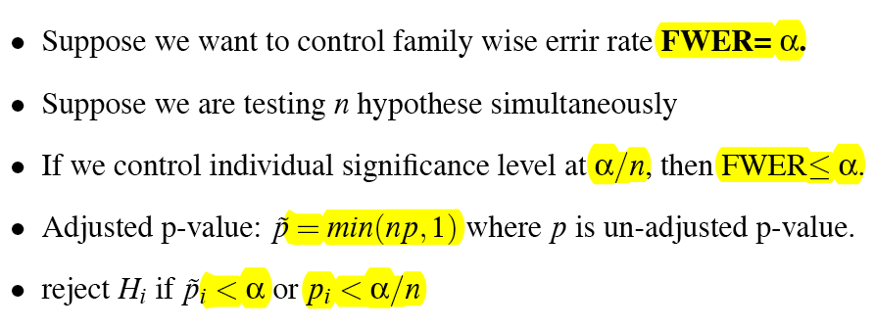
Bonferroni adjustment
Very conservative. If you have n=10000, a family wise error at 0.05 give you 0.05/10000 for an individual test to be claimed as significant .

Slide 22
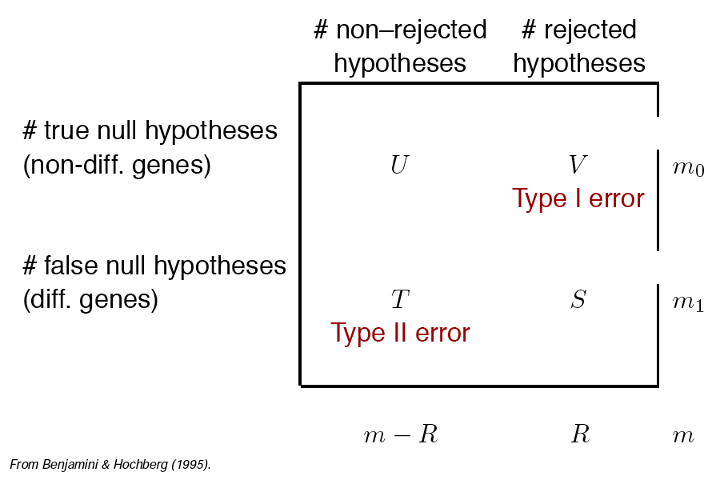
Type I vs Type II errors
Family-wise type I error: FWER=Prob(V>0)
False discovery Rate: FDR=E(V/R|R>0)Prob(R>0),
Note: FDR=FWER if m0=m, of under complete null hypotheses.
Notes:
V/mo = alpha

Slide 23
False positive rate vs False discovery rate
If α=0.05, in average 5% of the true hypotheses will be falsely rejected.
if control FDR=0.05, then among the hypotheses rejected, about 5% are true null hypotheses.
They are really different!

Slide 24
Prostate Cancer example: Singh et al 2002
> data[1:10,]
Gene N1 N2 N3 N4 N5 N6 T1 T2 T3 T4 T5 T6
1 1000_at 7.7 7.7 7.6 7.6 7.4 7.5 7.2 7.3 7.4 7.1 7.3 7.4
2 1001_at 4.0 4.4 4.4 4.6 4.7 4.3 4.0 4.2 4.3 4.0 4.1 4.2
3 1002_f_at 3.6 4.0 4.1 4.3 4.3 4.2 3.7 3.8 3.8 3.7 4.0 4.0
4 1003_s_at 5.8 7.2 7.0 7.1 6.9 7.2 6.2 6.9 6.9 6.5 6.7 6.8
5 1004_at 5.5 6.2 6.0 6.1 6.0 6.1 5.7 5.7 5.9 5.5 5.8 6.0
6 1005_at 7.2 5.4 5.5 5.5 5.5 5.5 8.7 5.2 5.6 6.2 5.4 6.1
7 1006_at 3.4 3.8 3.9 3.8 3.7 3.8 3.8 3.7 3.8 3.2 3.6 3.6
8 1007_s_at 7.5 7.4 7.3 7.5 7.1 7.3 7.6 7.2 7.4 7.2 7.2 7.6
9 1008_f_at 7.4 12.4 12.3 12.1 12.4 12.7 10.1 12.1 12.4 11.4 12.0 12.1
10 1009_at 8.7 6.8 7.1 6.8 7.2 6.5 9.1 8.4 7.7 8.8 8.8 7.8
total number of genes: 12525
adjusted significance level at FWER=0.05: 0.05/12525=4e-6
adjusted Bonferroni p-value: p*12525

Slide 25
> adjp[1:10,]
rawp Bonferroni Holm Hochberg SidakSS SidakSD BH BY
[1,] 0.0018 1 1 1 1 1 0.38 1
[2,] 0.0162 1 1 1 1 1 0.46 1
[3,] 0.0720 1 1 1 1 1 0.55 1
[4,] 0.4672 1 1 1 1 1 0.77 1
[5,] 0.1396 1 1 1 1 1 0.62 1
[6,] 0.5119 1 1 1 1 1 0.79 1
[7,] 0.3814 1 1 1 1 1 0.74 1
[8,] 0.8610 1 1 1 1 1 0.94 1
[9,] 0.9003 1 1 1 1 1 0.95 1
[10,] 0.0097 1 1 1 1 1 0.44 1
Replication also plays a role (Lee et al 2000, PNAS). More replicates often yield more significant p-value if the true mean differ between two samples.
>sum(adjp[,1]<0.05)
[1]1206
>sum(adjp[,2]<0.05)
[1]0

Slide 26
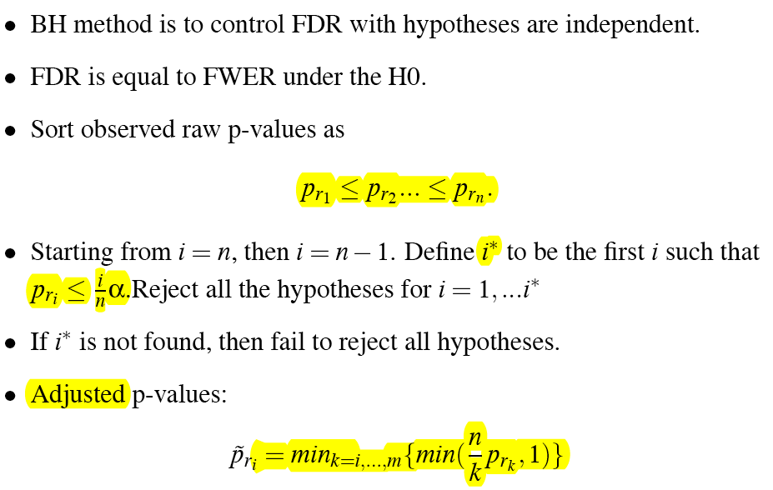
Other methods-- Benjamini and Hochberg (1995)
n

Slide 27
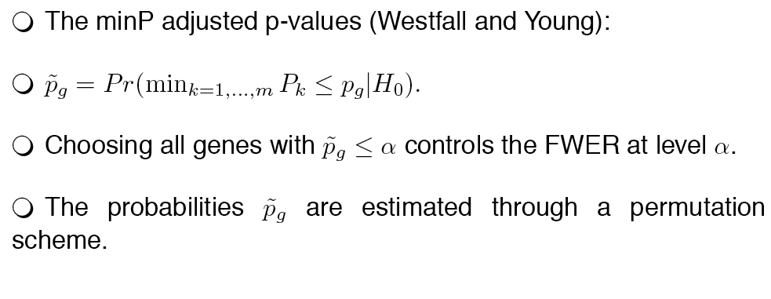
Resampling-based approach (Westfall/Young 1993, Ge et al 2003)
Recall: FWER = Prob (reject at least one H|H₀). If we set the significance level as p_{g}, then
Prob (reject at least one H|H₀)= Prob(min_{k=1,…n}P_{k}<=p_{g}|H₀)
n
P_{k}<p_{g}

Slide 28
Advantage and disadvantage
Advantage: take the dependence structure into consideration, it is more sensitive than other approaches.
Disadvantage: computationally more intensive (Ge et al 2003); Still tend to be conservative when the sample size is small. Consequently, it will miss truly differentially expressed genes when the sample size is relatively small.
FDR maybe a better criterion for gene differentiation then FWER.

Slide 29
multtest-- a R package for gene expression differentiation
#################
###permutaiton test
#################
x<-c(7.7,7.67,7.58,7.56,7.39,7.55,7.20,7.32,7.40,7.10,7.32,7.42)
T0 <- (mean(x[1:6])-mean(x[7:12]))/sqrt(var(x[1:6])*.5+var(x[7:12])*.5)/sqrt(1/3)
Tstat <- numeric()
for ( i in 1:2000){
sam <- sample(x,12,replace=F)
T1 <- (mean(sam[1:6])-mean(sam[7:12]))/sqrt(var(sam[1:6])*.5+var(sam[7:12])*.5)/sqrt(1/3)
Tstat <- c(Tstat,T1)
}
p <- 2*sum(Tstat>T0)/2000
#############################################################################
#This R codes demonstrate how to use multtest to test differential expression
##############################################################################
library(affy)
pcpc <- ReadAffy()
pc <- rma(pcpc) ##robust microarray average, fast but less versertile
write.exprs(pc,"pstCancer.txt")
pcnorm <- read.table("pstCancer.txt",sep="\t",header=F,col.names=F,skip=1)
colnames(pcnorm)<-c("gene","N01", "N02", "N03", "N04", "N05", "N06", "N10", "N11", "N13", "N14", "N15", "N16", "N17", "N18", "N19", "N20", "N21", "N23", "N24", "N25", "N26", "N27", "N28", "N30", "N31", "N32", "N33", "N34", "N35", "N36", "N37", "N38", "N39", "N40", "N41", "N42", "N43", "N44", "N45", "N46", "N47", "N50", "N53", "N54", "N55", "N58", "N59", "N60", "N61", "N62", "T01", "T02", "T03", "T04", "T05", "T06", "T10", "T11", "T13", "T14", "T15", "T16", "T17", "T18", "T19", "T20", "T21", "T22", "T23", "T24", "T25", "T26", "T27", "T28", "T29", "T30", "T31", "T32", "T33", "T34", "T36", "T37", "T38", "T39", "T40", "T41", "T42", "T43", "T45","T46", "T47", "T49", "T50", "T53", "T54", "T55", "T56", "T57", "T58", "T59", "T60", "T62")

Slide 30
#######use mlttest procedure
library(multtest)
pcnorm[1:10,1:10] ##prostate cancer data
###assigning the treatment label to pcnorm.cl
pcnorm.cl <-c(rep(0,50),rep(1,52))
###calcuate the teststat
teststat <- mt.teststat(pcnorm[,2:103],pcnorm.cl)
###calculate raw p-value
rawp0<-2*(1-pt(abs(teststat),df=100))
procs <- c("Bonferroni", "Holm", "Hochberg", "SidakSS", "SidakSD","BH", "BY")
###adjust p-value by different methods
res <- mt.rawp2adjp(rawp0, procs)
####sort the adjusted p-value to original order
adjp <- res$adjp[order(res$index), ]
###round the adjusted p-value to the second decimal places
round(adjp[1:10, ], 2)
###permutation based
resT <- mt.maxT(pcnorm[,2:103],pcnorm.cl,B=2000) #pvalue is in decreasing order
ord <- order(res$index) ##recover to original gene order
rawp <- resT$rawp[ord] ##raw pvalue from permutation test
maxT <- resT$adjp[ord] ##adjusted p-value from permutation test

