Slide 1
Supervised learning in microarray data analysis
Ji-Ping Wang
Department of Statistics
Northwestern University

Slide 2
Classification and discriminant analysis with microarray data
Linear and quadratic discriminant analysis
Nearest neighbor method
Logistic regression method

Slide 3
Tumor classification
Normal versus Tumor
Tumor tissue often has subtypes
A reliable and precise classification of tumors is essential for treatment.
Conventional classification of tumor reply on morphological, clinical diagnosis
DNA array data provides genome-wide expression profiles, can be used for tumor classification.

Slide 4
Three types of classification
Identifying new/unknown types of tumor by clustering/unsupervised learning
Classifying the new samples of tumor tissue to known classes: discriminant analysis/supervised learning
Identify genes that characterize the tumor classes.

Slide 5
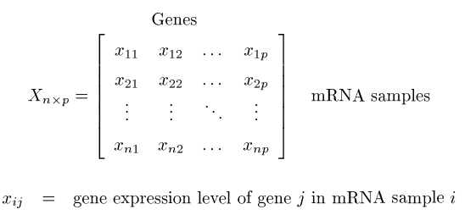

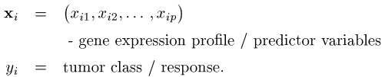
Gene expression data

Slide 6
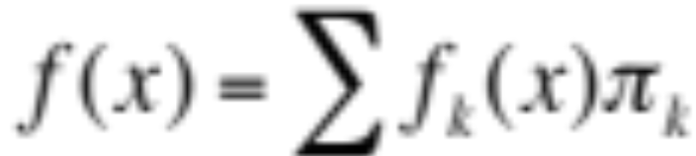
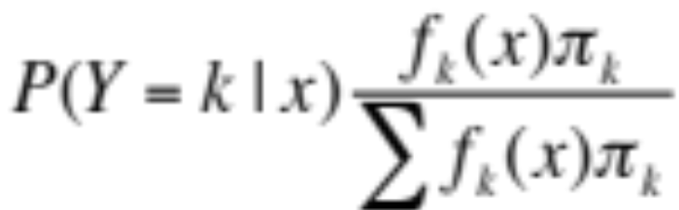

Bayes rule in classification
If we have K subgroups (heterogeneous) in a population distribution, and π_{k} be the prior distribution, then the marginal distribution of x would be
Weighted average
The posterior probability that x is from group K given observing x is
What pi group is individual x in?
We make a decision G=k such that the posterior probability
is the largest.

Slide 7
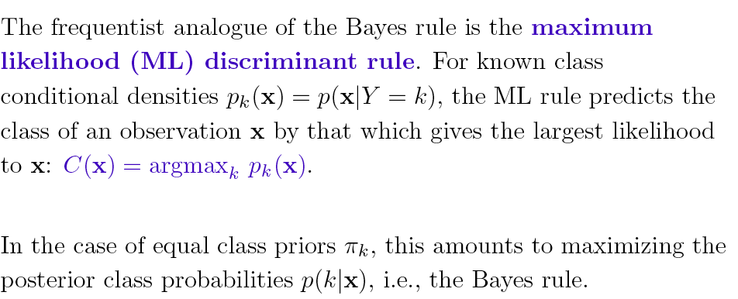
Maximum likelihood discriminant rule
Notes:
No weighting of population distributions. Assume there are equal populations

Slide 8
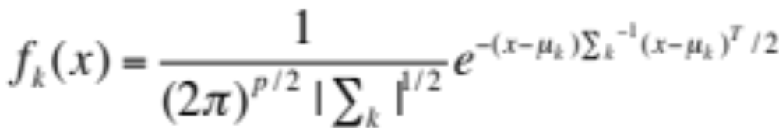
Gaussian assumption
Multivariate Gaussian distribution
where Σ_{k} is the covariance matrix and μ_{k} is the mean of
the Gaussian distribution for kth group.
Minus Logarithm of f_{k}(x) is:
(x-μ_{k})Σ_{k}⁻¹(x-μ_{k})^{T}+log|Σ_{k}|
Quadratic form of x
Notes:
Each gene is an x -

Slide 9
Two groups--Fisher’s linear discriminant
If you have two groups, and covariance matrix to be same as Σ. Then
L=log(f₁/f₂)=(u₁-μ₂)Σ⁻¹(x-(μ₁+μ₂)/2)^{T}
If L >0 , then we classify X as from μ₁,
If L<0, then μ₂.
This is called Fisher’s linear discriminant
function.

Slide 10
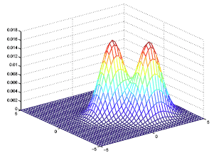
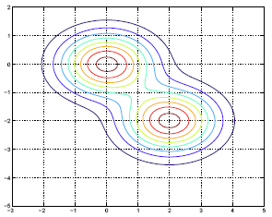

Slide 11

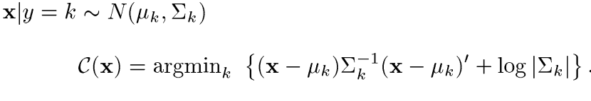
Quadratic discriminant rule
Maximum likelihood discriminant rule
For multivariate normal distribution
If Σ_{k} is same across k, then this rule is called Linear
discriminant analysis
Note if there are only two classes, then
this rule reduced to Fisher’s discriminant analysis.

Slide 12
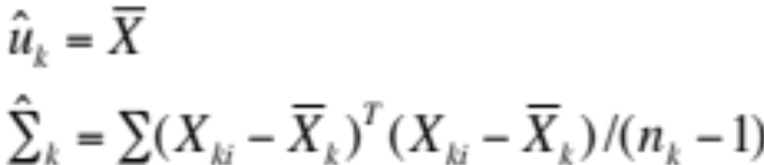


Estimate μ_{k} and Σ_{k,} π_{k}
where n_{k} is the number of observations in kth group
Under the homoscedastic (equal variance) assumption :
Prior probability

Slide 13
LDA vs QDA
LDA:
Simple and intuitive
Easy to implement: linear boundaries, why?
Good performance (Dudoit et al 2000)
QDA:
Can be less biased than LDA
More variable because estimation of the covariance of gene expression matrix. e.g., if 50 genes are used, then 50*49/2+50 parameters must be estimated in Σ_{k.}

Slide 14
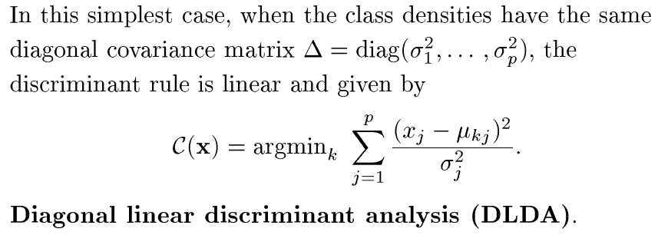
Using diagonal covariance matrix
Advantage: the number of parameters to estimate is greatly reduced.

Slide 15
Nearest Neighbors
Nearest Neighbor method is the simplest among all.
Find observations(arrays) nearest to the observation under
investigation, say X0 under certain distance metric.
Classify the X0 according to the majority rule in the K obs.
How to choose K?
Choose K that gives the best prediction result in
cross-validation

Slide 16
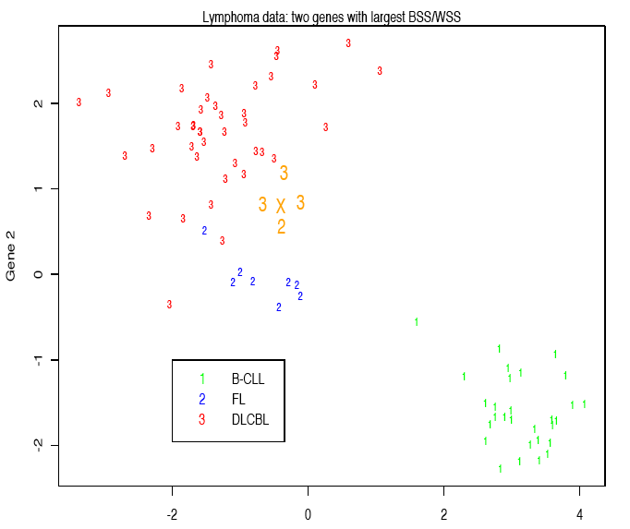
Dudoit et al 2000

Slide 17
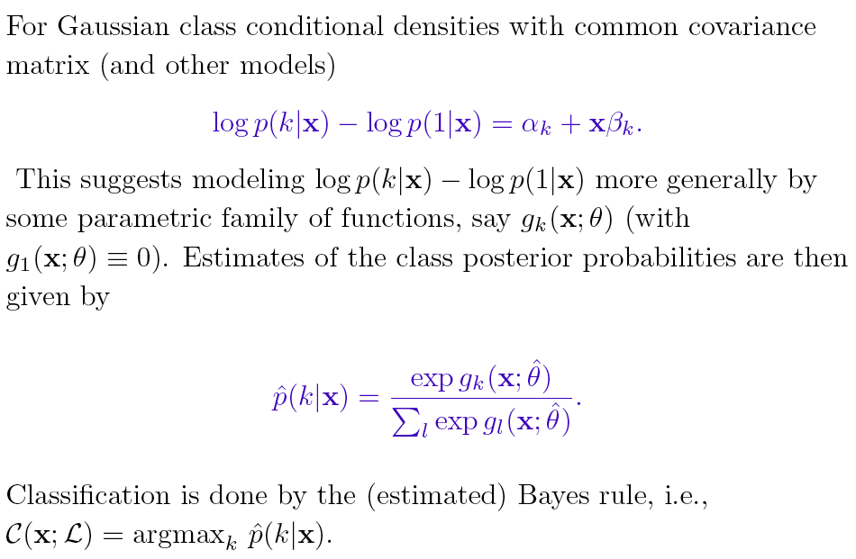
Logistic regression in classification

Slide 18
Choose genes for classification
Define the within and between class sum of square WSS and BSS for each gene.
User the ratio BSS/WSS as criterion to choose genes, e.g., choose the top 10 to 100.
The reason is that a larger ratio gives you better separation of different types of tumors.

Slide 19
Cross validation
Train
Train
Train
Train
Test
Divide the whole training set (with known classification of tumor types) into groups about the equal size.
Each time use the four training subsets to predict the test subset.
Error rate can be calculated based on the false predictions.

Slide 20
Three-way data split
Training
Cross-validation
Validating
Data
Test
Cross-validation givens a final classification model to be applied
to the test sample.

Slide 21




Prediction analysis of microarray(PAM)
d_{ik} is similarly defined as the ratio of between cluster distance and within cluster distance
d_{ik}’ definition is essentially equivalent to choosing genes with differential expression between groups, similar as between and within cluster ratio.
Tibshirani et al 2002

Slide 22
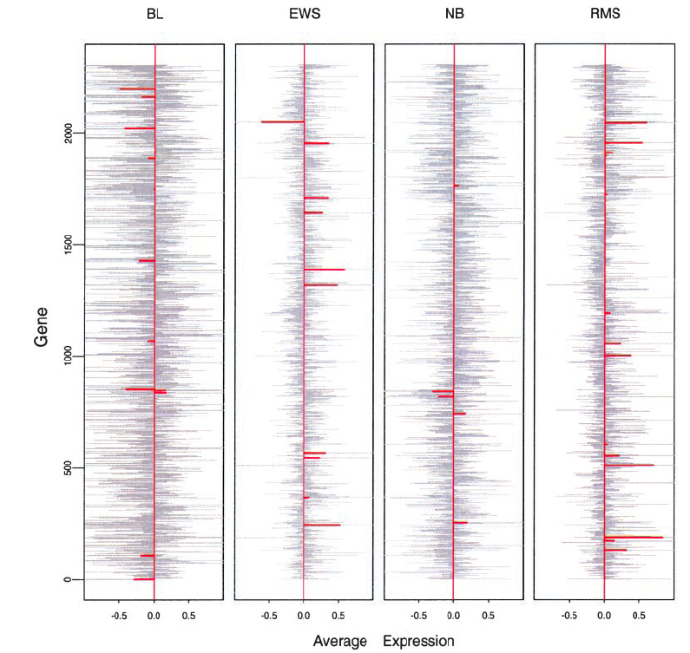

Slide 23
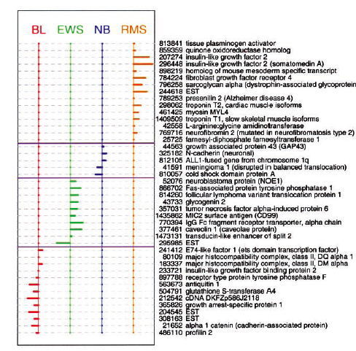
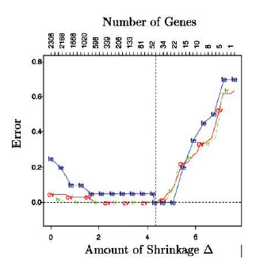

PAM

Slide 24
Case studies, Dudoit et al 2000
Leukemia data : two-classes called ALL and AML.
ALL class contains two subtype classes called B-cell and T-cell.

Slide 25
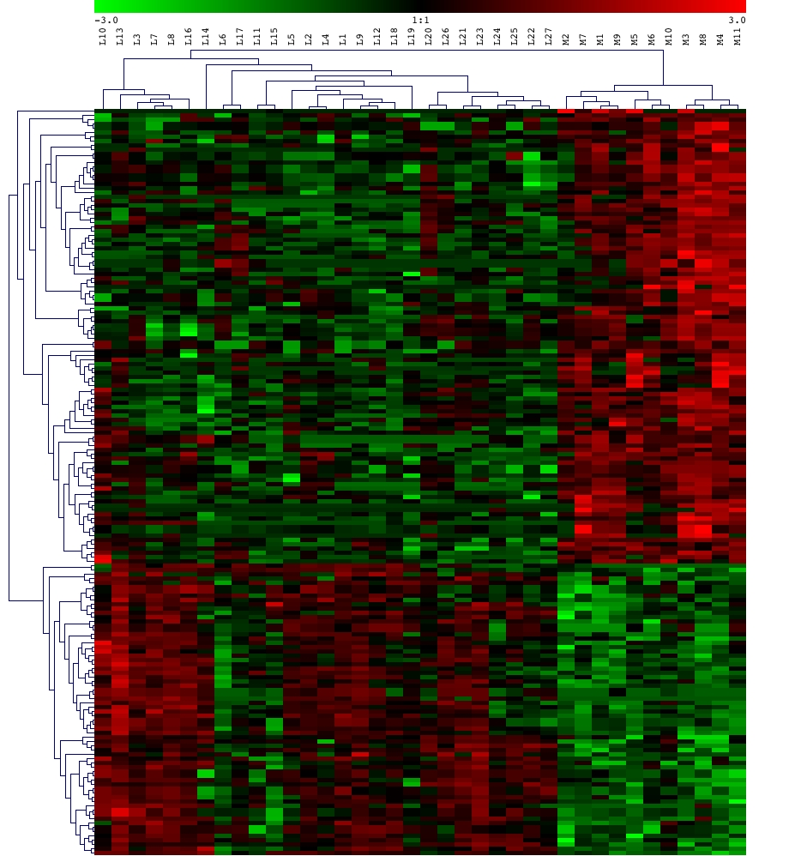

Slide 26
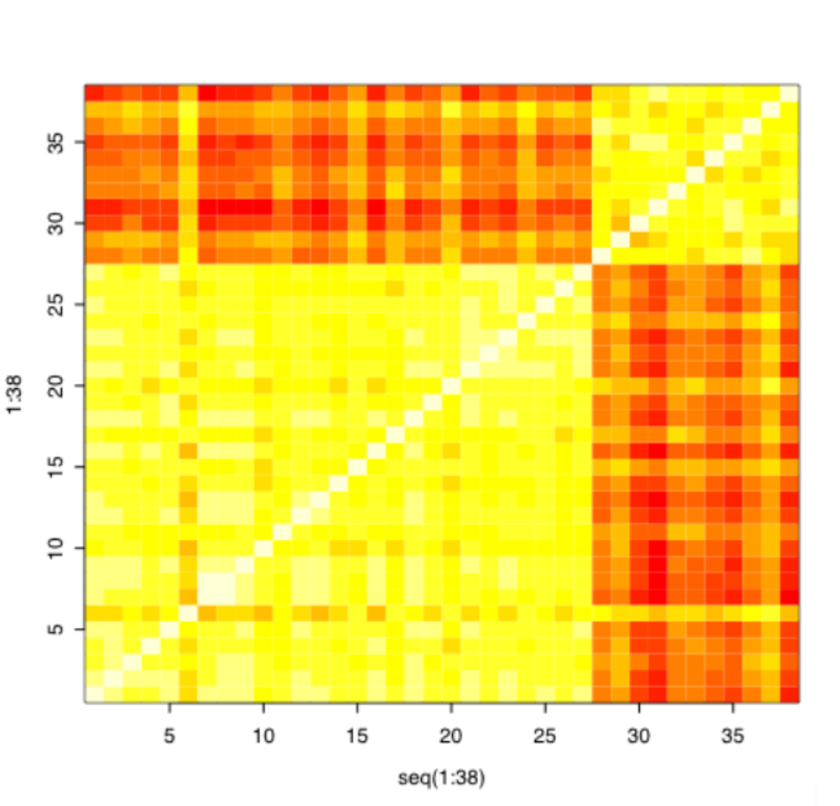
Correlation plot, Array 1-27 are ALL, 28-38 are AML

Slide 27
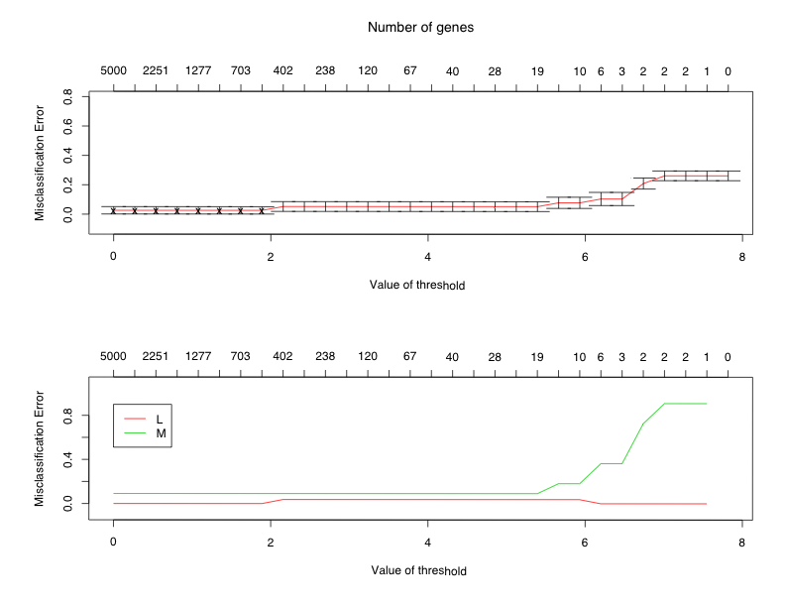
PAM cross validation

Slide 28
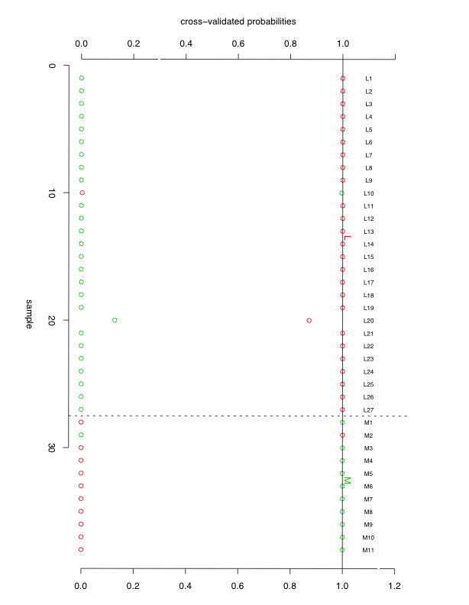
PAM probability plot at Δ=4

Slide 29
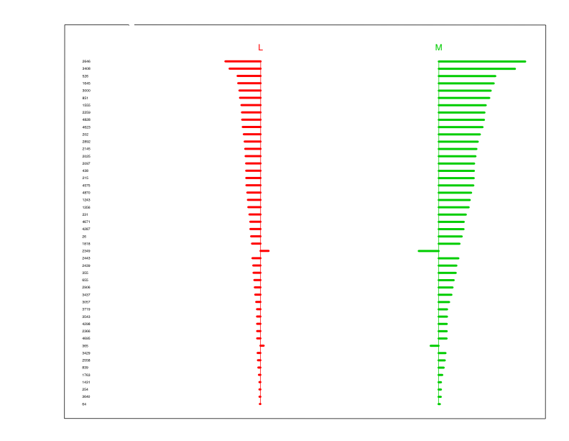
PAM centroid plot at Δ=4

