Slide 1
Pairwise Comparison of DNA and Protein sequences
Ji-Ping WANG
Department of Statistics
Northwestern University

Slide 2
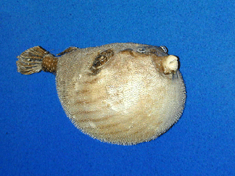
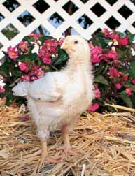
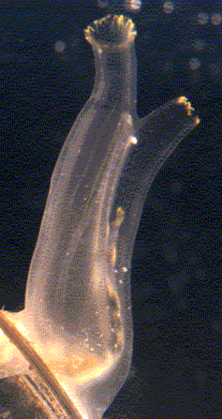
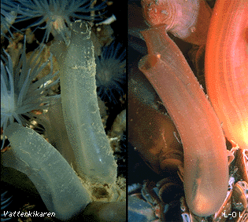
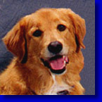
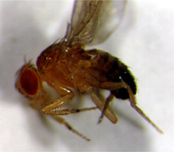

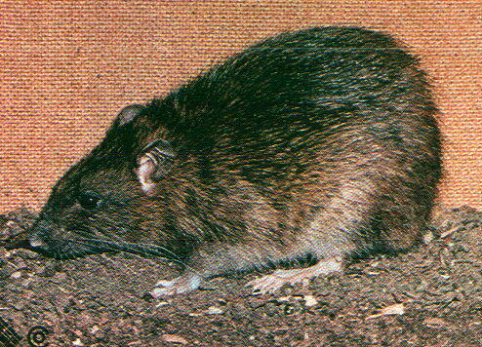
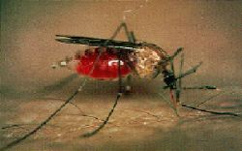
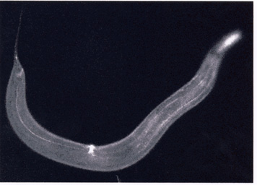


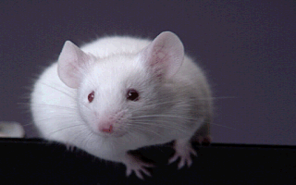
Comparing Genomics

Slide 3
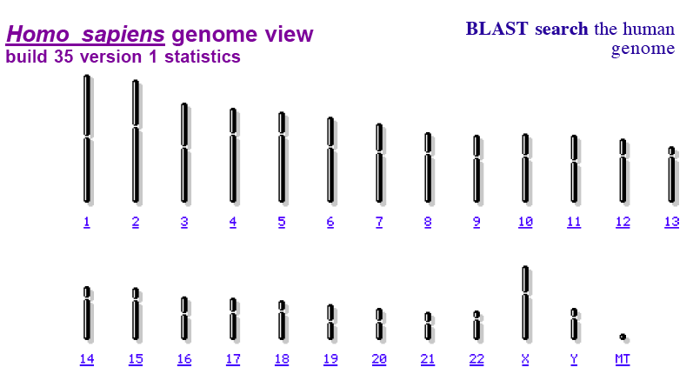
What is genome?

Slide 4

Similarity in genetic codes
The life has been evolved from simplicity to existing diversity after millions of years
The genetic materials (DNA) between species or within species share similarity.
DNA sequence diverged due to speciation is called orthologues.
DNA sequence diverged due to gene duplication is called paralogues.
Both orthologues and paralogues are called homologies.

Slide 5
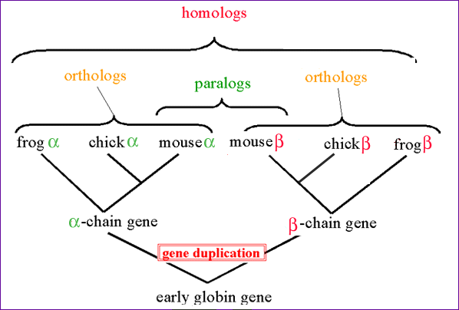
Example of homoloies

Slide 6
Molecular evolution
C
…ACGGTGCAGTCACCA…
Deletion
inversion,
rearrangement
Mutation
…ACGTTGCAGT_CACCA…
Similarity and dissimilarity of homologies are indicative of
speciation, gene duplication, and DNA functions!

Slide 7
Why compare DNA sequences?
Genomic difference in homologies measures the distance between species.
Genomic similarity and dissimilarity are indicative for evolution of genes.
Genomic variation also reflect natural selection, causes of cancers and diseases etc.

Slide 8
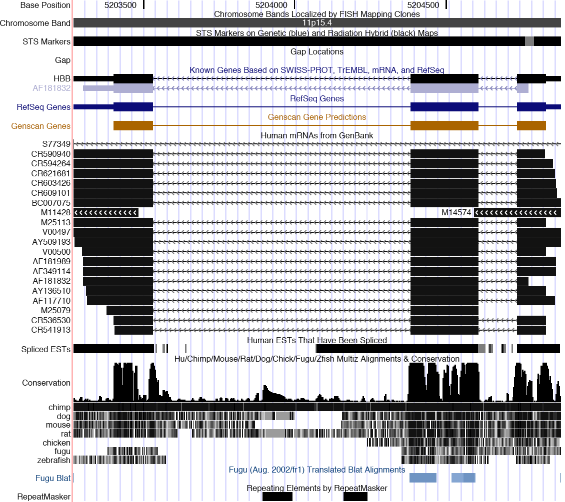

Slide 9
See also: alignment score statistics for Beta HOMOglobin
aliGnment 2 of 20 in window, score 129826.0
Human May 2004 (hG17) Chr11:5203386-5203551, strand +, size 166
Chimp Nov. 2003 (pantro1) Chr9:5282217-5282382, strand +, size 166
Mouse May 2004 (mm5) Chr7:91325622-91325785, strand +, size 164
Rat Jun 2003 (rn3) Chr1:161700184-161700347, strand +, size 164
DoG Jul. 2004 (CanFam1) Chr21:30428658-30428817, strand +, size 160
FuGu auG. 2002 (fr1) ChrUn:269727068-269727233, strand +, size 166
Zebrafish Nov. 2003 (danRer1) ChrFinished:6686393-6686547, strand -, size 155
hG17.Chr11 GACAGCAAGAAAGCGAGCTTAGTGATACTTGTGGGCCAGGGCATTAGCCACACCAGCCACCACTTTCTGA
pAnTro1.Chr9 GACAGCAAGAAAGCGAGCTTAGTGATACTTGTGGGCCAGGGCATTAGCCACACCAGCCACCACTTTCTGA
mm5.Chr7 -ATAGCAGAAAAGGGGCGTTAGTGGTACTTGTGAGCCAGGGCAGCAGCCACTCCAGCCACCACCTTCTGG
rn3.Chr1 -AGAGCAGGAAAAGAGGTTTAGTGGTACTTGTGAGCCAGGGCACTGGCCACTCCAGCCACCACCTTCTGG
CAnFAm1.Chr21 ----GCAAGAAAGAGAACTCAGTGGTATTTGTGGGCCAGGGCATTGGCCACACCAGCCACCACCTTCTGG
fr1.ChrUn GACGTCTTGGGGGACATCTTAGTGGTACTGTCTTCCCAGAGCAGAGACGACAACGGCCAGGAACTTCTGG
dAnRer1.ChrFinished ----------GTCTGTATTTAGTGGTACTGTCTTCCCAGAGCGGACACCGCAACAGCGATGAATTTCTGG
* **** ** * **** ** * * * ** * * *****
hG17.Chr11 TAGGCAGCCTGCACTGGTGGGGTGAATTCTTTGCCAAAGTGATGGGCCAGCACACAGACCAGCACGTTGC
pAnTro1.Chr9 TAGGCAGCCTGCACTGGTGGGGTGAATTCTTTGCCAAAGTGATGGGCCAGCACACAGACCAGCACGTTGC
mm5.Chr7 AAGGCAGCCTGTGCAGCGGGGGTGAAATCCTTGCCCAGGTGGTGGCCCAGCACAATCACGATCATATTGC
rn3.Chr1 AAGGCAGCCTGTGCACAGGGGGAGAATTCCTTGCCCAGGTGGTGGCCCAACACAATCACAATCATGTTGC
CAnFAm1.Chr21 TAGGCAGCCTGAGCCAATGGGGTGAATTCCCTGCCAAAGTGGCGGGCCAGCACACACACCAACACGTTGC
fr1.ChrUn AAGGTGGCCTGGATCTCAGGTGTGAACTTGCTTCCCATTTTGGTGGCGACGACGATGGTCAAGCAGTCAG
dAnRer1.ChrFinished AAAGCGGCCTGAACTTCAGGTGTGAATCCAGCACCCATCTGAGCAGCAACAACGATGGTCAAGCAATCAG
* * ***** ** * *** ** * * * * ** * *

Slide 10
Sequence alignment
hg17.Chr11 TCAGTTACAATTTATATGCAGAAATATTTATATGCAGAGATATTGCTATTGCCTT
canfam1.Chr21 TCACCCTCATTTTACATTGAGAA-----ATGGTTC------TTTCCTTCTGTTTT
Definition:
  Given two strings, X=X₁X₂X₃X₄…X_{M}
  Y=Y₁Y₂Y₃Y₄…Y_{N}
  An alignment is an arrangement of two strings that allows insertion of gaps between letters such that every letter
  in each sequence either match to a gap or a letter in the other sequence.

Slide 11
Scoring function
Match: +m
Mismatch: -s
Gap: -d
Score F = (# matches) × m - (# mismatches) × s - (#gaps) × d
s(x_{i},y_{j}) will be used for score if x_{i} and y_{j} are aligned.

Slide 12
How to find the best alignment?
AGTGCCCTGGAACCCTGACGGTGGGTCACAAAACTTCTGGA
A diagonal line in a grid means
the letters in the row and column
are aligned(diag).
A vertical line means the letter in
the column is aligned with a gap(up)
A horizontal line means the letter
in the row is aligned with a gap(left).
AGTGACCTGGGAAGACCCTGACCCTGGGTCACAAAACT
The total number of alignment: O(2^{M+N}).
means the order. This number corresponds to how many
possible path exist, traveling form left upper corner vertex to right
bottom corner.

Slide 13
Additivity of alignment scores
The score of aligning x₁……x_{M}
y₁……y_{N}
is additive
Example: x₁…x_{i} x_{i+1}…x_{M}
aligns to y₁…y_{j} y_{j+1}…y_{N}
F(x[1:M], y[1:N]) = F(x[1:i], y[1:j]) +
F(x[i+1:M], y[j+1:N])

Slide 14
Dynamic programming
Additivity property allows to find the optimal alignment of
  Seq 1: x₁x₂…x_{i}
  Seq2: y₁y₂…y_{j}
  for arbitrary i and j recursively.
  Let F(i,j) be the optimal score till ith symbol in Seq 1 and jth symbol in Seq 2 are aligned.
  e.g.
  F(3,2) = max{F(2,2)+s(x₃,gap), F(3,1)+s(gap,y₂), F(2,1)+s(x₃,y₂)}

Slide 15
Dynamic programming (cont’d)
x_{i} aligns to y_{j}
x₁…x_{i-1} x_{i}
y₁…y_{j-1} y_{j}
2. x_{i} aligns to a gap
x₁…x_{i-1} x_{i}
y₁…y_{j} -
3. y_{j} aligns to a gap
x₁…x_{i} -
y₁…y_{j-1} y_{i}
F(i,j)=F(i-1,j-1)+ s(x_{i}, y_{j})
F(i,j)=F(i-1, j)-d
F(i,j)=F(i, j-1)-d

Slide 16
Needleman-Wunsch algorithm
F(i-1,j-1) | F(i-1,j)
F(i,j-1) | F(i,j)
-d
+s(x_{i},y_{j})
-d
F(i,j)=max {F(i-1,j-1)+s(xi,yj), F(i-1,j)-d, F(i,j-1)-d}

Slide 17
Example
Score m= 1
s= -1
d= -1
X=CGAT
Y=CTGA
i=0
F(i,j)
 |  | C | G | A | T
 | 0 | -1 | -2 | -3 | -4
C | -1 | 1 | 0 | -1 | -2
T | -2 | 0 | 0 | -1 | 0
G | -3 | -1 | 1 | 0 | -1
A | -4 | -2 | 0 | 2 | 1
Optimal alignment:
C-GAT
CTGA
j=0
CPU time: O(MN)
Memory: O(MN)

Slide 18
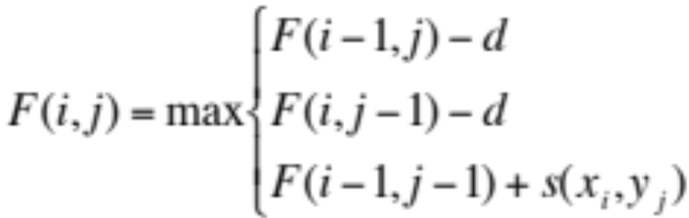
Needleman-Wunsch Algorithm
Initialization
  F(0,0) =0
  F(0, j) = - j × d
  F(i, 0) = - i × d
Main iteration
Keep track of path: up, left, diag for each step
Termination
  F(M,N) is the optimal alignment score

Slide 19
A Variant of algorithm for overlapping
Initialization:
F(i,0) = 0
F(0,j) = 0
Termination:
F_{opt}= max(F(M,j), F(i,N), for all i, j)
Overlap determination:
We don’t want to penalize the gaps in
the beginning and end of the alignment!

Slide 20
Overlap alignment
 |  | A | T | T | G
 | 0 | 0 | 0 | 0 | 0
A | 0 | 1 | 0 | 0 | 0
T | 0 | 0 | 2 | 1 | 0
G | 0 | 0 | 1 | 0 | 2
C | 0 | 0 | 0 | 0
A
C

Slide 21
Global and local alignment
Global alignment aligns two sequences from the beginning to the end of two sequences.
Global alignment is most useful when the sequences are quite similar.
Local alignment identifies similar fragment within sequences under comparison. The length of the fragments can differ.
Local alignment is most useful for aligning more diverged sequences.

Slide 22
Local alignment
Local alignment ignores those
regions badly conserved.
One fragment in one sequence
is allowed to be repeatedly
aligned to several regions in the
other sequence.
An local alignment is defined
by a score threshold.

Slide 23
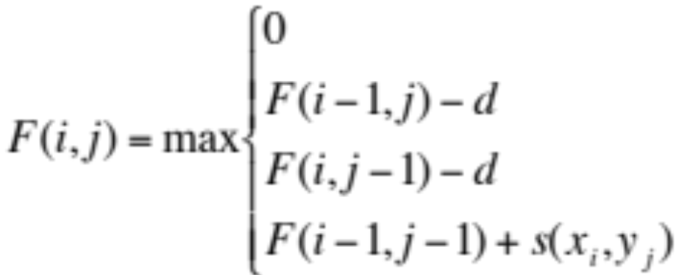
Smith-Waterman algorithm
Initialization
  F(0, j) = 0
  F(i, 0) = 0
Main iteration
Keep track of path: up, left, diag for each step
If F(i,j)>score threshold, then we trace the path backward until F(i₀,j₀)=0. Then (i₀,j₀) and (i,j) defines a local alignment.

Slide 24
An example
(i₀.j₀)
F(i,j)>t and F(i₀,j₀)=0
(i,j)
Four local alignments.

Slide 25
General penalty for gaps
Linear : penalty γ is linear in number of gaps
Convex gap penalties: gaps often exist as a block, linear penalty is too critical.
γ(n)
γ(n)

Slide 26
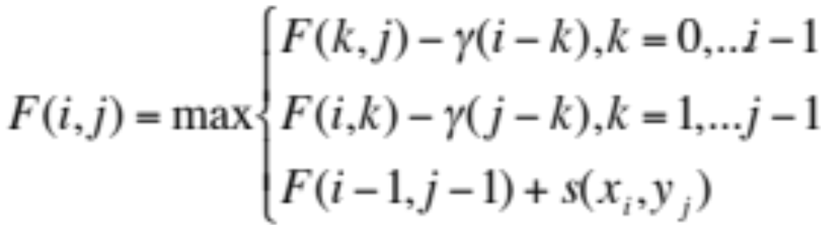
General gap dynamic programming
Initialization
  F(0, j) = 0
  F(i, 0) = 0
Main iteration
Keep track of path: up, left, diag for each step
If F(i,j)>score threshold, then we trace the path backward until F(i₀,j₀)=0. Then (i₀,j₀) and (i,j) defines a local alignment.
Requires O(n³) CPU time, n² memory space!

Slide 27
Protein sequence alignment
The protein (amino acid) alphabet is
Protein sequence is coded by DNA sequences,
hence similarity is derived from DNA sequences.
Hemo globin for homo sapiens
MRDNTSPISV ILVSSGSRGN KLLFRYPFQR SQEHPASQTS KPRSRYAASN 50
TGDHADEQDG DSRFSDVILA TILATKSEMC GQKFELKIDN VRFVGHPTLL 100
QHALGQISKT DPSPKREAPT MILFNVVFAL RANADPSVIN CLHNLSRRIA 150
TVLQHEERRC QYLTREAKLI LALQDEVSAM ADGNEGPQSP FHHILPKCKL 200

Slide 28
Score matrix for protein alignment
Score matrix used in sequence alignment (DNA or protein)
often reflects the similarity or distance of the two sequences.
PAM (Percent Accepted Mutation, Dayoff 1978, extrapolated
from closely related sequences with 1572 changes in 71
groups of protein>85%):
    PAM1= 1 percent accepted mutation
    PAM250=20% similarity
    PAM120=40% similarity
    The score for aligning A and R is :
    log[Prob(A-->R)*prob(A)]+ log[Prob(R-->A)*prob(R)]

Slide 29
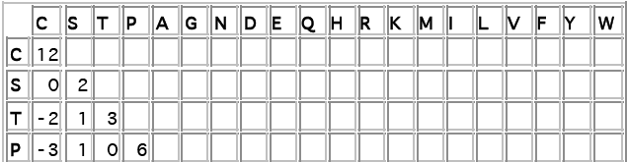
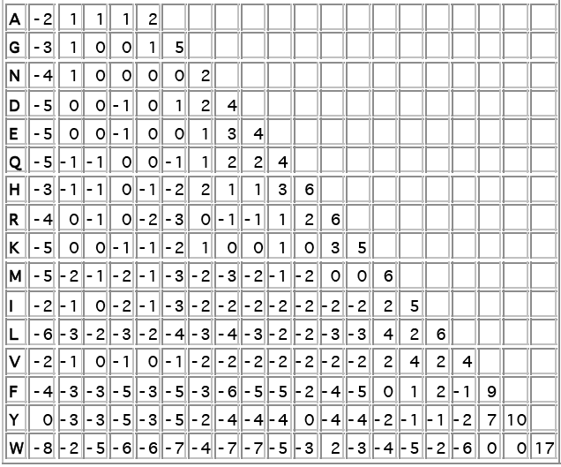
PAM250

Slide 30
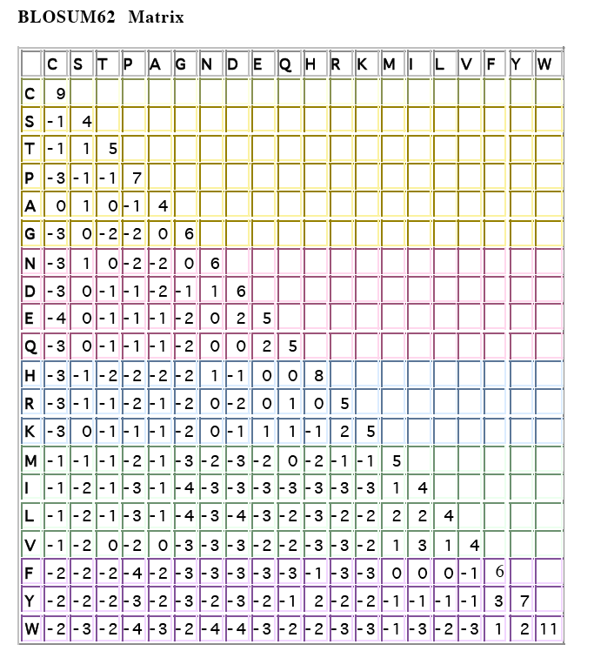
Blosum (Blocks amino acid substitution matrices) by
Henikoff and Henikoff, 1992 based on 2000 conserved
Protein blocks
62% of identity

Slide 31
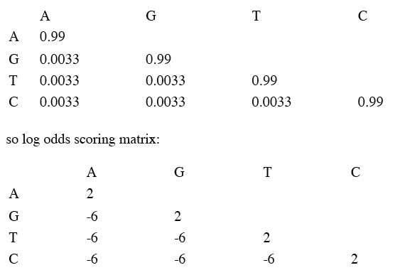
DNA score matrix--corresponding to 1PAM
Uniform mutation model
s_ij=log2(p_iM_ij/p_ip_j)
where p_i and p_j are the freq of i and j, and M_ji is the entry value in the table. p_i and p _j are assumed to be 0.25

Slide 32
Assessing significance based on Extreme Value Distribution (Karlin and Alstrul 1990)
E-value : the number of scores that would exceed the actual observed score S is:
  E = Kmn e^{−λS}
  where m n are the sequence length, K and λ are constants related to the scoring matrix and size of search.
The probability to find a higher score is:
p=1-e^{-E}
Under the Poisson assumption, treating E
as the expectation. E=p when E<0.01.

Slide 33
Basic Local Alignment Search Tool--BLAST
BLAST is a program which can search database more efficiently. (Alstrul et al 1990)
Query seq: MRDNTSPISVILVSSGSRGN
A list of words of length 3 is made starting with positions
1, 2, 3 etc.
For example: MRD, RDN, DNT,….
Each word is compared with every database entry,
matches with score greater than pre-specified value are found.
Such a match will be used as a seed, alignment is extended to
the neighborhood of these words until accumulated score stop
to increase or fall by certain amount.
Score from each local alignment is compared with threshold
value .

Slide 34
FASTA format of DNA or protein sequences
A sequence in FASTA format begins with a single-line description
Followed by lines of sequence data.
The description line must start with “>”
The length of the data line is recommended to be <=80
>ref|NT_086596.1|Hs1_86290:5012297-5042143 Homo sapiens chromosome TAGTGATGAAAAATTCAGGTGGTGACCTCTGCTCTGGGCTCTCCCACACCTTCATAGAACCCCCGTGGTA CCCAAAAGCAGCTTCCTGGTACCCCCACCACACTGGCCTTCAAGAGGAGAGGAGCCCCACTTTCTCCCCA ACCTCTGCTCTCCTAGCCCAGGTCTCAGCAAAATGCTCCTGCACAGAAGATCTTGCTTTGACAGAAAACA CTGTGCAAAAGGTATTATTATTTGGGGAGGCAGCCAGATAAAACAGAAAGAAACCAGTCCTTGGCGCAAG ATAAAGTTGAATTTGTTTGGGTTTTTTTTCTTTTTGTTTCAATTATATATTAATTGCTGAGATGCCCATC
FASTA format is required in many DNA sequence
analysis tools.

Slide 35
BLAST family programs
blastn: nucleotide query to nucleotide database
blastp: protein to protein
blastx: DNA to protein
Find more in blast tutorial

