Slide 1
Intro to Stat basics and R
Ji-Ping Wang, Ph.D.
Department of Statistics
Northwestern University

Slide 2
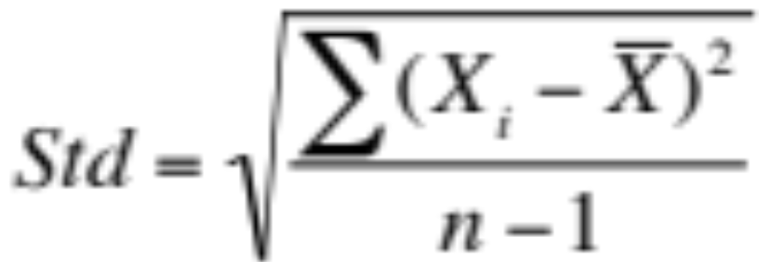
Statistics background
Mean: average of a list of numbers (X1+X2+…Xn)/n.
Median: the number below which there is 50% of the the observations
Standard deviation: measuring the variability of the sample observations:

Slide 3
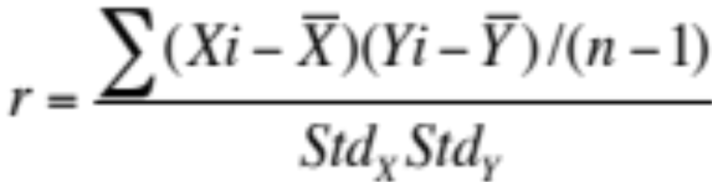
Statistics background
Correlation coefficient: Measuring the linear dependence relationship between two variables.
Observe (X1,Y1), (X2,Y2) … (Xn,Yn). The correlation between the two variables X and Y is defined as:
Range of -1<= r <=1. Correlation r=1 or -1 means X and Y are perfectly linearly correlated.

Slide 4
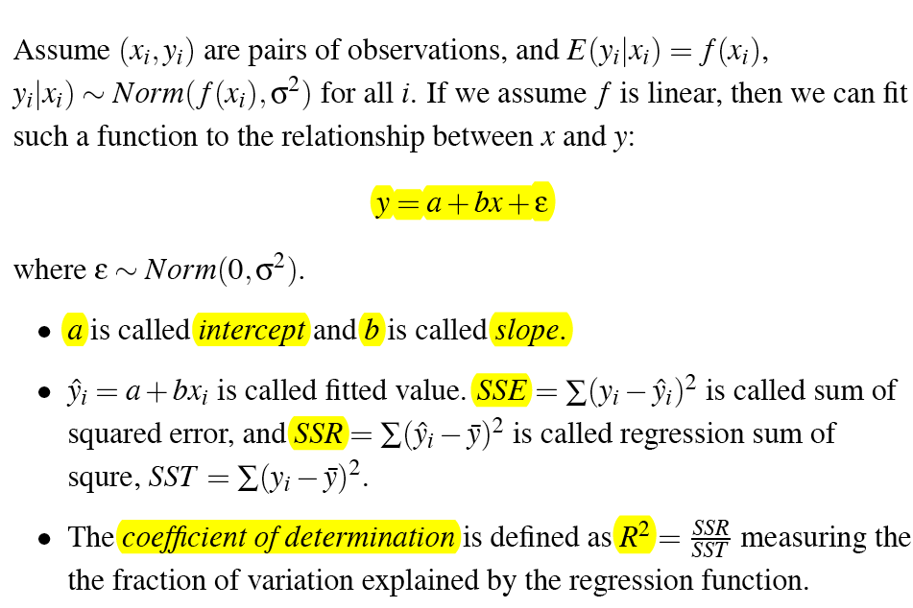
Regression

Slide 5
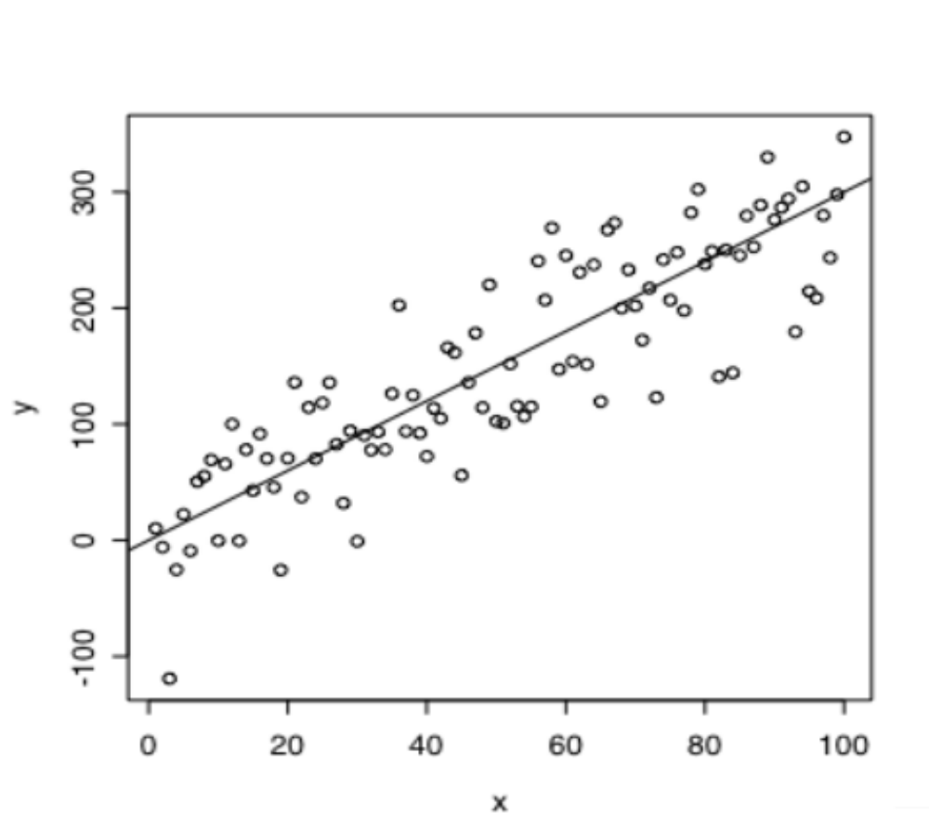
Regression

Slide 6
Statistics background---LOESS plot
LOESS is local weighted smoothing method.
--Suppose we observe pairs of observations (x1,y1),
(x2,y2)… (xn,yn). LOESS will fit a curve to describe
the relationship between variables Y and X.
LOESS does not make assumptions on distribution of X
and Y, and thus is more robust. It is also robust to outliers.

Slide 7
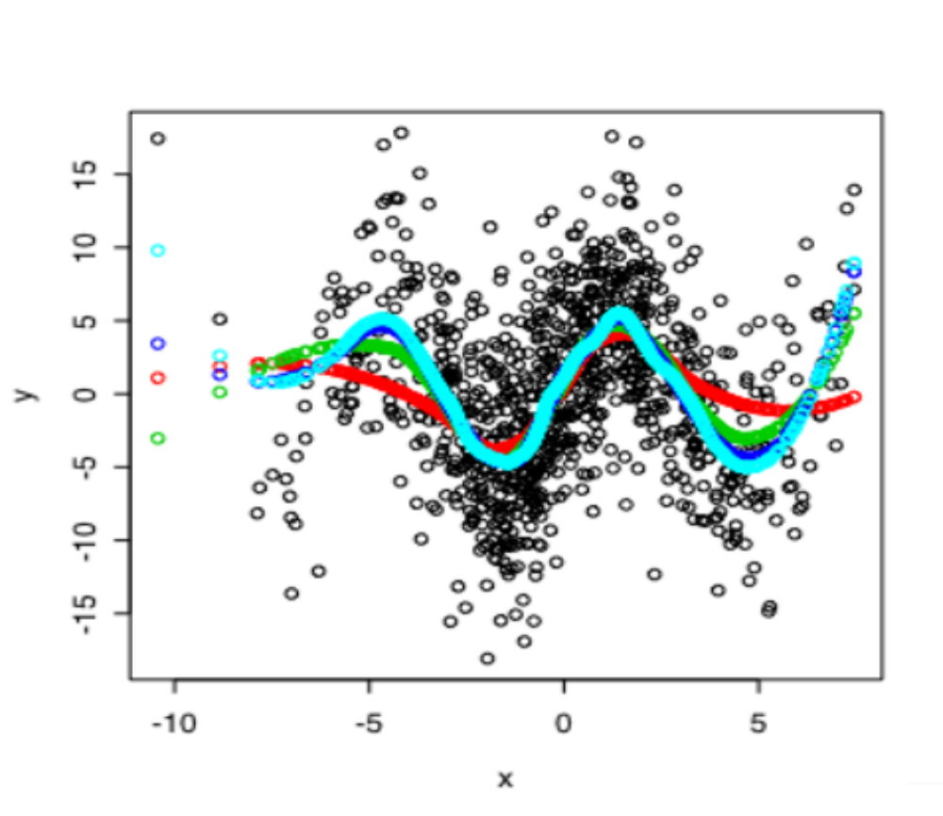
span=0.3 or 0.4 recommended
A sine plus noise curve.
>x<-rnorm(1000,0,3)
>y<-sin(x)*5+rnomr(1000,0,3)
>plot(x,y) >points(x,predict(loess(y~x,span=0.75)),col=2) >points(x,predict(loess(y~x,span=0.5)),col=3)
>points(x,predict(loess(y~x,span=0.3)),col=4) >points(x,predict(loess(y~x,span=0.2)),col=5)
span is the parameter to control the degree of smoothing. Roughly, it corresponds to the proportion of data points in the neighborhood to be used for curve fitting.

Slide 8
Introduction to R and bioconductor
Ji-Ping Wang, Ph.D.
Department of Statistics
Northwestern University

Slide 9
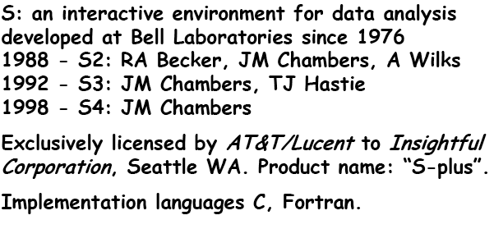
What is R?

Slide 10
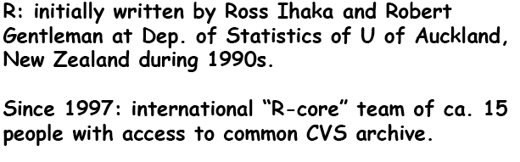
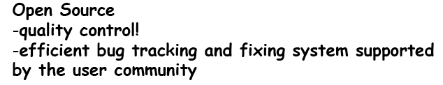
Bioconductor: R packages for various bioinformatic
tools including microarray data analysis.

Slide 11
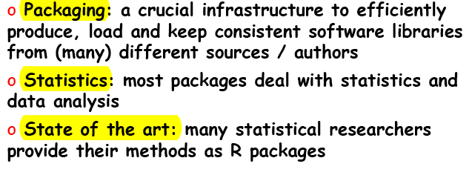
R and Statistics

Slide 12
R Installation
Download R to personal computer for widows, Unix, Linux, MAC at
http://cran.r-project.org
Launch R:
  In unix or linux or MAC osx : type “R” in command line
  In widows or MAC desktop: click “R” icon.
  Quite R by
  > q()

Slide 13
R as a calculator
>log(10)
[1] 2.302585
> sqrt(100)
[1] 10
> 5*10
[1] 50
> 5/10
[1] 0.5
> 5^2
[1] 25

Slide 14
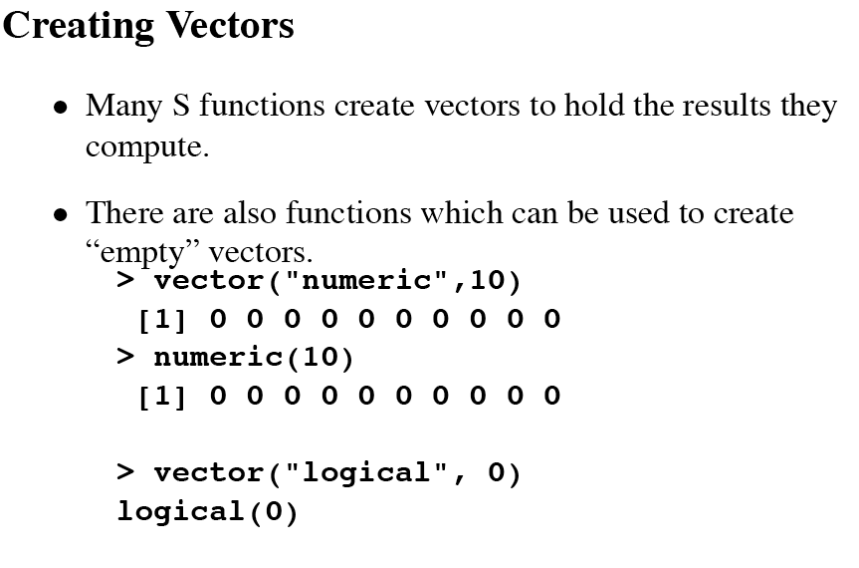
Vectors, matrices and arrays
Assigning values: “<-” or “=“
> x=3
> x
[1] 3
>y<-x+3
>Y
[1] 6

Slide 15
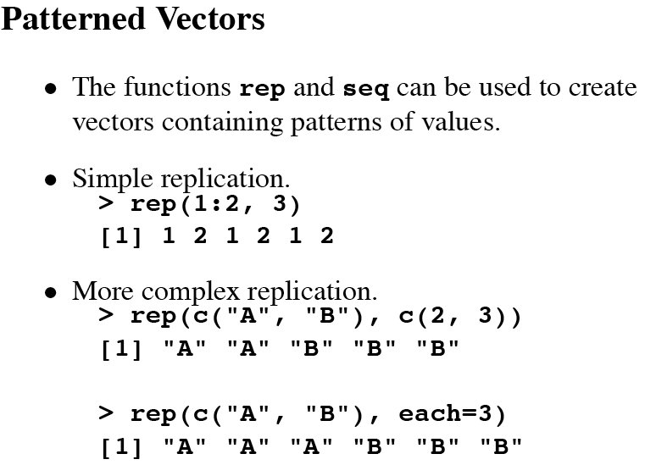
From bioconductor, By ross Ihaka

Slide 16
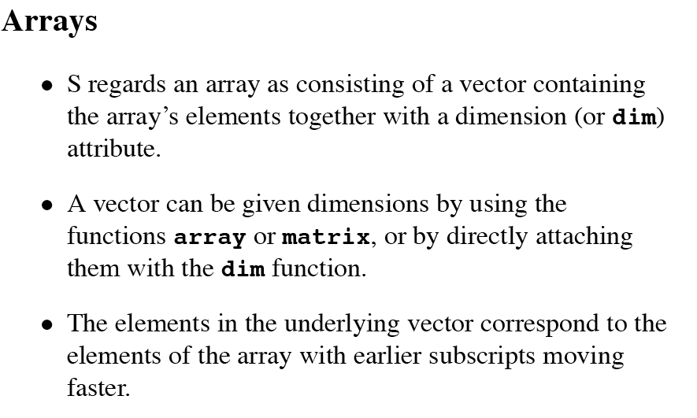

Slide 17
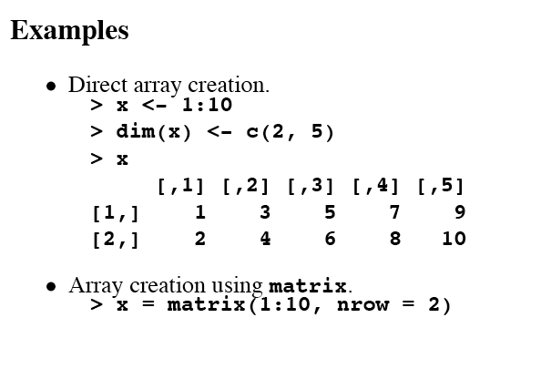

Slide 18
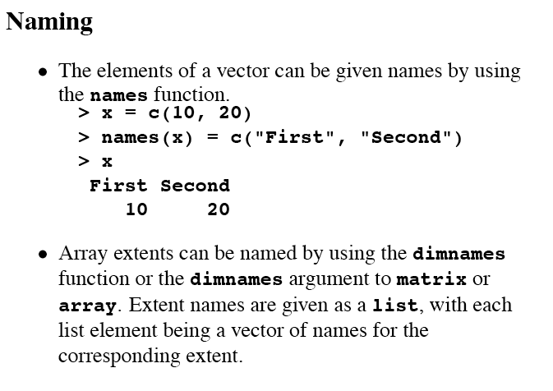

Slide 19
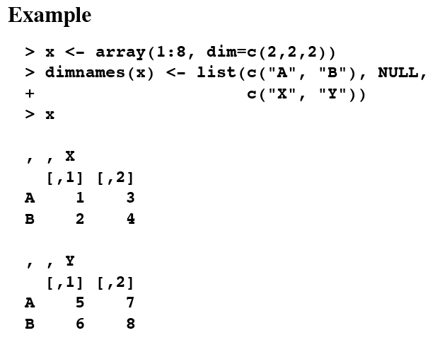
>x<-matrix(0,3,2)
>colnames(x)<-c(“a”,”b”)
>rownames(x)<-c(“c”,”d”)

Slide 20
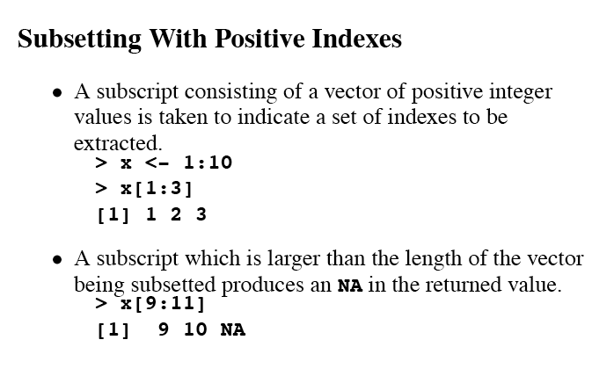
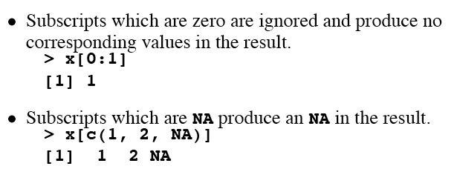

Slide 21
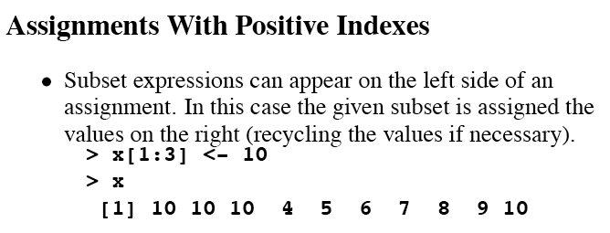
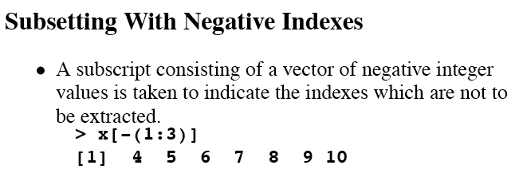

Slide 22
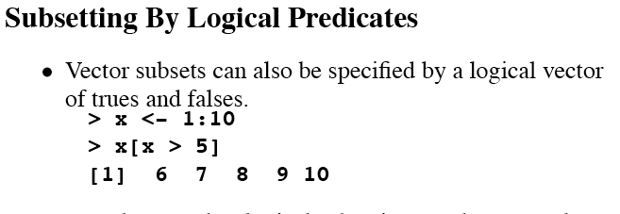
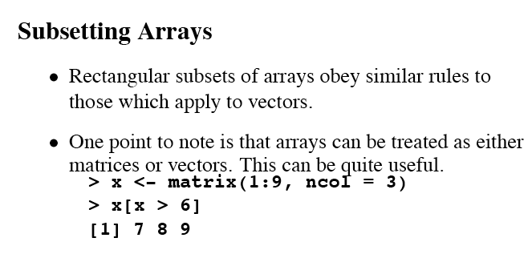

Slide 23
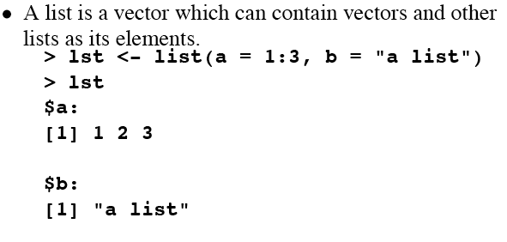
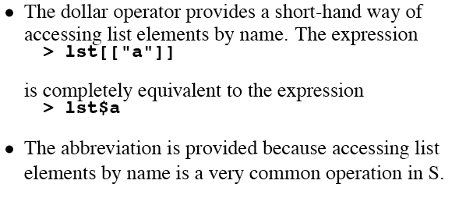
List

Slide 24
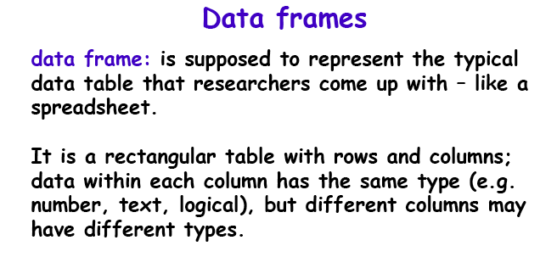
>data<-read.table("~/Desktop/cDNAdata/NielsonbCancer/2164.txt",header=T,sep="\t")
> data[1:10,1:4]
Accession X.Grid.Coordinate..within.sector. Y.Grid.Coordinate..within.sector. Sector
1 AA406372 1 1 1
2 H17047 2 1 1
3 N77807 3 1 1
4 H19439 4 1 1
5 W49672 5 1 1
6 H73053 6 1 1
7 AA192136 7 1 1
8 H15111 8 1 1
9 T50788 9 1 1
10 H20742 10 1 1

Slide 25
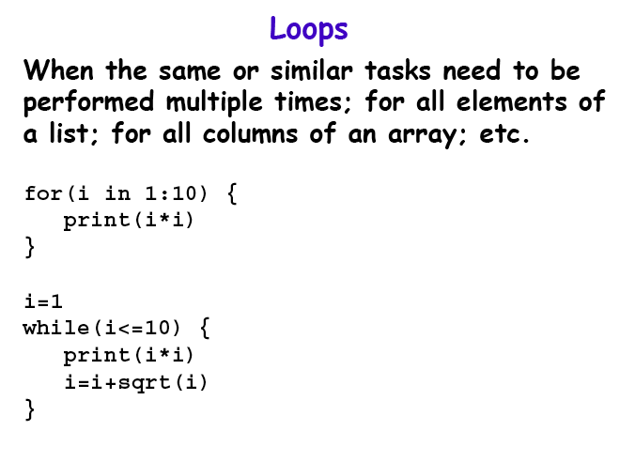

Slide 26
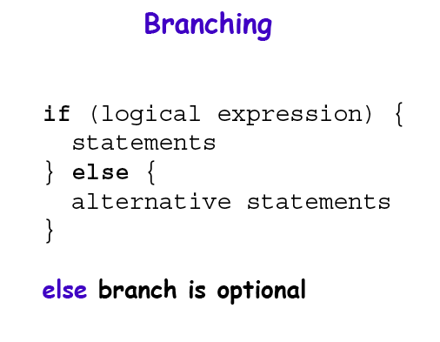

Slide 27
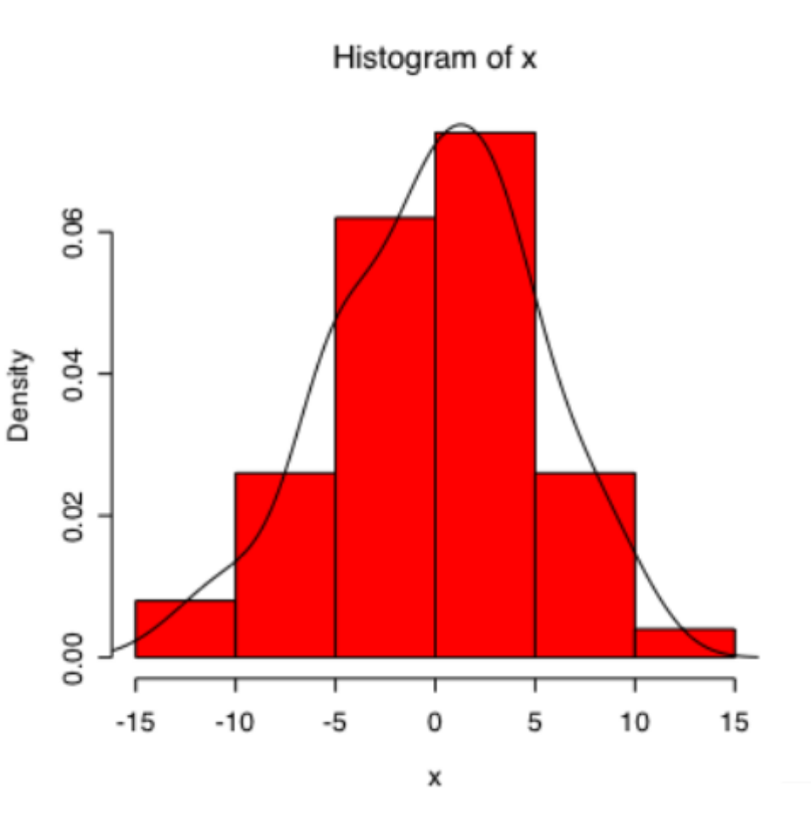
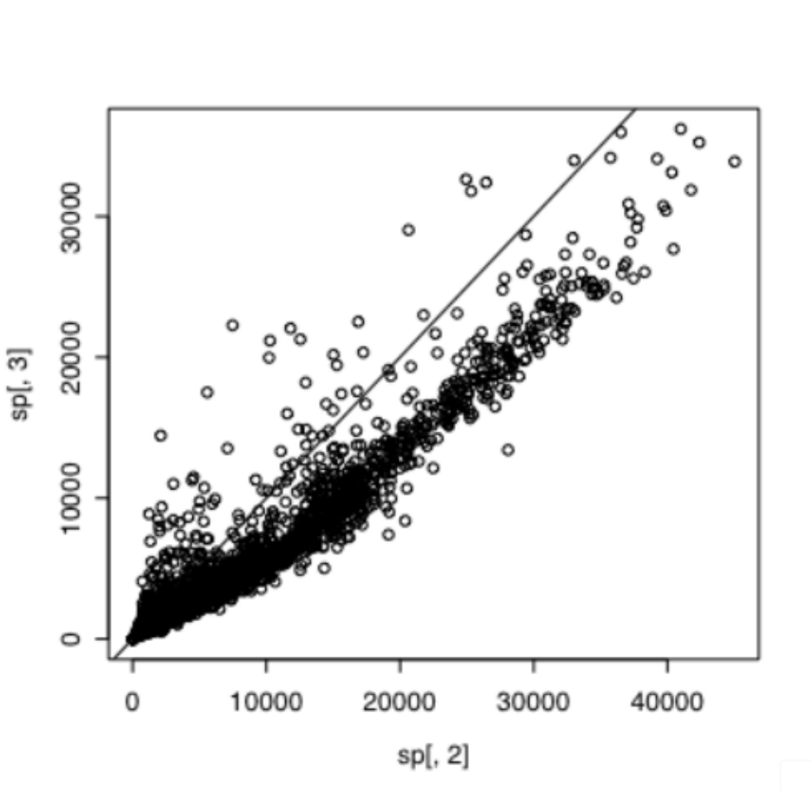
>x<-rnorm(1000,0,1)
>hist(x,col=2,freq=F)
>y<-density(x)
>lines(y)
>plot(sp[,2],sp[,3])
# Sp is matrix of Green and red channel of an array

Slide 28
Packaging
What is R package?
  R package is a user-written R codes that realizes certain functions.
  In a R package, author usually defined some data input format, R functions, and output objects.

Slide 29
Bioconductor
http://www.bioconductor.org
Bioconductor is an open source and open development software project for the analysis and comprehension of genomic data.
R package from Bioconductor most related to microarray normalization in this course:
marray: cDNA data low-level analysis
affy: affymetrix microarray data lower analysis
Install bioconductor:
>source("http://www.bioconductor.org/biocLite.R")
>biocLite()

