Slide 1
Exploratory analysis of Microarray data -- Unsupervised learning
Ji-Ping Wang
Department of Statistics
Northwestern University

Slide 2
Outline
Classification tasks in microarray data
Similarity measures
Clustering algorithms

Slide 3
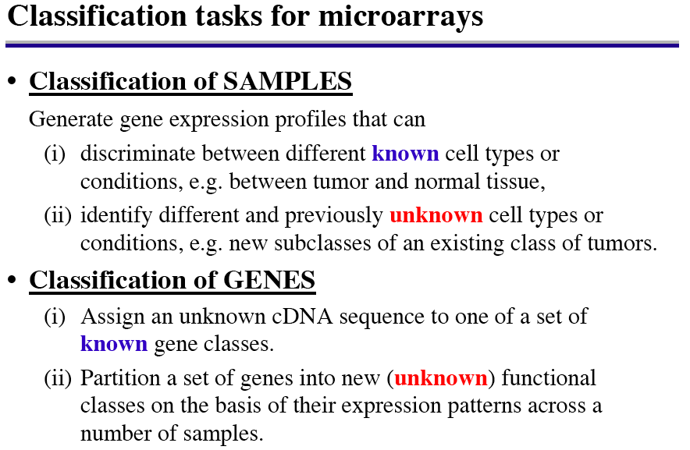

Slide 4
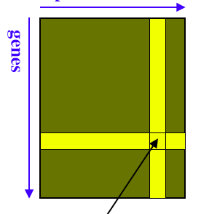
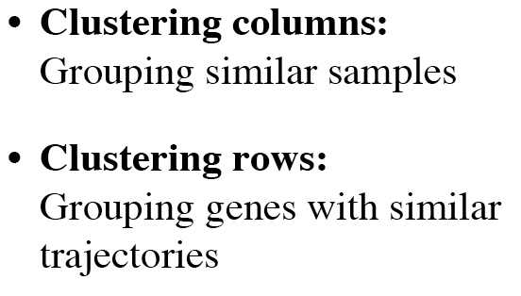
Cluster analysis
samples
X_{ij:} ith gene, jth sample

Slide 5
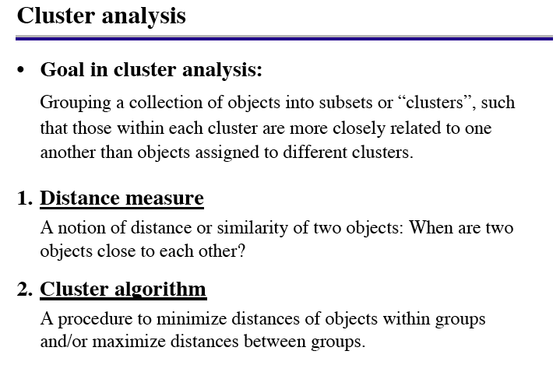

Slide 6
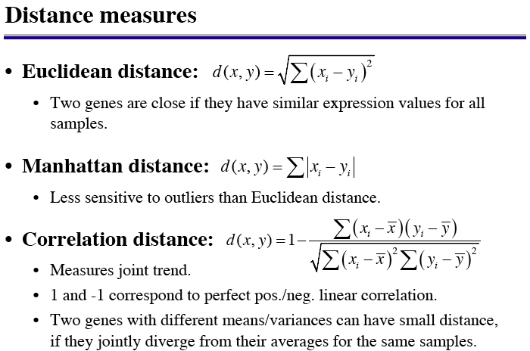

Slide 7
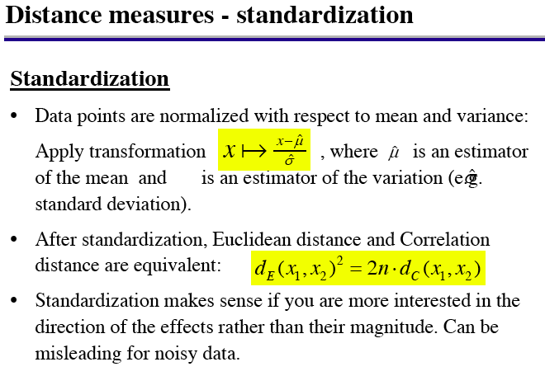

Slide 8
Clustering methods
Hierarchical clustering methods
K-means clustering
Self-organizing maps (SOM)

Slide 9
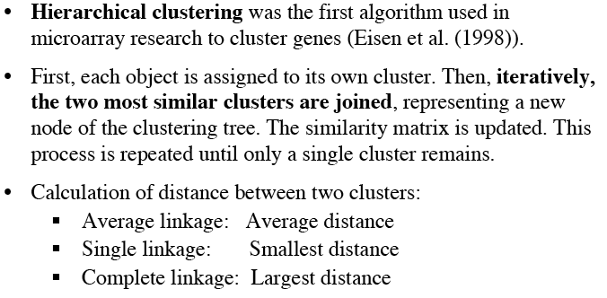
Hierachical clustering

Slide 10
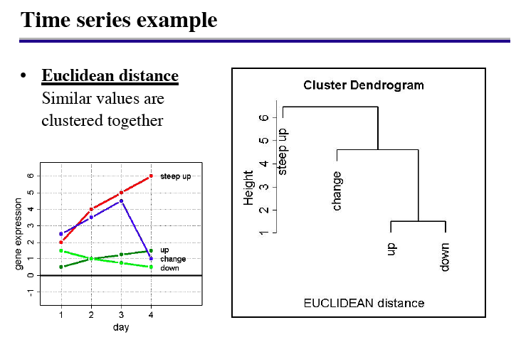
linkage between two groups G and H:
Single: d_{SL}(GH)=min{d_{ii’}: i in G, i’ in H}
Complete Linkage: d_{CL}(GH)=max{d_{ii’}: i in G, i’ in H}
Group Average: d_{GA}(GH)=mean{d_{ii’}: i in G, i’ in H}

Slide 11
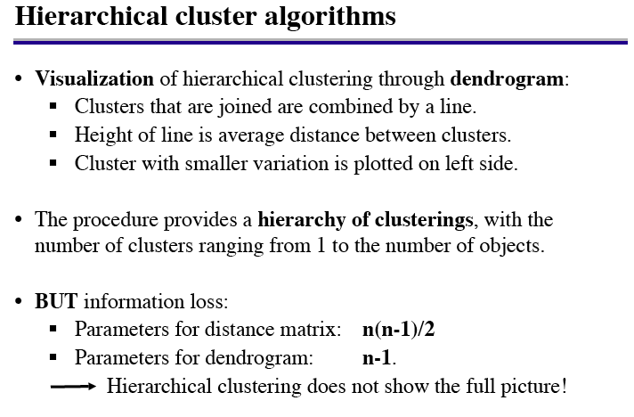

Slide 12
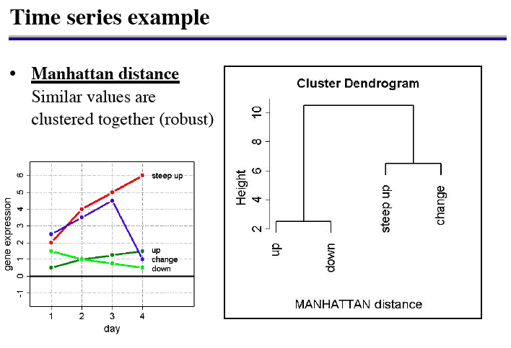

Slide 13
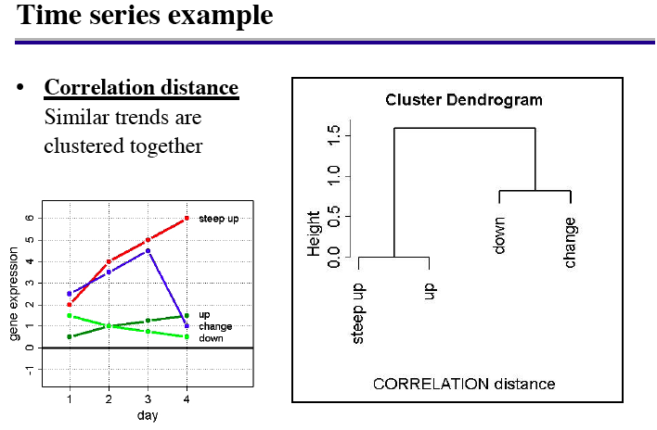

Slide 14
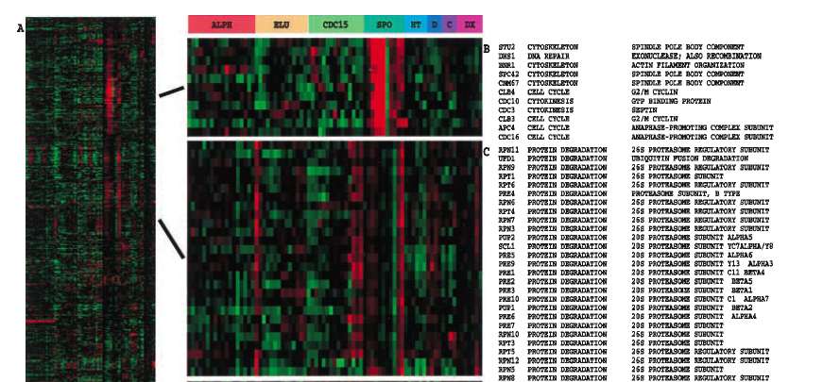
Eisen et al 1998, yeast cell cycle
Rows: genes
Columns: different time points of different cell cycles: (ALPH, ELU, CDC15, SPD,HT,D,C,DX are different cell cycles)

Slide 15

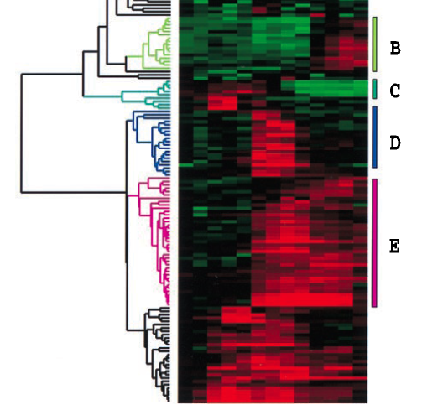

Slide 16
Cluster genes or experiments
Genes or experiments?
  genes: expression measurement must have functional correlation, clustering replicates is not meaningful
  experiments (arrays): cluster overall gene expression
What metrics to choose?
  correlation ignore scale, only cluster pattern
  Euclidian distance or other distance without standardization often will fail to cluster the pattern.

Slide 17
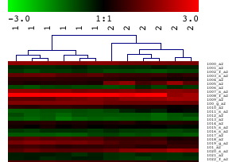
Prostate Cancer data 6 normal vs 6 tumor
under correlation distance metrics

Slide 18
Comments about HCL
The distance metrics in HCL is represented by height of node as an average. The pairwise distance reduced from n(n-1) to (n-1).
Once a gene is grouped with group G, it must immediately link with G. No chance to regroup with other genes.
Lack of robustness: A small change of data can change the structure of the tree dramatically.

Slide 19
K-means clustering
K-means is a partitioning algorithm with prefixed number K of clusters
It minimizes the within-cluster variances
The algorithm chooses K points randomly as the starting centroids (midpoinds).
Algorithm iterates between the following two steps:
  Assign points to the cluster whose controid is closed to the point
  update centroids by taking the average of the points within the cluster

Slide 20
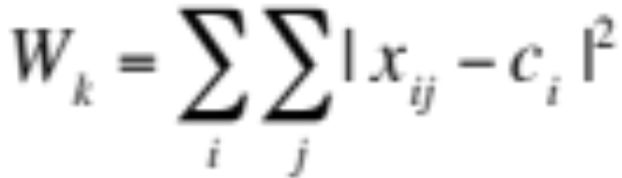

How many clusters?
Define with cluster total sum of squares, where I indexs cluster j index observation within ith cluster, ci is the centroids.
Choose the K such that the declination of within cluster total W_{k} becomes flat from K to K+1.
Use the between cluster and within cluster sum of squares ratio (Calinski and Harabasz 1974), choose K such that CH achieves the largest where B and W stand for the between cluster and within cluster sum of squared distances.

Slide 21
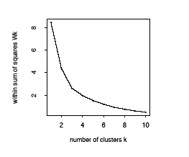
Other methods, see Hastie et al 2000

Slide 22
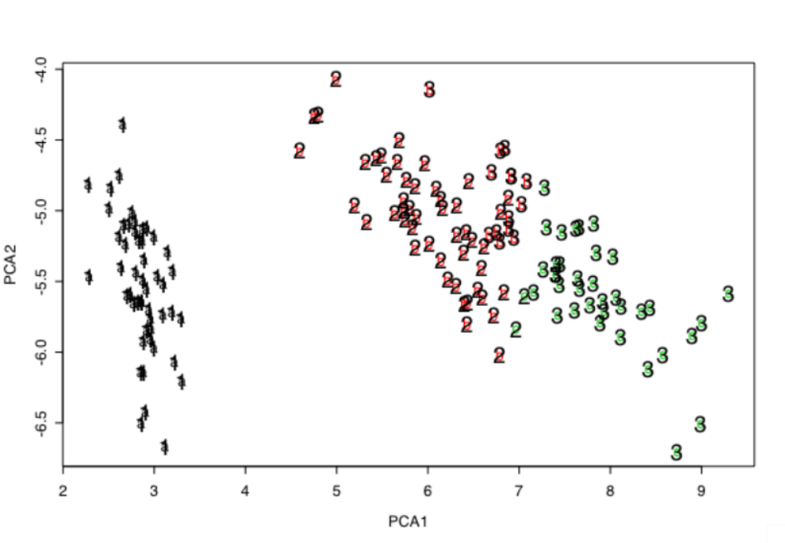
Kmeans examples-- Fisher’s Iris data
V1 V2 V3 V4 V5
1 5.1 3.5 1.4 0.2 setosa
2 4.9 3.0 1.4 0.2 versicolor
3 4.7 3.2 1.3 0.2 virginica
……

Slide 23
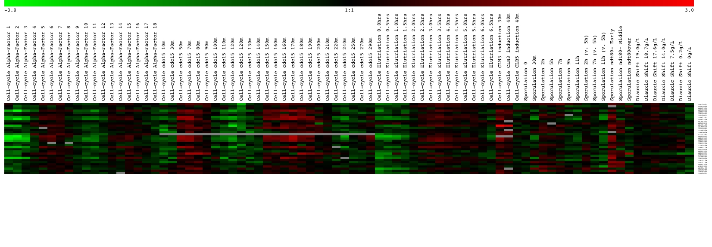
Cluster from yeast cell cycle data

Slide 24
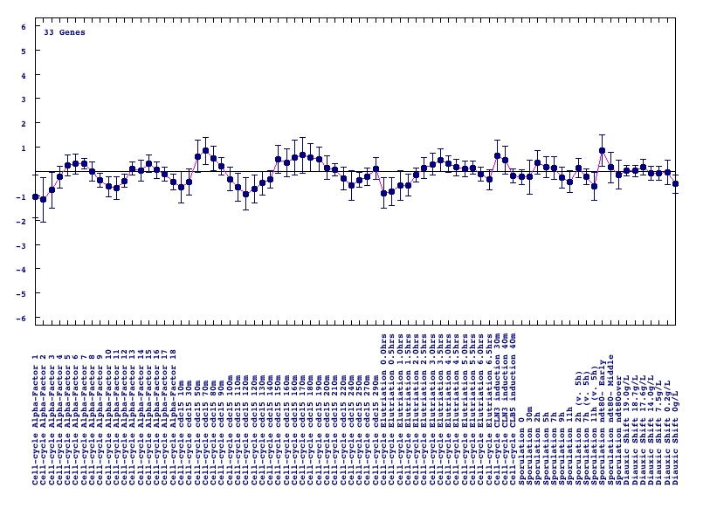
Centroid graph--cell cycle regulated genes

Slide 25
Comments about K-means
K-means does not guarantee a unique solution. Best clustering is the one with least within-cluster variance.
No nesting structure as HCL.
Within cluster, there is no linear ordering of genes.
K-means clustering is a simplified Gaussian-mixture model assuming equal variance.

Slide 26
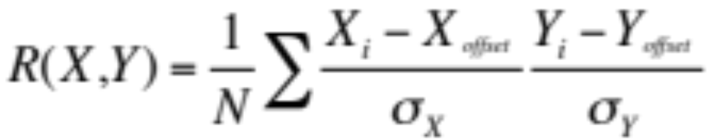
Centered and uncentered correlation
Pearson correlation:
X_{offset} is take as the mean for centered. and 0 for uncentered.
Reason is: if the ratio of green and red channels is 1 in the
cDNA data, then the log ratio must be 0.
My recommendation: Take centered always.

Slide 27
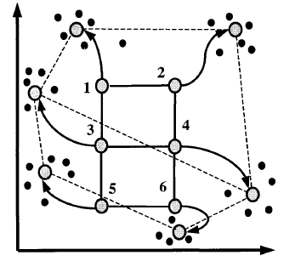
SOM--Self Organizing Map
Tamayo et al 1999
Algorithm:
Initiate prototypes m_{j} in a grid on a plane e.g., principle component plane.
update mj <--m_{j}+α(x_{i}-m_{j}), if xi is in a neighborhood of m_{j ,} under certain threshold.
decrease α as algorithm proceeds until 0, that mean m_{j} will fixed at some points
Advantage: the constraint between these prototypes(nodes) remain throughout the algorithm

Slide 28
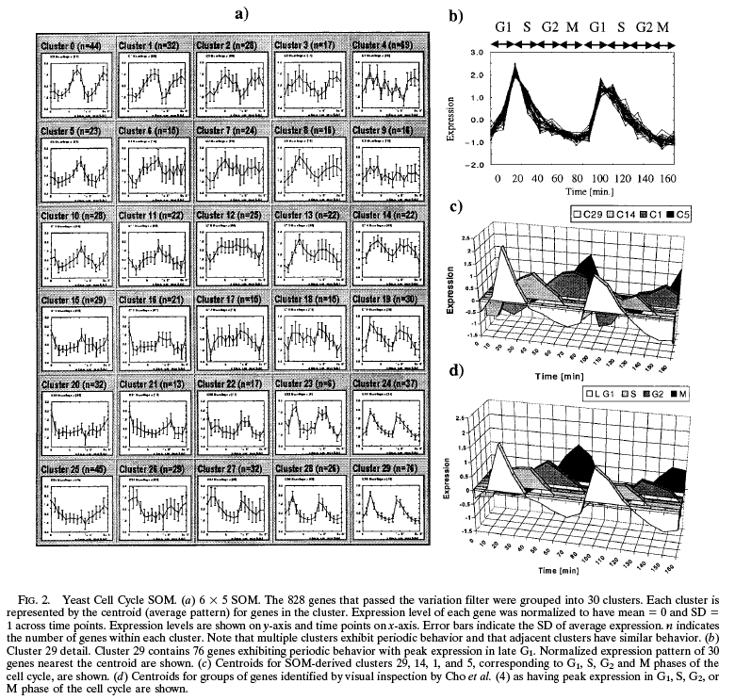
An example

Slide 29
Some remarks
HCL well defines a neighboring structure in a tree format, but sensitive to linkage and slight perturbation of the data
K-means clustering must specify a K, it does not imply between cluster relationship.
SOM performs in the similar way as K-means, but the imposed structure is hard to verify for its optimality.

